Slide 1
Cataloging Audio Recordings: Audio Media Players
Presented by
Illinois Heartland Library System
Notes:
Last month we covered general guidelines for audio recordings in general, with a focus on audiobooks.
This month we’re not going to go back over the general stuff, but are going to talk about what specifically applies to audio media players
Disclaimer: a lot of things are confusing about this format
Slides were posted late yesterday, as well as a revised editing checklist.
Revised the checklist to add a lot more about these audio media players, so you’ll want to download this latest version.
You can also find guidance in our cataloging standard on sound recordings on the SHARE website.
I want to give a big shout-out to Robert Brady for his help in putting this presentation together.

Slide 2
Topics
Types of audio media players
Descriptive cataloging
Subject headings
Resources
Notes:
Last month we covered general guidelines for audio recordings in general, with a focus on audiobooks.
This month we’re not going to go back over the general stuff, but are going to talk about what specifically applies to audio media players

Slide 3
Types of audio media players
Stand-alone preloaded audio players
Playaway
Go Reader
Me Reader
Audio-enabled books--a print book with a pre-loaded audio player permanently bound to the cover
Wonderbook
Vox Book
Etc.
Notes:
In this presentation, we’re using audio media players as a generic term to encompass the different types of these players
Both types contain preloaded content—not like e-readers where you delete a book off when you’re done and load another one
Stand-alone—device with one or more books preloaded on them.
Playaways and Go Readers are small cartridges. The Me Reader is bigger—more like a small tablet.
Audio-enabled books
These are examples of brands that we have records for in Polaris
There may also be other brands now or in the future so these guidelines would apply for them as well

Slide 4
Preloaded audio media players
Playaway container
Playaway cartridge
Notes:
Playaway—container and cartridge is pictured
Playaway device has one book preloaded on it.

Slide 5
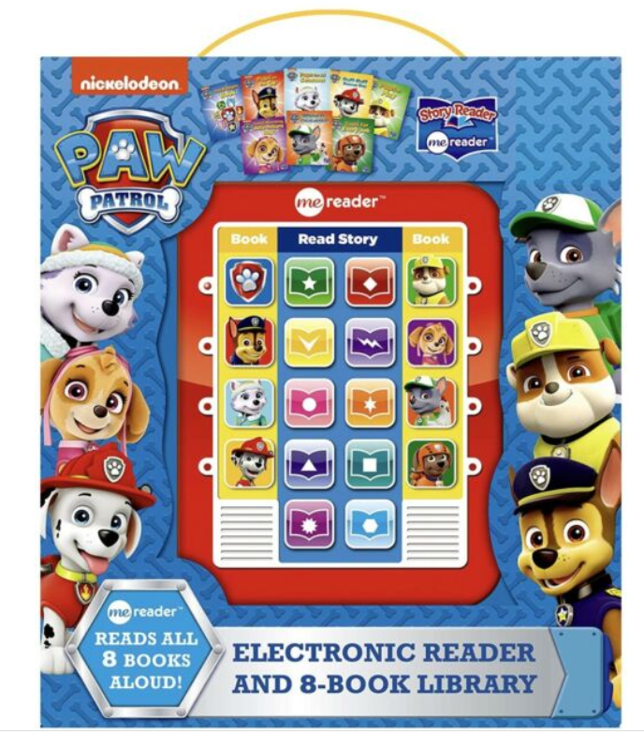
Preloaded audio media players
Me Reader
Go Reader
Notes:
Me Readers have multiple books loaded on them and usually come in a container with physical books. I understand you choose a book and then click the icon on the reader to hear the book being read
Go Readers may also have more than one title loaded them, are like Playaways in that they don’t come with the physical books.
You will see places in our records where Go Reader is recorded as one word, which is how they used to be packaged. Now the company uses Go Reader as 2 words.

Slide 6
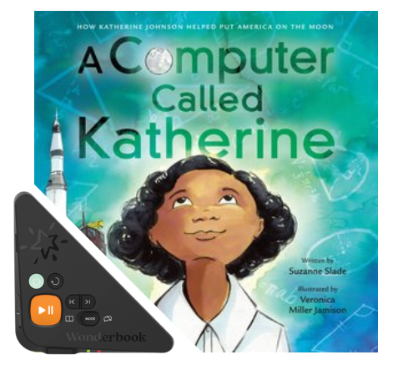
Audio-enabled books
Wonderbook
Vox Book
Notes:
Physical book with the player attached to the cover

Slide 7
Preferred sources of information
Cartridge—preloaded audio players
Title page—audio-enabled books
If there is no title on the preferred source, check (in order of precedence):
The container, cover, or accompanying material
Other source such as a website or vendor catalog, etc.
Last resort: Cataloger devises a title
Notes:
Last month talked about audiobook on CD, where the preferred source of information is the disc label with a second choice of the container or outside source
For the standalone devices, if there’s a title on the device itself, take your title from there.
If not, will need to look next at the container.
For the audio-enabled books, there is nothing on the device, so the title will come from the title page of the book that’s it’s attached to.
Remember, you always need to include a note in a record for an audio recording that tells where the title comes from.

Slide 8
Matching
Findaway World enters records in OCLC for Playaways and Wonderbooks
Full records with consistent standard information and notes
Information may differ if records have been edited by other entities
When matching, look for records with PLAYA in 040 $a and $c
Notes:
When looking for OCLC records for these devices, we get a lot of help from Findaway World, who is the publisher of Playaways and Wonderbooks.
Findaway World records for Playaways and Wonderbooks are good full records, though they generally have encoding level M.
Look for records that have not been edited by other organizations since Findaway World entered them
Records for the other brands may not be as consistent

Slide 9
General material designation (GMD)
Not used in RDA; do not add to OCLC records
SHARE local practice: add GMD to all audio media player records in Polaris
$h comes after $a, $n, and $p
$h comes before $b
Preloaded audio players:
245 _ _ $aTitle proper$n$p$h[electronic resource] :$b
Audio-enabled books:
245 _ _ $aTitle proper$n$p$h[sound recording] :$b
Indicators will vary; not shown in this example.
Notes:
Because these are non-print formats, SHARE local practice is to add a gmd in the 245 $h to the records in Polaris.
We don’t add gmds to records in OCLC, only in Polaris
For the standalones, Playaway, Go Reader and Me Reader, the gmd is electronic resource
For the Wonderbook and Vox Book, the gmd is sound recording.
Sometimes in OCLC you’ll see them cataloged as books and sometimes as sound recordings.
No matter how they’re cataloged in OCLC, for Polaris, we consider these to be audio recordings so we add the gmd

Slide 10
Examples--GMD
Preloaded audio player:
OCLC record: 245 12 $aA boy called Bat
SHARE local edit:
245 12 $aA boy called Bat$h[electronic resource]
Audio-enabled book:
OCLC record: 245 14 $aThe adventures of Beekle : $bthe unimaginary friend
SHARE local edit:
245 14 $aThe adventures of Beekle$h[sound recording] :$bthe unimaginary friend

Slide 11
Edition statement
Record Abridged or Unabridged as an edition statement in all audio media player records
The word “edition” does not have to be present
If multiple edition statements:
Record in one MARC tag 250, separated by comma
or
In separate 250 fields (preferred option in OCLC)
Record Abridged or Unabridged as the first edition statement—do not put in brackets
Notes:
As with all audiobooks, we should record an edition statement to indicate if the content is abridged or unabridged.

Slide 12
Abridged or Unabridged not on item
If the item doesn’t indicate Abridged or Unabridged:
Consider audio-enabled books to be unabridged
Record in brackets
Notes:
If your item doesn’t say abridged or unabridged but it does have a time listed on it, you can look for an audiobook record and compare the time if available
If you can’t tell, leave it off

Slide 13
Edition statement—SHARE cataloging
Original or copy cataloging in OCLC
Single or multiple 250s are acceptable
SHARE local practice:
If not already present, add edition statement for preloaded audio media players to distinguish brand
Record in brackets
Combine multiple edition statements in single 250
250 _ _ $aUnabridged, [GoReader].
Notes:
SHARE local practice is to add an edition statement for the brand of reader in addition to the abridged or unabridged.
Records may already have an edition statement that identifies them as a Wonderbook or Vox Book, etc.
We’re using GoReader as one word because that’s how it was on the items when we wrote the cataloging standard

Slide 14
Publication, distribution, etc.
May have multiple 264s for different functions—denoted by 2nd indicator
264 _0 $aPlace of production :$bProducer,$cProduction date.
264 _1 $aPlace of publication :$bPublisher,$cPublication date.
264 _2 $aPlace of distribution :$bDistributor,$cDistribution date.
264 _3 $aPlace of manufacture :$bManufacturer,$cDate of manufacture.
264 _4 $cCopyright date
Notes:
Publisher is pretty much the same as how we do it for other formats
We use MARC tag 264 and if we are recording more than one function, we use separate 264s with the 2nd indicator to show the function

Slide 15
Note on Publisher
Publisher of Playaways and Wonderbooks should be Findaway World, LLC
Record in 264 _1
However: If the cataloger chose a different entity on the resource as the publisher, i.e., Playaway or Harper Audio, etc., record Findaway World, LLC as an additional publisher
Notes:
When Findaway puts in records for Playaways and Wonderbooks, they record Findaway World LLC in the 264 _1 as the publisher.
Will sometimes see records that have a different publisher.
When Playaways first came out, we often used Playaway as the publisher, so you’ll see that in older Playaway records
Sometimes you’ll see a company like Hatchette Audio or Scholastic Audiobooks in the 264 as the publisher because that name is either on the cartridge or on the container.
That’s more likely the company that produced the audiobook, but what we’re cataloging is the device, the audio media player
If you come across a record with a different publisher, don’t delete that publisher, but add Findaway World as an additional publisher so that we can be consistent with Findaway World in the 264.

Slide 16
Dates
Publication date – core element – use the most recent publication date
Audio media players rarely have a publication date
Copyright date – use the copyright date for the device, not the phonogram date (℗) for the original audiobook, or the copyright date for the print book
Record in 264 _1 $c as implied publication date, in brackets
Record in 264 _4 $c with copyright symbol
If phonogram date or copyright date for other formats are present, may be recorded in a note
Notes:
Like with all formats, publication date is the 1st priority for a date to record in the 264 subfield c
But just like audiobooks on CD, audio media players rarely have a publication date on the resource
So the next thing you look for is a copyright date
What we’re looking for is the copyright date of the device.
Your item may have a date on it for the print book and/or for the audiobook, but what we’re going to use for the 264 is the copyright date of the device.
Just like with other formats, you’ll record the copyright date as an implied publication date in 264 _1, and the copyright date in the 264 _4
You can include the dates for the other formats in a note, and you will often see that in records.

Slide 17
Example—dates on Playaway container
Copyright date for print book
Phonogram date for audiobook
Copyright date for Playaway device
Notes:
Picture of the back of a Playaway container that has what looks like the date for the print book and the audiobook, and then below the date for the device.

Slide 18
Example—MARC tag 264
264 _ 1 $aSolon, Ohio :$bFindaway World, LLC, $c [2018]
264 _ 4 $c©2018
If a different entity on the item is recorded as publisher
264 _ 1 $aNew York, New York :$bScholastic Audiobooks ;$aSolon, Ohio :$bFindaway World, LLC,$c[2018]
264 _ 4 $c©2018

Slide 19
Physical characteristics--MARC tags 3XX
300 Physical description
336 Content type
337 Media type
338 Carrier type
340 Physical medium
344 Sound characteristics
347 Digital file characteristics
Indicators are blank; 300 may have ending punctuation
Notes:
340 because the print Wonderbook or Vox Book might be large print or braille

Slide 20
Extent—300 $a
Record the type of device, using this wording:
Preloaded audio players: 1 audio media player
Record playing time in parentheses, if readily available
Abbreviate hour(s) as hr.
Abbreviate minute(s) as min.
Spell out approximately, even if abbreviated on item
Audio-enabled books: 1 audio-enabled book
Record pagination of book in parenthesis
Playing time may be recorded in a note if available
Notes:
If the OCLC record says 1 Wonderbook (or other brand), change to this wording

Slide 21
Other physical details—300 $b
Previously used to record sound characteristics (i.e., digital, optical, stereo)
Current practice: Omit 300 $b and record sound characteristics in MARC tag 344
OK to retain if present, but add 344
When creating an original record, use current practice
Notes:
OK for a record to have both 300 $b and 344, but it must have the 344

Slide 22
Other physical details—300 $b (cont.)
Preloaded audio players:
If present, will include “digital”
May also see “HD audio”
Don’t need to add if not present; record in MARC tag 344
Audio-enabled books:
Record illustrative contents of book

Slide 23
Dimensions—300 $c
Preloaded audio players:
Record dimensions of device in inches
Note: Dimensions of Playaway devices have changed slightly. Difference in dimensions may be disregarded when matching, if the record otherwise matches
Previous dimensions: 3 1/2 x 2 1/4 in.
Current dimensions: 3 3/8 x 2 1/8 in.
Audio-enabled books:
Record dimension(s) of book in cm

Slide 24
Accompanying material—300 $e
Give details as you would describe the item in an individual record, omitting subfields
Do not include batteries or earphones in $e
Do not describe book as accompanying material in records for audio-enabled books
Books packaged with the Me Reader should be coded as accompanying material
300 _ _ $a1 audio media player :$bdigital ;$c5 x 4 x 1 in. +$e8 books (20 pages each : color illustrations ; 24 cm)
Include applicable 33X and 34X fields for substantial accompanying material

Slide 25
Examples—300
Preloaded audio players:
300 _ _ $a1 audio media player (2 hr., 15 min.) :$b digital, HD audio ;$c 3 3/8 x 2 1/8 in.
Audio-enabled books:
300 _ _ $a1 audio-enabled book (30 unnumbered pages) :$bcolor illustrations ;$c28 cm
Notes:
Do not add additional period after in. in cases where a 490 is present in the record

Slide 26
MARC tags 33X—general guidelines
Preloaded audio players:
Record applicable 33X fields for the spoken word aspect and the electronic resource aspect
Audio-enabled books:
Record applicable 33X fields for the spoken word aspect, the electronic resource aspect, and the book aspect

Slide 27
MARC tags 33X for preloaded audio players
336 _ _$aspoken word$bspw$2rdacontent
337 _ _$aaudio$bs$2rdamedia
337 _ _$aunmediated$bn$2rdamedia
338 _ _$aother$bsz$2rdacarrier
338 _ _$aother$bnz$2rdacarrier
Note: 337 $a unmediated is included for the electronic resource aspect
If record says computer, change to unmediated. Disregard error message in MARC report.
338 $b sz corresponds to 337 $a audio and 338 $b nz corresponds to 337 $a unmediated
Notes:
MARC Report will give an error message to add 338 other cz to correspond with computer

Slide 28
MARC tags 33X for audio-enabled books
336 _ _$aspoken word$bspw$2rdacontent
336 _ _$atext$btxt$2rdacontent
337 _ _$aaudio$bs$2rdamedia
337 _ _$aunmediated$bn$2rdamedia
338 _ _$aother$bsz$2rdacarrier
338 _ _$aother$bnz$2rdacarrier
338 _ _$avolume$bnc$2rdacarrier
Note: Do not add 337 $a computer. Disregard error message in MARC Report.
OK to retain 336 $a still image if present; do not need to add.

Slide 29
MARC tags 34X—general guidelines
Record each term in a separate 34X field (per OCLC)
Use controlled vocabulary terms from lists on the RDA Registry website if available
Links to lists can be found in the Bibliographic Formats and Standards entry for the field and subfield
Enter the code for the list in $2
Not every term is included in an RDA Registry list
If using a term not on a controlled list, omit $2

Slide 30
MARC tags 344 and 347
Playaways
344 _ _ $adigital$2rdatr
344 _ _ $bnon-volatile flash memory
347 _ _ $aaudio file$2rdaft
347 _ _ $bACELP
Wonderbooks
344 _ _ $adigital$2rdatr
344 _ _ $bnon-volatile flash memory
347 _ _ $aaudio file$2rdaft
347 _ _ $bMP3
Go Readers, Me Readers, and Vox Books:
344 _ _ $adigital$2rdatr
347_ _ $aaudio file$2rdaft
Notes:
344 is sound characteristics and 347 is digital file characteristics
Records for Playaways and Wonderbooks have non-volatile flash memory in the 344 $b. This is supplied by Findaway World when they put these records in—we take what they give us
Records for Playaways have ACELP in 347 $b and Wonderbooks have MP3—again take what Findaway World gives us
Will often see Playaway and Wonderbook records with the 344 and 347 terms in a single field—split to separate fields
We don’t have any info for Go Readers Me Readers, or Vox Books, so we can only supply the basic digital in the 344 and audio file in the 347

Slide 31
Notes
Additional information about the resource
Source of information
The item itself, or other sources
MARC coding
Some note fields use indicators—see OCLC Bib formats
ISBD punctuation
Most notes have ending punctuation; a few do not—See OCLC Bib formats

Slide 32
Notes for audio media player records
Include all appropriate notes
All records should have:
588 note for source of title
Change 500 to 588 when editing
511 note for reader(s)
520 note for summary of contents
505 contents note if item contains multiple titles
500 standard notes for type of player

Slide 33
Standard notes--Playaways
Findaway includes these notes in all records for Playaways
Do not delete
Add if not present
500 _ _ $aRelease date supplied by publisher.
500 _ _ $aIssued on Playaway, a dedicated audio media player.
500 _ _ $aOne set of earphones and one AAA battery required for listening.
Notes:
Release date note

Slide 34
Standard notes--Wonderbooks
Findaway includes these notes in all records for Wonderbooks
Do not delete
Add if not present
500 _ _ $aRelease date supplied by publisher.
500 _ _ $aIssued as a Wonderbook, a pre-loaded audiobook player permanently attached to a hardcover book.
500 _ _ $aPowered by a rechargeable battery ; USB charger required for recharging.
500 _ _ $aAudiobook player has 2 modes. Read-Along mode narrates the story. Learning mode asks questions related to the story.

Slide 35
Standard notes—Go Readers and Vox Books
Include these notes in all records for Go Readers:
500 _ _ $aIssued on Go Reader, a dedicated audio media player.
500 _ _ $aOne set of earphones and two AAA batteries required for listening.
Include this note in all records for Vox Books:
500 _ _ $aVOX Audio playback device includes headphone jack, external speaker, play/pause button, volume controls, page-turning controls, rechargeable battery, low battery indicator, and removable AC adapter.

Slide 36
Standard notes—Me Readers
Include these notes in all records for Me Readers:
500 _ _ $aAudio recordings issued on Me Reader, a dedicated audio media player electronic pad.
500 _ _ $aThree AAA batteries required for listening.

Slide 37
Other notes
Include as appropriate
Include quoted note for “Playaway Kids” if present on container
OK to retain quoted notes “HD”, “Light”, or for publisher of audiobook version if present on Playaway records—do not need to add
Retain notes about other versions if present, i.e, notes about audiobook version or print book, etc.
Add if considered important
Include note on publishing information for book in records for Wonderbooks and Vox Books

Slide 38
Subject headings
Add as applicable—use the same headings as in the print record
Topical
General subject(s) of the work
Geographic
Heading for the setting(s) of the work
Names
Real person(s) or fictitious character(s)
Do not add the subdivision Sound recording after subject headings
650 _0$aTwins$vFiction.
Not 650 _0$aTwins$vFiction$vSound recording.

Slide 39
Genre and form headings
Add as applicable for genre of literature or form of item
Always add:
For adult material:
655 _7 $aAudiobooks.$2lcgft
For juvenile material:
655 _7 $aChildren’s audiobooks.$2lcgft

Slide 40
Genre and form headings—SHARE local practice
Add these headings as applicable in records for audio media players
Always add:
655 _0 $aElectronic books.
655 _0 $aPreloaded audio players.
Playaways
655 _0 $aPlayaway (Preloaded audio player)
Go Readers
690 _ _ $aGoReader (Preloaded audio player)
Me Readers
690 _ _ $aMe Reader (Preloaded audio player)

Slide 41
Genre and form headings—SHARE local practice—cont.
Wonderbooks
690 _ _$aWonderbook (Audio-enabled book)
655 _0 $aMP3 (Audio coding standard)
Vox Books
690 _ _ $aVox Book (Audio-enabled book)

Slide 42
Additional access points
May see records with entries for publisher, distributor, production company, etc.
OK to retain; do not need to add
If retained, add $e with relationship designator
In records for Playaways, consider Playaway Digital Audio a distributor, even if not listed in the body of the record
Use relationship designator production company in entries for producer of original audiobook
Include access points for titles of contents
Retain 776 fields for related formats, i.e., print or audiobook version
Notes:
Recording Playaway Digital Audio as a distributor without it being justified in the body of the record is an exception to SHARE local practice
May see 776 for print version of audio-enabled book or for audiobook version

Slide 43
Standard numbers
020-International Standard Book Number (ISBN)
024-UPC number
028-Publisher’s number
050, 090, 082, 092 Call numbers
Check OCLC Bib Formats for applicable indicators and punctuation

Slide 44
MARC tags 006 and 007
Records for preloaded audio players should have:
006 for electronic resource
007 for electronic resource
007 for audio recording

Slide 45
MARC tags 006 and 007—cont.
Records for preloaded audio-enabled books should have:
006 for electronic resource
006 for book if item has been cataloged as a nonmusical sound recording
007 for electronic resource
007 for audio recording

Slide 46
MARC tag 006
Include 006 for electronic resource and others as appropriate
Code Type as applicable
Electronic resource: m
Book: a
Always code Form as q—direct electronic
Code other elements as applicable for your item

Slide 47
007 for electronic resource
$a c electronic resource
$b s standalone device
$d n not applicable
$e z other
$f a sound
$g nnn not applicable
$h u unknown
$i u unknown
$j u unknown
$k u unknown
$l u unknown
Notes:
If your resource contains more than one non-print format, i.e. a CD with an accompanying DVD, will need an 007 for that format also

Slide 48
007 for audio recording
$a s sound recording
$b z other
$d z other
$e u unknown
$f n no grooves
$g z other
$h n not applicable
$i n not applicable
$j n not applicable
$k z other
$l n not applicable
$m e digital recording
$n d digital storage
Notes:
If your resource contains more than one non-print format, i.e. a CD with an accompanying DVD, will need an 007 for that format also

Slide 49
Fixed field elements— MARC tag 008
Code as appropriate for your item
Code Form fixed field element as q—direct electronic
Preloaded audio players are generally cataloged as Type i—nonmusical sound recording
May see OCLC records for audio-enabled books cataloged as a book (Type a) or as a nonmusical sound recording (Type i)
In SHARE, these are considered audio recordings

Slide 50
Polaris format icon for audio media players
Format icon is Audio Book
May need to add or change coding when importing the record into Polaris to generate the correct format icon

Slide 51
Polaris PAC brief view

Slide 52
Resources
SHARE cataloging standards
SHARE Editing Checklist for Audio Recordings
OCLC’s Bibliographic Formats and Standards
MARC21 Format for Bibliographic Data
Original RDA Toolkit
RDA Registry Reference Value Vocabularies

