Slide 1
Cataloging Audio Media Players
SHARE Catalogers
Cataloger’s Training Session – Nov. 14, 2023
Created 2021 – Updated 2023

Slide 2
Topics
Varieties of audio media players and pre-loaded audio players
How to catalog
SHARE local practices
Going through a record together
Tonie record
Playaway record (time permitting)

Slide 3
Types of audio media players
Playaways
Go Readers
Me Readers
Yoto Players
Tonieboxes
Wonderbooks
Vox Books

Slide 4
Playaways
Container
Cartridge

Slide 5
Other pre-loaded audio players
Me Reader
Go Reader

Slide 6
Yoto cards and Tonie figurines
Yoto player
Toniebox

Slide 7
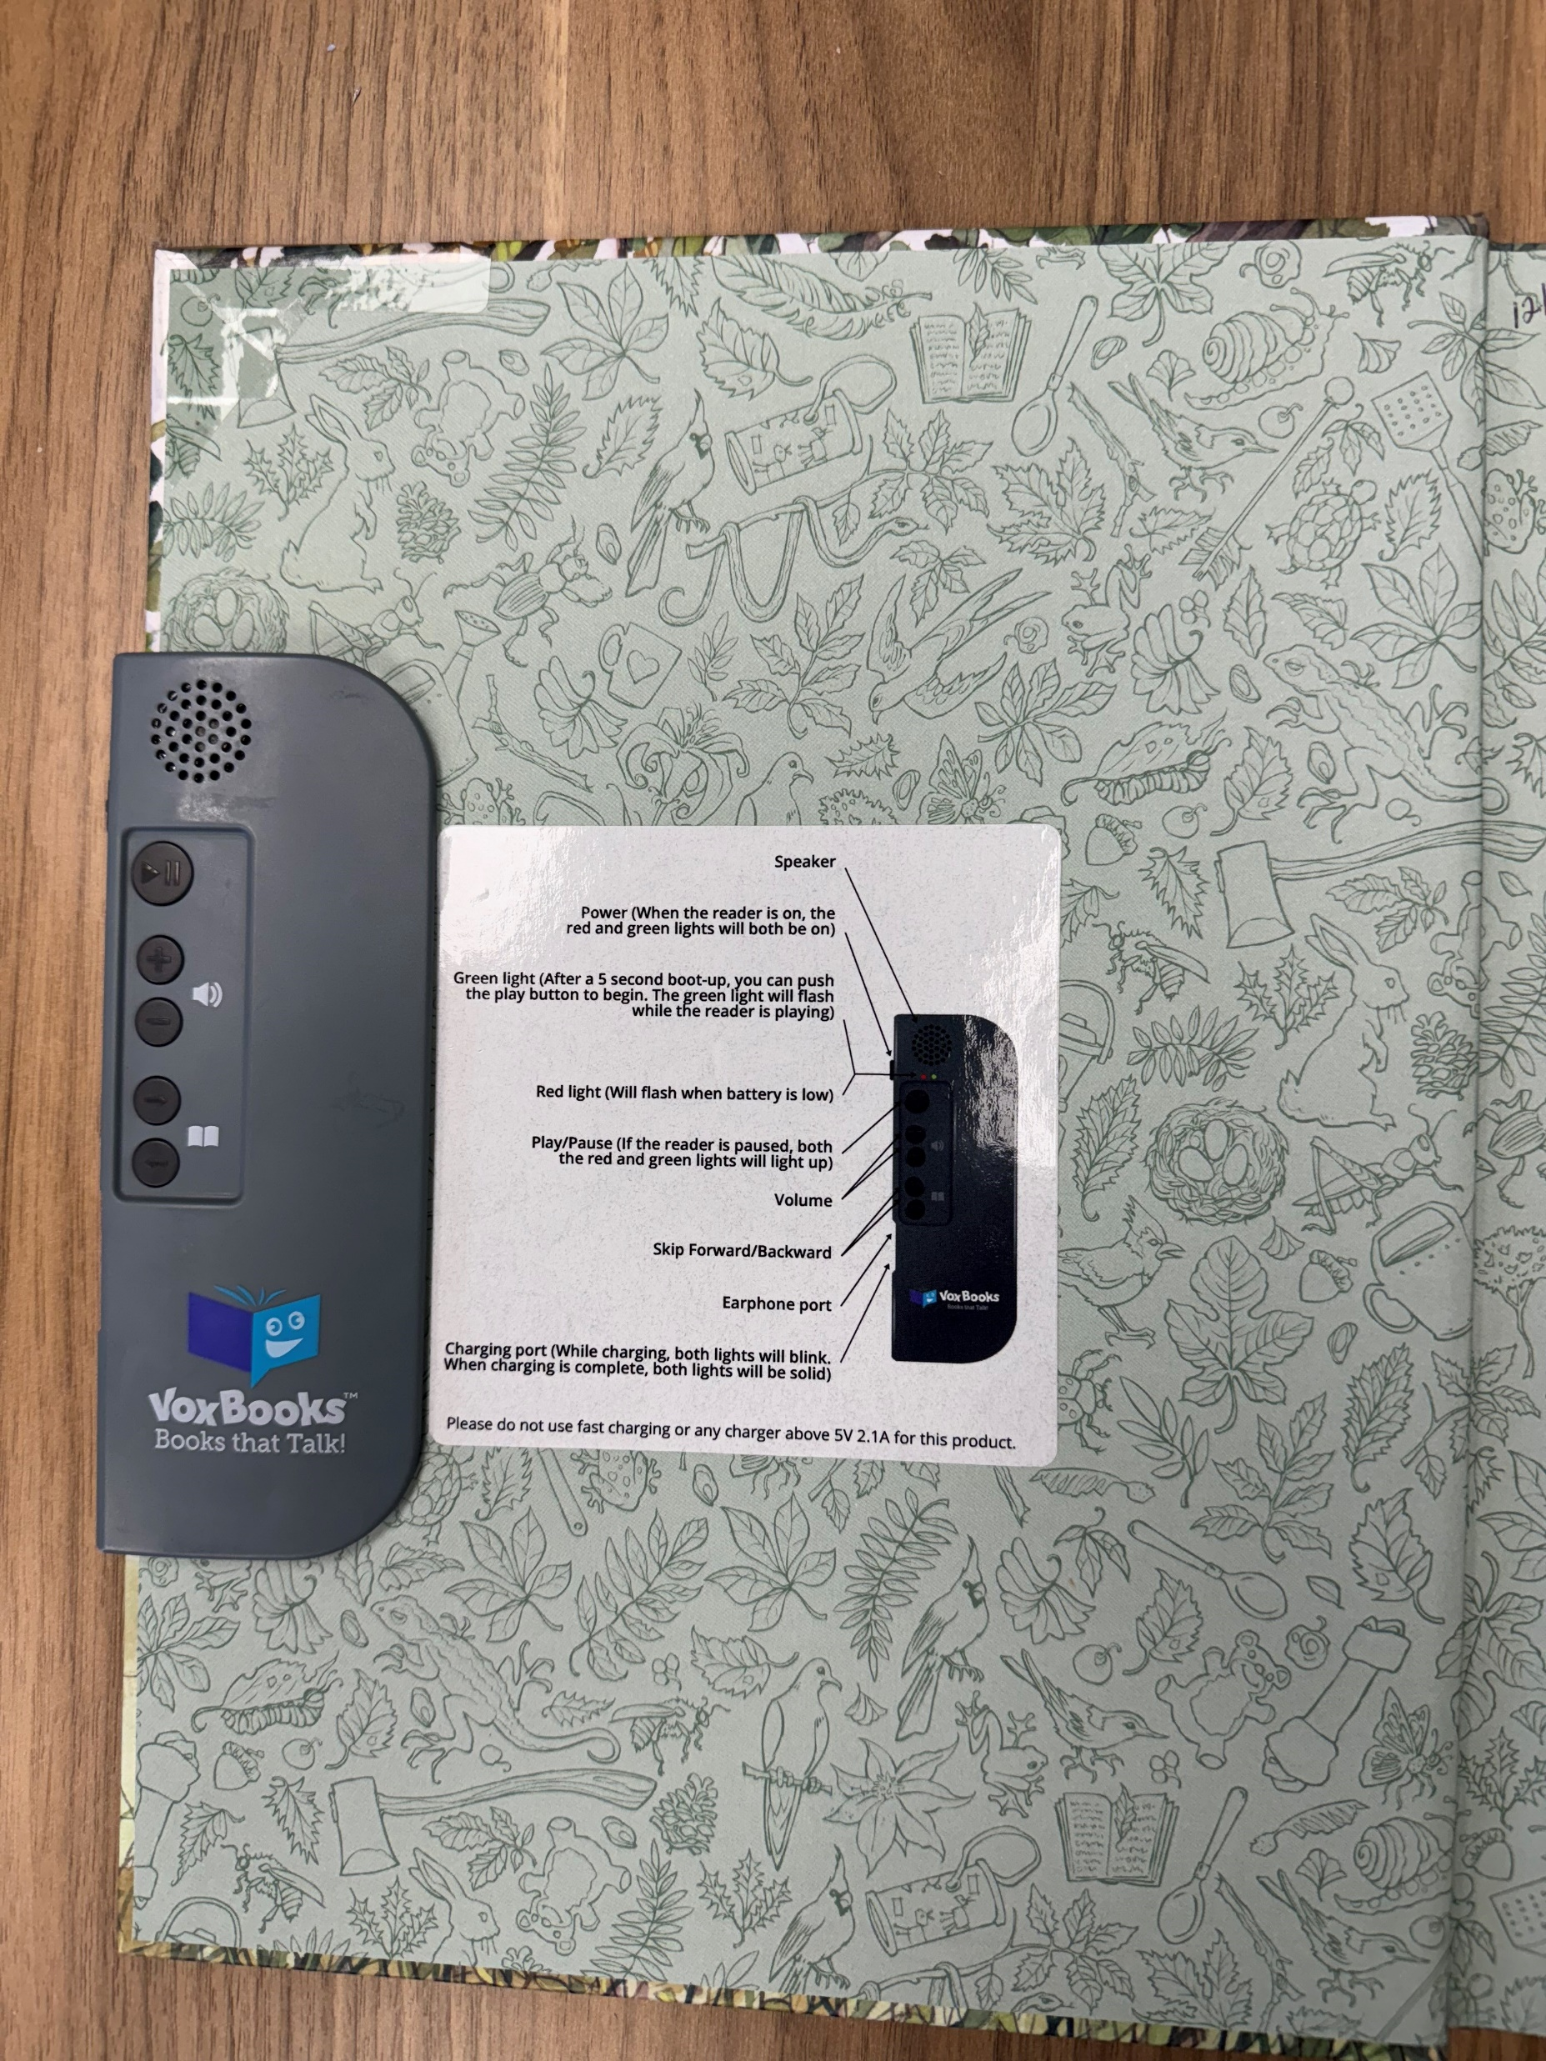
Audio-enabled books
Wonderbooks
Vox Books

Slide 8
Preferred sources of information
Cartridge for pre-loaded audio players
Title page for audio-enabled books
If no title there, then check:
Container/Cover
Accompanying material
Outside source, such as website or vendor catalog
Cataloger devises title

Slide 9
OCLC records and matching
Look for PLAYA records in the 040 when matching (for Playaway/Findaway World materials)
Publisher of Playaways and Wonderbooks
May have encoding level M; update to full level before bringing into Polaris
Audio-enabled books: some OCLC records cataloged as sound recordings, some as books

Slide 10
245 and GMDs
Title and statement of responsibility
Might be different from print version for Tonies and Yotos
Do not include narrator information in 245
511 note
Don’t add GMDs to OCLC records
Subfield h
SHARE local practice to add later

Slide 11
Edition statement
MARC field 250
Record Abridged or Unabridged for all audio media players
This comes first; do not put in brackets if on item
If multiple edition statements, can be in one field separated by a comma, or in separate 250 fields
Example: 250 _ _ $a Unabridged, Collector’s Edition.
Consider audio-enabled books unabridged
Record in square brackets

Slide 12
264 – Publication information
Can have multiple 264s for different functions
For Playaways/Wonderbooks: used to be Findaway World, LLC but is now Playaway Products, LLC
Yoto cards: Yoto Limited (London)
Tonies: Boxine GmbH or Boxine US, Inc., (Dusseldorf/Palo Alto)
Vox Books: Library Ideas, LLC (Vienna, Virginia)
Me Readers: pi kids, Phoenix International (Chicago, Illinois)
Go Readers (Scobre Educational): Go Reader Audiobooks (California)

Slide 13
Examples
Example Playaway:
$a Solon, Ohio : $b Playaway Products, LLC, $c [2023]
Example Vox book:
[Fairfax, Virginia] : $b [Library Ideas, LLC], $c [2023]

Slide 14
Publication dates
Publication date: core element, but audio media players rarely have them
Look for the copyright date of the device, not the phonogram date for the original audiobook
Record in 264 _1 $c as implied publication date in brackets
Record in 264_4 $c with copyright symbol
If phonogram date or copyright date for other formats present, may be recorded in a note

Slide 15
3XX Fields – Physical characteristics
300 physical description
336 content type
337 media type
338 carrier type
340 physical medium
344 sound characteristics
347 digital file characteristics

Slide 16
300 field
1 audio media player, 1 audio-storage figurine, 1 audio-enabled book, 1 audio-storage card, etc.
Don’t use brand names
Include run-time/pagination in parenthesis in subfield a
Spell out word “approximately”, even if abbreviated on item, if necessary
lllustrative content in subfield b
Sound characteristics now go in 344 fields
Extent in subfield c
Standard sizes for some of these formats; look at other records and use the same measurements

Slide 17
33X Fields
Preloaded audio players
Record applicable 33X fields for the spoken word aspect and the electronic aspect
Audio enabled books
Record applicable 33X fields for the spoken word aspect, the electronic aspect, and the book aspect
Yotos and Tonies
Record applicable 33X fields for the spoken word aspect, the electronic resource aspect, and the physical toy aspect

Slide 18
344 and 347 Fields
Record each term in a separate 34X field
Use controlled vocabulary terms when available
Use $2 with the code from the list
Links can be found in Bib Standards and Formats
Not every term is included in an RDA registry list
If not using a term from a controlled list, omit $2
340: physical medium
Can use, with appropriate subfields, for material or illustrative content

Slide 19
Examples
Preloaded audio players
Audio-enabled books
336 ‡aspoken word‡bspw‡2rdacontent
337 ‡aaudio‡bs‡2rdamedia
337 ‡aunmediated‡bn‡2rdamedia
338 ‡aother‡bsz‡2rdacarrier
338 ‡aother‡bnz‡2rdacarrier
344 ‡adigital‡2rdatr
344 ‡bnon-volatile flash memory
347 ‡aaudio file‡2rdaft
347 ‡bACELP
336 ‡aspoken word‡bspw‡2rdacontent
336 ‡astill image‡bsti‡2rdacontent
336 ‡atext‡btxt‡2rdacontent
337 ‡acomputer‡2rdamedia
337 ‡aaudio‡bs‡2rdamedia
337 ‡aunmediated‡bn‡2rdamedia
338 ‡aother‡bsz‡2rdacarrier
338 ‡avolume‡bnc‡2rdacarrier
344 ‡adigital‡2rdatr
344 ‡bnon-volatile flash memory
347 ‡aaudio file‡2rdaft
347 ‡bMP3

Slide 20
Examples
Yotos
Tonies
336 ‡athree-dimensional form‡btdf ‡2rdacontent
336 ‡aperformed music‡bprm‡2rdacontent
336 ‡aspoken word‡bspw‡2rdacontent
337 ‡aaudio‡bs‡2rdamedia
337 ‡aother‡bx‡2rdamedia
338 ‡aobject‡bnr‡2rdacarrier
338 ‡aother‡bsz‡2rdacarrier
344 ‡adigital‡2rdatr
344 ‡bnon-volatile flash memory
347 ‡aaudio file‡2rdaft
336 ‡athree-dimensional form‡btdf ‡2rdacontent
336 ‡aperformed music‡bprm‡2rdacontent
336 ‡aspoken word‡bspw‡2rdacontent
337 ‡aaudio‡bs‡2rdamedia
337 ‡aother‡bx‡2rdamedia
338 ‡aobject‡bnr‡2rdacarrier
338 ‡aother‡bsz‡2rdacarrier
340 ‡aplastic‡2rdamat
340 ‡amagnetic particles‡2rdamat
340 ‡gpolychrome‡2rdacc
344 ‡adigital‡2rdatr
344 ‡bnon-volatile flash memory
347 ‡aaudio file‡2rdaft

Slide 21
Notes
Include all appropriate standard notes in 500 field
All records should have:
588 0_ Source of title note
511 note for readers/performers
520 content summary note
505 contents note if item contains multiple titles

Slide 22
Playaway Standard Notes
500 _ _ $aRelease date supplied by publisher.
500 _ _ $aIssued on Playaway, a dedicated audio media player.
500 _ _ $aOne set of earphones and one AAA battery required for listening.

Slide 23
Wonderbooks Standard Notes
500 _ _ $aRelease date supplied by publisher.
500 _ _ $aIssued as a Wonderbook, a pre-loaded audiobook player permanently attached to a hardcover book.
500 _ _ $aPowered by a rechargeable battery ; USB charger required for recharging.
500 _ _ $aAudiobook player has 2 modes. Read-Along mode narrates the story. Learning mode asks questions related to the story.

Slide 24
Go Readers and Vox Book Standard Notes
Include these notes in all records for Go Readers:
500 _ _ $aIssued on Go Reader, a dedicated audio media player.
500 _ _ $aOne set of earphones and two AAA batteries required for listening.
Include this note in all records for Vox Books:
500 _ _ $aVOX Audio playback device includes headphone jack, external speaker, play/pause button, volume controls, page-turning controls, rechargeable battery, low battery indicator, and removable AC adapter.

Slide 25
Me Readers Standard Notes
500 _ _ $aAudio recordings issued on Me Reader, a dedicated audio media player electronic pad.
500 _ _ $aThree AAA batteries required for listening.

Slide 26
Tonies and Yotos
538 System details note
“For use in Yoto Player or Yoto Mini Player” or “For use with a Toniebox Speaker”
Depending on the material, you might also include a note about:
App compatibility
Headphones
Read-along versions/songs

Slide 27
Subject and Genre Headings
Add as applicable: topical, geographic, names, etc.
Do not add the $v Sound recordings
Use fiction/juvenile fiction instead when appropriate
Always add:
655 _7 $a Audiobooks. $2 lcgft (for adult material)
655 _7 $a Children’s audiobooks. $2 lcgft (for juvenile material)

Slide 28
Access Points
May see entries for publisher, distributor, production company
Ok to retain; do not necessarily need to add
Add for illustrators, narrators, etc.
Add relationship designators with $e for any access points
If multiple titles, include access points for titles of contents
Can retain 776 fields for related formats

Slide 29
Standard numbers
020: ISBN
024: UPC
028: Publisher numbers
Call numbers
Check OCLC Bib formats for indicators
Can also check the SHARE editing checklists

Slide 30
MARC fields 006 and 007
Records for preloaded audio players should have:
006 for electronic resource
007 for electronic resource
007 for audio recording
Records for preloaded audio-enabled books should have:
006 for electronic resource
006 for book if item has been cataloged as a nonmusical sound recording
007 for electronic resource
007 for audio recording
Notes:
Instructions for what these look like and how to add them are included with the SHARE editing checklists.

Slide 31
Fixed Fields and MARC 008 fields
Code as appropriate
Form: q for direct electronic
Pre-loaded audio media players are generally type i for non-musical sound recording

Slide 32
SHARE Local Practices
Edition statement
Record brand/material type in square brackets
Put multiple edition statements in one line
Example: 250 _ _ $a [Yoto].
General Material Designations (GMDs)
Put in $h, after subfields a, n, and p, but before subfield b
Use [electronic resource] for preloaded audio players
Use [sound recording] for audio-enabled books and Yotos/Tonies
Example: 245 1 0 $a Robin Hood ‡h [sound recording] /‡c Storytime Soundtracks.

Slide 33
SHARE Local Practices
Add as applicable:
655 _0 $a Electronic books.
655 _0 $a Preloaded audio players.
655 _0 Playaway (Preloaded audio player)
690 __ $a GoReader (Preloaded audio player)
690 _ _ $a Me Reader (Preloaded audio player)
690 _ _ $a Wonderbook (Audio-enabled book)
690 _ _ $a Vox Book (Audio-enabled book)E\

Slide 34
SHARE Local Practices
Continued, add as applicable
655 _0 $a MP3 (Audio coding standard)
690 _ _ $a Toniebox.
690 _ _ $a Tonie figurine.
690 _ _ $a Yoto Player.
Do not use $4 with code for relationship designator; change to $e with full word

