Slide 1
A Place for Everything: Digital File Organization
Kat Anderberg, CMC Metadata Cataloger
December 14, 2023
Notes:
Hello everyone, welcome to today’s Online with the CMC, A Place for Everything: Digital File Organization. My name is Kat Anderberg, and I’m the Metadata Cataloger here at the CMC. Today I will share some things to keep in mind when organizing and naming digital files, and then share some examples from my own file library.

Slide 2
File Organization & Naming
There is no right or wrong way—figure out what works best for your system and workflow
Consistency is key!
Notes:
There is no one right way to name and organize digital files. While this is a good thing in that it allows for you to create a system that works best for your organization and your working style, it also means that the possibilities can be overwhelming, especially if you have a lot of files you’re working with. The most important thing is to be consistent. When I show examples in a bit, you’ll see that I use a couple different file naming schemes between different projects, but each project has an internal consistency.

Slide 3
File Organization
Folders by project/collection
Folders by date
Subfolders are your friend!
Notes:
Two of the most common organization methods for files are by project and by date. In my work, I have several different collections from several different libraries that I’m working on at any given time, so what works best for me is to have folders for each library that I work with, and then if I have multiple collections for one library I can create additional subfolders. For example, here is my folder of collections for New Lenox Public Library. Some of the collections I have from this library are photos of the Gougar family, materials on churches in New Lenox, and materials from schools in New Lenox.

Slide 4
File Naming
Be descriptive
Don’t make file names too long
Notes:
As far as file names, beyond keeping your naming scheme consistent, it’s important to be sure that you can identify your files based on the names. This can be tricky as descriptive file names can get lengthy, and some applications have trouble opening or hosting files with overly long path names. For example, Adobe has trouble opening files with path names longer than 256 characters directly from file explorer. The path name is made up of all the subfolders a file is in as well as the file name itself, so they can get pretty long if you have multiple levels of subfolders keeping your files organized. Here, you can see a pair of files named “CPI_DigitalArchive_EvPsaCon04.” According to my usual file naming scheme, this means that the collection the file is in is the Chicago Psychoanalytic Institute—“CPI”—and it is a part of their Digital Archive. “EvPsaCon04” is an abbreviation for the title of the lecture in these files—Evolution of Psychoanalytic Concepts, Lecture IV.” The abbreviation gives me enough information to know exactly what is in the file without ending up with a file name that is so long as to be unwieldy.

Slide 5
File Names: Before
Notes:
Here is an example of putting a file naming scheme into practice. This is a screenshot from a folder of images that have not been renamed yet. These images are photographs and scans taken during a recent Mobile Memory Lab event, and they are all related to the Dog n Suds restaurant in Marshall, Illinois. In the navigation bar at the top, you can see that this folder is named “DogNSuds,” for the restaurant, and is nested in the folder “20231103Marshall,” indicating the date and location of the event, which is finally nested in the folder “Mobile Memory Lab.” Right now, these images have the basic file names that were assigned by the camera or scanner, which aren’t very descriptive, and there could be other files in my library with the same name.

Slide 6
File Names: After
Notes:
Here is the folder again, with updated file names. Each of the files now have the same file name prefix: “MML,” for Mobile Memory Lab, “20231103Marshall,” for the date and location of the event, “DNS” for Dog n Suds, and a two-digit number. All of these parts are separated by underscores, keeping the file names as one word, which is important for my work in CONTENTdm. If your files are only going to be used in-house, it may not be necessary for you to keep your file names as one word. This naming scheme ensures that all of these files can be identified as coming from the Mobile Memory Lab project, from the specific event held on November 3, 2023, in Marshall, Illinois, and from the Dog n Suds restaurant. If you take a look at the upper right-hand corner of this folder, you’ll see that the file name “MML_20231103Marshall_DNS_07” has two files associated with it, and the file names end with “-1” or “-2.” This is because these two photographs are of the same item, showing front and side views. I chose to have these files share a name this way to make sure that these two photographs are not separated and are entered into the same record in CONTENTdm. If you look further down in the folder, “MML_20231103Marshall_DNS_08” and “MML_20231103Marshall_DNS_19” also have two files associated with them.

Slide 7
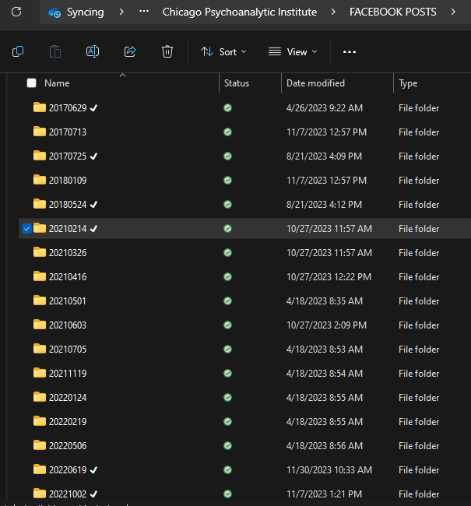
Folder & File Naming
Notes:
On the left here is a folder of Facebook Posts from the Chicago Psychoanalytic Institute. Each post has its own folder, which is named with the date that the materials inside were originally shared on the Institute’s Facebook page. You may notice the check marks at the end of some of the folder names; this is simply my way of tracking which folders have been fully cataloged and added to CONTENTdm. On the right is the inside of one of these folders, which shows the naming scheme I used for this collection: “CPI” for Chicago Psychoanalytic Institute, “Digital Archive,” and the date of the original Facebook post. This is a slightly different scheme from the Evolution of Psychoanalytic Concepts Lecture files I showed you earlier, but it still follows the basic principle of identifying the collection it’s in, and since the last part of the file name is just a date, I know instantly that this was a Facebook post. The dates are written in YYMMDD format, which makes them possible to sort chronologically.

Slide 8
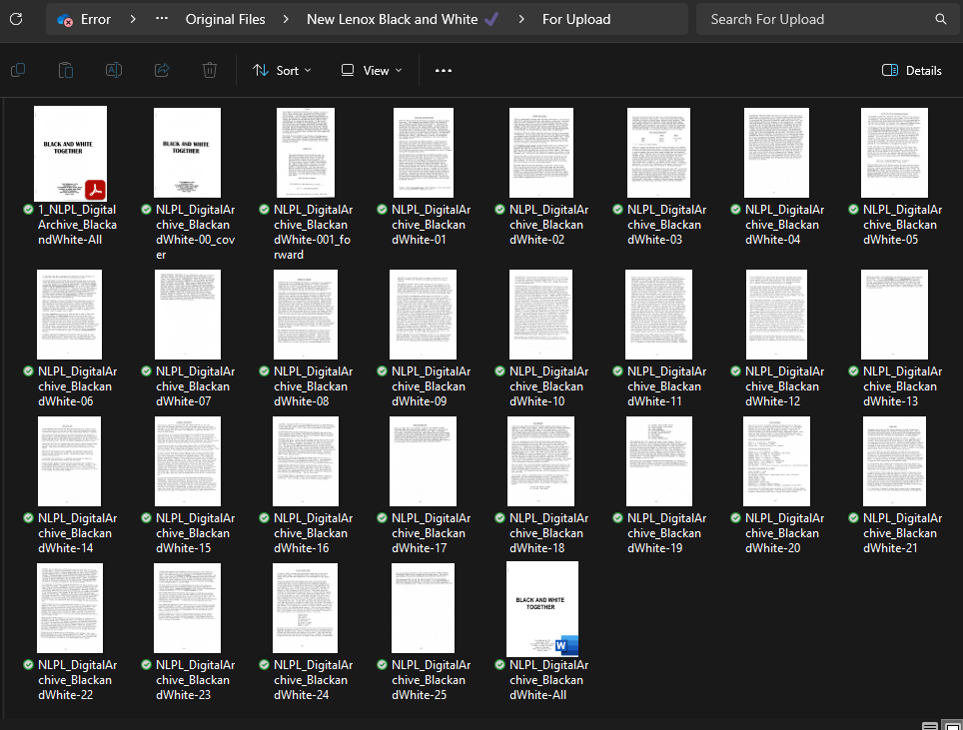
File Naming
Notes:
Here is a screenshot of a folder containing images of the pages of a booklet that was cataloged and added to CONTENTdm for the New Lenox Public Library, titled “Black and White Together.” Each file has the prefix “NLPL” for New Lenox Public Library, “Digital Archive,” “BlackandWhite,” for the title of the booklet, and a two-digit numerical identifier that correlates to the page numbers. When numbering files, it’s helpful to use leading zeroes in the file names—File01, File02, etc.—so that each file number has the same number of digits. This keeps the files organized in numerical order. When you have a hundred of files, use two leading zeroes—File001, File001, etc.—and when working with thousands of files, use three leading zeroes—File0001, File0002.

Slide 9
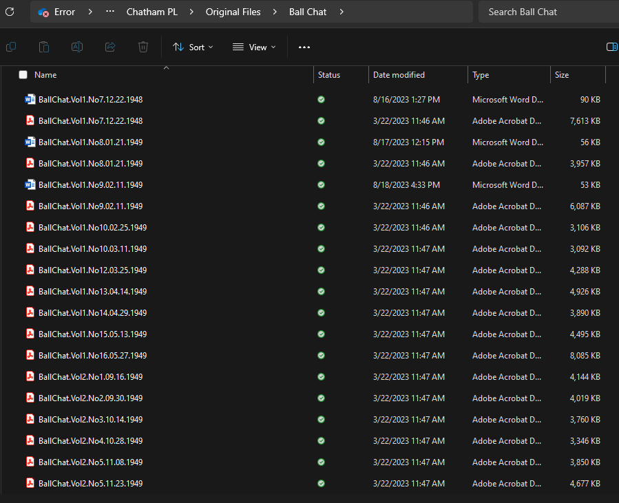
File Naming
Notes:
Here is another collection I’m working on, of school newspapers for Chatham Public Library. This specific newspaper is called The Ball Chat, and each file name starts with “BallChat” and then lists volume, issue number, and date. The different pieces are all separated with periods, to keep the file names as one word. This was the naming scheme used by Chatham Public Library, and while it’s a little different to the formula I use for many of my collections, these are great file names, and all consistent within the Chatham Public Library collections that I work with, so I kept them.

