Slide 1
A Place for Everything: Digital File Organization
Kat Anderberg, CMC Metadata Cataloger
December 14, 2023

Slide 2
File Organization & Naming
There is no right or wrong way—figure out what works best for your system and workflow
Consistency is key!

Slide 3
File Organization
Folders by project/collection
Folders by date
Subfolders are your friend!

Slide 4
File Naming
Be descriptive
Don’t make file names too long

Slide 5
File Names: Before

Slide 6
File Names: After

Slide 7
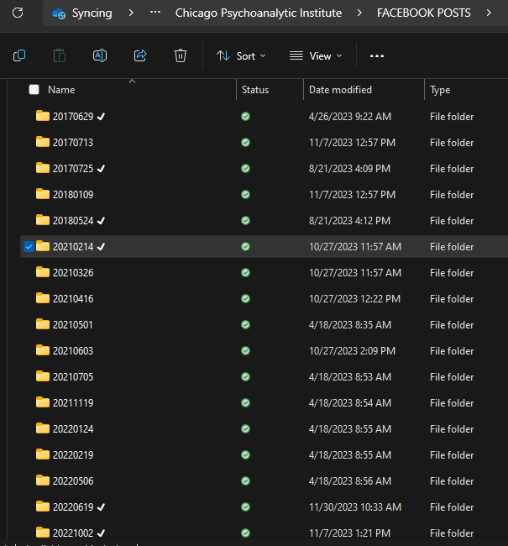
Folder & File Naming

Slide 8
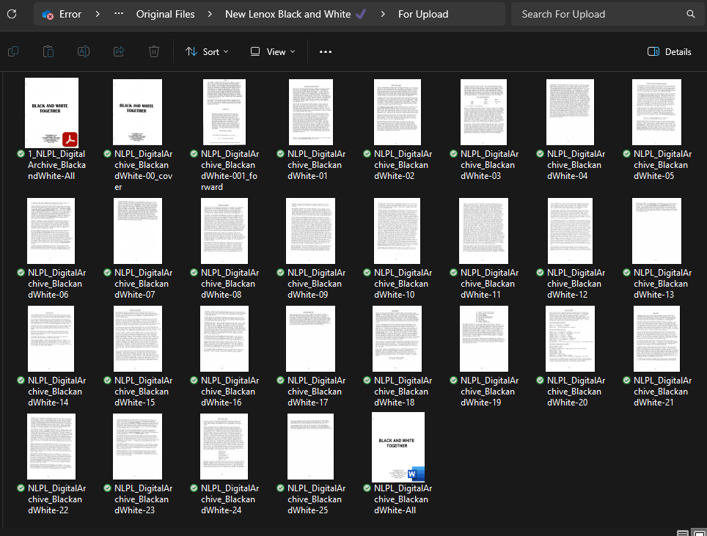
File Naming

Slide 9
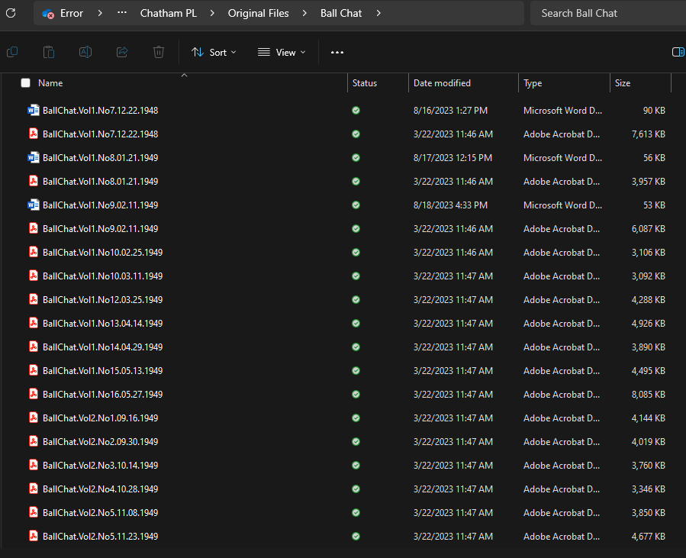
File Naming

