Slide 1
Large/Larger Print
Linda Johnson, SHARE Cataloger
Hanan Jaber, SHARE Cataloger
January 9, 2024

Slide 2
What is Large Print?
Books set in a type size larger than normal to enhance readability, improve letter and word recognition, and aid reading comprehension.
Large-print materials are most commonly available in 16- to 18-point type. The minimum size for large-print materials as defined by the US Postal Service Free Matter for the Blind mailing standard is 14-point type.
Notes:
First definition is from the authority file. The second definition is from The National Library Service for the Blind and Print Disabled, Library of Congress.

Slide 3
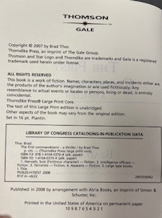
Examples of Large Print

Slide 4
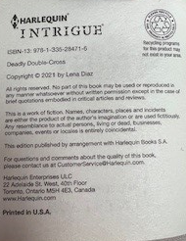
Examples of Larger Print

Slide 5
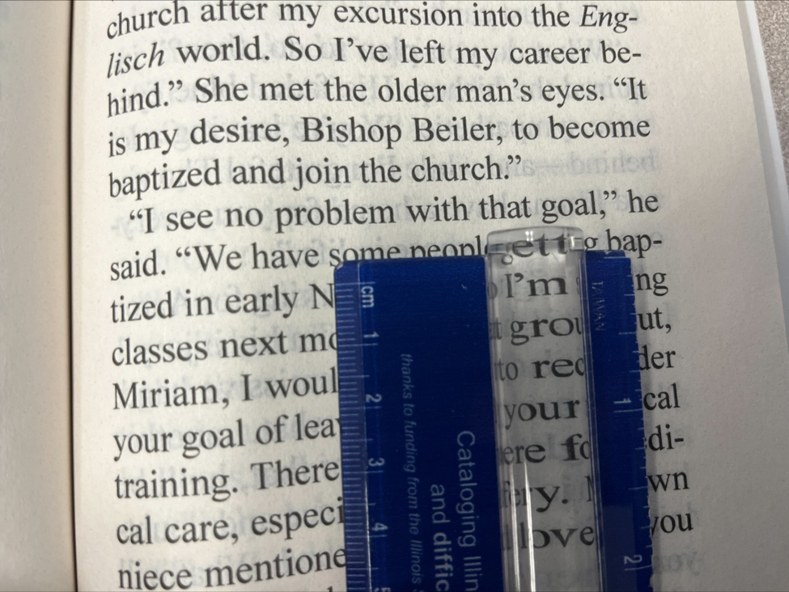
Example of large text

Slide 6
Appears to Be Large Print
It is uncommon, but if you run across a book that has obviously large print, but it is not labeled as such, please contact a SHARE cataloger for assistance.

Slide 7
Children's Books
Many children's books, especially picture books, will have larger than normal print.
Unless the book specifically says Large Print, do not consider these to be large print.
Notes:
I have only seen juvenile fiction books labeled as large print, but other catalogers have run across them in varying formats.

Slide 8
245 field ǂh
OCLC record
245 04 The trees of North America. ǂp Pines and firs of Canada.
SHARE local edit
245 04 ǂaThe trees of North America.ǂpPines and firs of Canadaǂh[text (large print)]
245 10 ǂaCounting lost starsǂh[text (large print)] :ǂba novel /ǂcKim van Alkemade.
Notes:
This is an old practice no longer used in RDA records. SHARE has decided to keep because it helps the format to be more visible in the PAC.
SHARE local practice: add GMD to all Large/larger print records in Polaris
This is a local edit only. Do not add to WorldCat records in OCLC and delete from WorldCat records if present.
Subfield h comes after subfields a, n, and p
Subfield h comes before subfield b

Slide 9
Dates
DtSt/Date Type – t
Dates 1&2 2022, 2022
264_1 Waterville, Maine : ǂb Thorndike Press, a part of Gale, a Cengage Company, ǂc 2022.
264_4 ǂc ©2022
Notes:
Many times, LP will have both a publication date and a copyright date of the same year.
In this case both should be in the record because the copyright date is for the originally published regular print and the pub date is for the large print.
If the copyright and pub dates are different and both are included, list them as you normally would.
If only the pub date or only the copyright date is present, list them as you normally would.

Slide 10
250 Field
250 _ _ Gale large print edition.
250 _ _ [Larger print edition].
Notes:
First example -- If the item has a large print or larger print edition statement, add that in a 250 field.
Second example -- Add edition statement [Larger print edition] to records for larger print books to keep them from being incorrectly merged. The larger print books usually only say Larger Print on the front cover so place the edition statement in square brackets.

Slide 11
300 field
300 _ _ 317 pages (large print) ; ǂc 24 cm
Notes:
For large print and larger print books, add “(large print)” after the page numbers in ǂa.

Slide 12
340 Fields
340 _ _ ǂn large print ǂ2 rdafs
340 _ _ ǂn 16 pt
Notes:
Add ǂn with large print to records for large print and larger print materials followed by $2rdafs.
If the item specifically states the size of the font include it in a separate 340 field $n without using the $2 rdafs. Thorndike Press usually includes the font size info on the title page verso.

Slide 13
500 Field
Examples:
500_ _ "Larger print"--Front cover.
500_ _ "True large print"--Back cover.
Notes:
If a cataloger is treating the item as large/larger print based solely on the statement from the cover, include a 500 note.

Slide 14
655_7
655 _7 Large print books. ǂ2 lcgft
Notes:
For all large and larger print books, add the LCGFT Large print books.

Slide 15
655_0 and 650_0
Remove
655_0 Large type books.
655_0 Large print books.
Remove
650 _0 Large print books.
650 _0 Large type books.
Unless the item in hand is about large type/print books.
Notes:
655_0 First two examples: This is an older LCSH formulations of the genre term that has been replace by the 655 _7 Large print books. ǂ2 lcgft

Slide 16
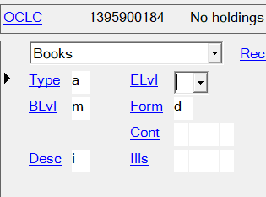
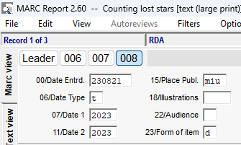
Fixed Fields
Form/Form of item is coded d for large print and larger print

Slide 17
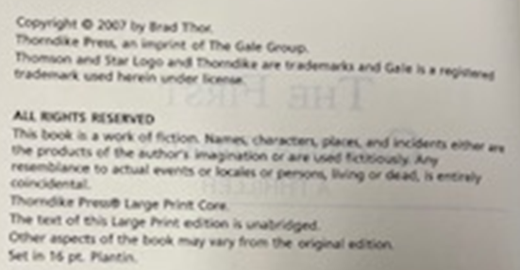
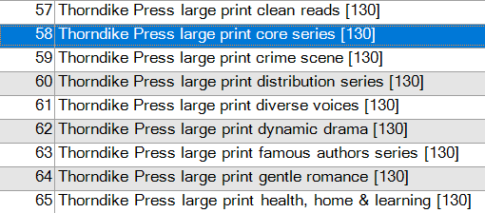
Thorndike Press series statements
490 1_ Thorndike Press large print core
830 _0 Thorndike Press large print core series
Notes:
There are series title authority records for approximately 80 Thorndike large print series. This series statement should be included in addition to any other series which apply.
If you are working with patrons that come in asking for a clean read, historical fiction, gentle romance, etc. it is helpful to include this series information.

Slide 18
Live Demonstration: Deriving a large print record from an existing regular print record.
Notes:
The great thing about creating a new WorldCat record for large print is that there is usually an existing regular print record that can be used to derive the new large print one. The most important step in this process is to find a GOOD existing regular print record. It's a bonus if you find an exiting LC record as those are most times the best records.

Slide 19
Large Print Record – MarcReport View

Slide 20
Large Print Record – MarcReport View, continued

Slide 21
Resources
Large Print and Larger Print Materials | SHARE (illinoisheartland.org)
Use of General Material Designation (gmd) | SHARE (illinoisheartland.org)
Mini-checklist for editing large/larger print books

Slide 22
Questions?

Slide 23
Thank you for your time!

