Slide 1
Equipment, Realia & Kits
SHARE Catalogers
Training Session, September 10, 2024

Slide 2
The Eternal Question: What do I do with this thing?
Equipment/objects/realia can be tricky because they don’t always have good information
Is it for in-house use and you just need to keep track of it?
Is it one thing or a collection of things?

Slide 3
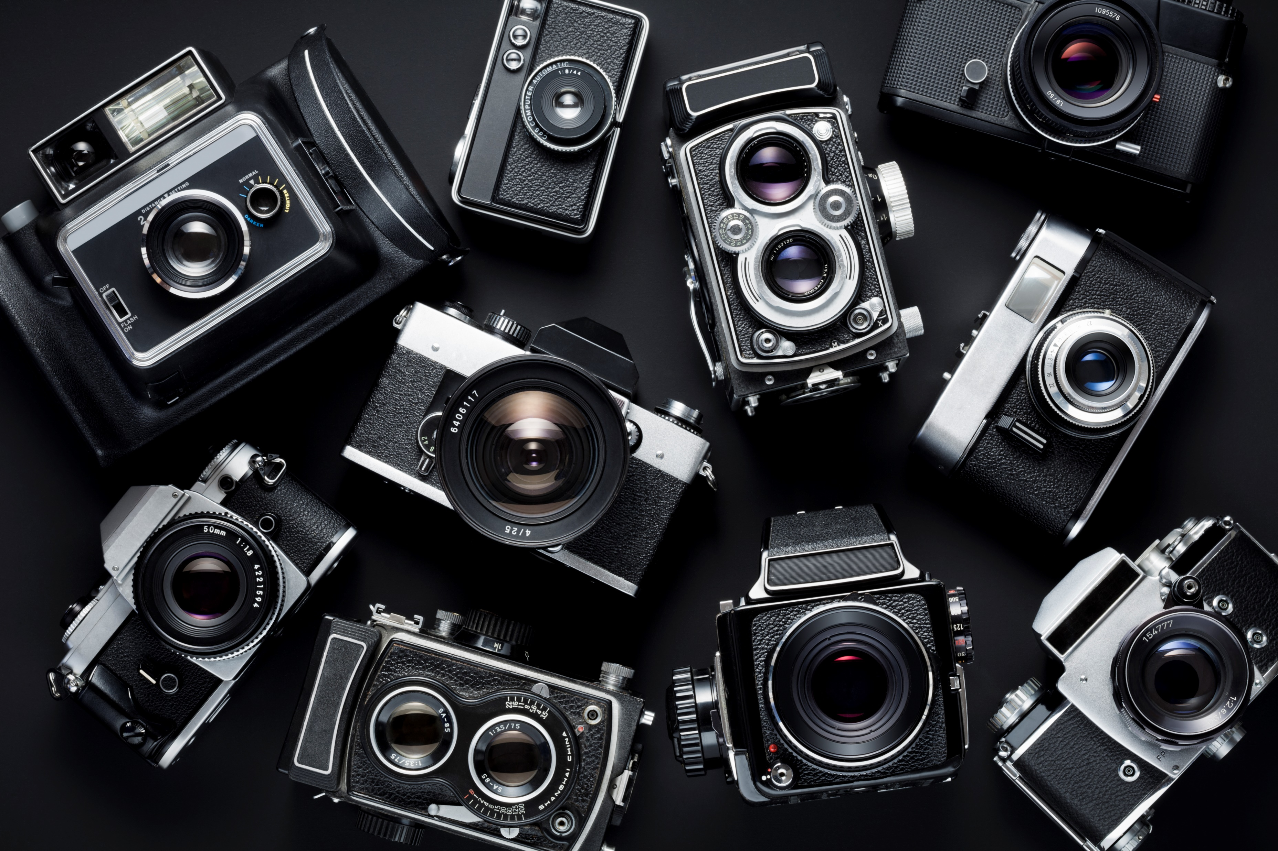
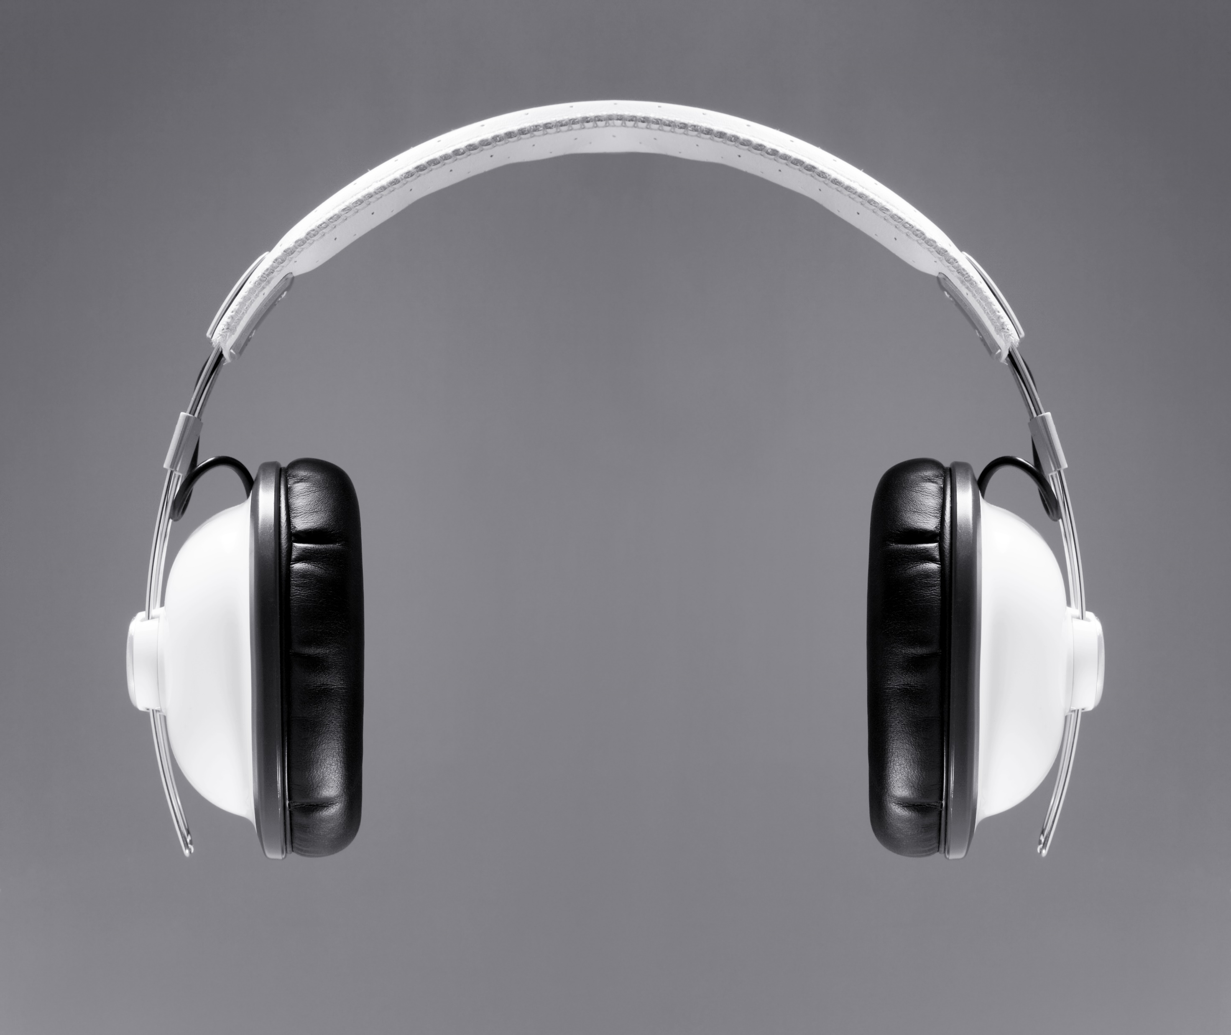
Equipment
May include, but is not limited to, items such as cameras, projectors, laptops, sewing machines, etc.

Slide 4
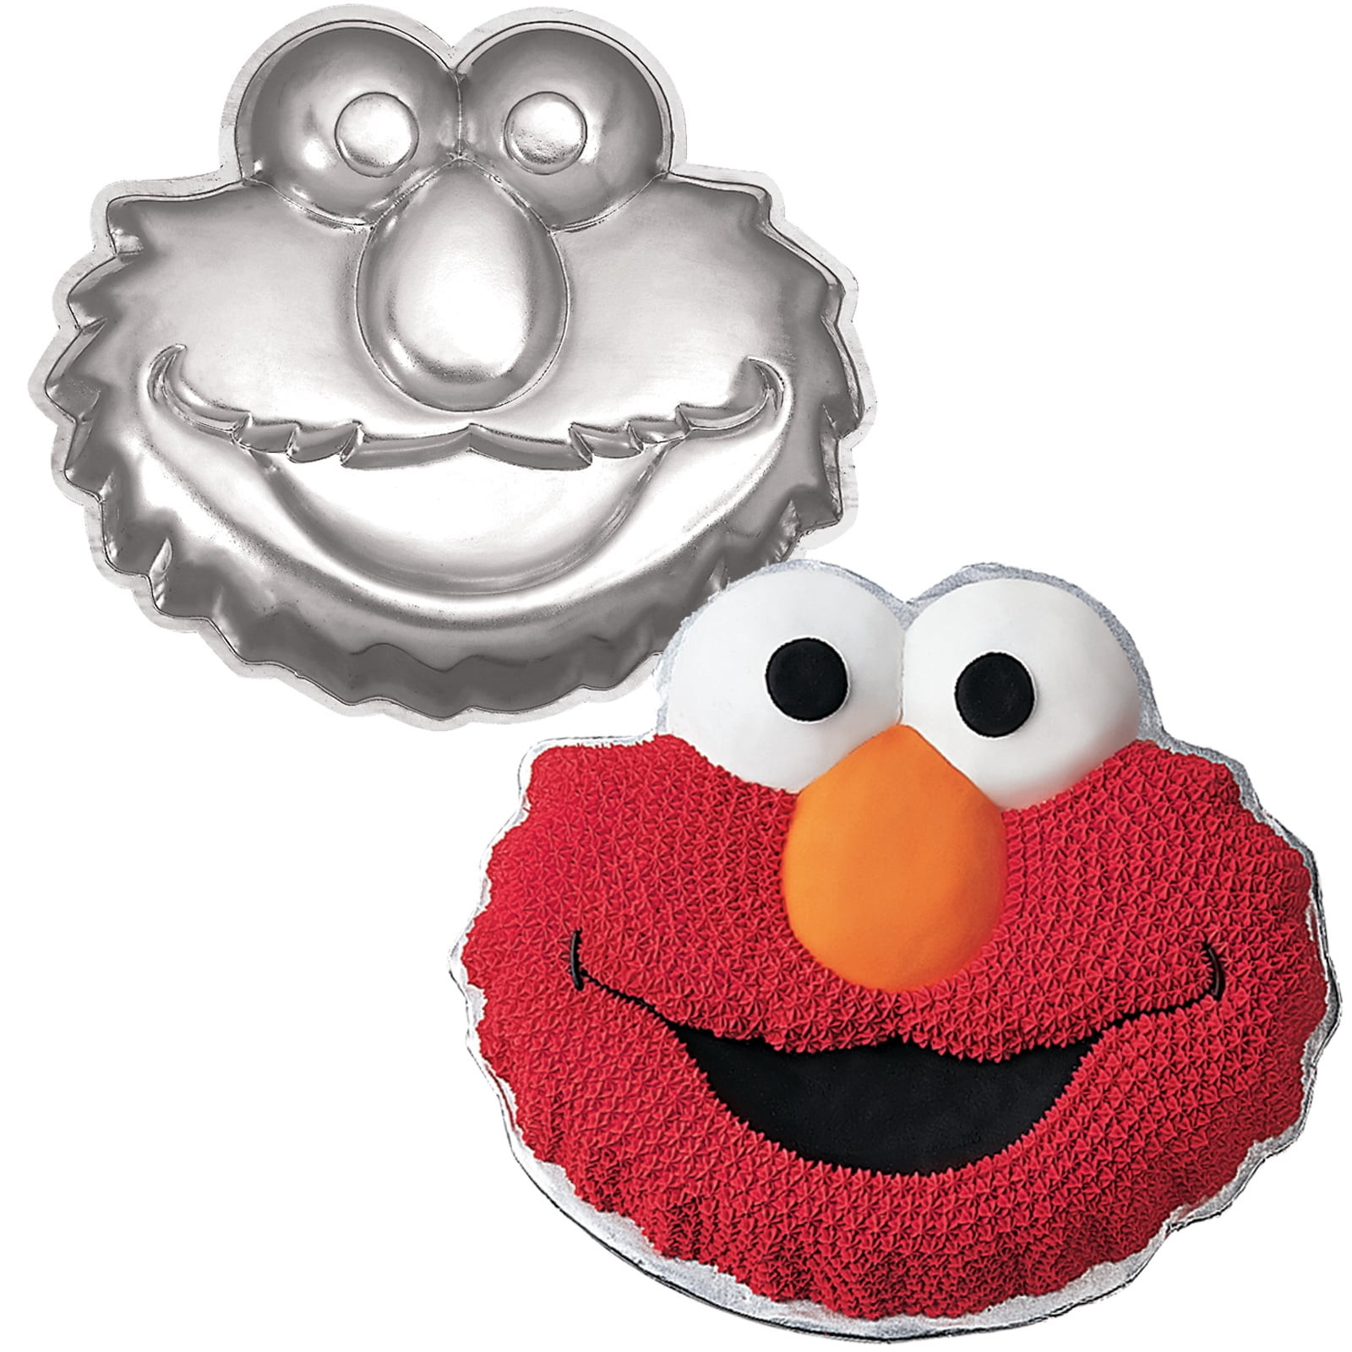
Realia
Have not seen this word outside of library land
Covers anything that is something you want to circulate but isn’t technically equipment
Dancing lizard sculptures! Puppets! Masks! Bells! Mini models of Michelangelo’s statue of David! Cake pans shaped like Elmo’s face!

Slide 5
Do I need to do this in OCLC?
If the resource will not be loaned outside of SHARE, an original local bibliographic record may be created in Polaris
If the resource will be loaned outside of SHARE, an original record must be created in OCLC and brought into the Polaris database

Slide 6
To create the record
Step 1: Check Polaris
Step 2: Check OCLC
Step 3: Decide if you’re going to catalog it in OCLC or locally in Polaris
Most things can probably be cataloged in OCLC
Step 4: Create the record with as much detail as possible
Remember: it’s better to have a record you’re not totally sure about than no record at all!

Slide 7
Local practice: Some Common GMDs
These are a SHARE local thing! (not RDA)
Game, flash card, model, Realia, Toy, etc.
Use of General Material Designation (gmd) | SHARE (illinoisheartland.org)

Slide 8
Other things to consider
Local subject headings for Audio-visual equipment, Finger puppets, Hand puppets, 3-D printers and more
Approved local subject headings | SHARE (illinoisheartland.org)
It will probably be difficult to find good genre headings for objects that you’re cataloging
Add 945 $b OCLC DO NOT SET if you don’t want it to be a part of ILL

Slide 9
Example 1: Beatles Record Player

Slide 10
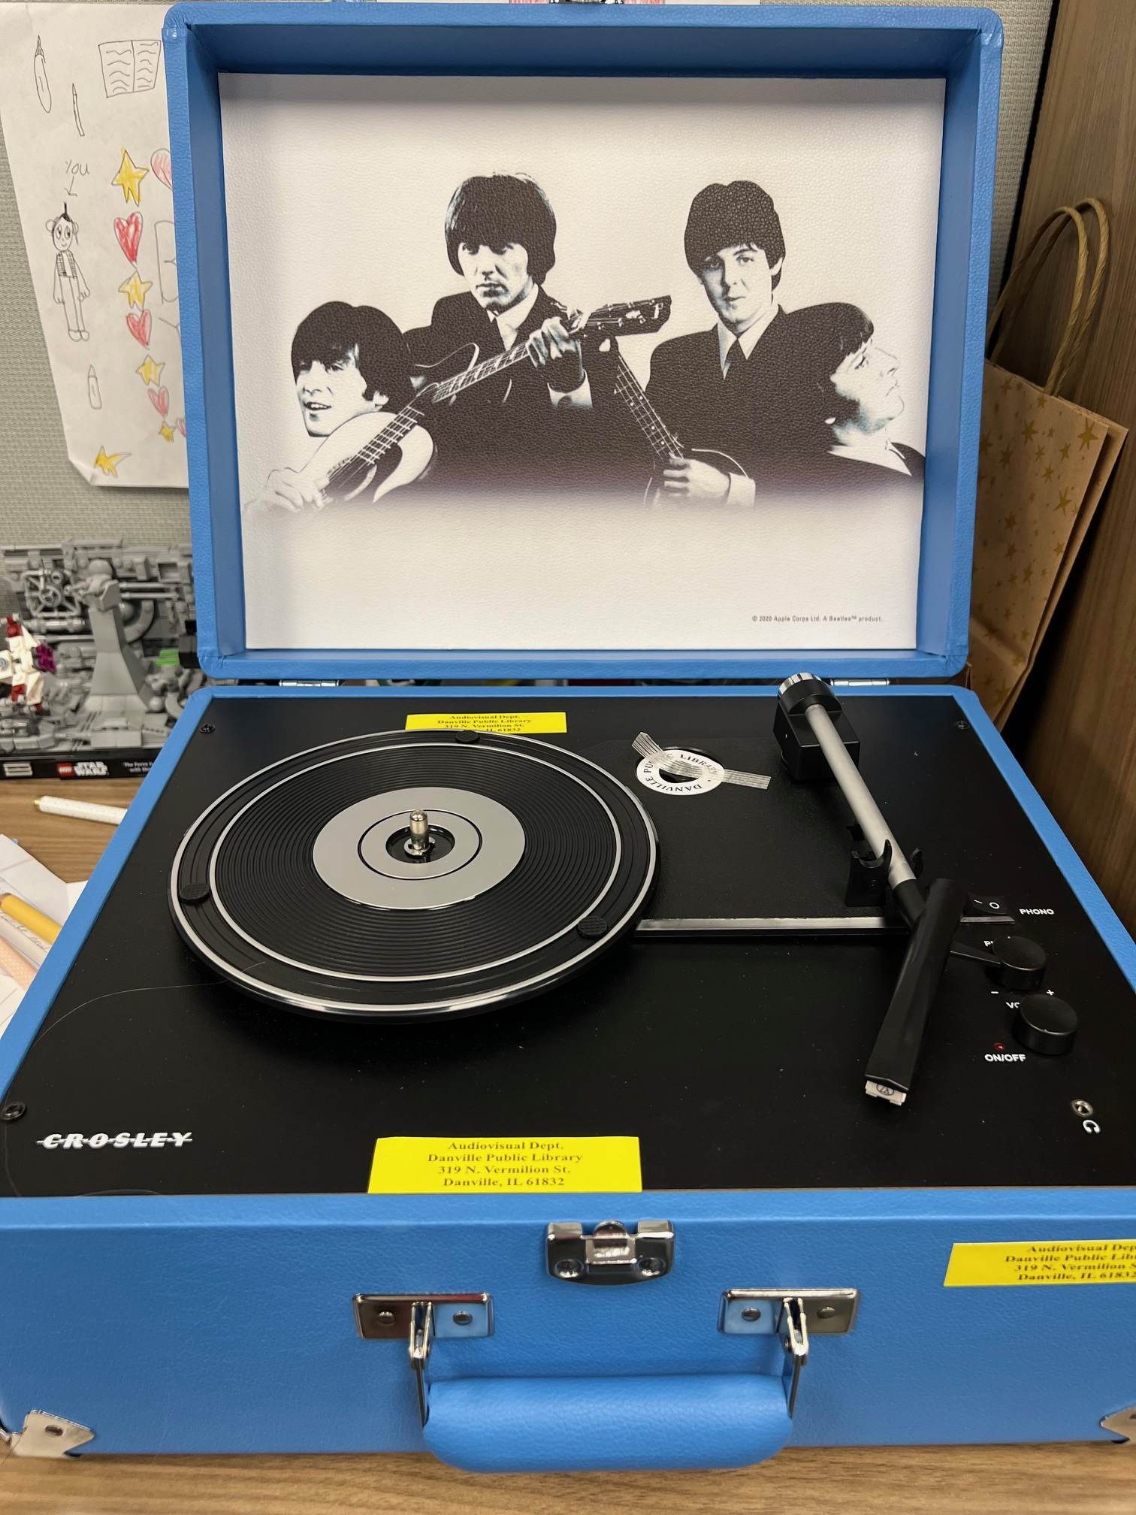
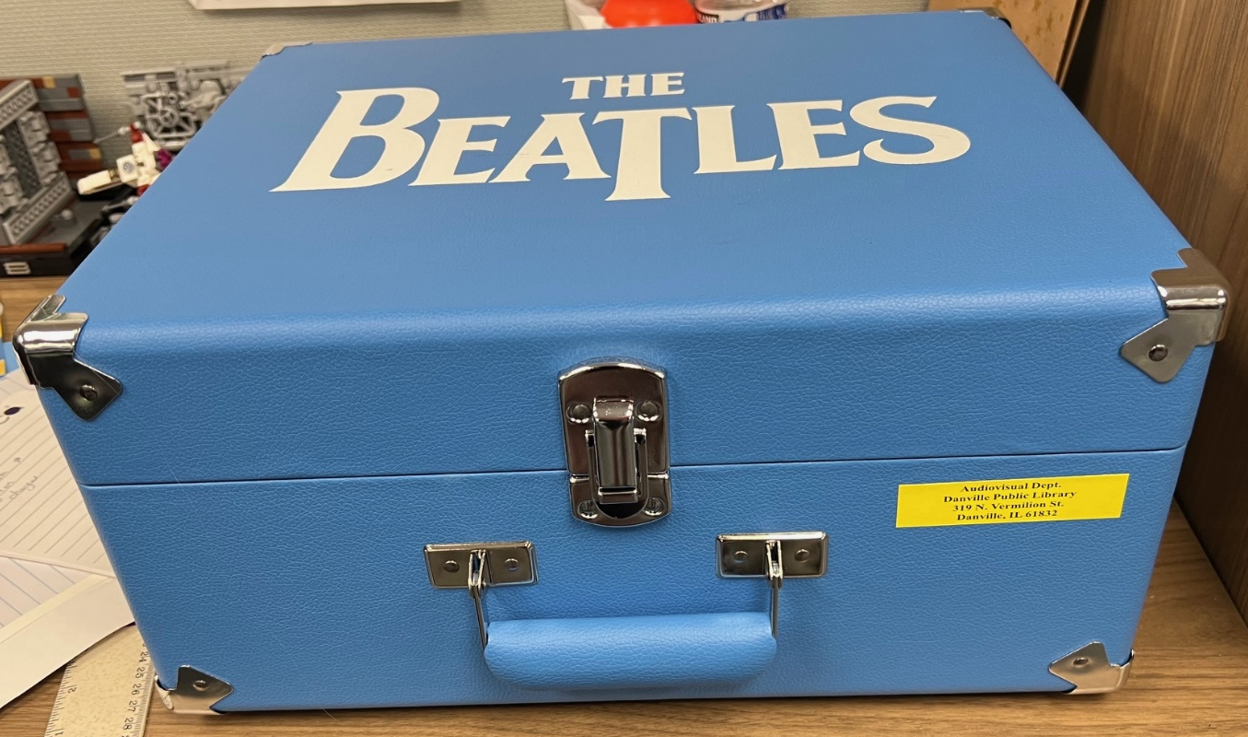

Slide 12
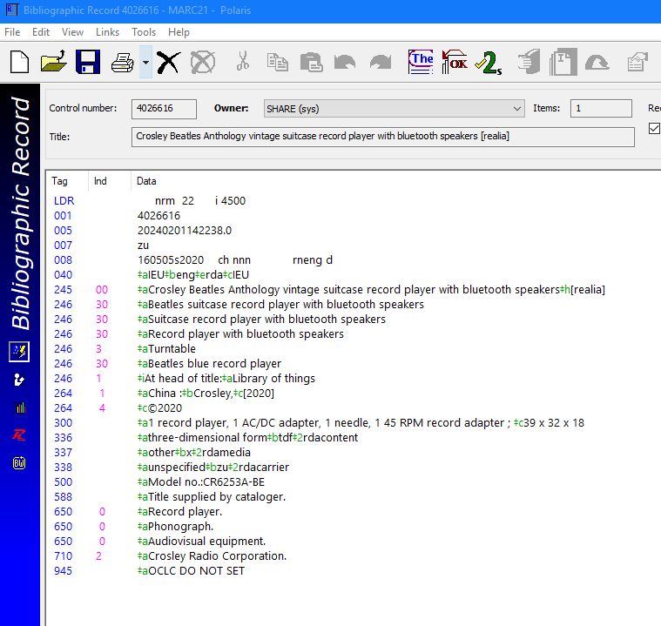

Slide 13
Example 2: Balloon Pump

Slide 14
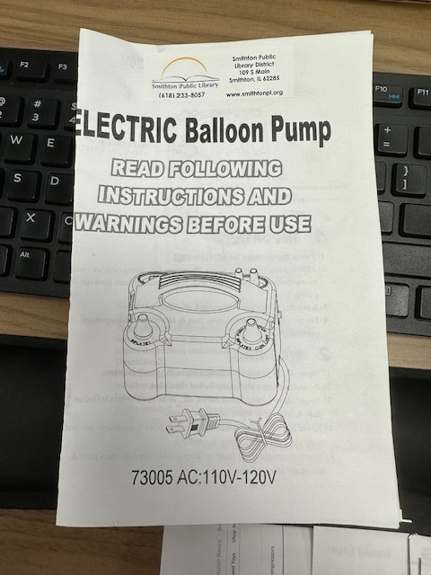
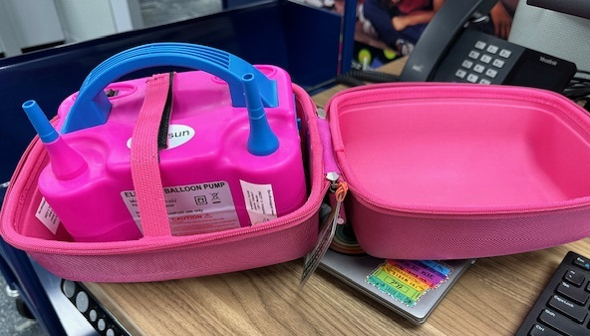

Slide 15
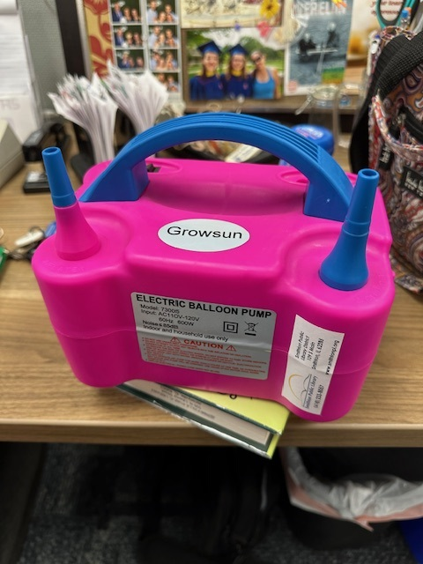
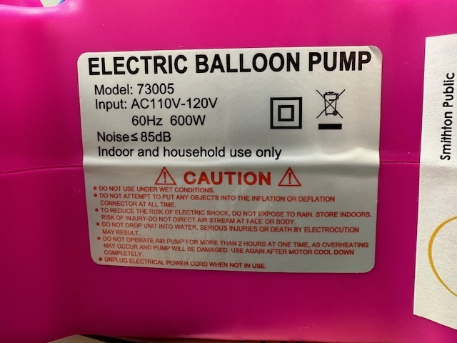

Slide 16
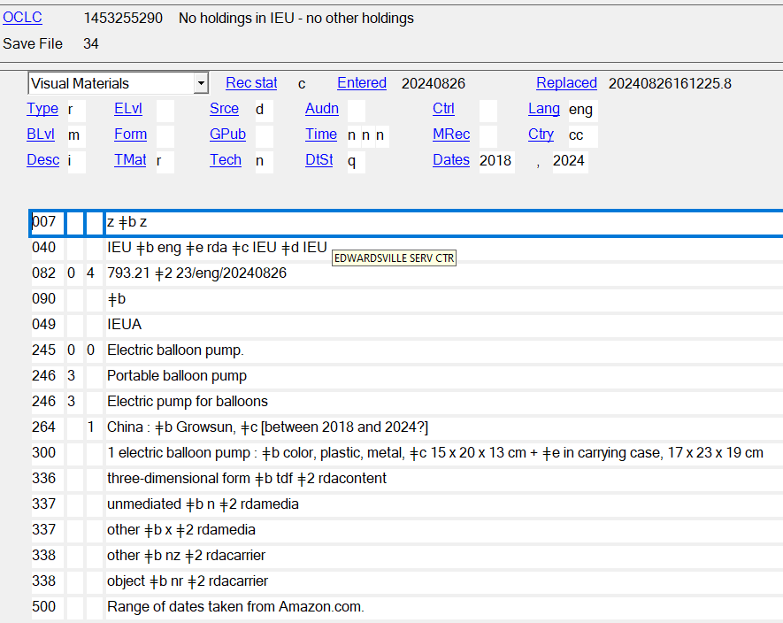
Notes:
Notice! There is no GMD because that is a local edit.

Slide 18
What if my item is part of a special collection?
It may be eligible for cataloging for FREE through the CMC!
Fill out the form on the IHLS/CMC website to request cataloging for an item or collection or send an email to cmc@illinoisheartland.org
Cataloging Maintenance Center | IHLS (illinoisheartland.org)

Slide 19
Local Equipment Records
Cataloging libraries may create local equipment records, or may request records be created by SHARE Bibliographic Services staff by submitting a help desk ticket
Example: my library has tables we need records for, but we can’t send them to you at SHARE
Barcoding libraries may request records be created by SHARE Bibliographic Services staff by submitting a help desk ticket
Example: We need a record for our school’s Chromebooks

Slide 20
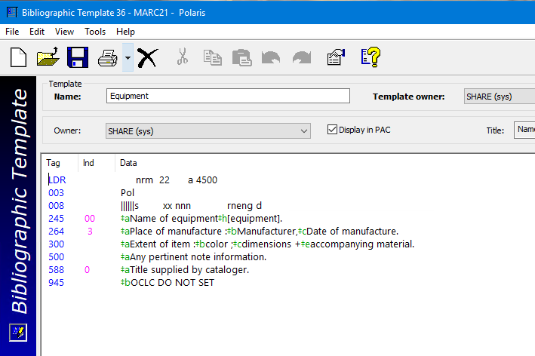
Bibliographic Templates > Equipment

Slide 21
Is your “item” actually 2+ items wearing a trench coat? It might be a kit!
*Image from Reductress.com

Slide 22
Kits/Library-assembled resources
AACR2 Definition: “an item containing two or more categories of material no one of which is identifiable as the predominant constituent of the item”
Example: A library packages a children’s book and a puppet together and circulates them as a unit; or, a library assembles a Thanksgiving-themed kit composed of a book, DVD, doll, and puzzle related to the holiday.
Notes:
There is no RDA definition for kits! It’s the wild west, folks!

Slide 23
How to Catalog Kits
Cataloging libraries are welcome to catalog their own kits if they feel so moved
SHARE is also happy to catalog kits for the normal cataloging fee
If the kit is too large to send through Delivery, you can contact us and arrange to drop them off at one of the hubs

Slide 24
Some points of note
690_ _ $a Kits – add this as a local edit to kit records
Add the GMD for kits as a local edit
Life hack: You can cheat on these by looking at kits that other people have already created!
These will probably take you a while to make! They are not quick.
Kit records usually use the Bibliographic Level code “c” for collection rather than “m” for monograph

Slide 25
How does Kit & Kaboodle work?
Free cataloging - a brief bibliographic record will be created by SHARE catalogers in Polaris only.
SHARE generously with other SHARE libraries and patrons.
Check and fill holds for Kit & Kaboodle through Polaris Request Manager.
The borrowing library is responsible for any lost or damaged items.
Notes:
To be included in the program the owning library must agree to generously loan kits to other SHARE libraries and patrons.
Kits will be housed at the owning library. It is the responsibility of the owning library to check, and fill, holds for Kit & Kaboodle through Polaris Request Manager.
As with all resource sharing through SHARE, the borrowing library is ultimately responsible for any lost or damaged items.

Slide 26
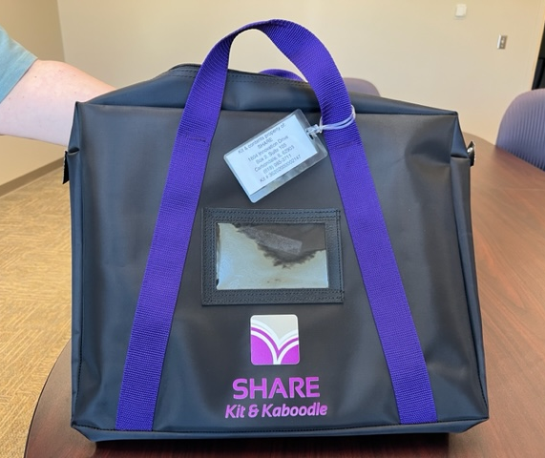
How does Kit & Kaboodle work?
If a kit is withdrawn or no longer included in Kit & Kaboodle, please inform SHARE and we will delete the brief bibliographic record.
The zippered tote should be returned in delivery to any of the IHLS hubs.

Slide 27
How does Kit & Kaboodle work?
Checking out kits
Kits are available for request and check out only by SHARE libraries or their patrons.
All kits check out for 42 days (6 weeks). Individually barcoded items contained in the kits check out for 35 days (5 weeks).
Notes:
Kits with individually barcoded items are the book club/classroom kits.

Slide 28
Delivery
How does Kit & Kaboodle work?
Weight limit of forty pounds.
Oversized items may not be able to be handled through IHLS delivery.
Overweight and oversized items can be included, but they must be limited to being available for pick up at the owning library.
If the kit is too large for the SHARE tote, the owning library will need to provide a container.
Notes:
Weight limit of forty pounds. This is to protect the safety of our delivery staff.
Oversized items, even if under forty pounds, may not be able to be handled through IHLS delivery.
Overweight and oversized items can be included in Kit & Kaboodle, but they must be limited to being available for pick up at the owning library.
If the kit is oversized, other arrangements for packaging the kit will need to be made by the owning library.
Please contact SHARE for questions.

Slide 29
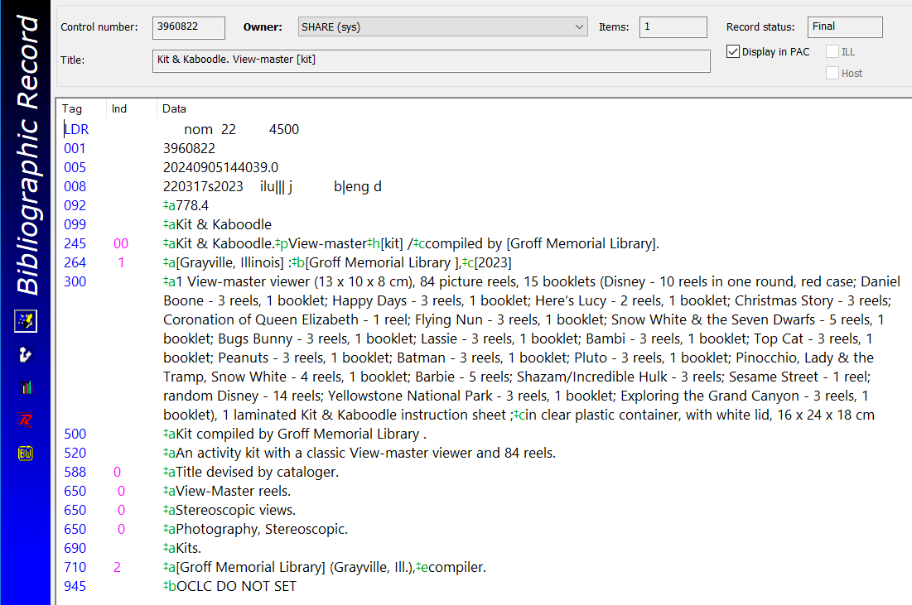

Slide 30
Kit & Kaboodle
The link to Kit & Kaboodle information is: https://share.illinoisheartland.org/kits
Contact Linda Johnson with questions.
ljohnson@illinoisheartland.org

Slide 31
Thanks for listening! Any questions? Any additional example records you would like to see or discuss?

