Slide 1
AI and the Library World: Part 2
An Online with the CMC production, brought to you by: Eric McKinney Caitlyn Stricklin
CMC Cataloging Trainer Intern
Cataloging Maintenance Center Cataloging Maintenance Center
Notes:
Good morning, everyone! Welcome to this month’s edition of Online with the CMC. This month we are diving back into the world of AI with AI and the Library World: Part 2.

Slide 2
Agenda
Introductions
Brief Recap of Part I
Acquisitions
Circulation
Interlibrary Loan
Free-for-all
Notes:
Our agenda for this session is as follows: Your fearless presenters shall introduce themselves; there will be a brief recap of Part 1; Caitlyn will share her research on library uses of AI (outside of cataloging) and we will end with a live demo featuring YOUR libraries query(s). We will see if we can develop a query to solve your need(s) with AI! Simply add your need(s) in the chat while Caitlyn shares her research, and we will see what we can do!

Slide 3
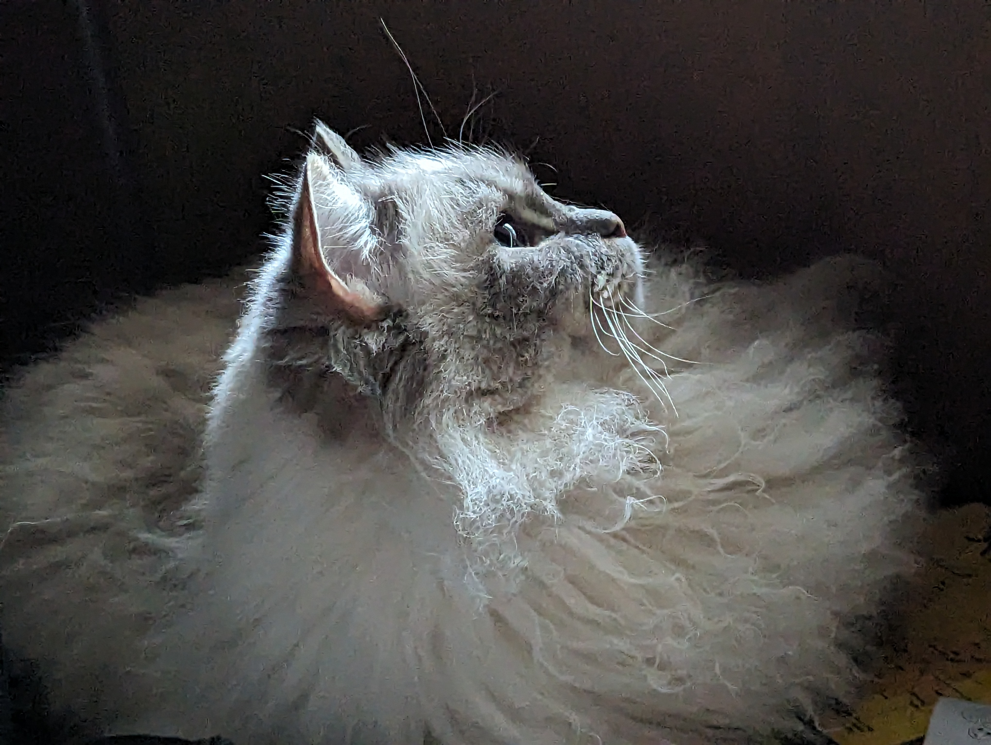
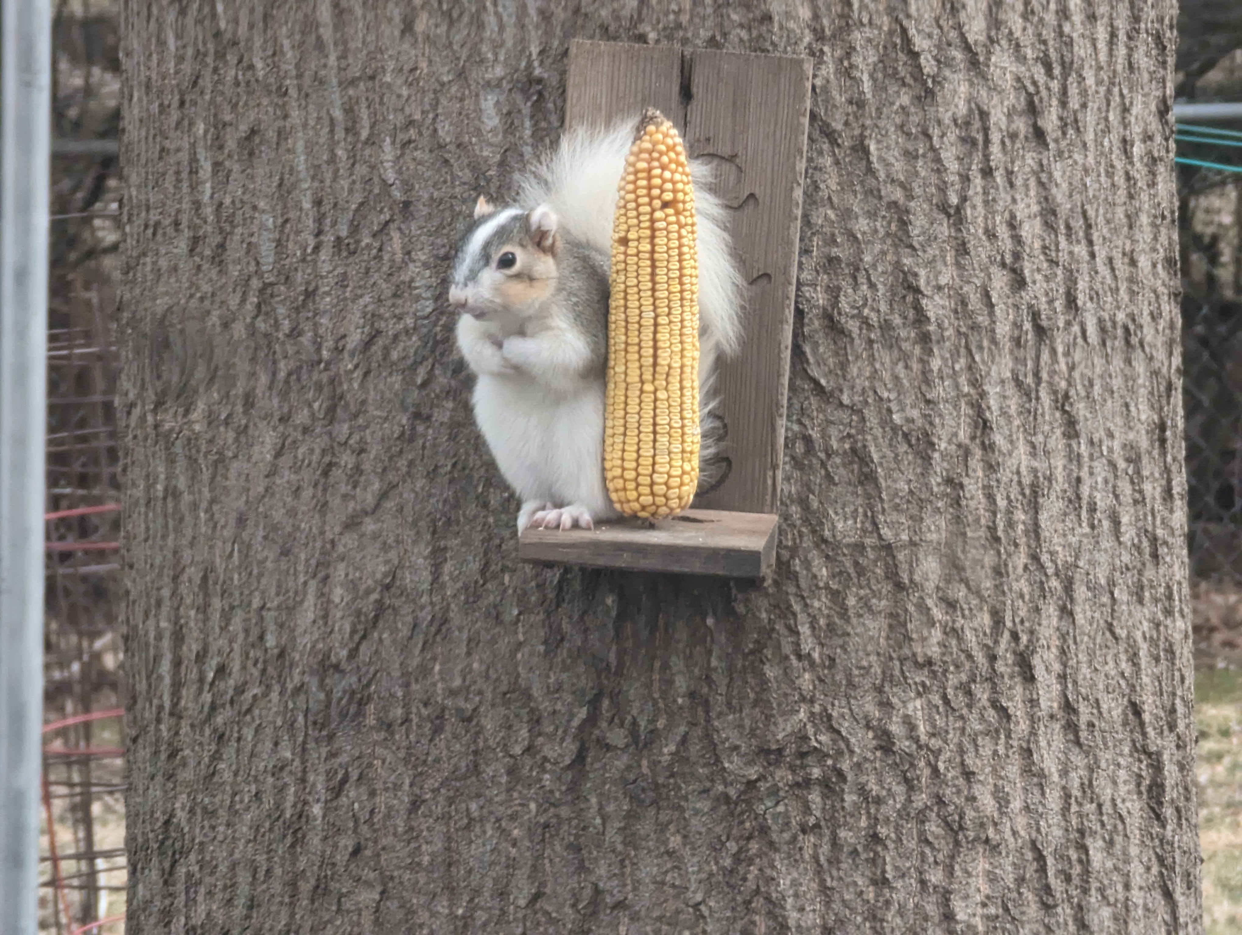
Eric McKinney
Notes:
My name is Eric McKinney, and I am the CMC Cataloging Trainer at the CMC. You may know me from such presentations as, AI and the Library World, Part 1 and Well, You See, Timmy. I have been here just over three years. I have cataloged for academic and public libraries in the past. I like the broad variety of items we get to catalog at the CMC. Plus, I get to play with AI! I was inspired to library work by my wife, a high school librarian (who was pulled out of the library years ago to teach non-library/information literacy related courses. But don’t get me started or this will turn into another presentation altogether!) Anyhoo, in my spare time I enjoy reading, video gaming, gardening, canning and magnet fishing. When working remotely, I enjoy hanging out with my furry co-workers. Though, none are terribly helpful. Tyrion (left) and Griffin (center) mostly nap. Piebald (right), or Pie for short, seems to need a lot of snack breaks.

Slide 4
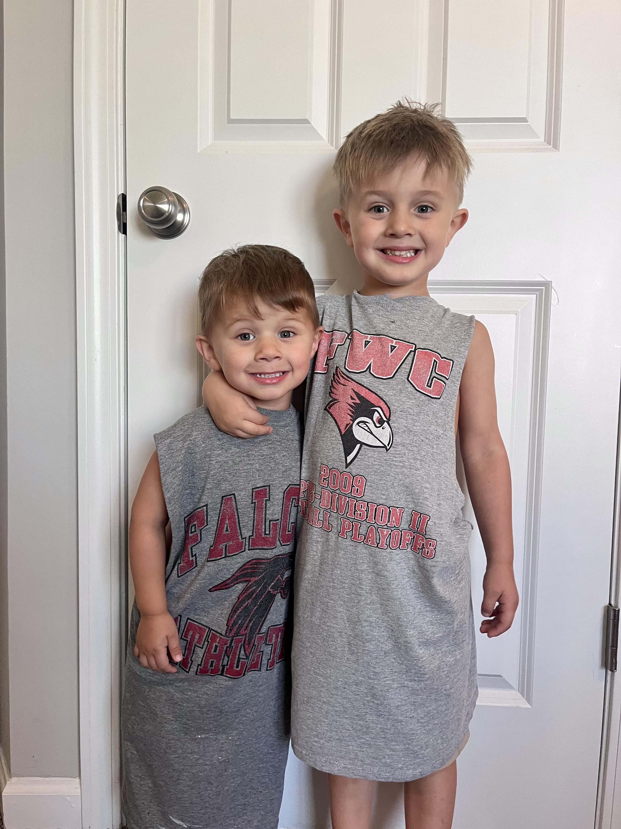
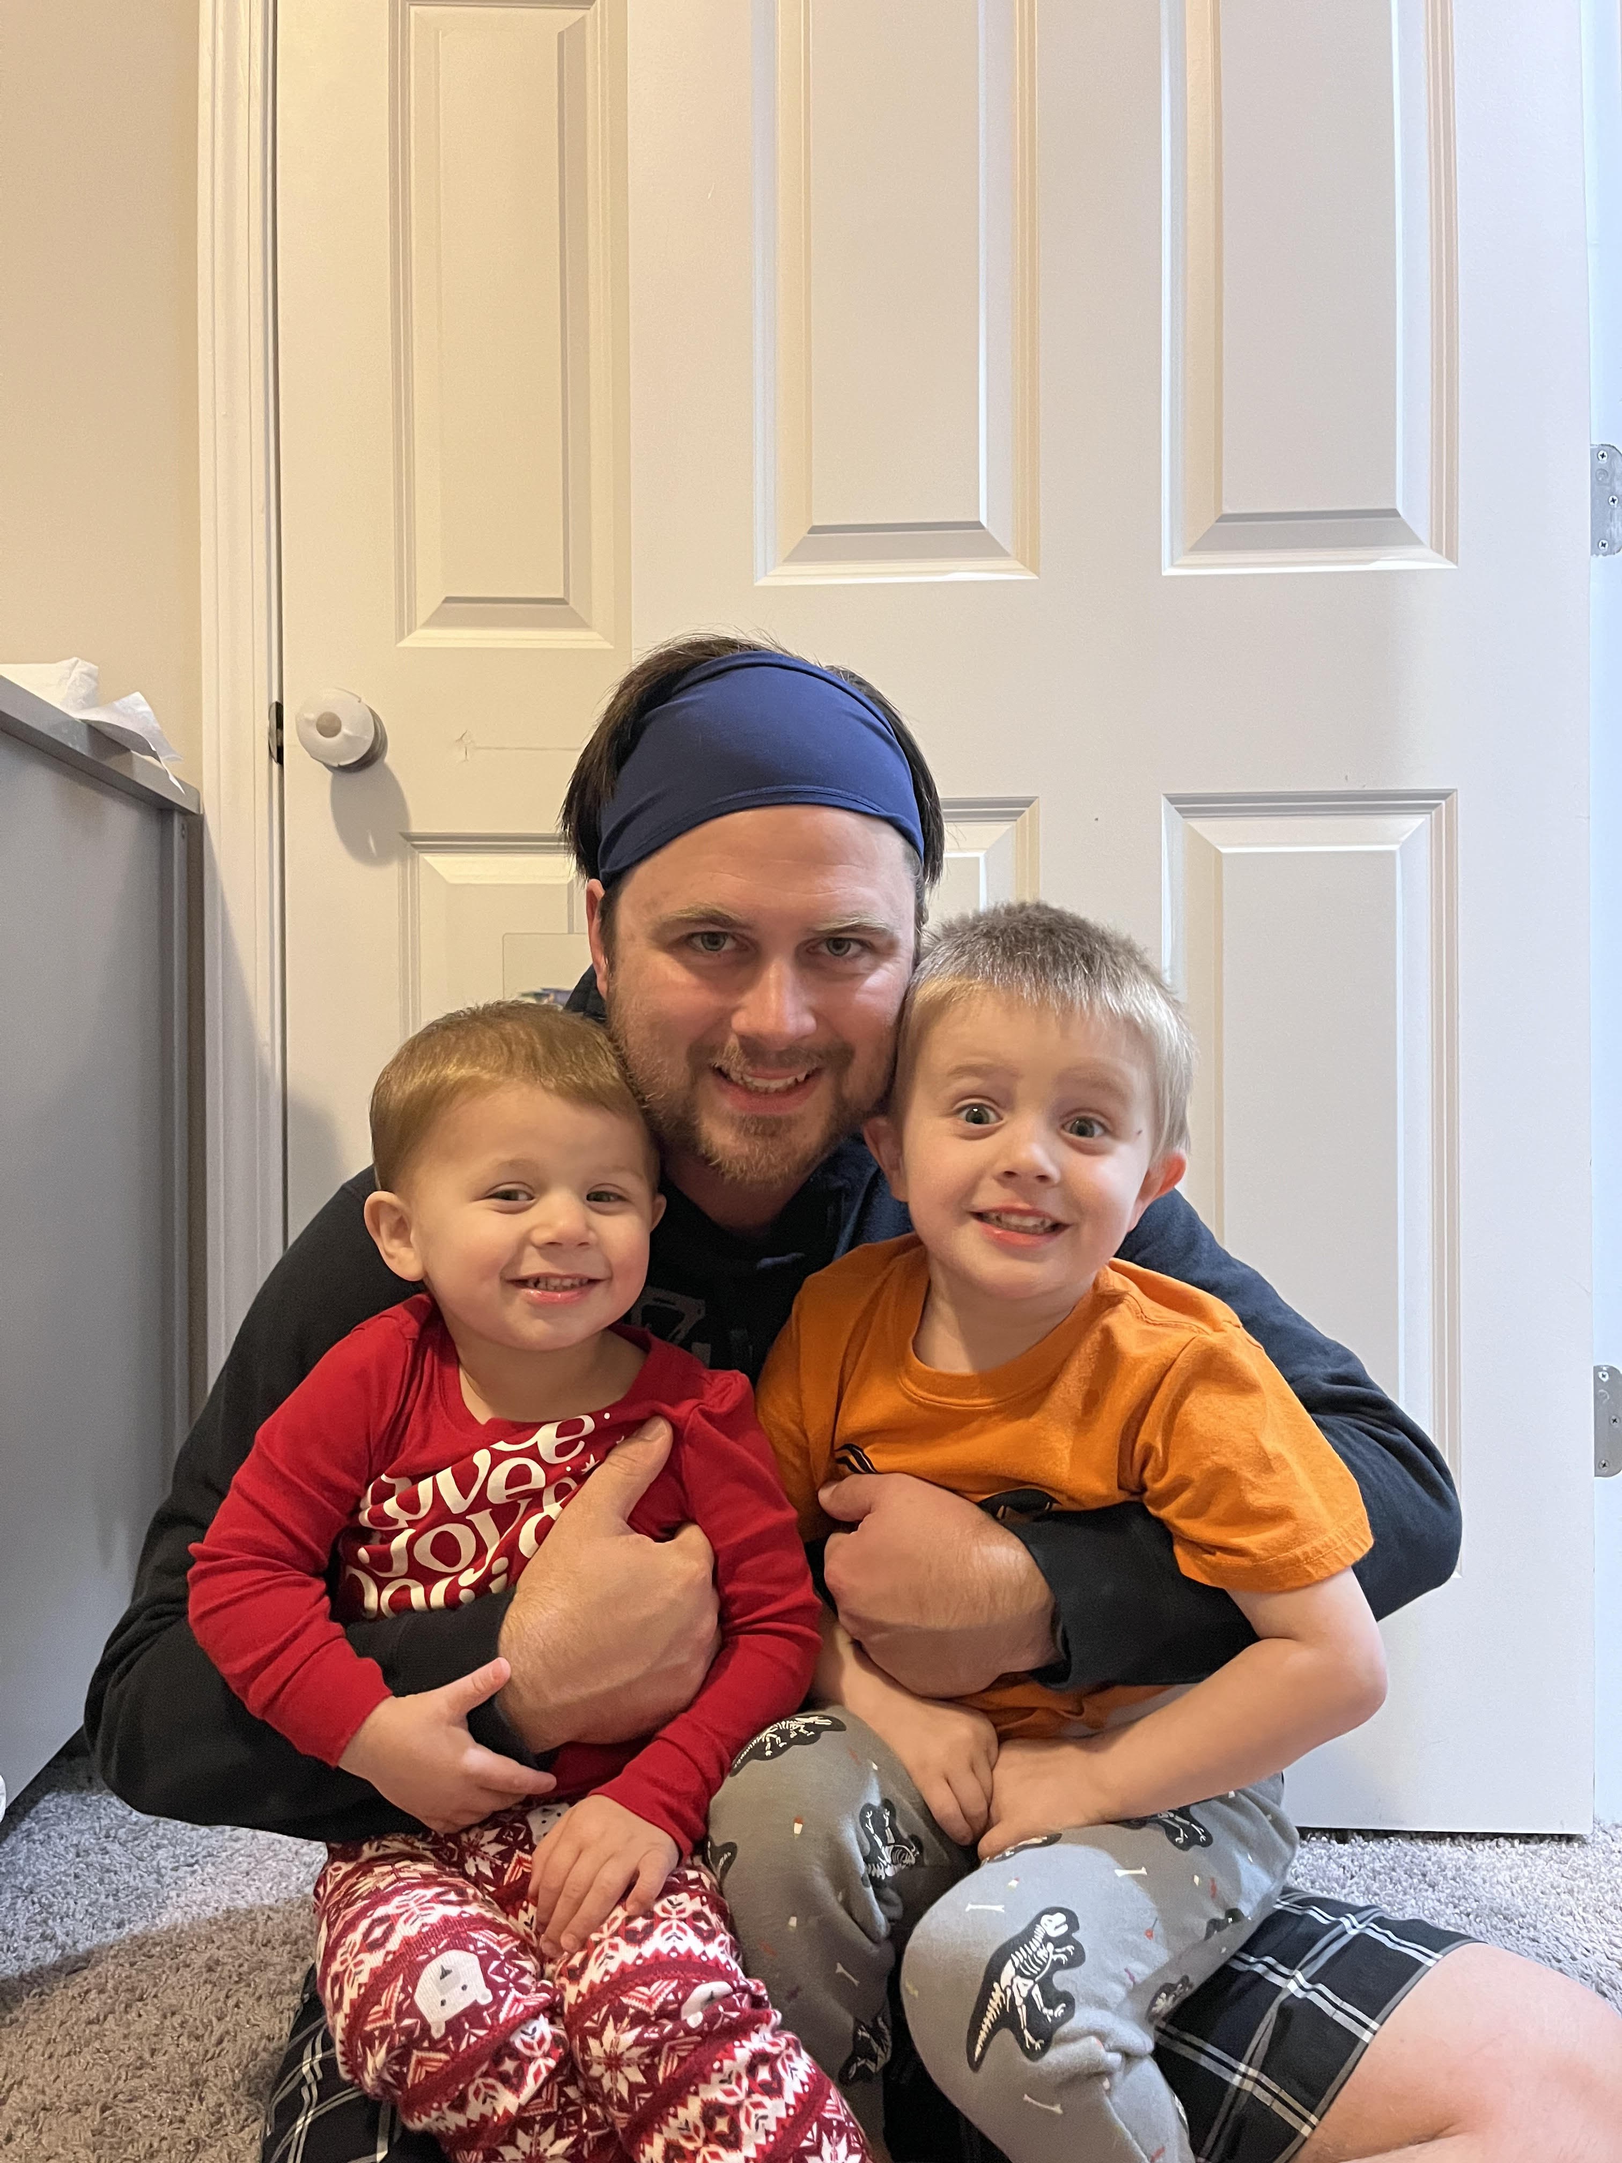
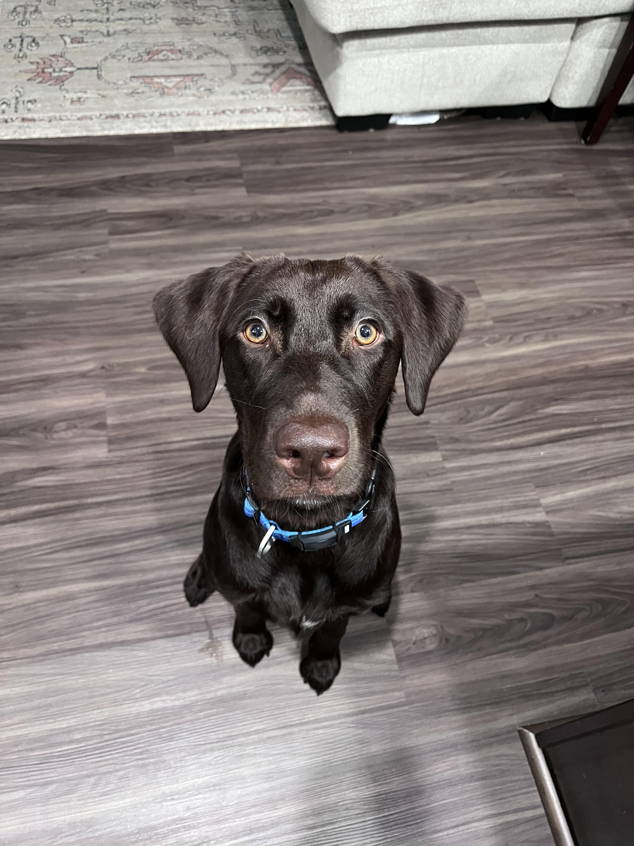
Caitlyn Stricklin
One of the interns during this Fall semester – my dream is to catalog at a university.
Pursuing my Master's Degree in Library and Information Science at the University of North Carolina – Greensboro.
Married, two kids (both boys), and our sweet chocolate lab, Freyja.
I love to do puzzles, play video games with my husband, and read late at night.
I am about to start learning to walk again after breaking my ankle and having 2 surgeries!
Notes:
My name is Caitlyn Stricklin. I am one of the interns here at the CMC for the fall semester. My dream is to catalog at some capacity at a university. I am currently pursuing my Master’s degree in Library and Information Science at the University of North Carolina – Greensboro. I am married, and have two little boys, aged 3 and 4, and we have our energetic 2-year-old chocolate lab Freyja. In my spare time I love to do puzzles of all sorts, practice coding, play video games with my husband, and binge read books late at night. I am about to start learning to walk again after breaking my ankle in August at a trampoline park and having two surgeries to repair it!
All of this to say, I am very excited to talk to you about how AI plays a role in the library world! Before I talk to you about AI use in acquisitions, interlibrary loan, and circulation, I am going to let Eric refresh your memory on part one of the AI and the Library World webinar that he presented in the spring.

Slide 5
Brief Recap of Part 1
●What is AI?
●What Can AI Do?
●Challenges with Implementing AI
●Demo Time
Notes:
If you were able to join us for Part 1, we looked at AI specifically through the lens of cataloging. Some of the feedback we received was that for a presentation on AI and the Library World, it dealt with little of the library world! I realized that was completely true. A great example of feedback really helping! That point didn’t even occur to me as I put the presentation together. I’m super-grateful it was pointed out. So, please, if you can take a minute to provide feedback, for this or any of our presentations, that might just give us an idea we wouldn’t have thought of otherwise. Alternatively, you can let us know if there are any topics you would like to see covered by contacting us at cmc@illinoisheartland.org. On the slide is the Agenda for Part 1. We started with a brief description of AI, looked at what it can do in regard to cataloging (spoiler alert: we couldn’t quite get it to spit out a good Bibliographic record, though with the right query…), reviewed some of the challenges of implementation, and closed with a live demo. The recording is available, along with all past Online with the CMC's, on our website. I have included a link on the References slide. Now, I'll turn it over to Caitlyn who will explain how AI is being used in the library, outside of cataloging.

Slide 6
Acquisition
Acquisition is the process of selecting and acquiring materials for library and information centers in all formats including digital items.
Examples of AI being used for Acquisition:
Stanford University Library AI Studio using AI for collection discovery and analysis.
The Helsinki Central Library Oodi uses AI technology for collection discovery as well as making reading suggestions for users.
Notes:
Thanks Eric! Okay, while I know that you all know what acquisition, circulation and interlibrary loan mean, I will still review what they are just in case there are people watching that may not know their meaning.
Acquisition is the process of selecting and acquiring materials for library and information centers in all formats including digital items. AI can be used in libraries to analyze usage patterns and assess collections to guide future acquisitions. AI can use an algorithm to make recommendations for each user, automating order processing for librarians, as well as assist in the cataloging process.
I found two examples of libraries using AI for the acquisition process. Stanford University Library AI Studio uses AI to help with collection discovery and analysis of their inventory. The Helsinki Central Library Oodi also uses AI technology for collection discovery. They also use AI technology to make reading suggestions for their users.

Slide 7
Interlibrary Loan
Interlibrary Loan allows users to request items and resources from another library that may not be at their own.
Examples:
WorldShare – uses AI to automate lending and borrowing through OCLC's WorldCat to gain access to millions of bibliographic records and resources.
Texas Tech University and the University of Houston use an interlibrary loan program to share 3D printing objects among a database.
Notes:
Now let’s talk about Interlibrary Loan. Interlibrary loan allows users to request items and resources from another library that may not be at their own library.
In regards to how AI can assist with this in the library, it can help with automating the processing of interlibrary loan requests between systems, using natural language processing to help interpret user requests accurately, and using chatbots to help provide instant responses to inquiries a user might have in regards to their loan requests. AI might also be able to help with analyzing costs for transactions related to interlibrary loans, thus helping librarians making decisions when it comes to sharing resources.
I was able to find two examples of how AI can be used within the library world. The first example is one that we should all be familiar with, and that is WorldShare with WorldCat. They use AI to automate lending and borrowing through OCLC’s Worldcat to gain access to millions of bibliographic records and resources. Another example is with Texas Tech University and the University of Houston using an interlibrary loan program to share 3D printing objects among a database for their students.

Slide 8
Research
The University of Alberta creates and uses AI for research purposes.
Examples of AI for research purposes:
SciSpace
LitMaps
Perplexity
Notes:
AI can also be used for research, like at a university library. For example, the University of Alberta creates and uses AI for research purposes for their students. Some examples of AI sites that you might use are SciSpace, LitMaps, and Perplexity. These sites will help users look for articles and topics relating to their research questions. Obviously you would need to go fact check some things, as I have personally tested this out myself just to see how the system works. However it is nice to see that you can potentially use AI to help find resources for a research topic.

Slide 9
Circulation
Circulation services in the library include the check-in and check-out of items, managing holds, renewing loans, issuing library cards, as well as managing overdue items.
AI can help automate some of these tasks to enhance the circulation service by:
Self-Checkout and Return Kiosk
Automated Fine Management (given there are libraries that give out fines for overdue materials)
Recommendation system for users based on borrowing patterns
Notes:
The last thing I wanted to talk to you about today is how AI can help with circulation in the library world. Circulation services in the library include the check-in and check-out of items, managing holds, renewing loans, issuing library cards, as well as managing overdue items.
AI can help automate some of these tasks to enhance circulation service in a couple of ways. For one, there can be a self-checkout and return kiosk for users that will help reduce wait times for patrons. There could also be an automated fine management system, given that there are libraries that still have late fees for overdue books and materials. There might also be a way for AI to help remind users about due dates for materials, and the arrival of new materials within the library. AI can also help by having a recommendation system for users based on analyzing their borrowing patterns.
While I could not find any specific examples of AI being used in a library for circulation services, I will use this an opportunity for Eric to open up to the public about your ideas or examples if you have any relating to circulation services, any questions you might have, or even other inquiries you might have.

Slide 10
Free-for-all
Let's have some fun!!
Notes:
Thank you, Caitlyn!
So, are there any tasks in your library you would like to see if AI can help with? Post in the chat and let's try it!! Describe what task you would like help with, and we can see if we can design a query that will accomplish it. To get our AI juices flowing, I'd first like to share a use I have found helpful when dealing with clunky spreadsheets. We will start with ChatGPT-4o in Poe, a useful app that contains a lot of AI's for different purposes. (Brief demo of Poe.)

Slide 11
References
"Acquisitions," American Library Association, May 5, 2009 https://www.ala.org/tools/topics/atoz/profresourcesacquisitions/acquisitions (Accessed September 23, 2024) Document ID: 139d7b68-cf0b-41d5-add3-c0410db2b88f
Omame, Isaiah & Alex-Nmecha, Juliet. (2020). Artificial Intelligence in Libraries. 10.4018/978-1-7998-1116-9.ch008
Hussain, A. (2023), "Use of artificial intelligence in the library services: prospects and challenges", Library Hi Tech News, Vol. 40 No. 2, pp. 15-17. https://doi.org/10.1108/LHTN-11-2022-0125
https://www.ualberta.ca/en/research/innovation/artificial-intelligence-discovery-place/index.html
https://repository.ifla.org/server/api/core/bitstreams/8d21df6c-e61b-41a5-b089-0353a5552dbd/content
https://digitalcommons.unl.edu/cgi/viewcontent.cgi?article=15415&context=libphilprac
https://www.illinoisheartland.org/events?field_event_types_target_id_1=1213&field_event_audience_target_id=All&field_event_topics_target_id=1176&field_event_system_program_target_id=1163
cmc@illinoisheartland.com

Slide 12
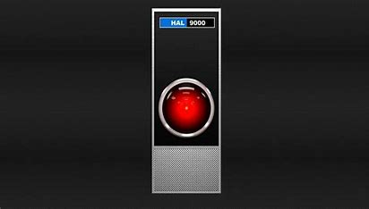
Thanks!

Slide 13
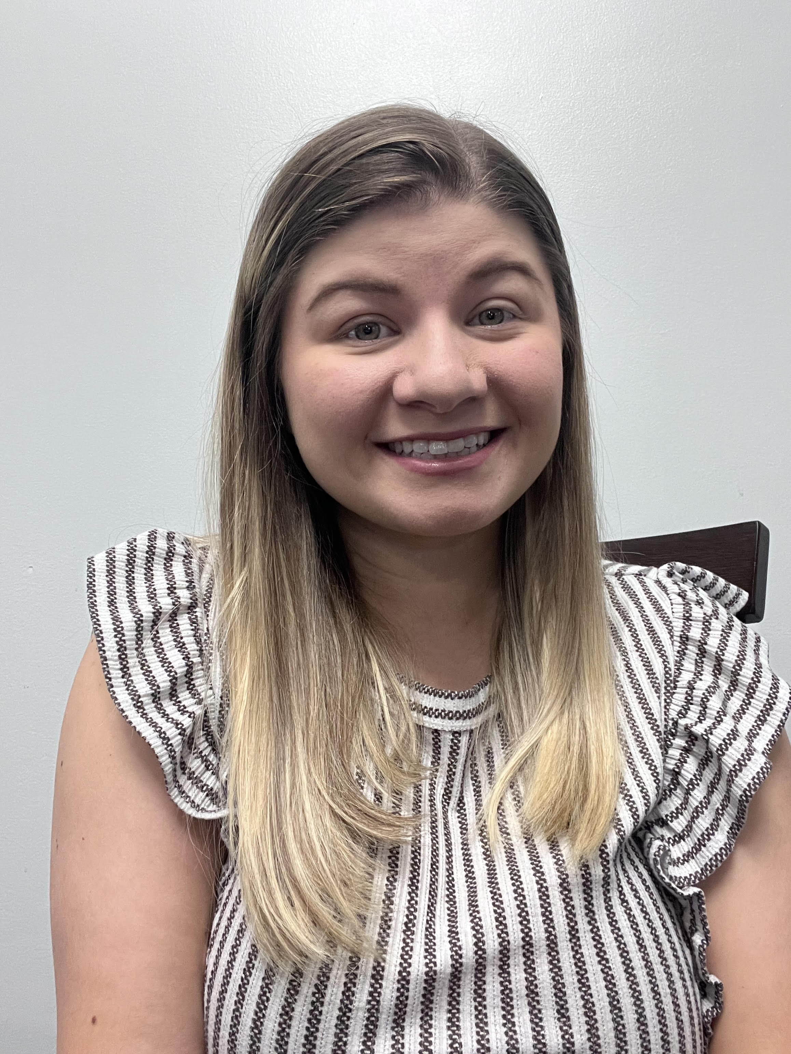
ON THE CALL TODAY
Questions? Contact the CMC: cmc@illinoisheartland.org
Barbera Scoby
CMC Cataloger
Dr. Pamela Thomas
Bibliographic Grant Manager
Caitlyn Stricklin
CMC Intern
Eric McKinney
CMC Cataloger
Kat Anderberg
Metadata Cataloger
Katie Roberts Special Project Cataloger
Notes:
We all look fabulous!!

