Slide 1
AI and the Library World: Part 2
An Online with the CMC production, brought to you by: Eric McKinney Caitlyn Stricklin
CMC Cataloging Trainer Intern
Cataloging Maintenance Center Cataloging Maintenance Center

Slide 2
Agenda
Introductions
Brief Recap of Part I
Acquisitions
Circulation
Interlibrary Loan
Free-for-all

Slide 3
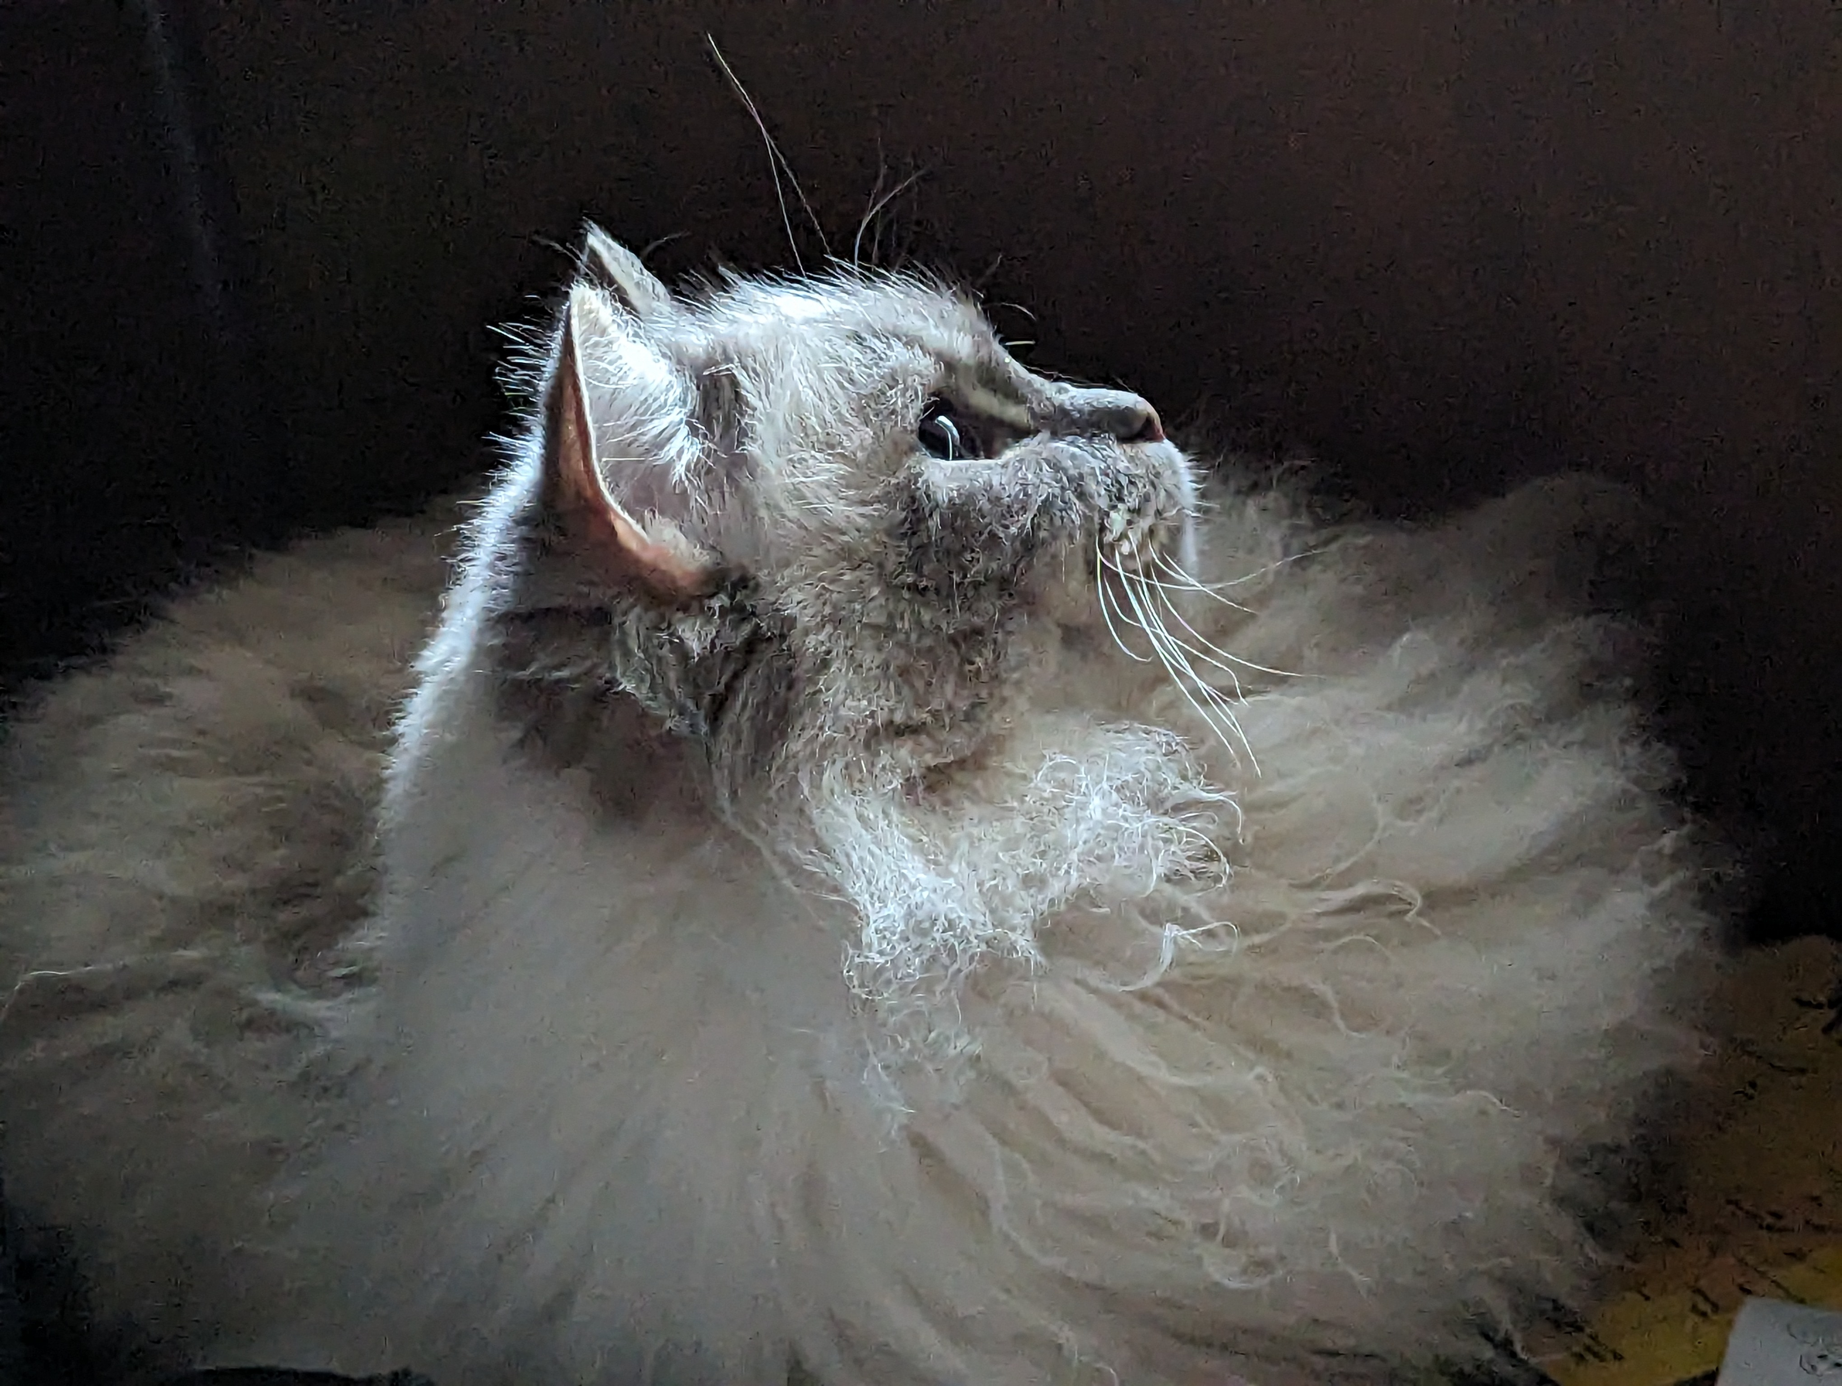
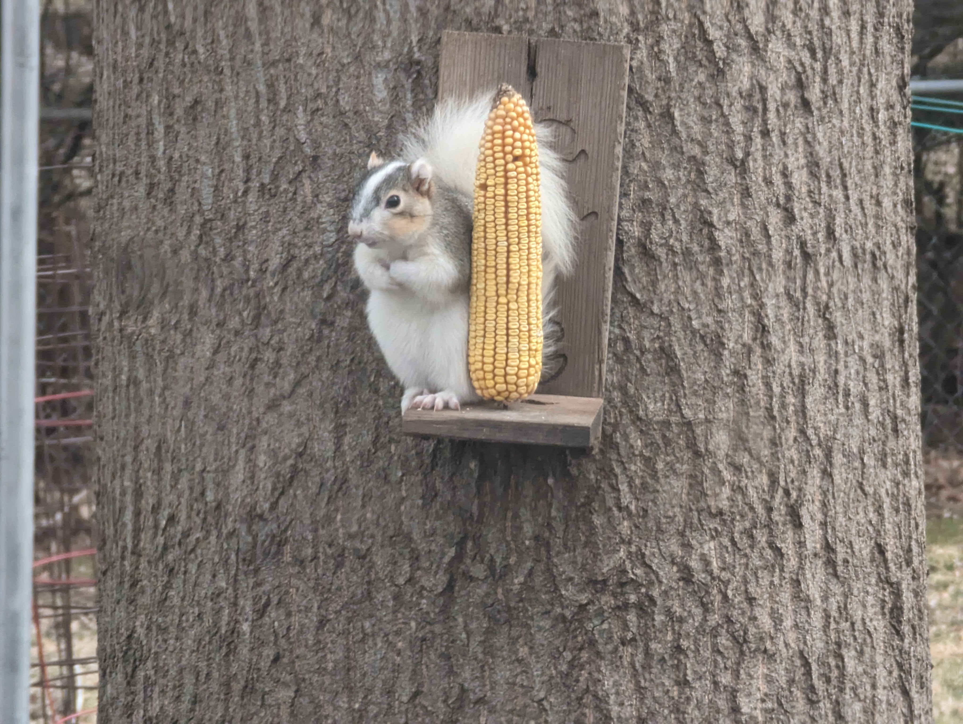
Eric McKinney

Slide 4
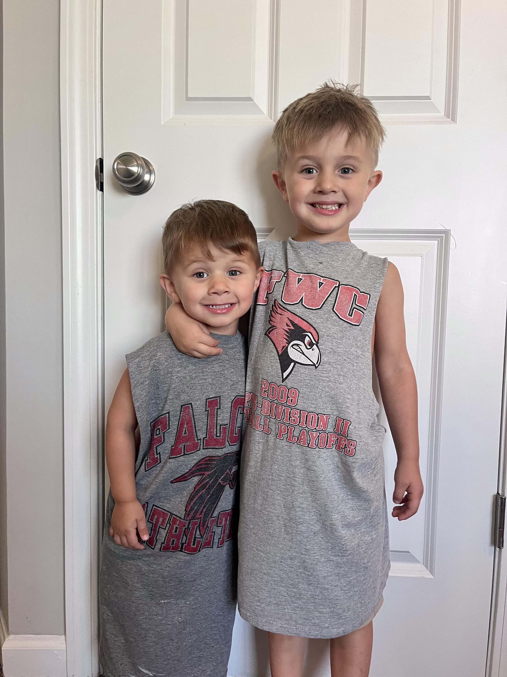
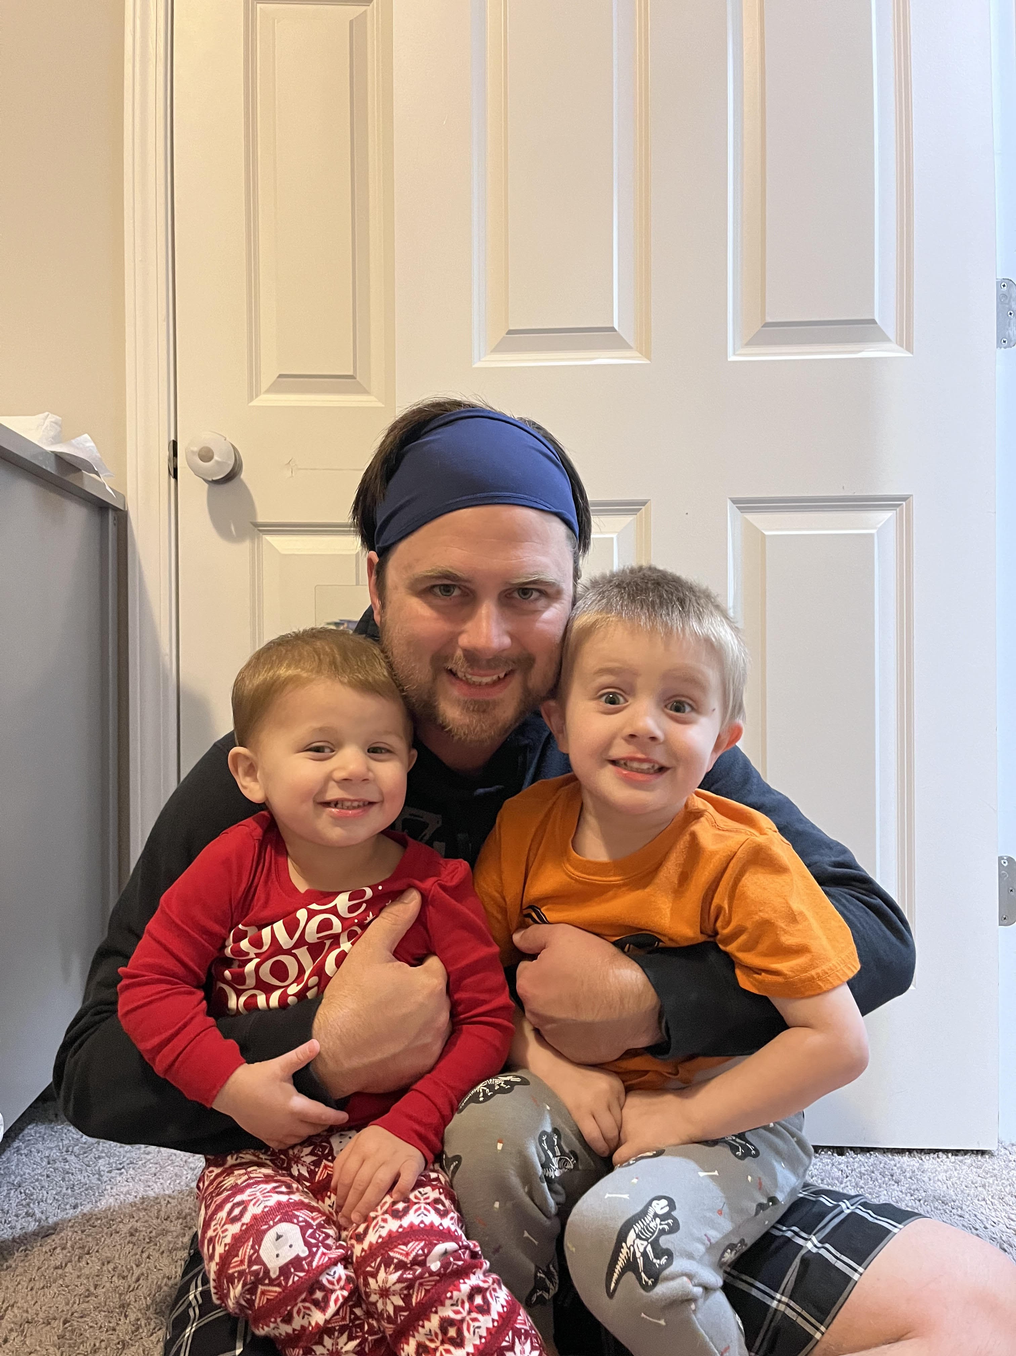
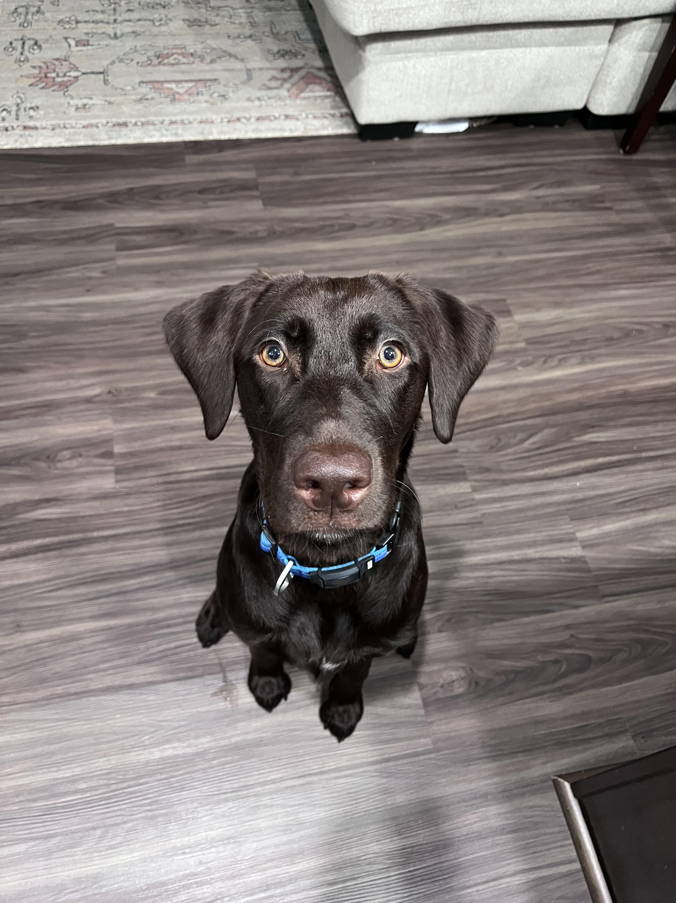
Caitlyn Stricklin
One of the interns during this Fall semester – my dream is to catalog at a university.
Pursuing my Master's Degree in Library and Information Science at the University of North Carolina – Greensboro.
Married, two kids (both boys), and our sweet chocolate lab, Freyja.
I love to do puzzles, play video games with my husband, and read late at night.
I am about to start learning to walk again after breaking my ankle and having 2 surgeries!

Slide 5
Brief Recap of Part 1
●What is AI?
●What Can AI Do?
●Challenges with Implementing AI
●Demo Time

Slide 6
Acquisition
Acquisition is the process of selecting and acquiring materials for library and information centers in all formats including digital items.
Examples of AI being used for Acquisition:
Stanford University Library AI Studio using AI for collection discovery and analysis.
The Helsinki Central Library Oodi uses AI technology for collection discovery as well as making reading suggestions for users.

Slide 7
Interlibrary Loan
Interlibrary Loan allows users to request items and resources from another library that may not be at their own.
Examples:
WorldShare – uses AI to automate lending and borrowing through OCLC's WorldCat to gain access to millions of bibliographic records and resources.
Texas Tech University and the University of Houston use an interlibrary loan program to share 3D printing objects among a database.

Slide 8
Resources
The University of Alberta creates and uses AI for research purposes.
Examples of AI for research purposes:
SciSpace
LitMaps
Perplexity

Slide 9
Circulation
Circulation services in the library include the check-in and check-out of items, managing holds, renewing loans, issuing library cards, as well as managing overdue items.
AI can help automate some of these tasks to enhance the circulation service by:
Self-Checkout and Return Kiosk
Automated Fine Management (given there are libraries that give out fines for overdue materials)
Recommendation system for users based on borrowing patterns

Slide 10
Free-for-all
Let's have some fun!!

Slide 11
References
"Acquisitions," American Library Association, May 5, 2009 https://www.ala.org/tools/topics/atoz/profresourcesacquisitions/acquisitions (Accessed September 23, 2024) Document ID: 139d7b68-cf0b-41d5-add3-c0410db2b88f
Omame, Isaiah & Alex-Nmecha, Juliet. (2020). Artificial Intelligence in Libraries. 10.4018/978-1-7998-1116-9.ch008
Hussain, A. (2023), "Use of artificial intelligence in the library services: prospects and challenges", Library Hi Tech News, Vol. 40 No. 2, pp. 15-17. https://doi.org/10.1108/LHTN-11-2022-0125
https://www.ualberta.ca/en/research/innovation/artificial-intelligence-discovery-place/index.html
https://repository.ifla.org/server/api/core/bitstreams/8d21df6c-e61b-41a5-b089-0353a5552dbd/content
https://digitalcommons.unl.edu/cgi/viewcontent.cgi?article=15415&context=libphilprac
https://www.illinoisheartland.org/events?field_event_types_target_id_1=1213&field_event_audience_target_id=All&field_event_topics_target_id=1176&field_event_system_program_target_id=1163

Slide 12
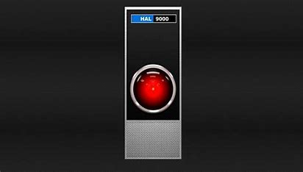
Thanks!

Slide 13
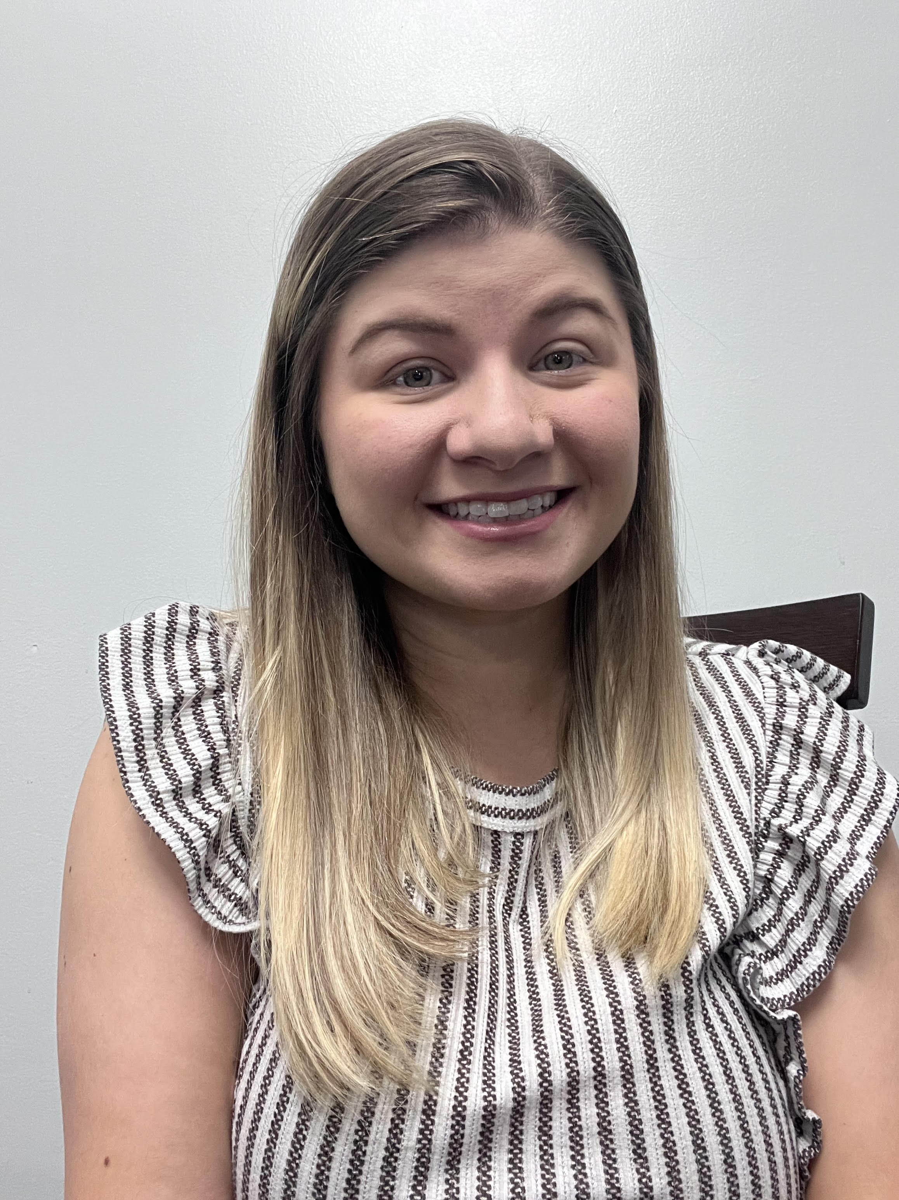
ON THE CALL TODAY
Questions? Contact the CMC: cmc@illinoisheartland.org
Barbera Scoby
CMC Cataloger
Dr. Pamela Thomas
Bibliographic Grant Manager
Caitlyn Stricklin
CMC Intern
Eric McKinney
CMC Cataloger
Kat Anderberg
Metadata Cataloger
Katie Roberts
Special Project Cataloger
Andrea Giosta
Special Project Cataloger

