Slide 1
Board Games and Card Games
SHARE Catalogers
Cataloger’s Training Session – November 12, 2024

Slide 2
General Notes on Games
In Polaris
In OCLC
Please use an individual, full level bib record for each game!
GMD [game] for field 245 subfield h
245: the statement of responsibility may include the developer/creator, or any illustrators
588: Always include a source of title note for non-book items

Slide 3
Example 1
Blokus

Slide 4
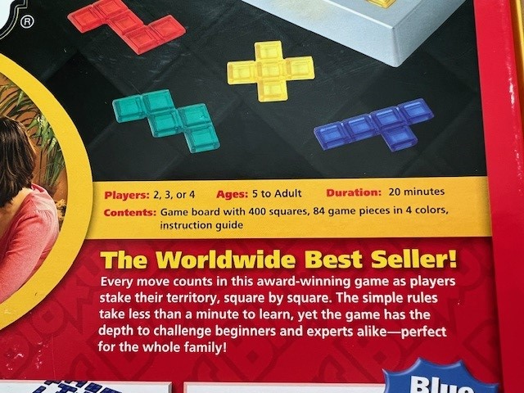
Pictures

Slide 5
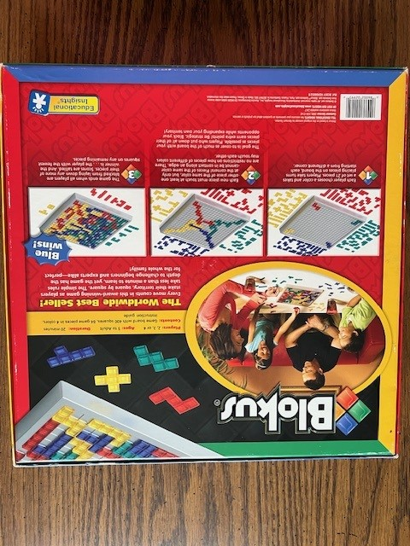

Slide 6
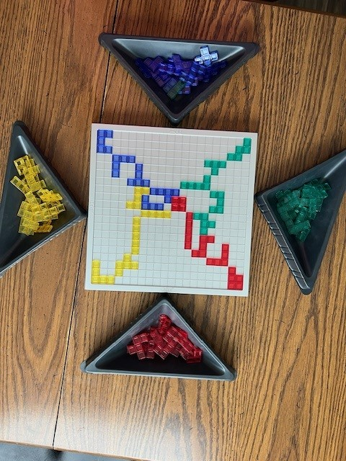
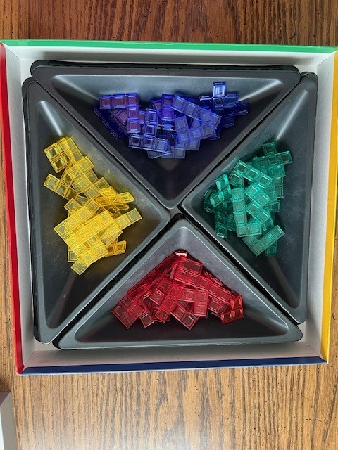

Slide 7
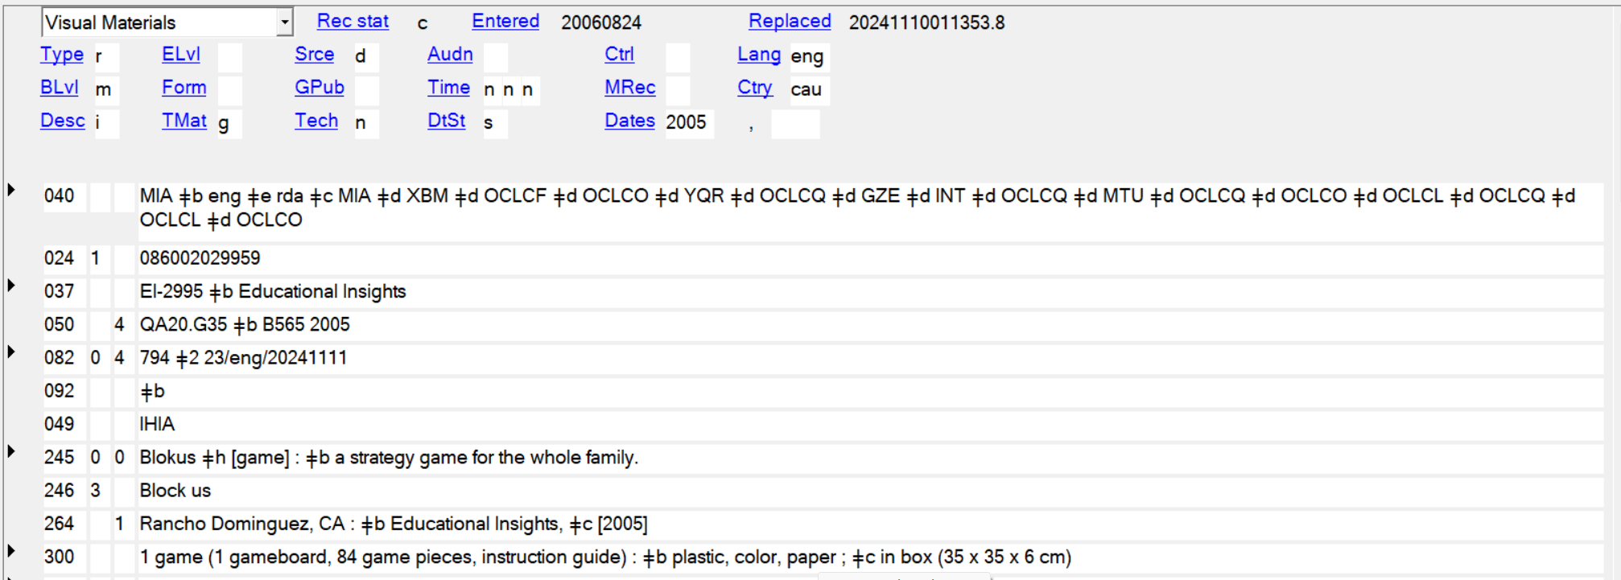
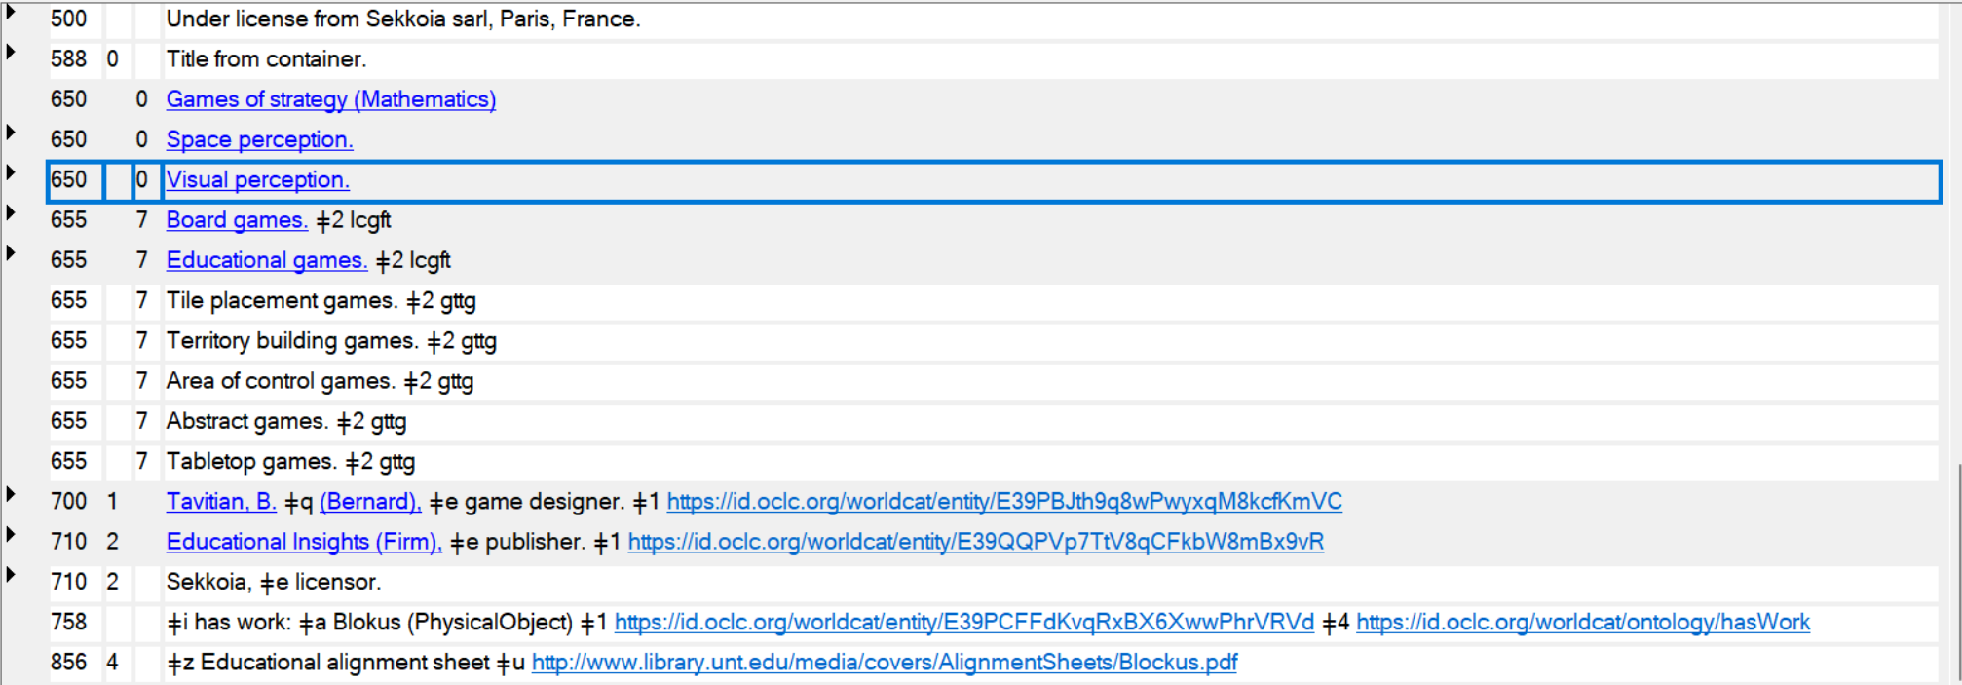

Slide 8
Example 2
Sushi Go!

Slide 9
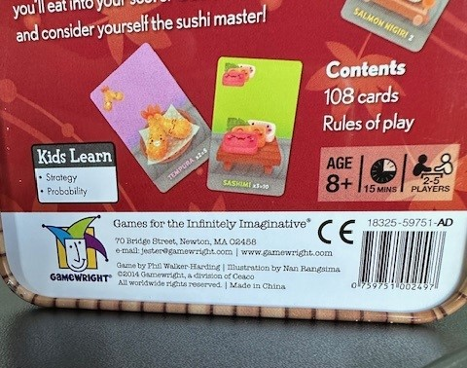
Pictures

Slide 10
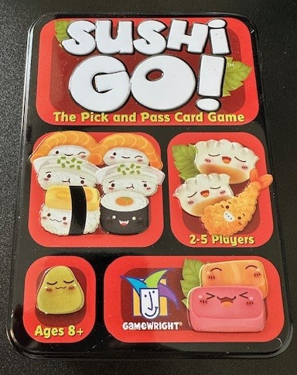
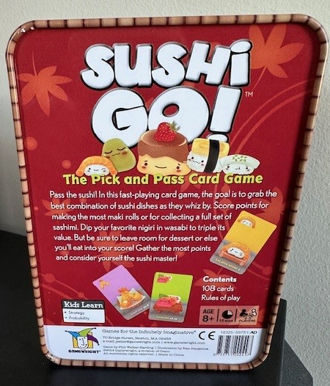

Slide 11
Final Result
In Polaris: Control no. 3536904
See changes after training session
In OCLC #896366585

Slide 12
Physical Description information
List the components in parentheses in the subfield a
Example: 1 game (181 cards, 22 menu tiles, 8 wooden pawns, 1 game board, 1 rule booklet (16 pages))
340: used for information about the medium
Example: 340 _ _ $a paper $2 rdamat
340 Physical Medium
RDA Registry | Vocabularies

Slide 13
Genre Terms for Tabletop Games
Genre Terms for Tabletop Games — University Libraries – UNT
Use them in a 655 _7 with the $2 gttg
The second indicator 7 tells you that the source of the term is specified in the subfield 2

Slide 14
If you have questions, contact Linda Johnson at ljohnson@illinoisheartland.org or Anna Wiegand at awiegand@illinoisheartland.org

