Slide 1

Solving the mystery: The Case of Cataloging Kits
Mary Cornell, CMC Cataloger
Online with the CMC: November 14, 2024

Slide 2
Agenda:
What is a kit?
Types of kits
Kit specific fields
Kit examples
Resources

Slide 3


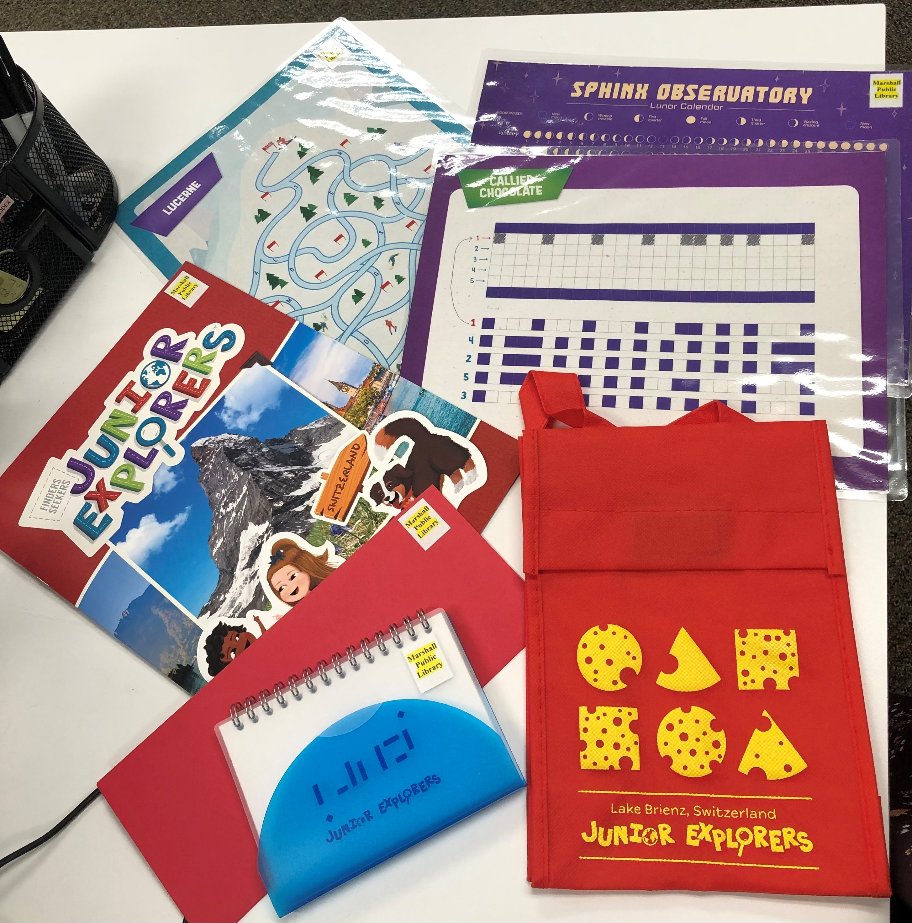
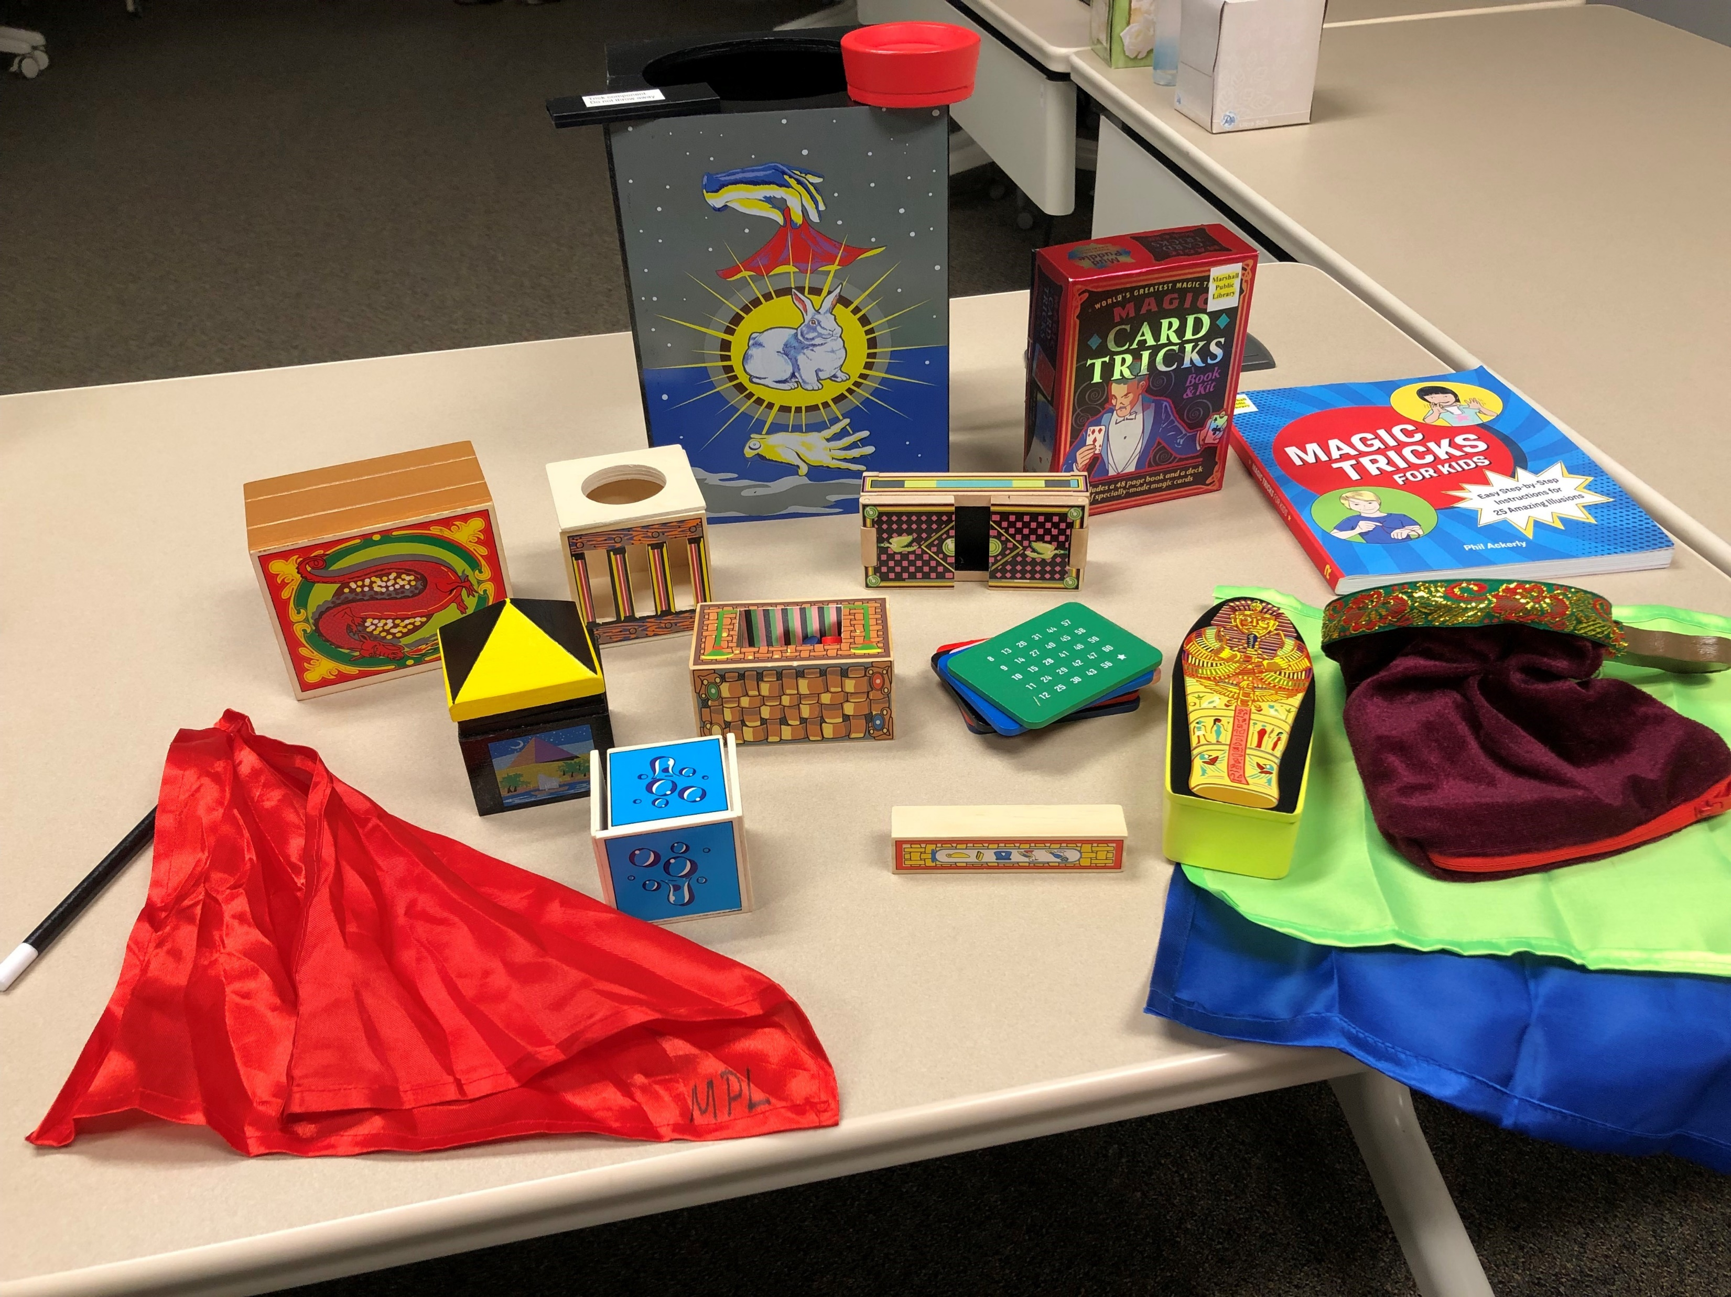
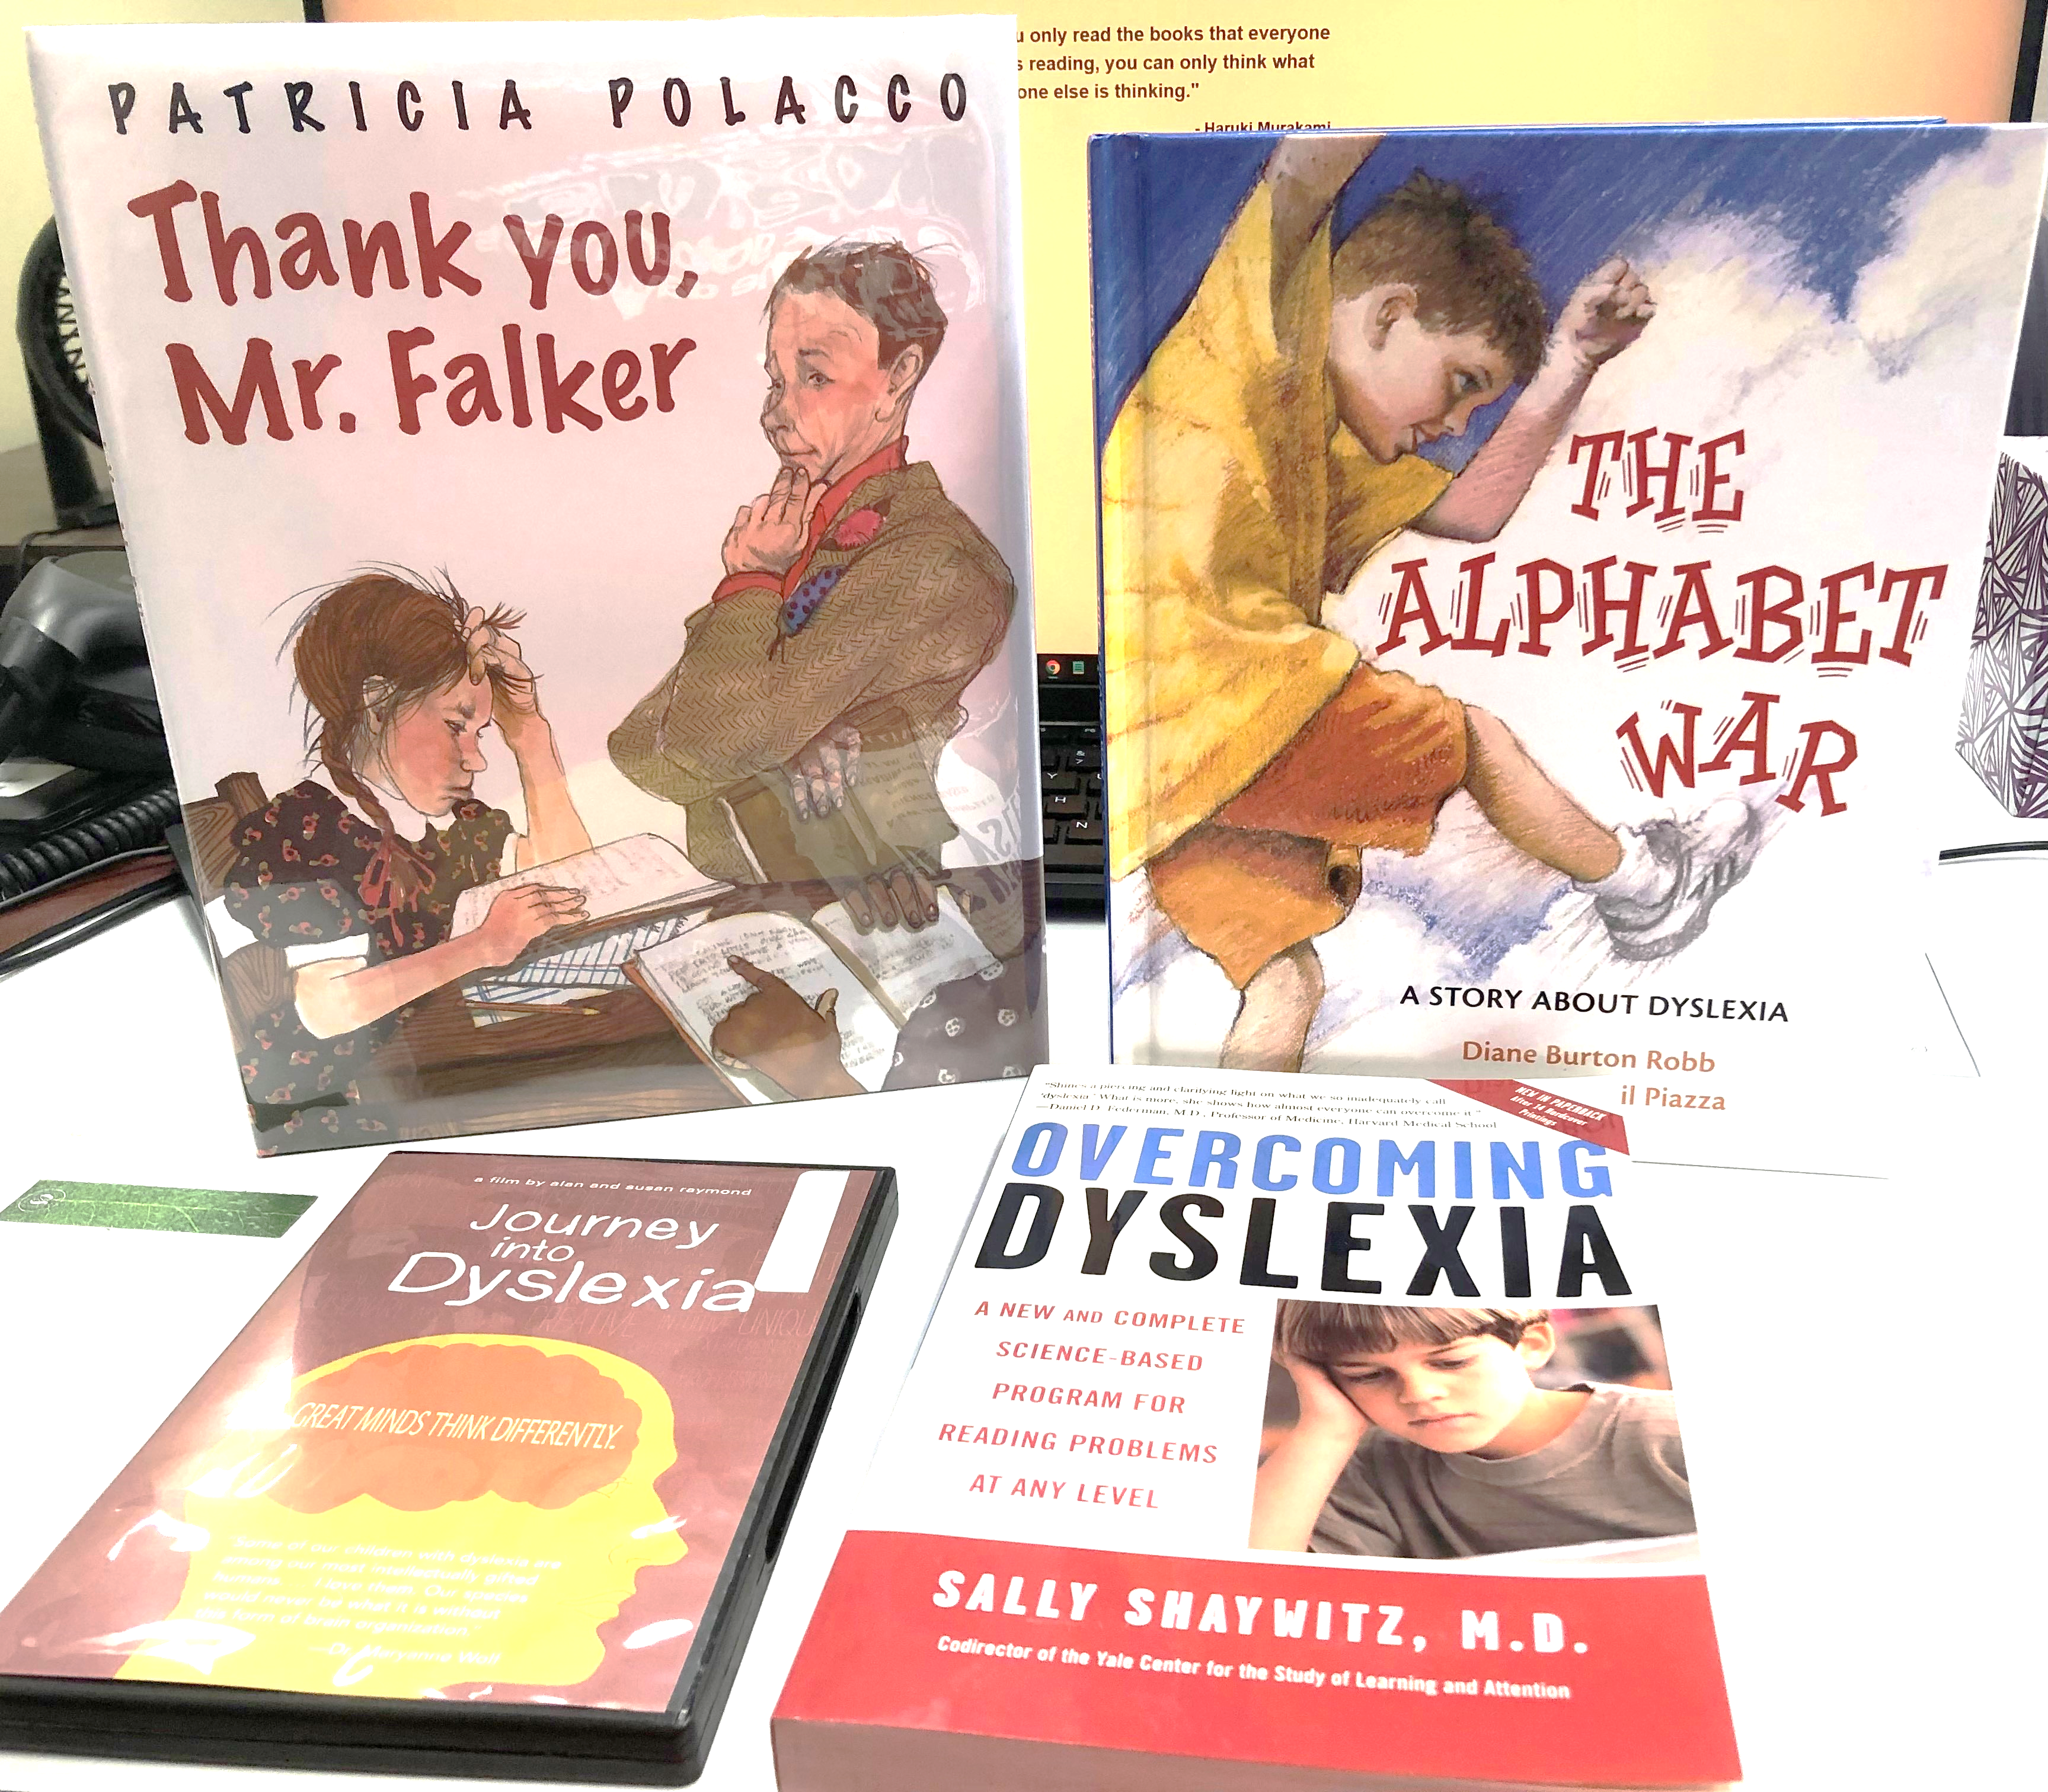
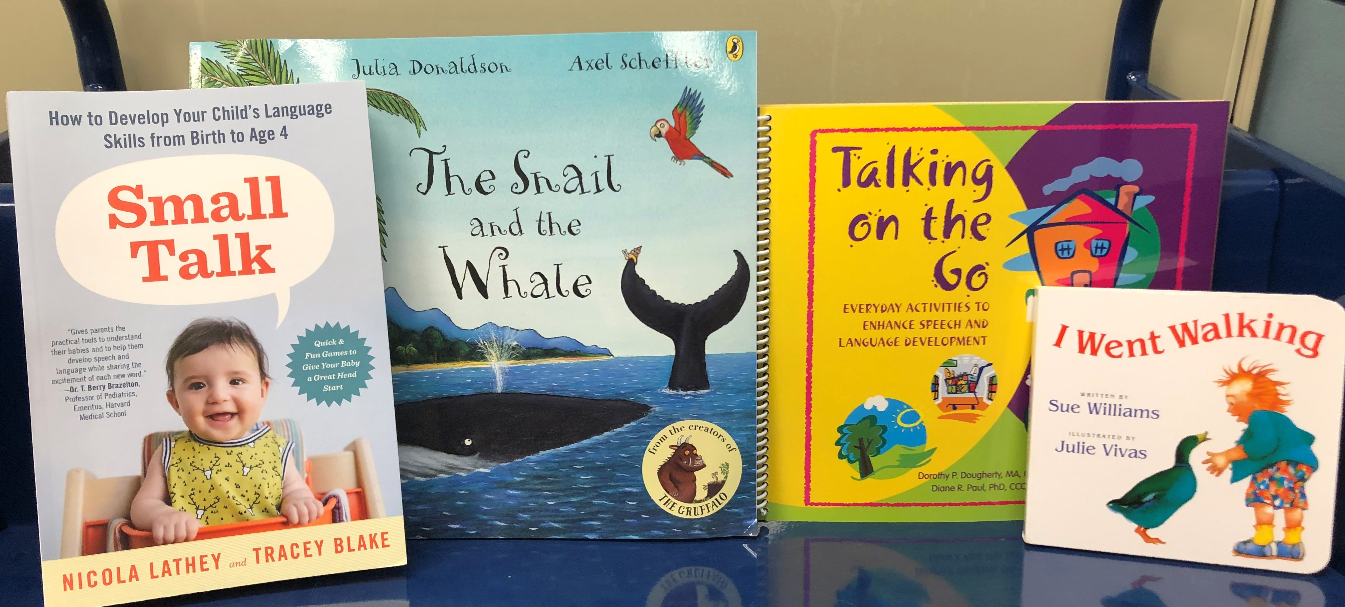
What is a Kit?

Slide 4
Types of Kits
Book in a bag
Adventure
Health
Murder mystery
And more!

Slide 5
Kit specific fields
Fixed fields
00X
02X & 03X
3XX
5XX
6xx &7XX

Slide 6
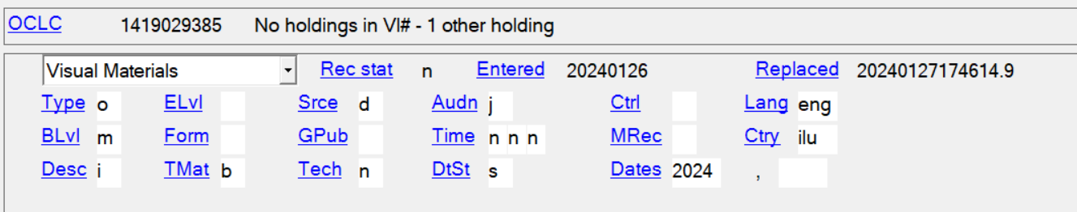

Fixed Fields

Slide 7
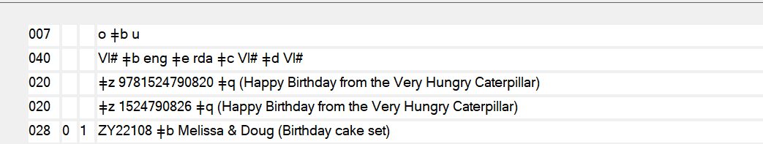
0XX & 02X/03X Fields

Slide 8
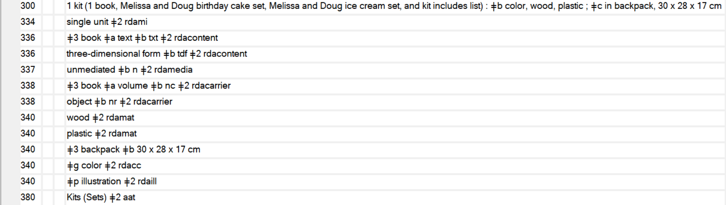
3XX Fields

Slide 9
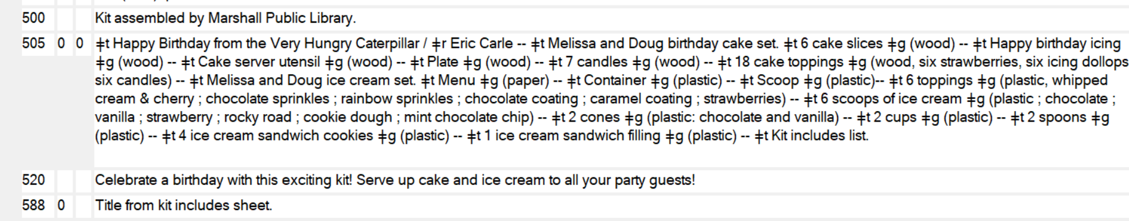
5XX Fields

Slide 10
6xx & 7xx Fields

Slide 11
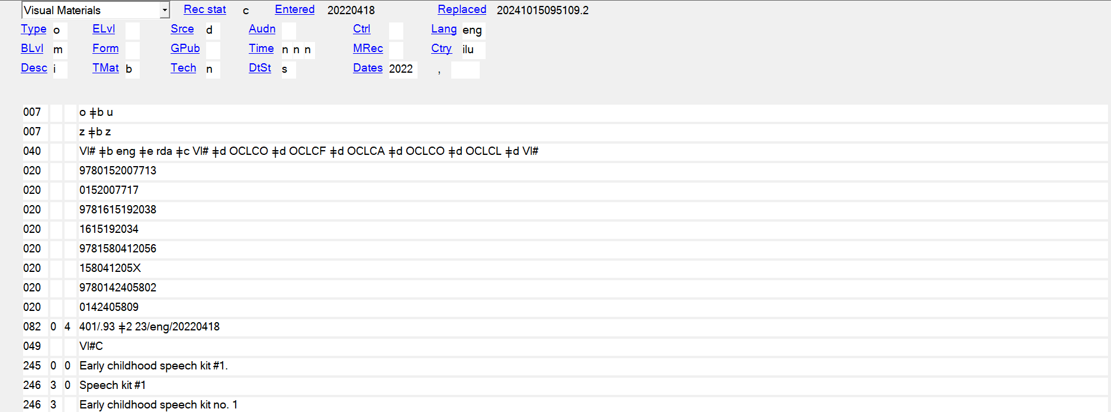
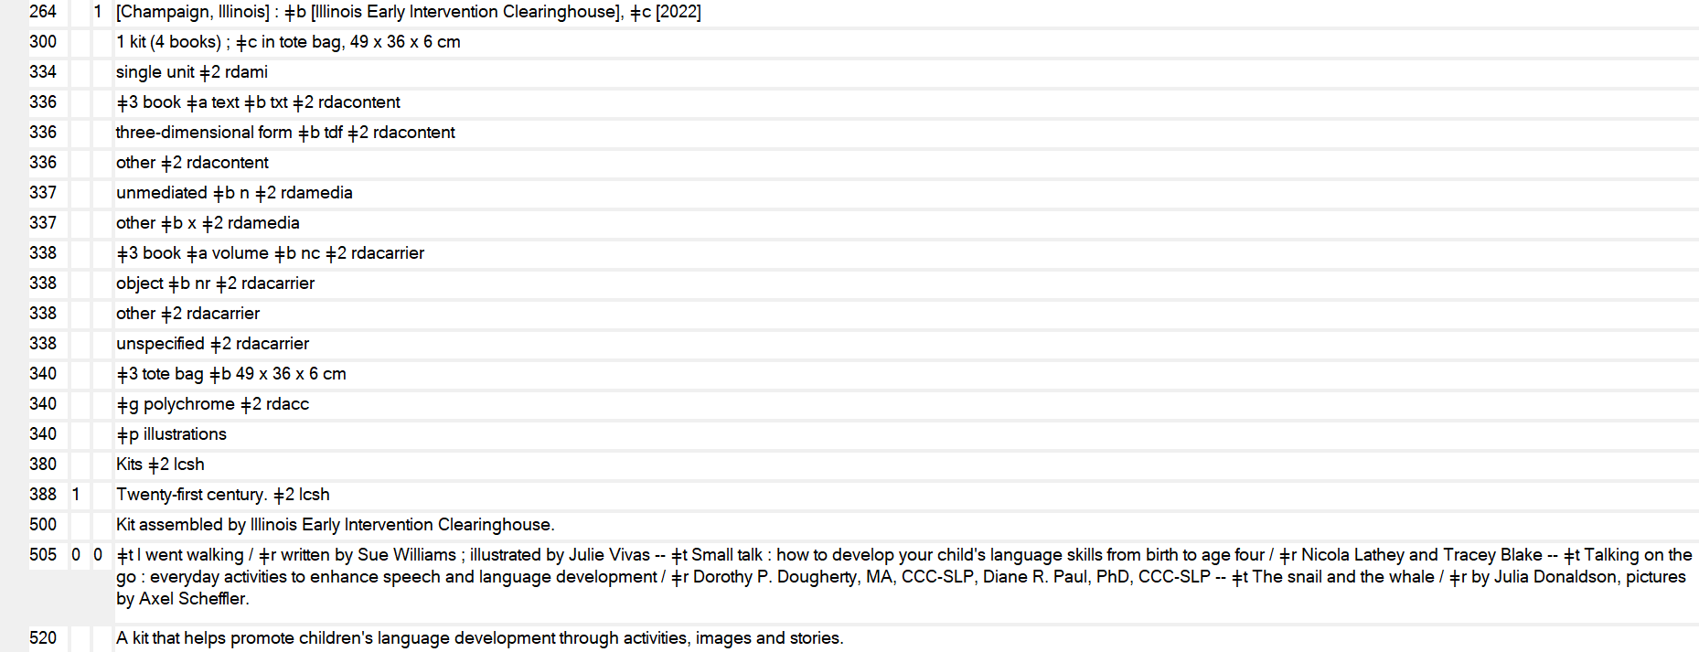
Early Childhood Speech Kit #1

Slide 12
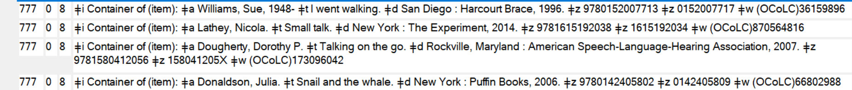
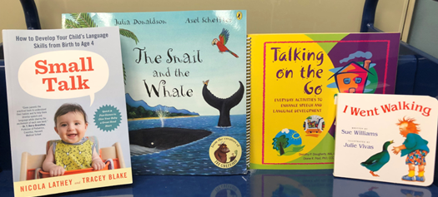
Early Childhood Speech Kit #1

Slide 13
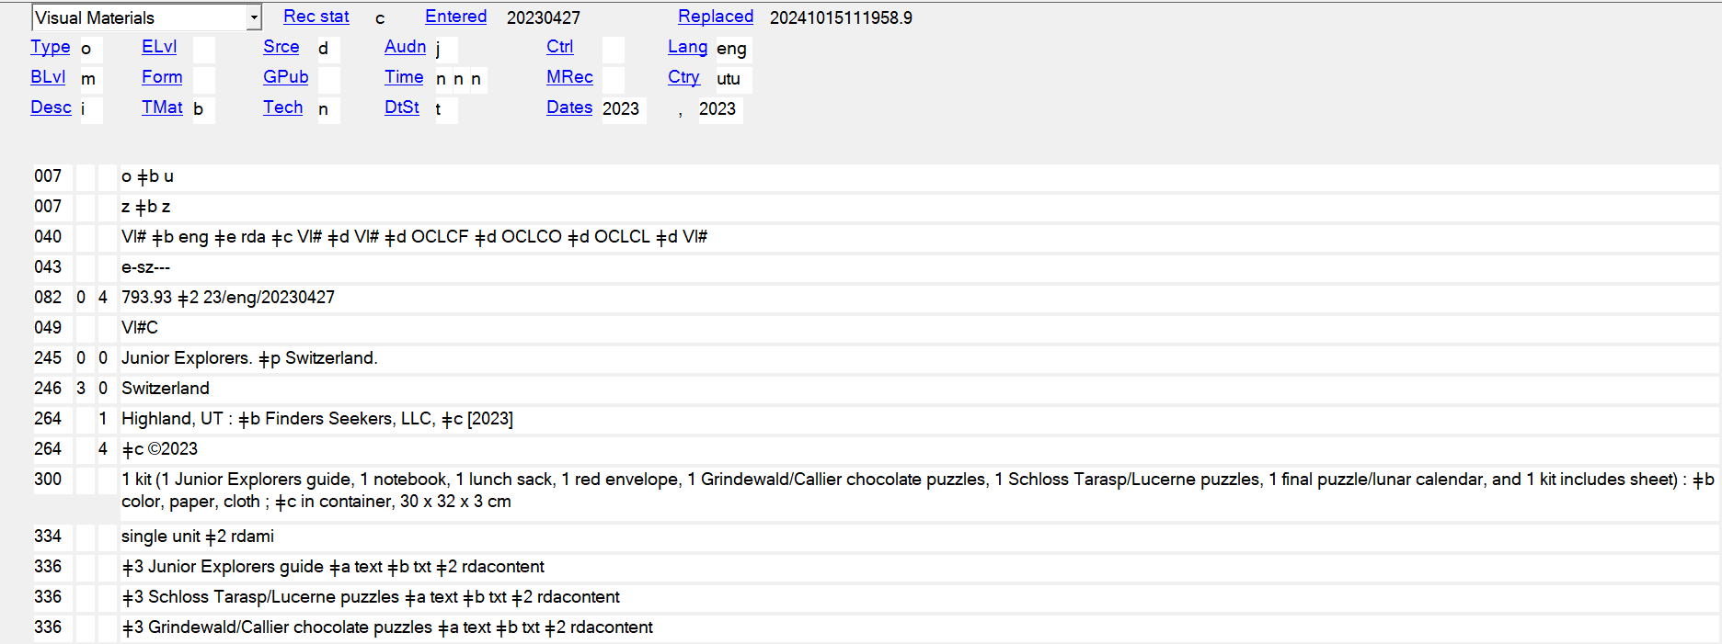
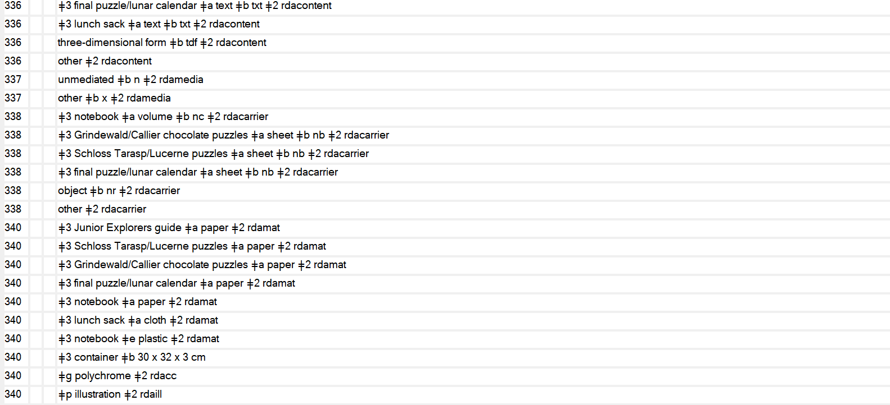
Junior Explorers: Switzerland

Slide 14

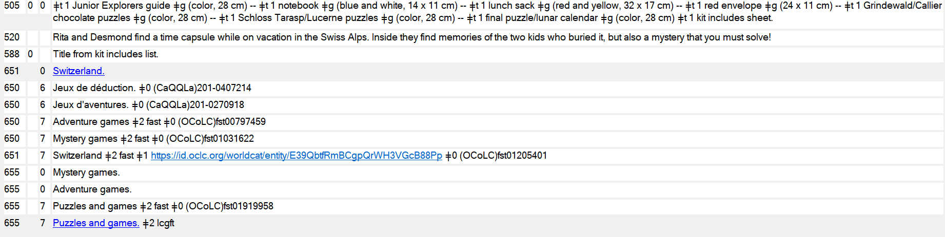
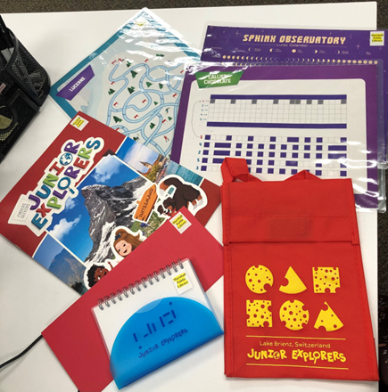
Junior Explorers: Switzerland

Slide 15
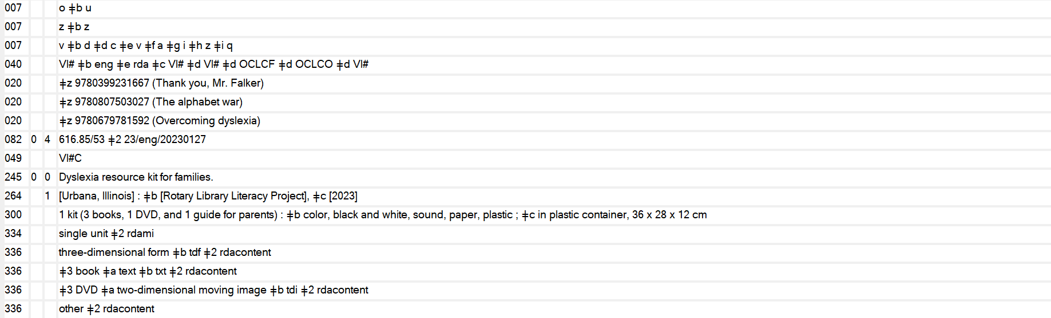
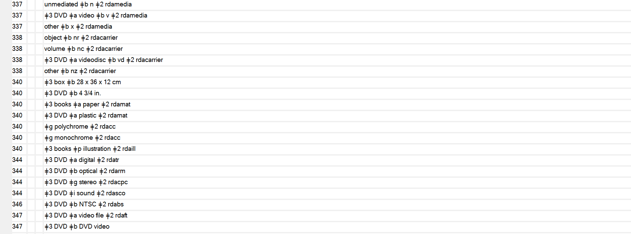
Dyslexia Resource Kit for Families

Slide 16
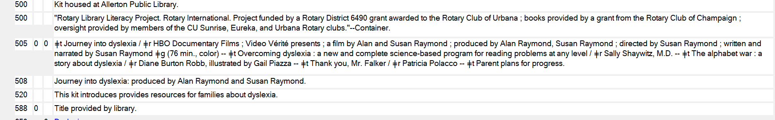

Dyslexia Resource Kit for Families

Slide 17
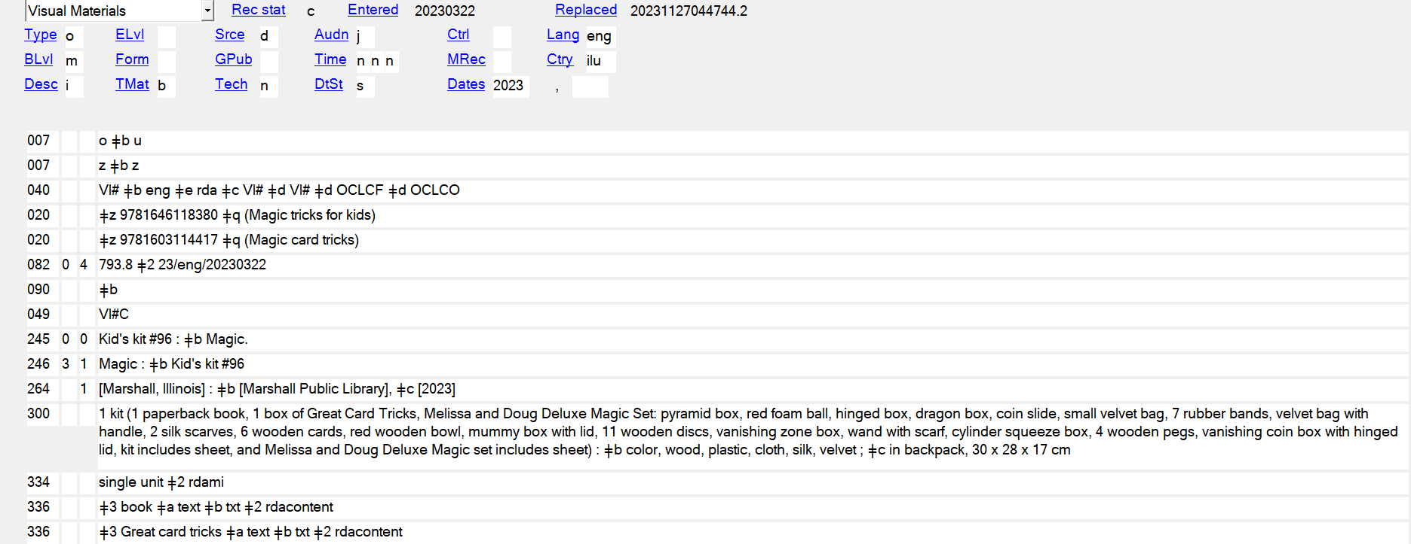
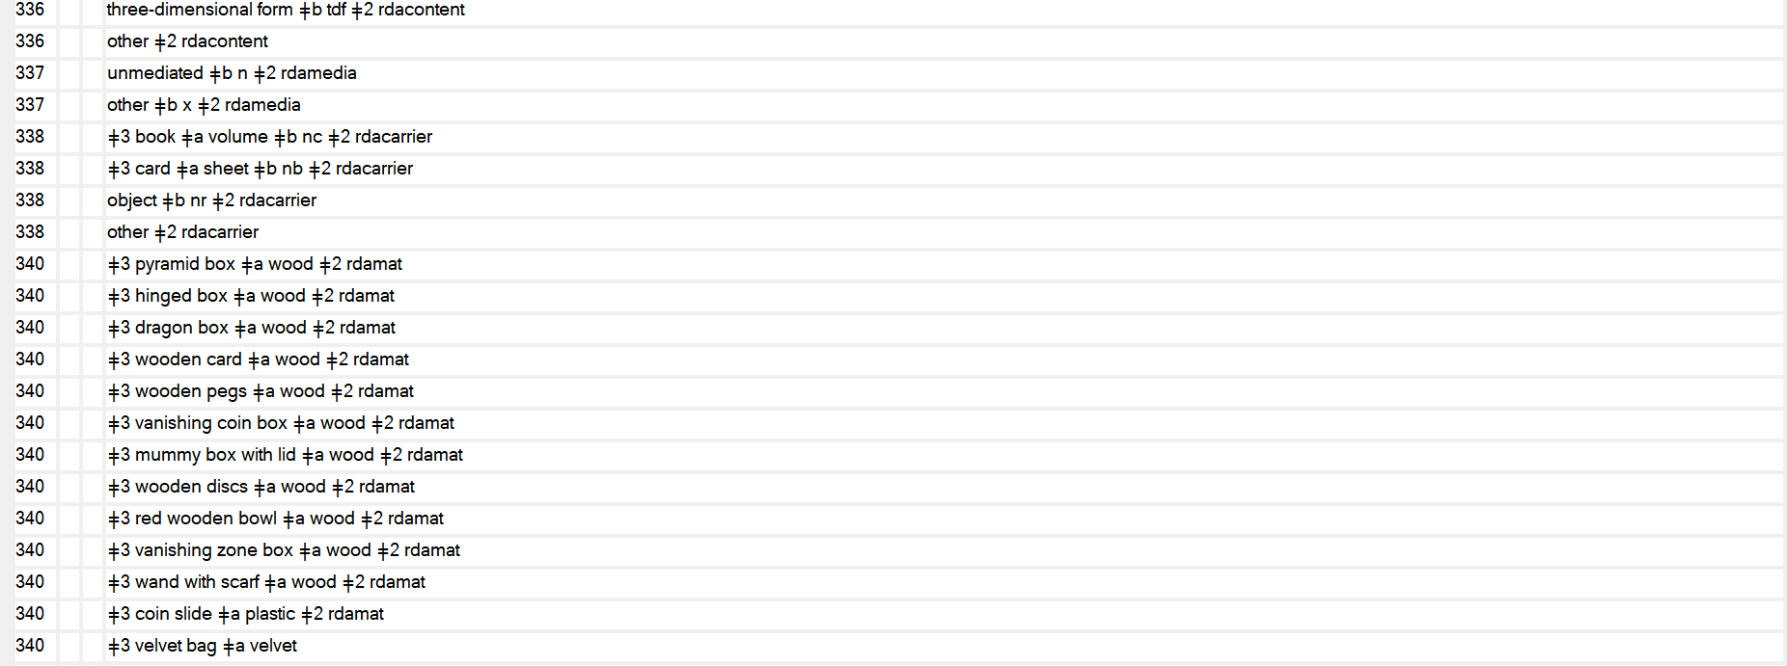
Kids Kit #96 : Magic

Slide 18
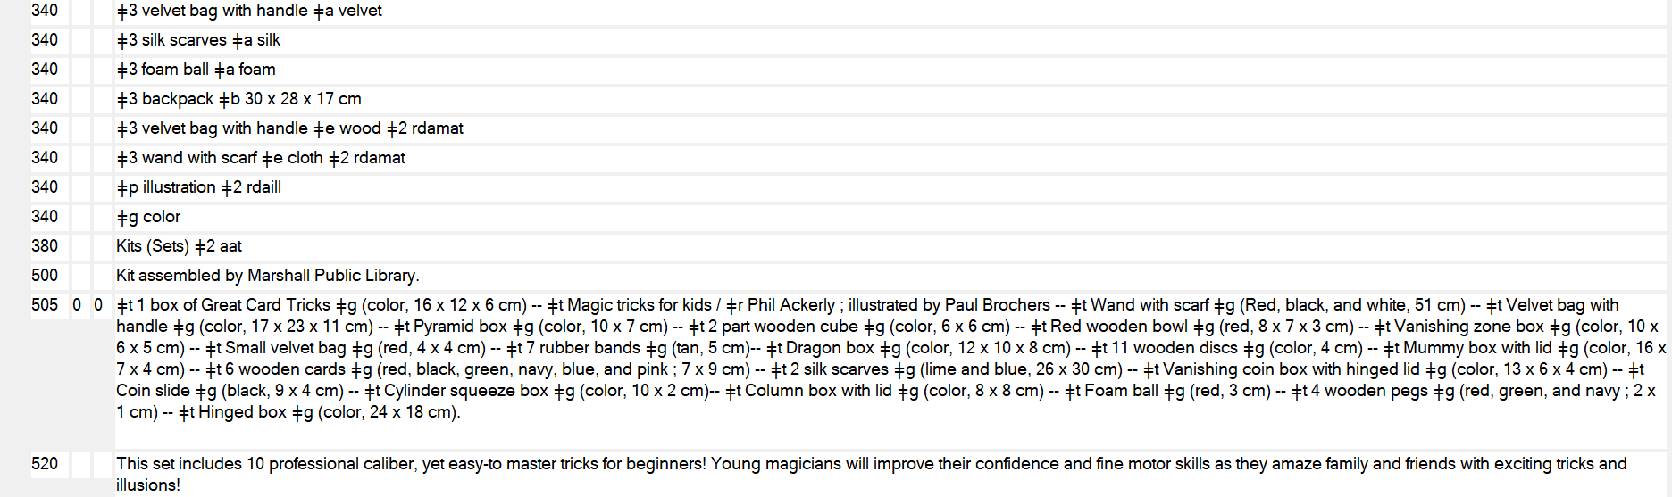
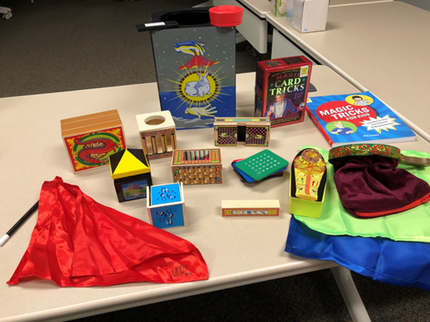
Kids Kit #96 : Magic

Slide 19
Resources
itsMarc. Definition: kit https://www.itsmarc.com/crs/mergedprojects/helptop1/helptop1/definitions/definition_kit.htm
OLAC Best Practices for Cataloging DVD-Video and Blu-ray Discs, Objects, Streaming Media, and Video Games Using the Original RDA Toolkit and MARC 21 https://cornerstone.lib.mnsu.edu/cgi/viewcontent.cgi?article=1027&context=olac-publications
OCLC Bibliographic Formats and Standards. 3xx fields. https://www.oclc.org/bibformats/en/3xx.html
OCLC Bibliographic Formats and Standards. 505 field. https://www.oclc.org/bibformats/en/5xx/505.html
RBMS Controlled Vocabularies. https://rbms.info/vocabularies/index.shtml

Slide 20
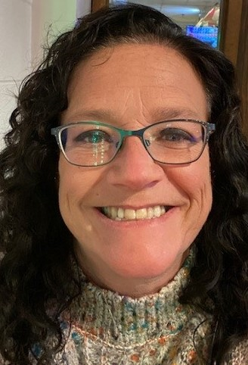
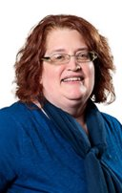
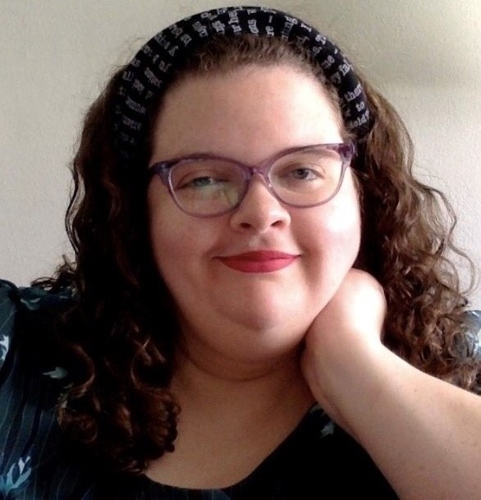

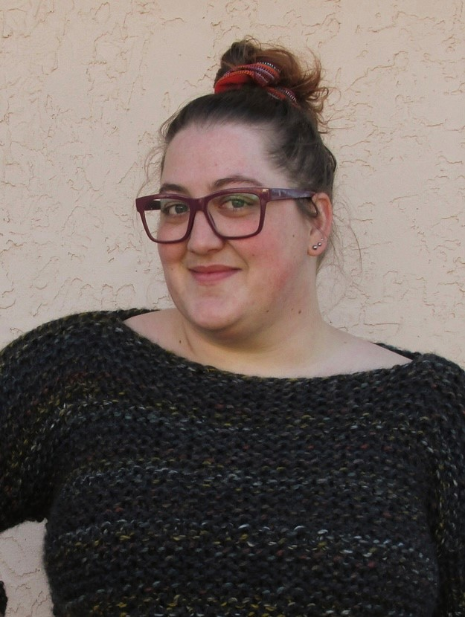
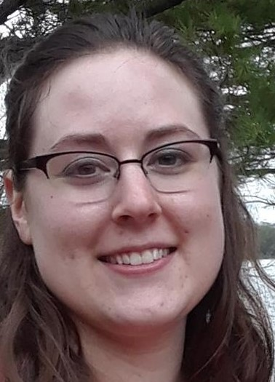
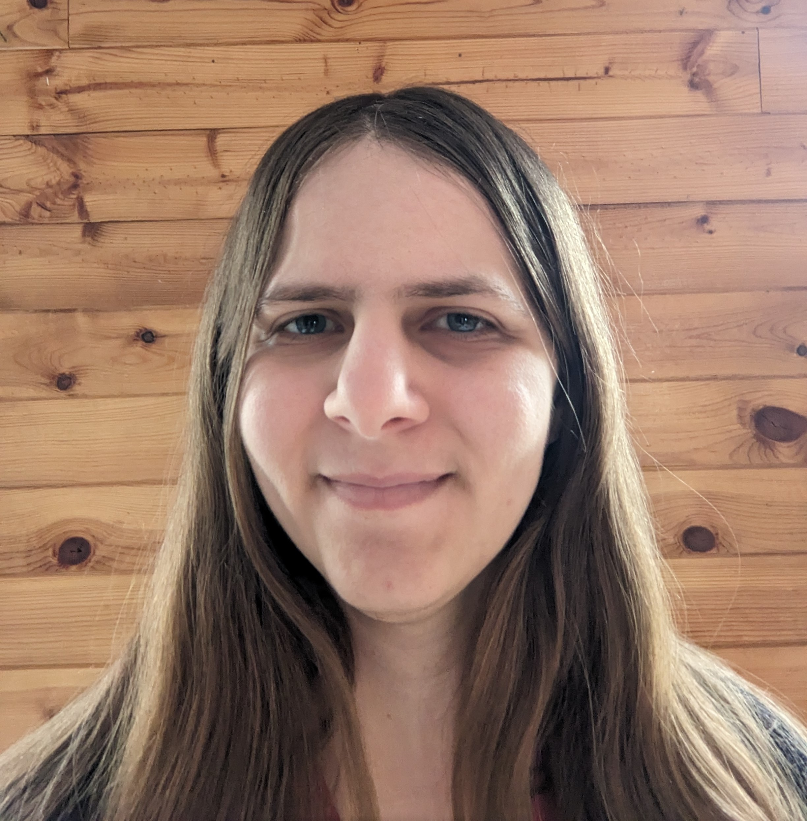
ON THE CALL TODAY
Questions? Contact the CMC: cmc@illinoisheartland.org
Barbera Scoby
CMC Cataloger
Dr. Pamela Thomas
Bibliographic Grant Manager
Mary Cornell
CMC Cataloger
Eric McKinney
CMC Training Cataloger
Kat Anderberg
Metadata Cataloger
Katie Roberts
Special Project Cataloger
Andrea Giosta
Special Project Cataloger

