Slide 1
OCLC Basics
SHARE Catalogers
Catalogers Training Session – January 14, 2025

Slide 2
Table of Contents
Searching WorldCat
Creating records
Searching authority records
Edit menu
Action menu
View menu
Tools menu
Window menu
Help menu
Local and online save files
Repair records in your save files

Slide 3
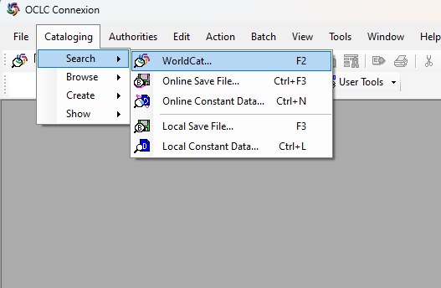
Searching WorldCat
Searching WorldCat from the cataloging drop-down menu OR
the icon for searching WorldCat (see arrow)

Slide 4
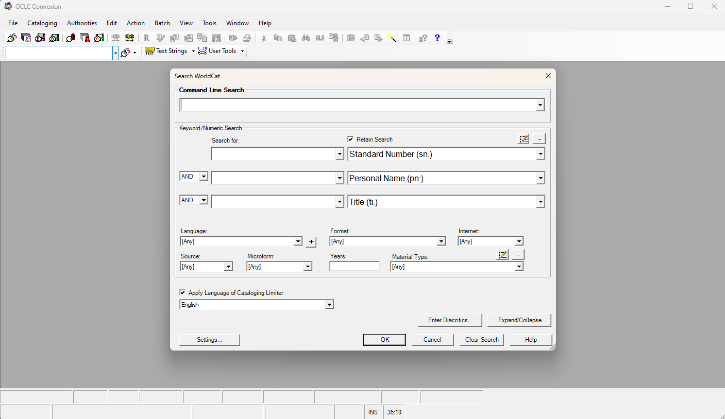
Searching WorldCat
Box for command line searches (begin with tags)
Plus or minus sign to add/delete search options
Choose between AND, OR, or NOT
Language of cataloging limiter: set to English for IHLS
Click retain search if you want your search parameters to stick around
Tags for command line searches

Slide 5
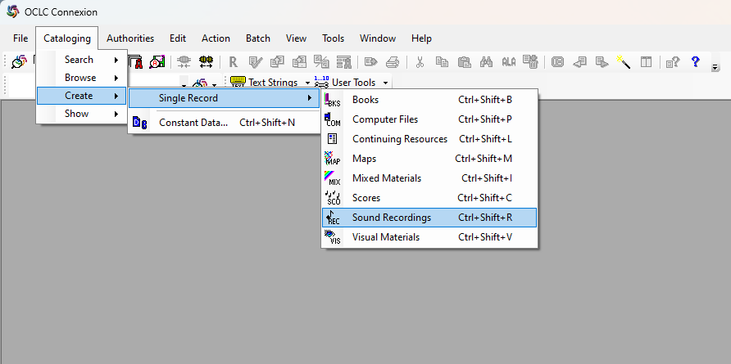
Creating new records
Keyboard shortcuts for creating each type of record can be seen to the right on the drop-down menu

Slide 6
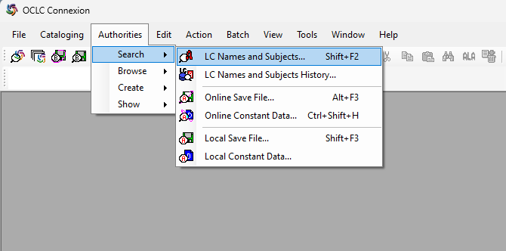
Searching Authority Records
Magnifying glass with an A or Shift + F2 for searching LC Names and Subjects
Important to search the authority records for all access points that you’re adding or checking for a bibliographic record!
Toolbar icon for authorities search

Slide 7
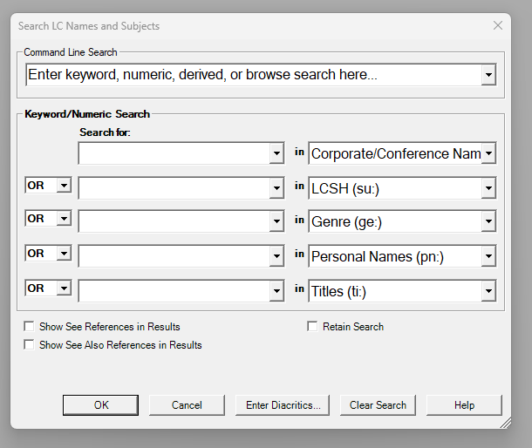
Searching Authority Records
Command line search bar (use tags)
Tags for command line searches. Click drop down menus to see more options for authority searches
Retain search option

Slide 8
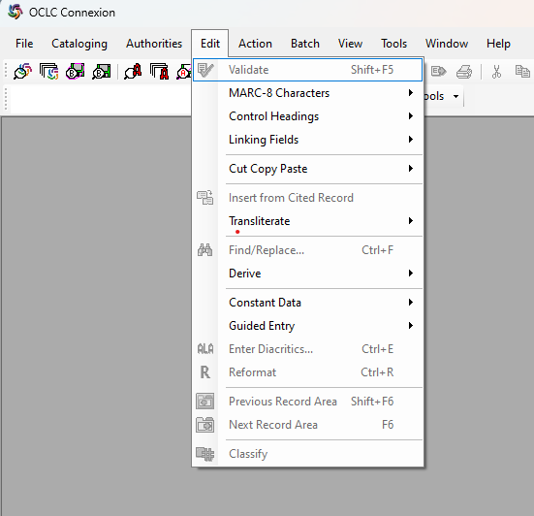
Edit Menu
Validate or Reformat records (validating also automatically reformats)
Derive new WorldCat records from the record you’re in
Constant data
Guided entry for 006 fields
Control headings from the drop-down menu or F11

Slide 9
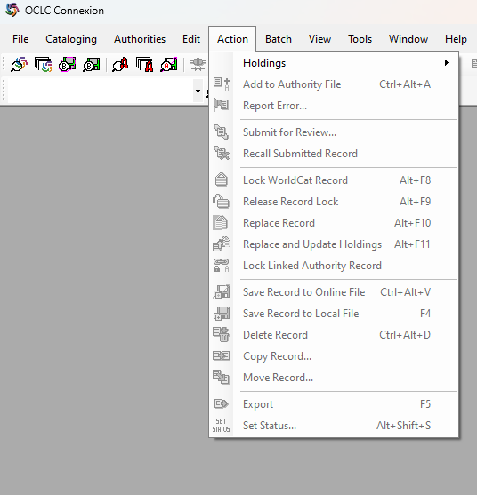
Action Menu
Lock record: lock while you are editing the master record
Replace record: for changes to the master record
Save to the online or local save files
Export records for importing to Polaris (F5)

Slide 10
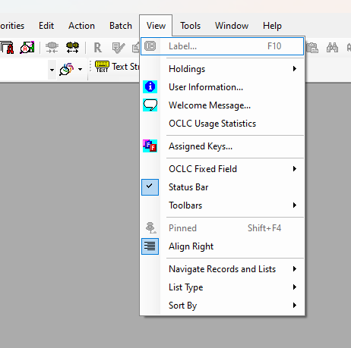
View Menu
List type: change from truncated to brief in searches if you want more/less information if your search results list
Pinning is useful if you want to see multiple screens when editing

Slide 11
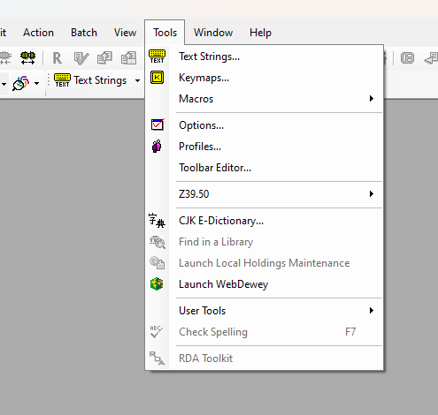
Tool Menu
Text string editor
Keymap editor
Macros
Spell check (very useful!)
RDA toolkit – this would need to be hooked up with your specific authorizations in order to work. It’s probably just easier to go to the toolkit separately and login there

Slide 12
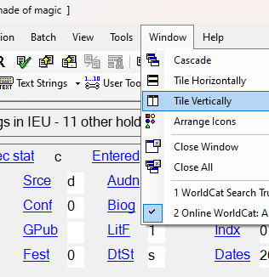
Window menu
Pin records (View > Pinned, or Shift + F4) if you want to tile multiple records and see them at the same time. Otherwise, tiling will work for whichever screens you have open at the time, including search results screens

Slide 13
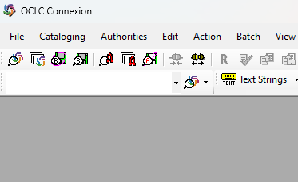
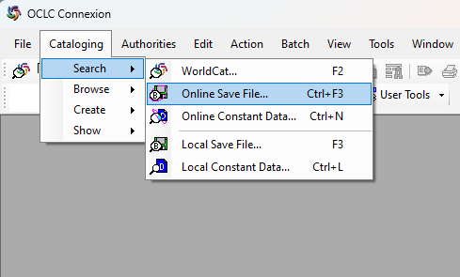
Accessing the save files
Search online save file
Search local save file
Drop-down menu with function key info for searching the online or local save files.

Slide 14
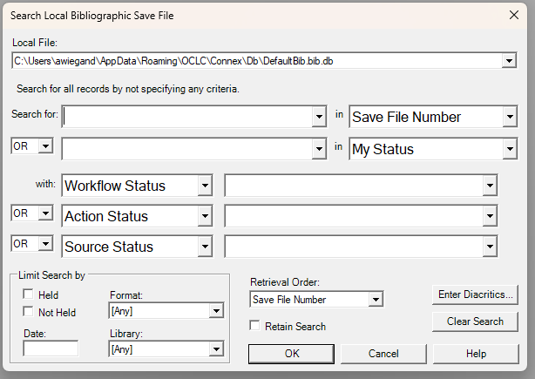
Accessing the save files
It will ask you for a file number. You can put in a specific file number, and it will take you straight there, or you can just hit “enter” without filling in any information, and it will take you to a list of your saved files. This works the same way for both the online and local save files.

Slide 15
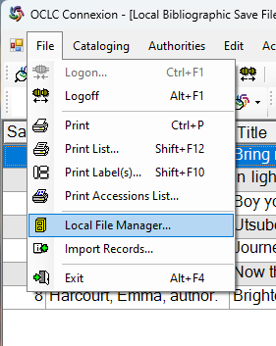
Repairing Records
You might come across files in your save file that won’t allow you to access or delete them. It might say that you’re “already editing” them. This can easily be fixed.
After selecting the problem file, go to File > Local file manager. Then hit the compact/repair button.

Slide 16
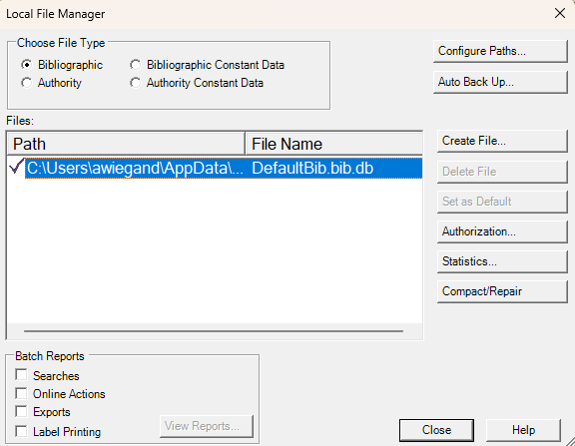
Repairing records

Slide 17
Links for working in OCLC
Default function keys
Default function keys - OCLC Support
OCLC quick reference guide
Quick reference: Cataloging in Connexion client - OCLC Support

