Slide 1
FABRICATED REALMS:
EXPLORING TEXTILE REALIA
Barb Scoby, Cataloger, Cataloging Maintenance Center
Online with the CMC, February 13, 2025, 10 a.m.

Slide 2
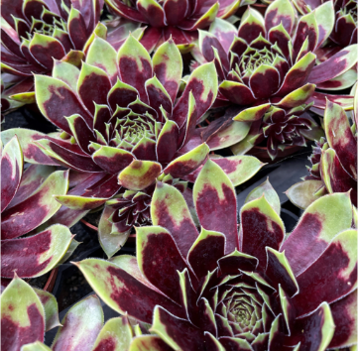
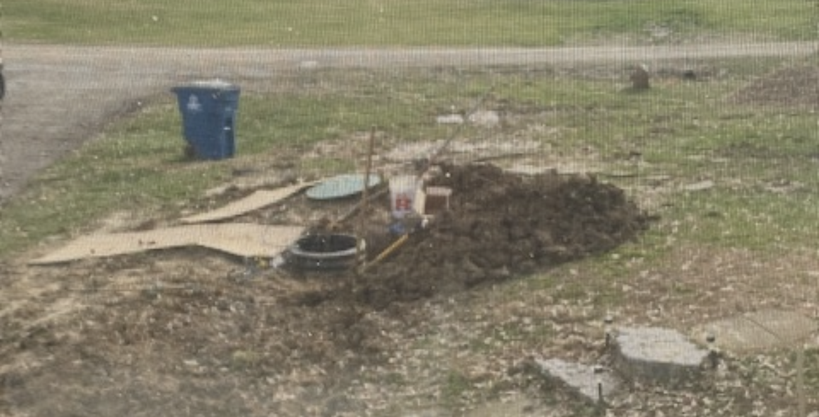
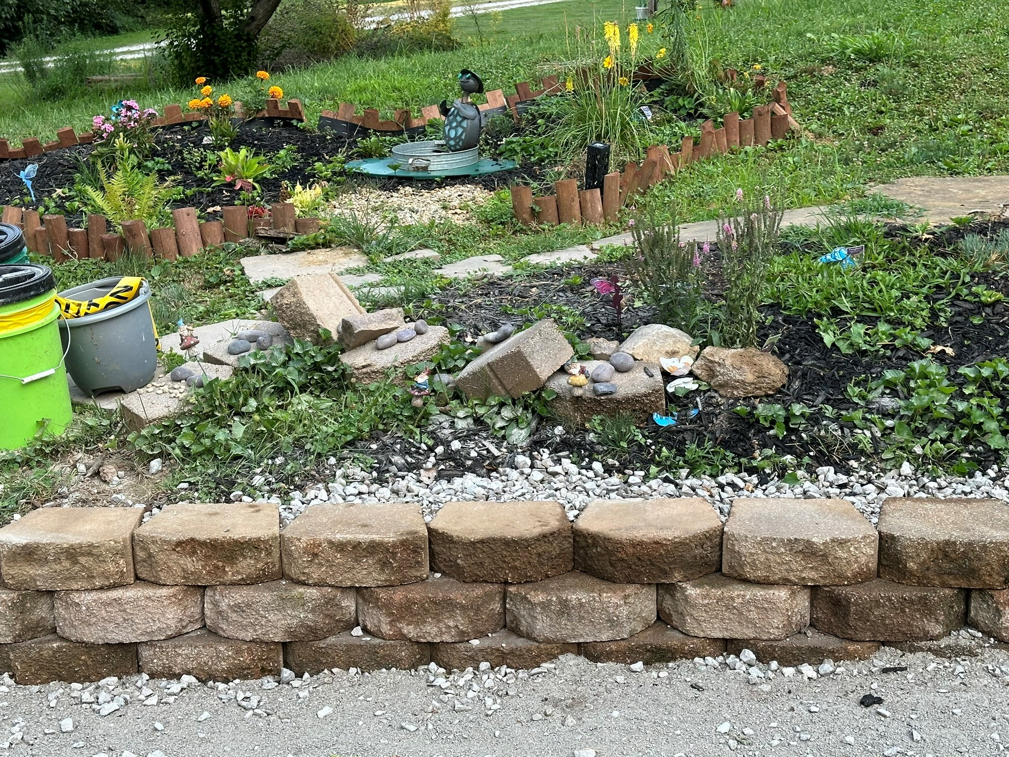
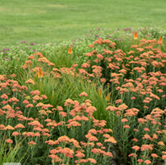
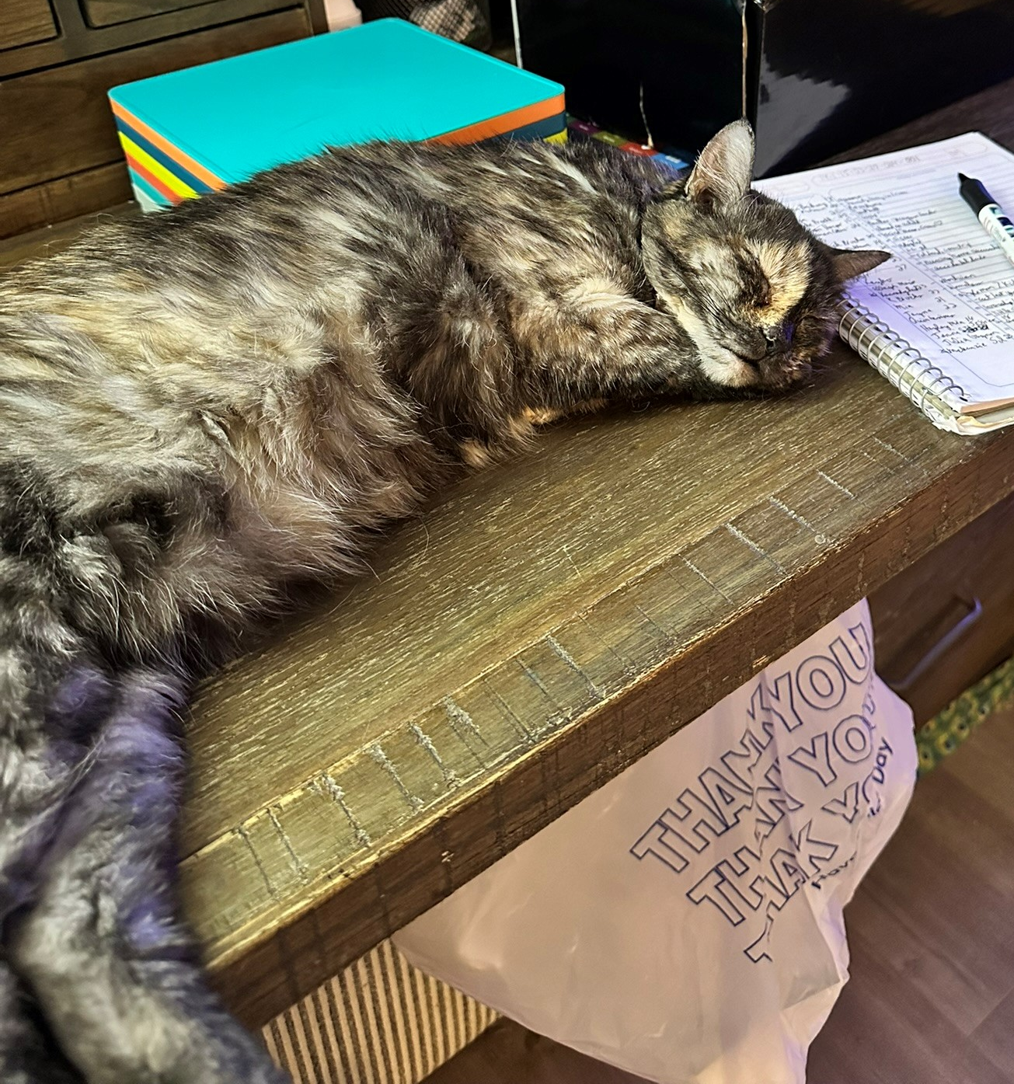
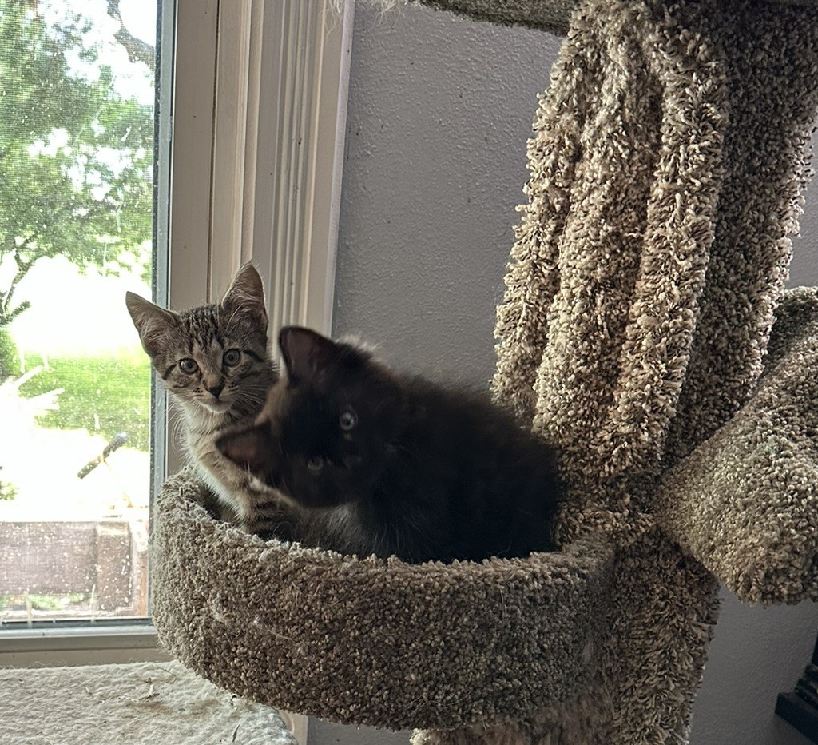
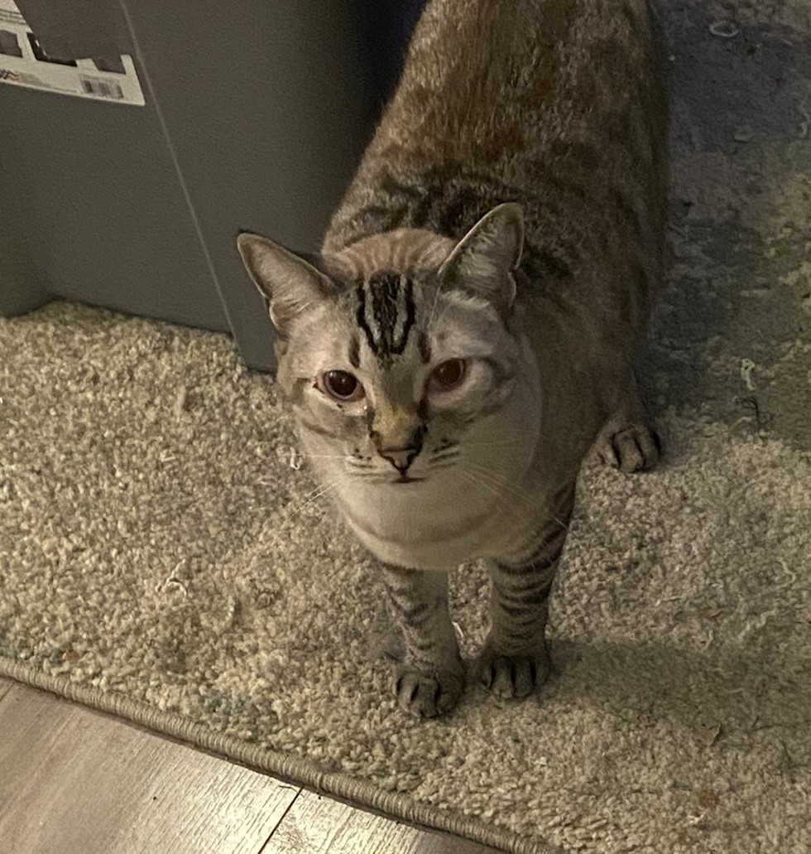
Barb Scoby
Notes:
Hello, I'm Barb Scoby and I have been with IHLS since December of 2021. I am also a cat mom to 5 spoiled cats. In January of 2024, I went to a conference where the author Jeff VanderMeer was the keynote speaker. His speech inspired me to create a pollinator garden in my yard. To my surprise and my family’s amazement, I not only kept the plants in my garden alive the whole season, I enjoyed the heck out of it! You see, I have been an indoor cat all my life and no one could imagine me digging in the dirt and getting it under my fingernails and liking it! I am so ready for spring to arrive, and I have pre-ordered four varieties of plants to add to the ones I planted last year. In the future I would like to try to add some sponge landscaping to my yard.

Slide 3
Agenda
Terminology
Fields of note
Examples
Questions
Notes:
Today I will discuss some of the terminology that I came across while preparing this presentation, describe MARC fields that play an important part in a bib record for realia, and share some examples. There will be time for questions at the end, but feel free to enter any questions you may have during the presentation into the chat.

Slide 4
TERMINOLOGY
IS IT TEXTILE OR TEXTILES?
WAIT… WHAT IS FABRIC THEN?
MY EXECUTIVE DECISION REGARDING THE TITLE OF THIS PRESENTATION: DELETE THE WORD TEXTILE AND REPLACE IT WITH MANUFACTURED?, FABRICATED?, CONSTRUCTED?
Notes:
Here is the problem with creating a title for a presentation before you have done research. TDLR: I should not have put the word textile in the title.
During my research on this topic, I found that the consensus is that Textile is the term that was originally used, and it referred to only woven fabrics. These days, the term Textiles (with an s) is preferred and refers to a broader range of materials. Ok. That makes sense… I think…
So, what is the difference between fabric and textile? According to fabricdesigntreasures.com
-Fabric usually refers to items that are designed for clothing - like shirts, trousers, etc.
-Textiles can be made into clothes, but they can also be used for other things like bed sheets, carpets, etc.
-Fabric is made through weaving, sewing or stitching techniques, whereas textiles are only made from woven fibers.
-Fabric is a specific type of textile that has a clear use - clothing. All other textiles are not fabrics and have other uses, or no defined use.
But some of those statements are contradictory, right? To me, this is like I before E except after C… So, I have decided to focus on the realia and fabricated aspects.

Slide 5
FIELDS OF NOTE
FIXED
FIELDS
007 007 Physical Description Fixed Field (Unspecified) (R)Optional/Optional
264 Indicators for this field are _3
336 Content type:
https://www.loc.gov/standards/valuelist/rdacontent.html
337 Media type: https://www.rdaregistry.info/termList/RDAMediaType/
338 Carrier type: https://www.rdaregistry.info/termList/RDACarrierType/
340 Physical medium: https://www.rdaregistry.info/termList/RDAMaterial/
Notes:
I just want to mention the Format and Type fixed fields – The items in my examples are all Visual Materials (format) and Type r for three-dimensional artifact.
007 – BibFormats indicates this field is optional. For these items, it would be 007 z ǂb z
264 – These items were manufactured not published so the indicators should be _3
336 – you can find the different content types on the website listed on this slide (slide also has links to other 3xx fields)
337 – For these examples, the media type is unmediated
338 - For these examples, the carrier type is object
340 – The bib records for the examples has two 340 fields. One for the physical medium and the other for color characteristics.

Slide 6
FIELDS OF NOTE CONTINUED
388 Time Period of Creation (R)
500 500 General Note (R)
Information about fabric, color, condition, accession number, and
other miscellaneous details
541 Immediate Source of Acquisition Note (R)
655 Subject Heading and Term Source Codes: Source Codes for
Vocabularies, Rules, and Schemes (Network Development
and MARC Standards Office, Library of Congress)
830 Collection information
856 Location information
Notes:
The fields on this slide are used to describe attributes of these objects. These attributes are quite different from the attributes of books, videos, and other materials. In these fields you record time period created, information about the objects, and other item specific information. The 541 is noteworthy because it conveys how/where this item was acquired, when it was acquired, and the accession number assigned to it by the institution.
When you are assigning subject headings, the link on the slide will take you to different vocabularies such as AAT which is used in the examples.

Slide 7
Notes:
Now on to the fun part! The first three records that we will look at were created by Brigham Young University for items in their historic clothing collection. Since the items described are unique to BYU, and the institution described the item as it fits them, I decided to copy the records and add/delete/shrug and leave alone some fields so that the record worked for our purposes, but didn’t mess with what BYU has going on in the record. One instance of “shrug and leave alone” is the measurement of the items in inches. The measurement is in cm as well so I left the 300s alone.

Slide 8
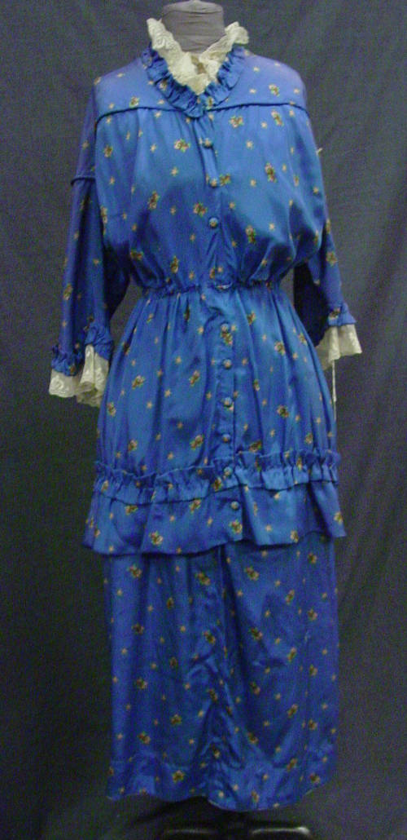
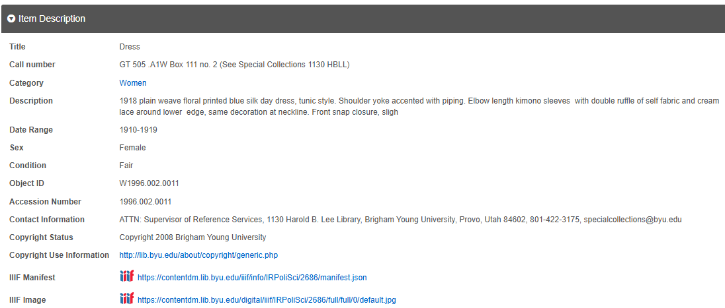
DRESS
© Brigham Young University.
All rights reserved.
Notes:
These screenshots are from the BYU digital collections library.

Slide 9
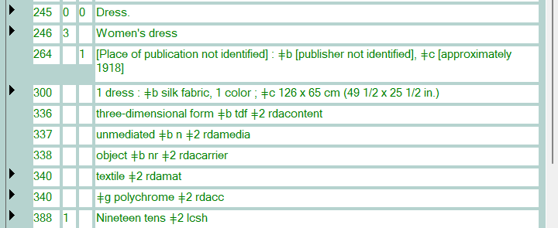
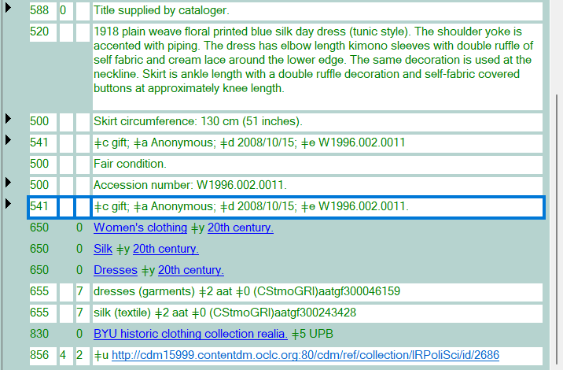
DRESS
Notes:
The OCLC record that I used as a starting point for this is 1274246082. I had to look up "self fabric" because I wasn't sure if it was a typo or a real thing. "Self-fabric, in sewing, is a fabric piece or embellishment made from the same fabric as the main fabric, as opposed to contrast fabric." Textileglossary.com
Notice that this dress was an anonymous gift given in 2008.

Slide 10
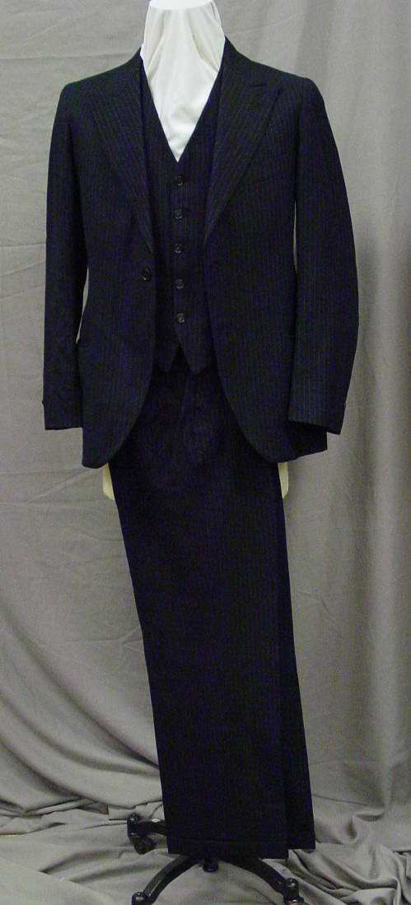
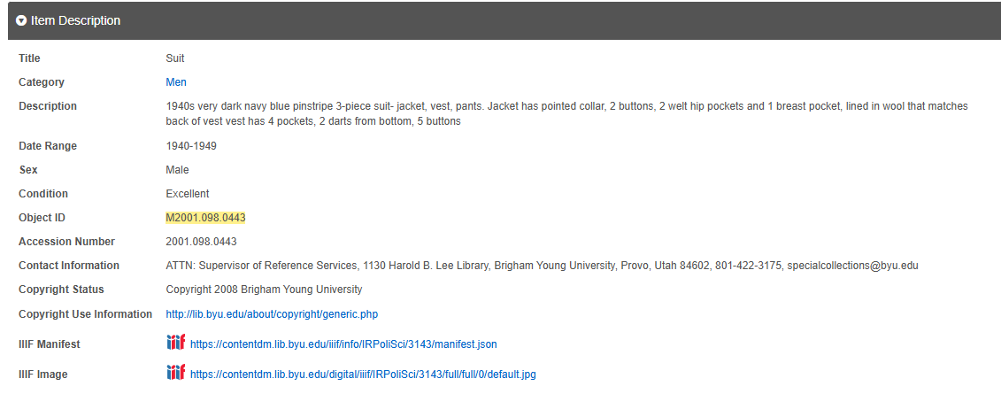
SUIT
© Brigham Young University.
All rights reserved.
Notes:
These screenshots are from the BYU digital collections library.

Slide 11
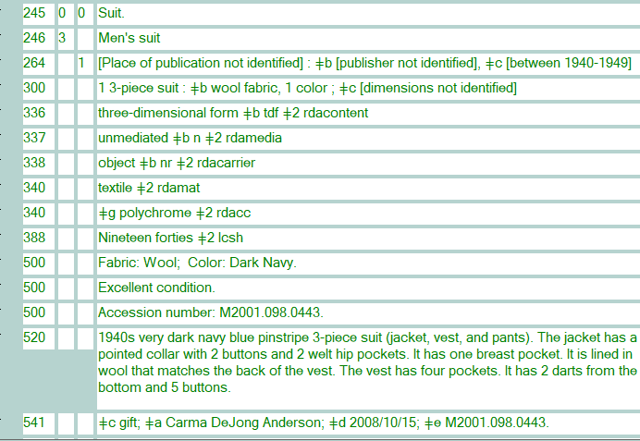
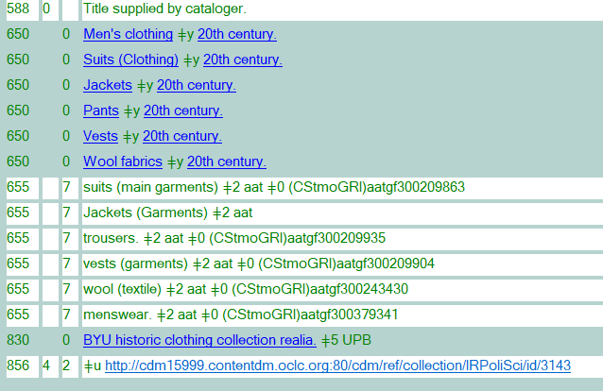
SUIT
Notes:
The OCLC record that I used as a starting point for this is 1265295907. This record makes use of AAT subject headings as do the records for the dress and the chemise.

Slide 12
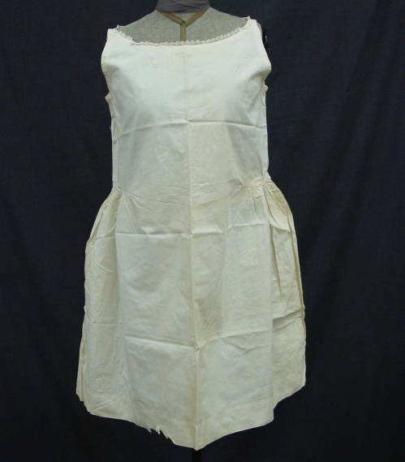
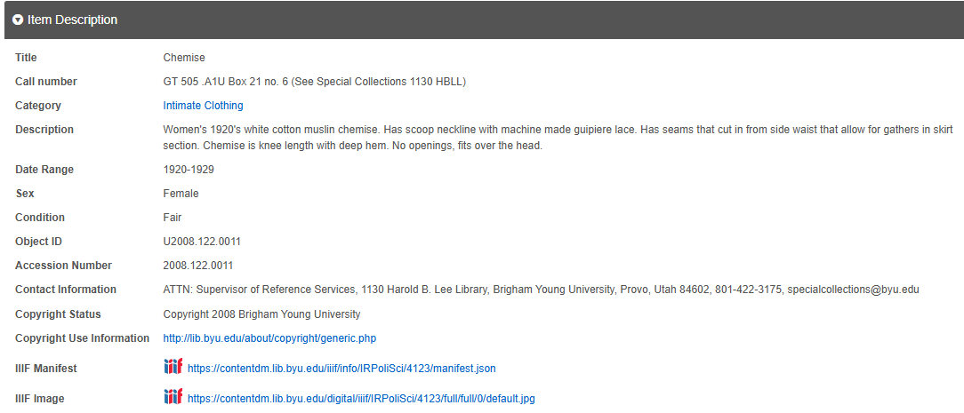
CHEMISE
Notes:
These screenshots are from the BYU digital collections library.

Slide 13
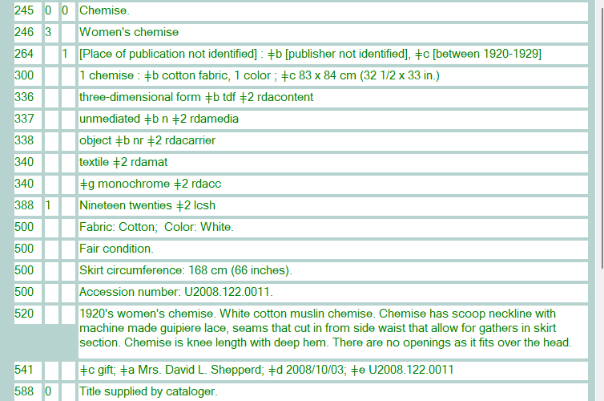
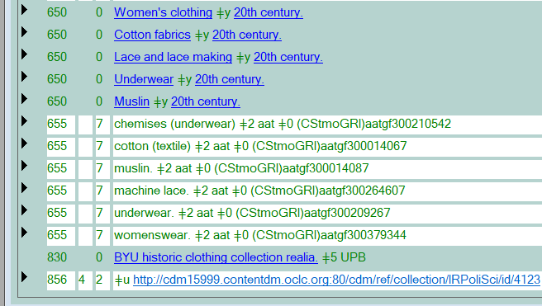
CHEMISE
Notes:
The OCLC record that I used as a starting point for this is 1203351390

Slide 14
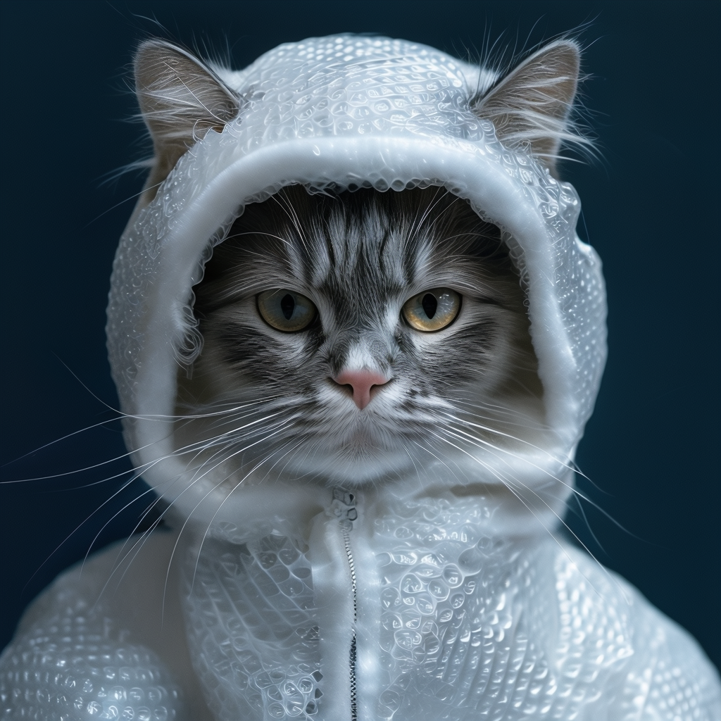
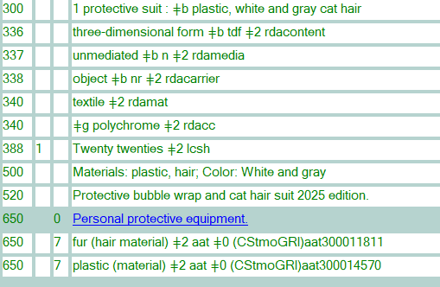
PROTECTIVE SUIT
Notes:
I wanted to have a little fun so I decided to create a bubble wrap suit for myself since I am very accident prone. I created this with Playground-v3 and as you can see it didn't turn out quite like I wanted it to. I decided to use what I had after about the 10th try. It is a protective suit made out of bubble wrap, duct tape, and has cat hair as the trim, and has an actual cat inside of it which is something I did not intend to happen. I wasn't going to go there, but I am feeling a bit punchy. Would this be considered PURRsonal protective equipment?

Slide 15
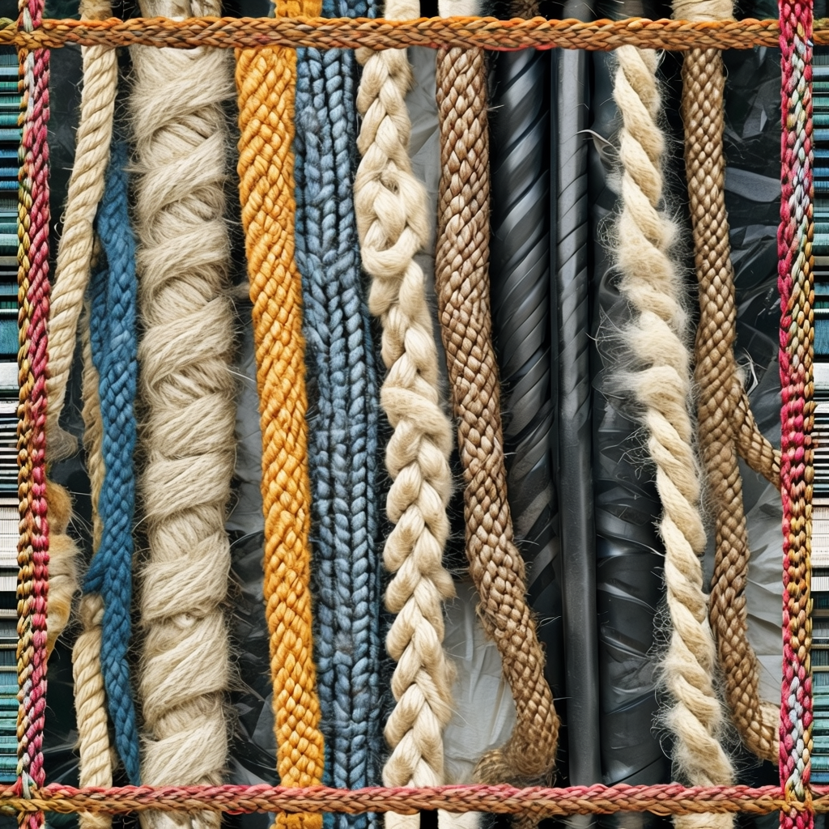
Resources
https://contentdm.lib.byu.edu/digital/collection/IRPoliSci/search
https://fabricdesigntreasures.com
https://www.merriam-webster.com
https://www.oclc.org/bibformats/en/home.html
https://www.rdaregistry.info/termList/ModeIssue/
https://www.textileglossary.com/
AI artwork created in Playground-v3

Slide 17
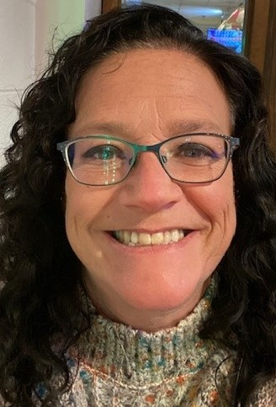
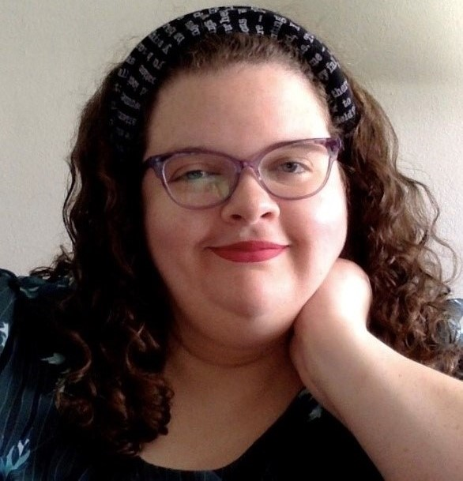
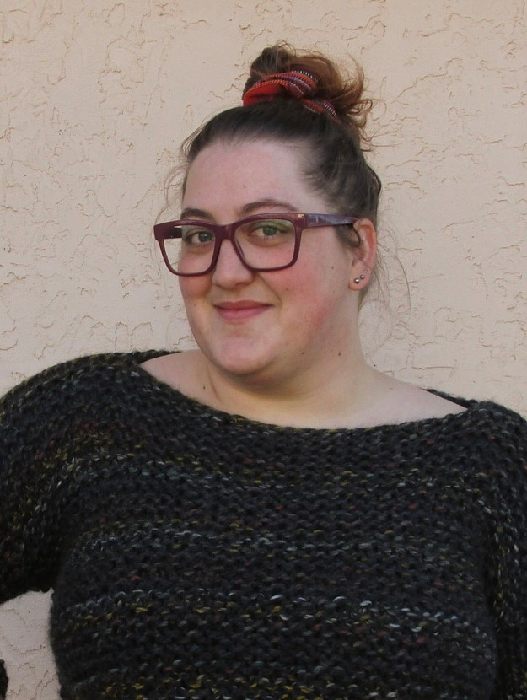
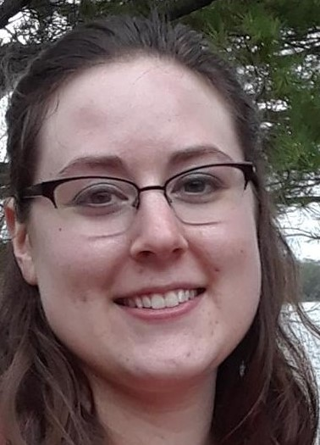
ON THE CALL TODAY​
Questions? Contact the CMC: cmc@illinoisheartland.org ​
Dr. Pamela Thomas​
Bibliographic Grant Manager – Our fearless leader.​
Barb Scoby​
CMC Cataloger - Presenter​
Eric McKinney​
CMC Cataloging Trainer ​
Mary Cornell​
CMC Cataloger
Kat Anderberg​
Metadata Cataloger
Ryan Rafferty​
Special Project Cataloger​
Katie Roberts​
Special Project Cataloger
Andrea Giosta​
Special Project Cataloger​

