Slide 1
CATALOGING GOVERNMENT DOCUMENTS
Online with the CMC​
April 17th, 2025, 10 a.m.
Barb Scoby, Cataloger,
Cataloging Maintenance Center

Slide 2
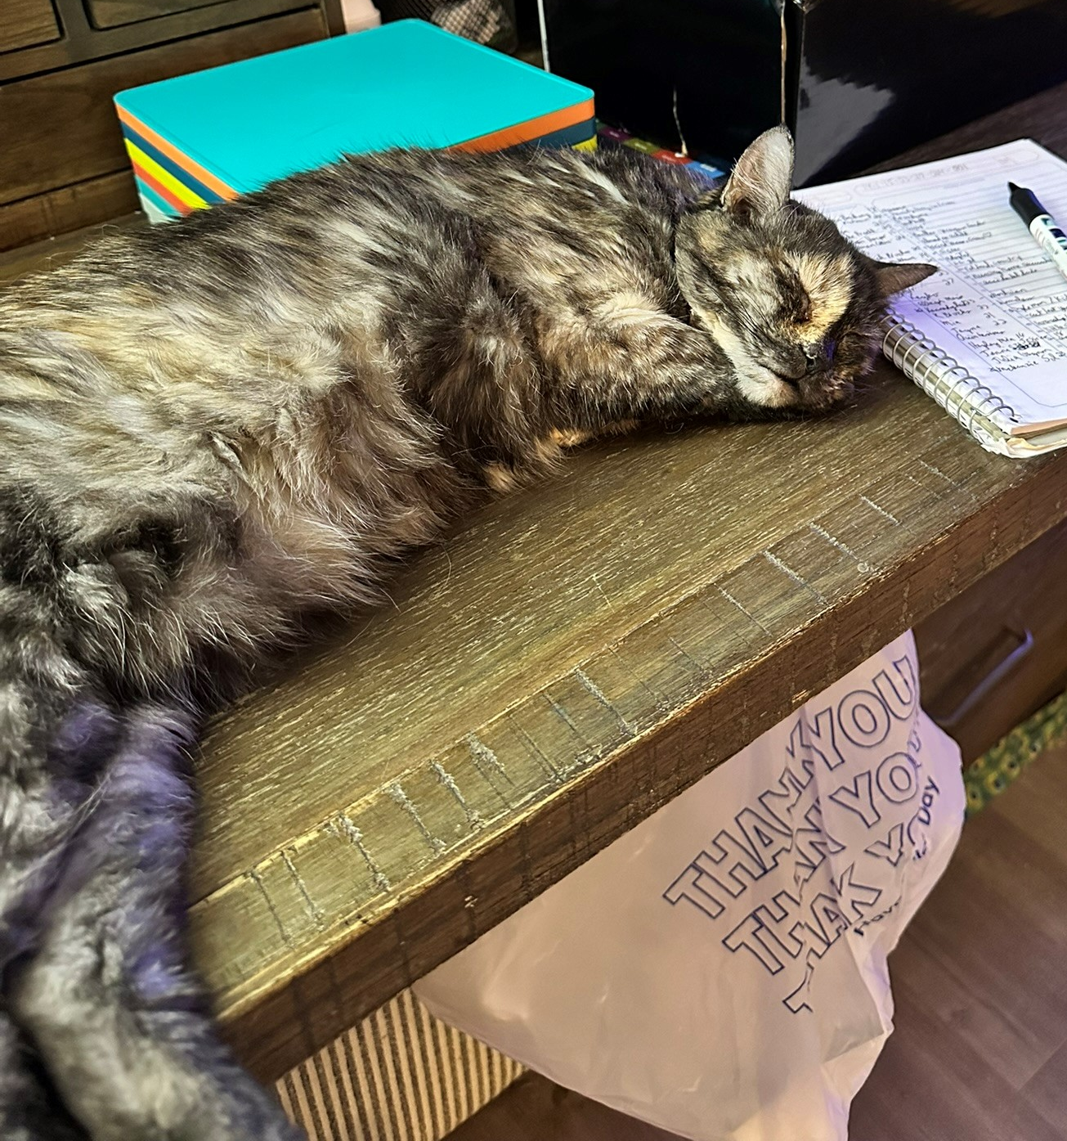
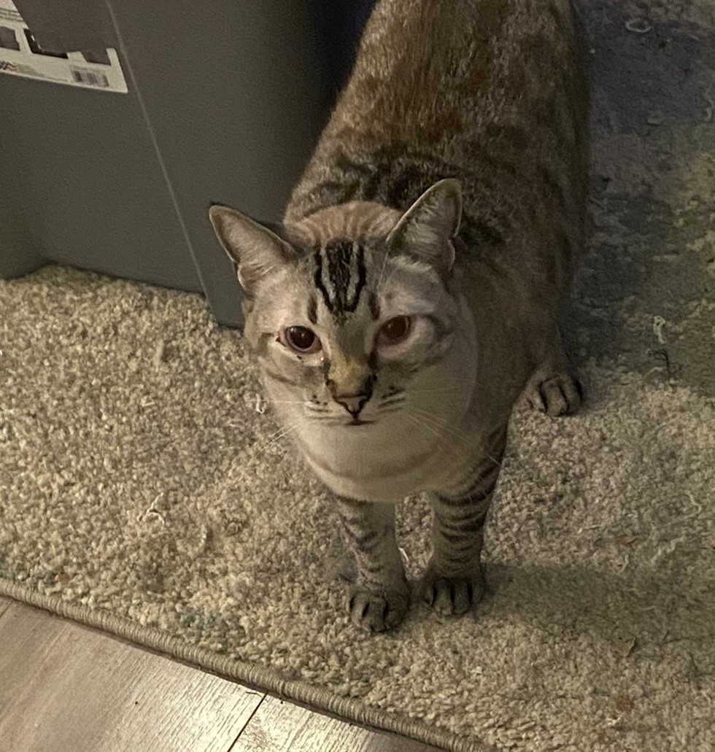
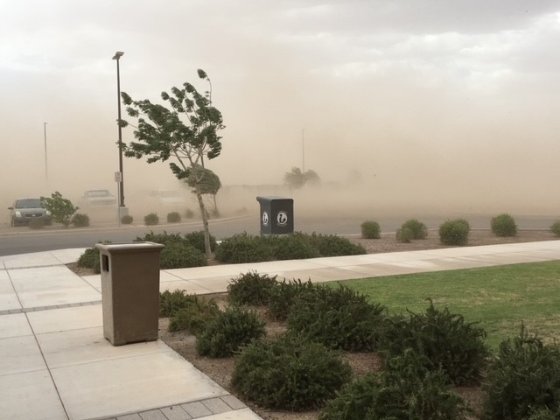
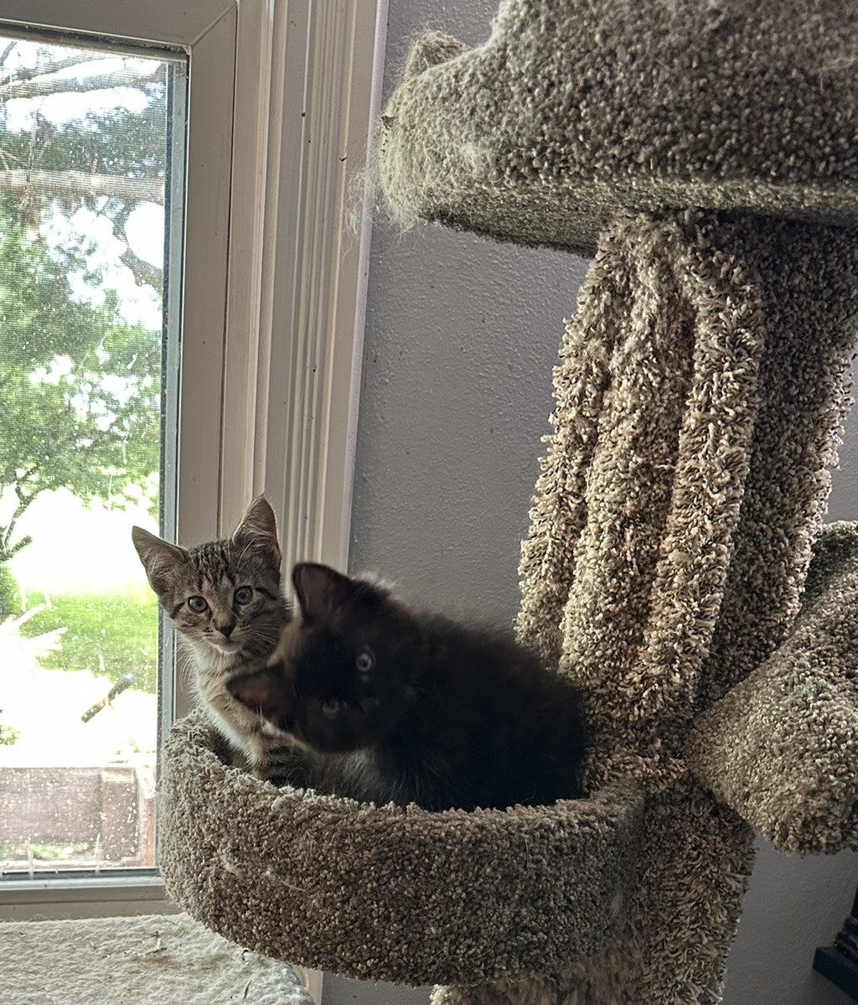
Barb Scoby
Notes:
Good morning! Thanks for attending Cataloging Government Documents. I'm Barb Scoby and I have been with IHLS since December of 2021. I started my library career as a part-time Library Assistant in a small Arizona town in 2010. In 2021, I decided that the wildfires were getting too close to my house for comfort (the picture on the slide is not of a wildfire, it is a dust storm or haboob) so I packed up my kitties and I moved back to Illinois.

Slide 3
Agenda
Brief overview of initialisms and acronyms associated with government documents
Examples
Questions

Slide 4
Acronyms & Initialisms
IDOT – Illinois Department of Transportation
GPO – Government Publishing Office
CGP – Catalog of Government Publications
CONSER – Cooperative Online Serials
(The GPO is a member)
FDLP – Federal Depository Library Program
Notes:
Most government documents that I receive for cataloging : are physical items not digital; come from IDOT ; were published between 1980 and the current year ; and are technical reports from studies conducted by government agencies (mostly transportation departments). I create records for these documents (or enhance existing records) in OCLC Connexion. Disclaimer: I have never worked at an FDLP library or received any training from the GPO.
The CGP is the authoritative source of all GPO bibliographic records and cataloging activity. GPO records obtained from other sources may have been modified by other cataloging/metadata agencies and thus are not the authoritative versions of the records. With some exceptions, GPO maintains its bibliographic records only in the CGP. I have come upon a few records in OCLC that were created by the GPO. Their OCLC symbol is…….. GPO.
Below is some additional information for your reference.
GPO Records in OCLC and Record Maintenance
GPO has been a member of OCLC since July 1976. GPO contributes bibliographic records for U.S. Government Publications in all formats.
GPO maintains its records in the following situations:
•As a CONSER (Cooperative Online Serials) member, GPO continually updates records for U.S. Government serials and integrating resources.
•GPO will only correct errors in its OCLC records that have been identified through quality control processes.
GPO is not responsible for any modifications to its records in OCLC:
•Additions, alterations, and deletions of metadata by other OCLC members
•Changes made by OCLC processes, such as the merging of records
• Ordinarily GPO will not make changes to its OCLC records at the request of libraries.
The Federal Depository Library Program (FDLP)
Administered by the U.S. Government Publishing Office (GPO). Established by Congress in 1813 to give public access to info produced by Government agencies.
www.fdlp.gov
There are 49 FDLP libraries in Illinois.
The Illinois State Library is an FDLP library as is the Milner Library at Illinois State (University). I originally thought that Milner Library was the name of the library for the State of Illinois which made things very confusing for me. Then I did some searching and I realized that the Milner Library is at Illinois State University and is different from the State of Illinois Library.
FDLP libraries are not required to catalog the print or online publications that they receive, but they must provide access to the content which is usually done through "other means, such as linking to the resources from their library website or LibGuides."
“The mission of Federal depository libraries is to provide local, free access to information from the Federal government in an impartial environment. Documents in print and electronic formats are available on a wide range of topics relevant to the general public and to professionals, researchers, and students in a variety of fields.”
“The U.S. Department of the Interior Library collects titles produced by executive agencies on science and technology, nature and wildlife, geology, energy, the environment, Native Americans, and much more.”
The Illinois Document List is a monthly listing of Illinois state government publications received by the Government Documents Unit of the Illinois State Library as required by law [15 ILCS 320/21].

Slide 5
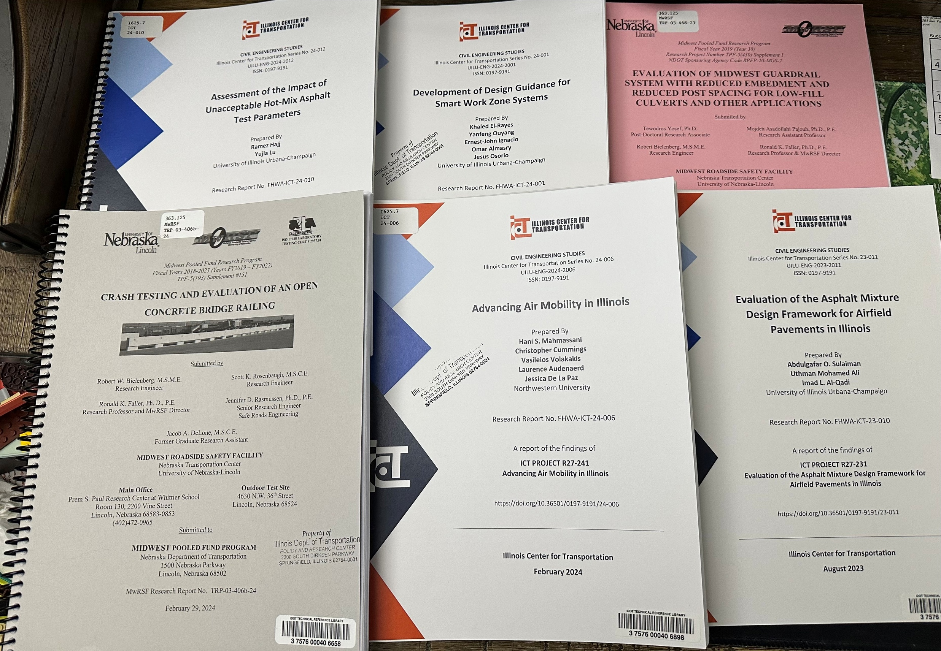
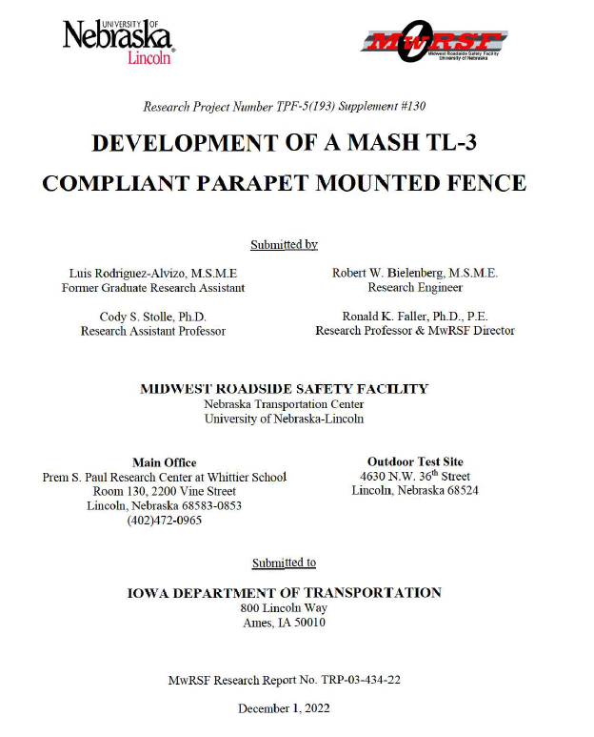
Examples
Notes:
Pictured on this slide are the covers of the 8 examples I prepared for this presentation.

Slide 6
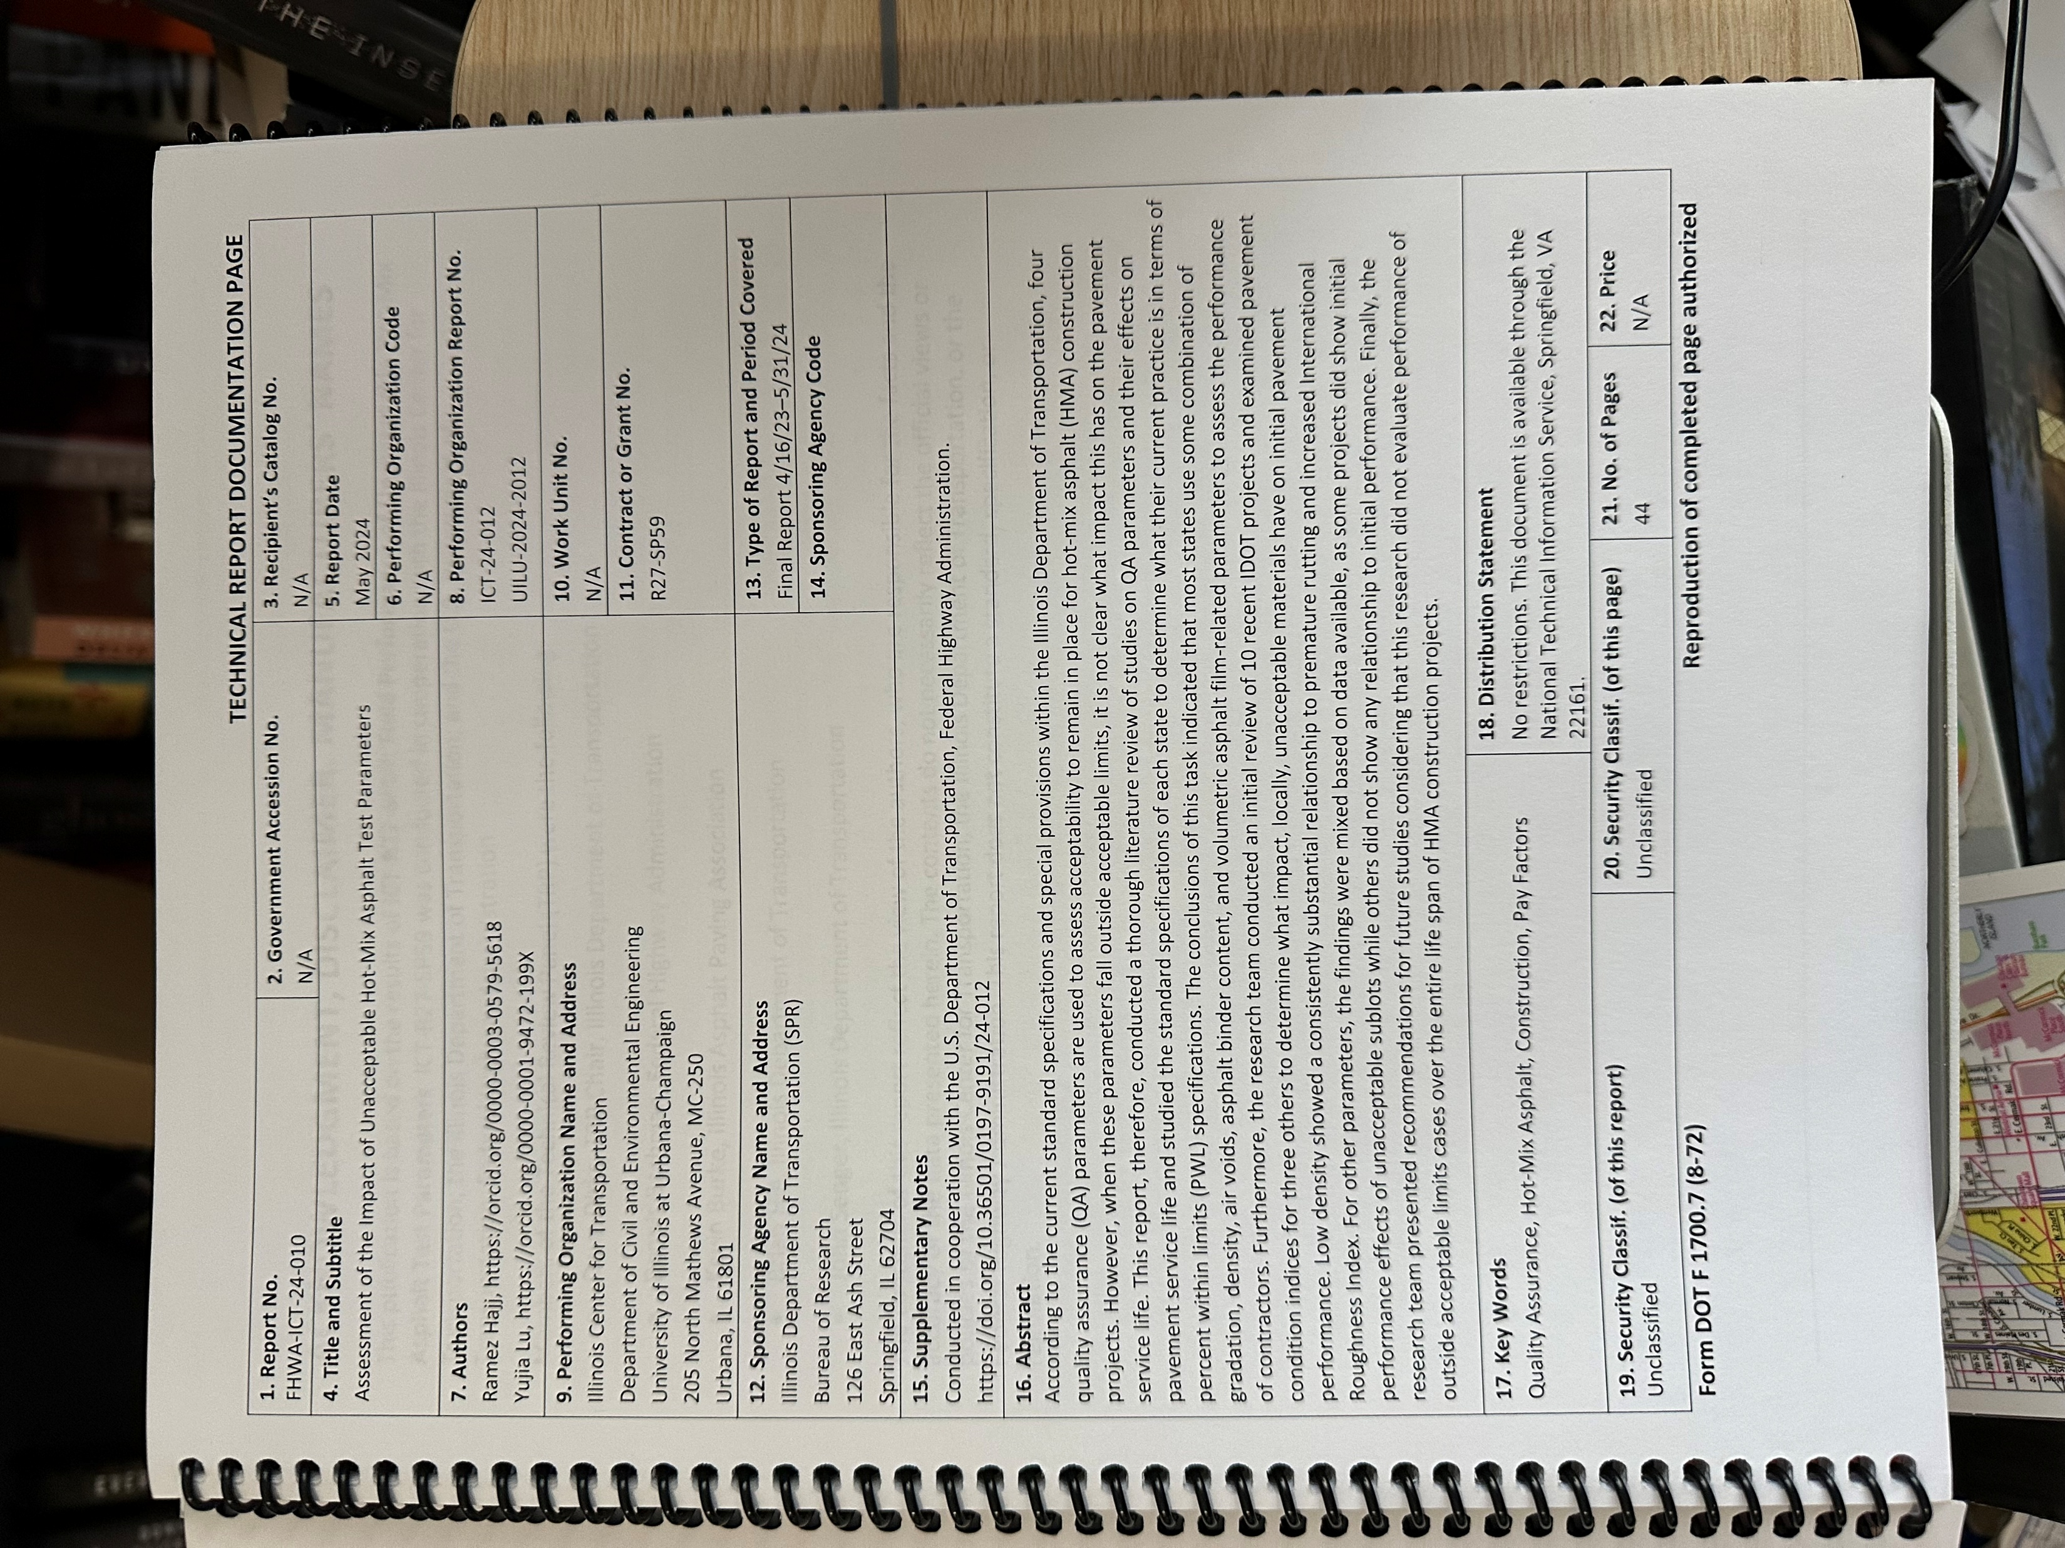
EXAMPLE 1
OCLC #1455346454
Notes:
My first example is a report titled Assessment of the Impact of Unacceptable Hot-Mix Asphalt Test Parameters. Most of the information needed to create a record for these type of documents is on the cover and the Technical Report Documentation page. I also flip through the pages and note if there are charts, graphs, illustrations, photographs, etc.

Slide 7
From the top
Notes:
I will go over all of the fixed fields for my first example and for the rest of the examples I will point out fixed fields that differ and explain why. Please note that I prefer to go through the fields in “Barb order” and not the order you would go in if you tabbed through them. Please let me know if I lose you.

Slide 8
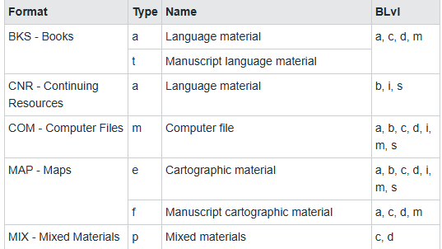
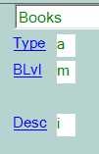
TYPE / BIBLIOGRAPHIC LEVEL
m = Monograph/Item
Notes:
All of my examples for today are books (Type a) and monograph/item (BLvl m) so these fields will be the same (a and m) for all the examples.

Slide 9
DESCRIPTIVE CATALOGING FORM
i | Desc ISBD. Descriptive portion of the record contains the punctuation provisions of ISBD.
Notes:
The CMC uses ISBD punctuation in all records, so Desc will always be i.

Slide 10
ENCODING LEVEL / FORM OF ITEM
Full level. The most complete MARC record created from an inspection of the material. The record conforms to OCLC full-level input standards.
None of the following. None of the other codes is appropriate.
This is not a Microfilm, Large Print, Online, Braille, etc.
Leave both fields blank
Notes:
The CMC always creates Full level records so this field remains blank.
All of the items in the examples are regular print books (as opposed to large print, online, braille, etc.) so this field will be blank for all of my examples.

Slide 11
NATURE OF CONTENTS
THIS EXAMPLE HAS A SUBSTANTIAL BIBLIOGRAPHY
THIS EXAMPLE CONTAINS TECHNICAL REPORT MATERIAL
Notes:
Bibliographies – b add a 353 field and 504 if there is a bibliography. I will go over those in later slides.
All of my examples have b t in the Cont field.

Slide 12
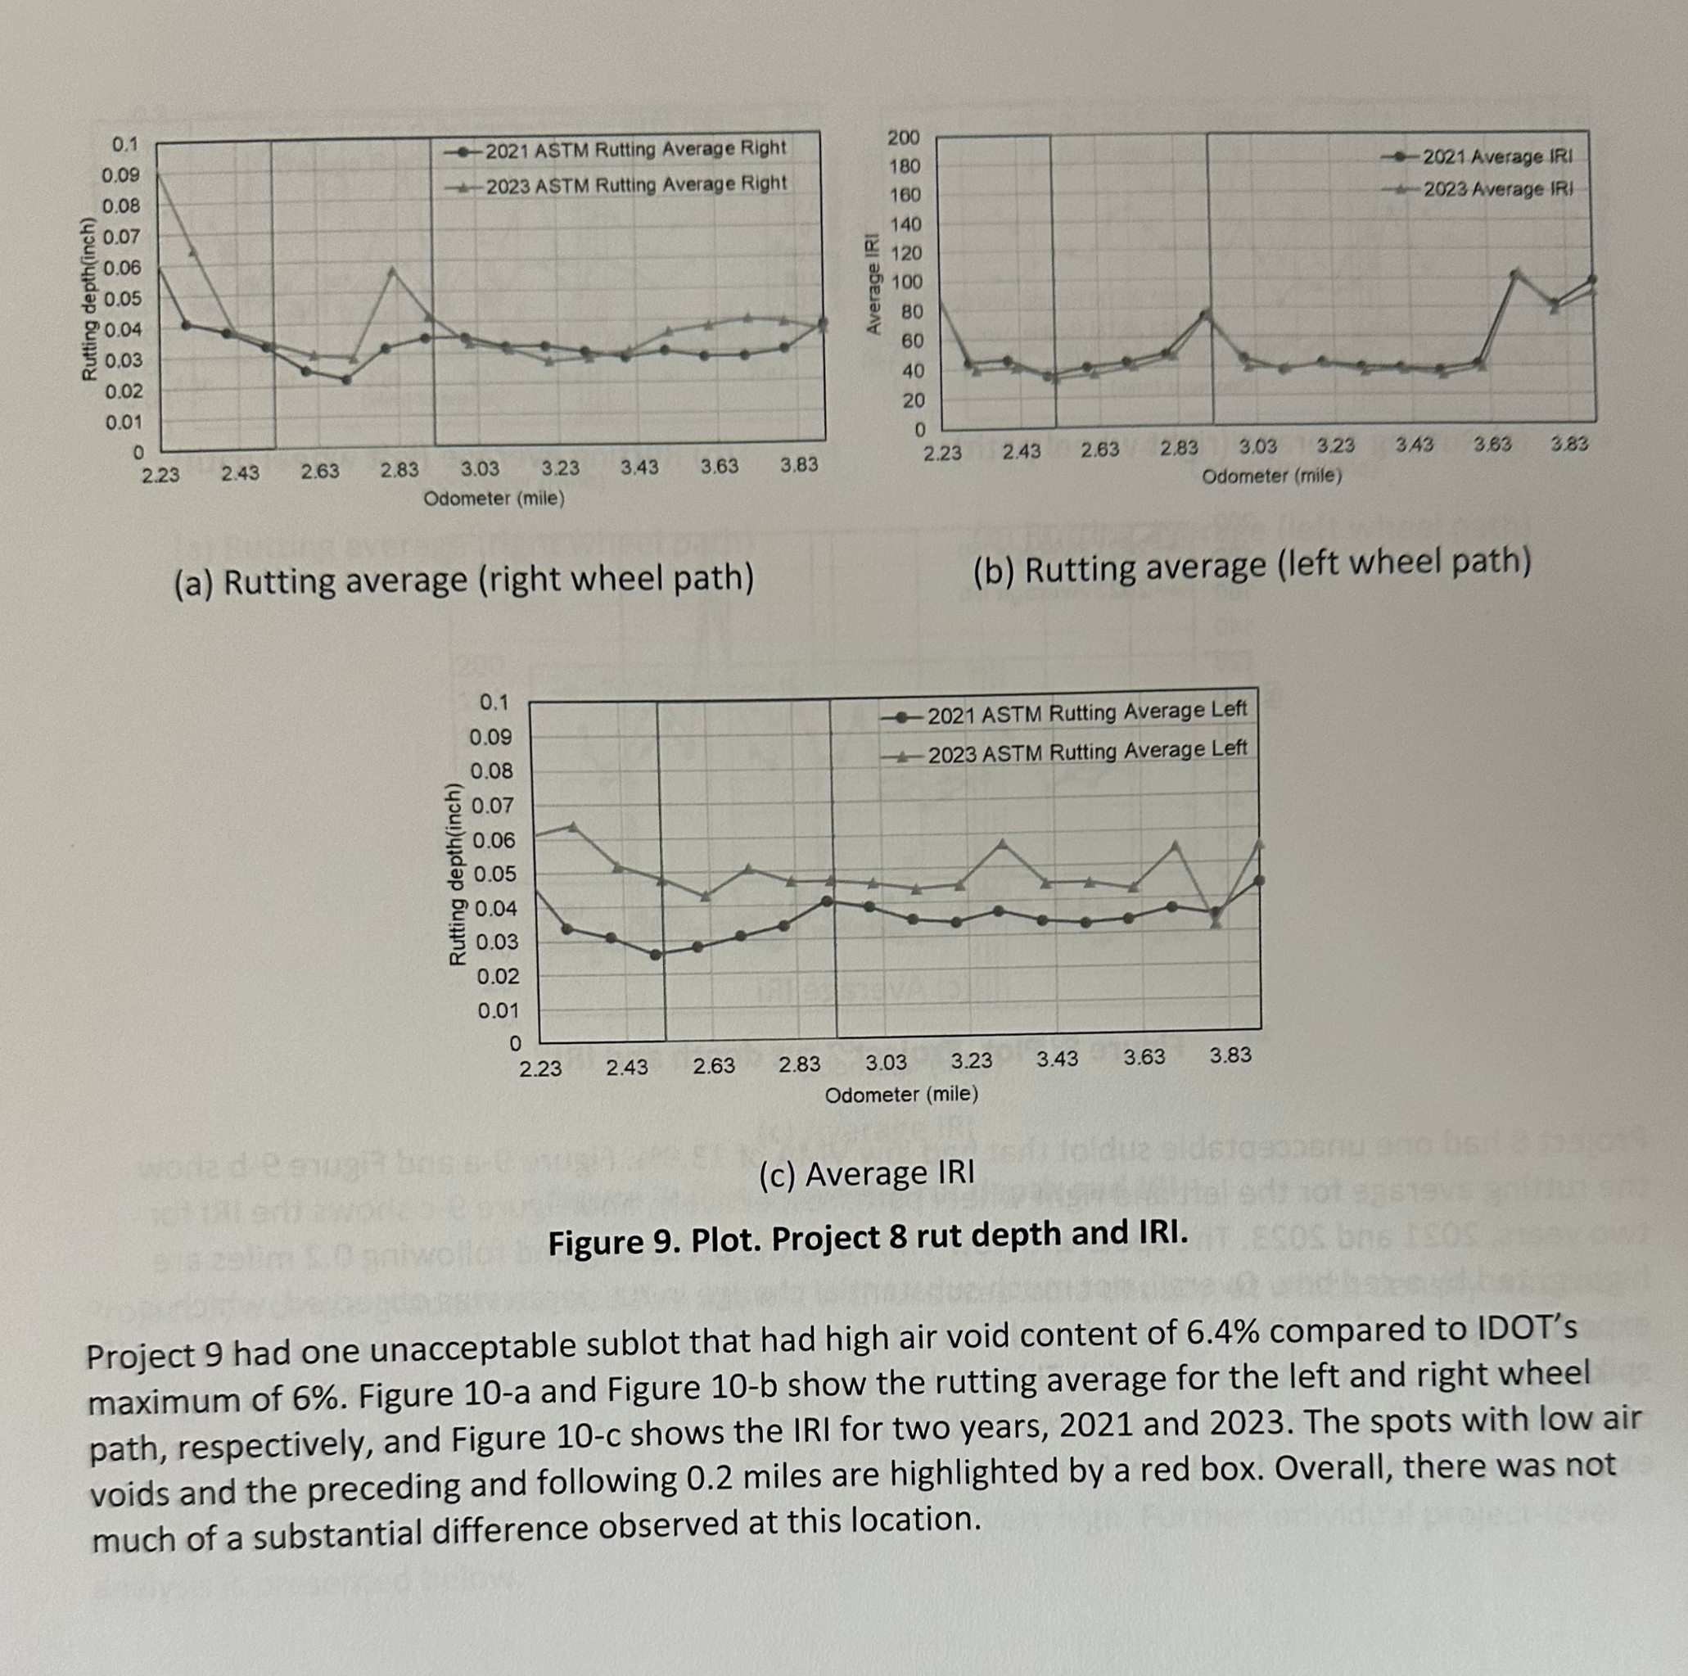
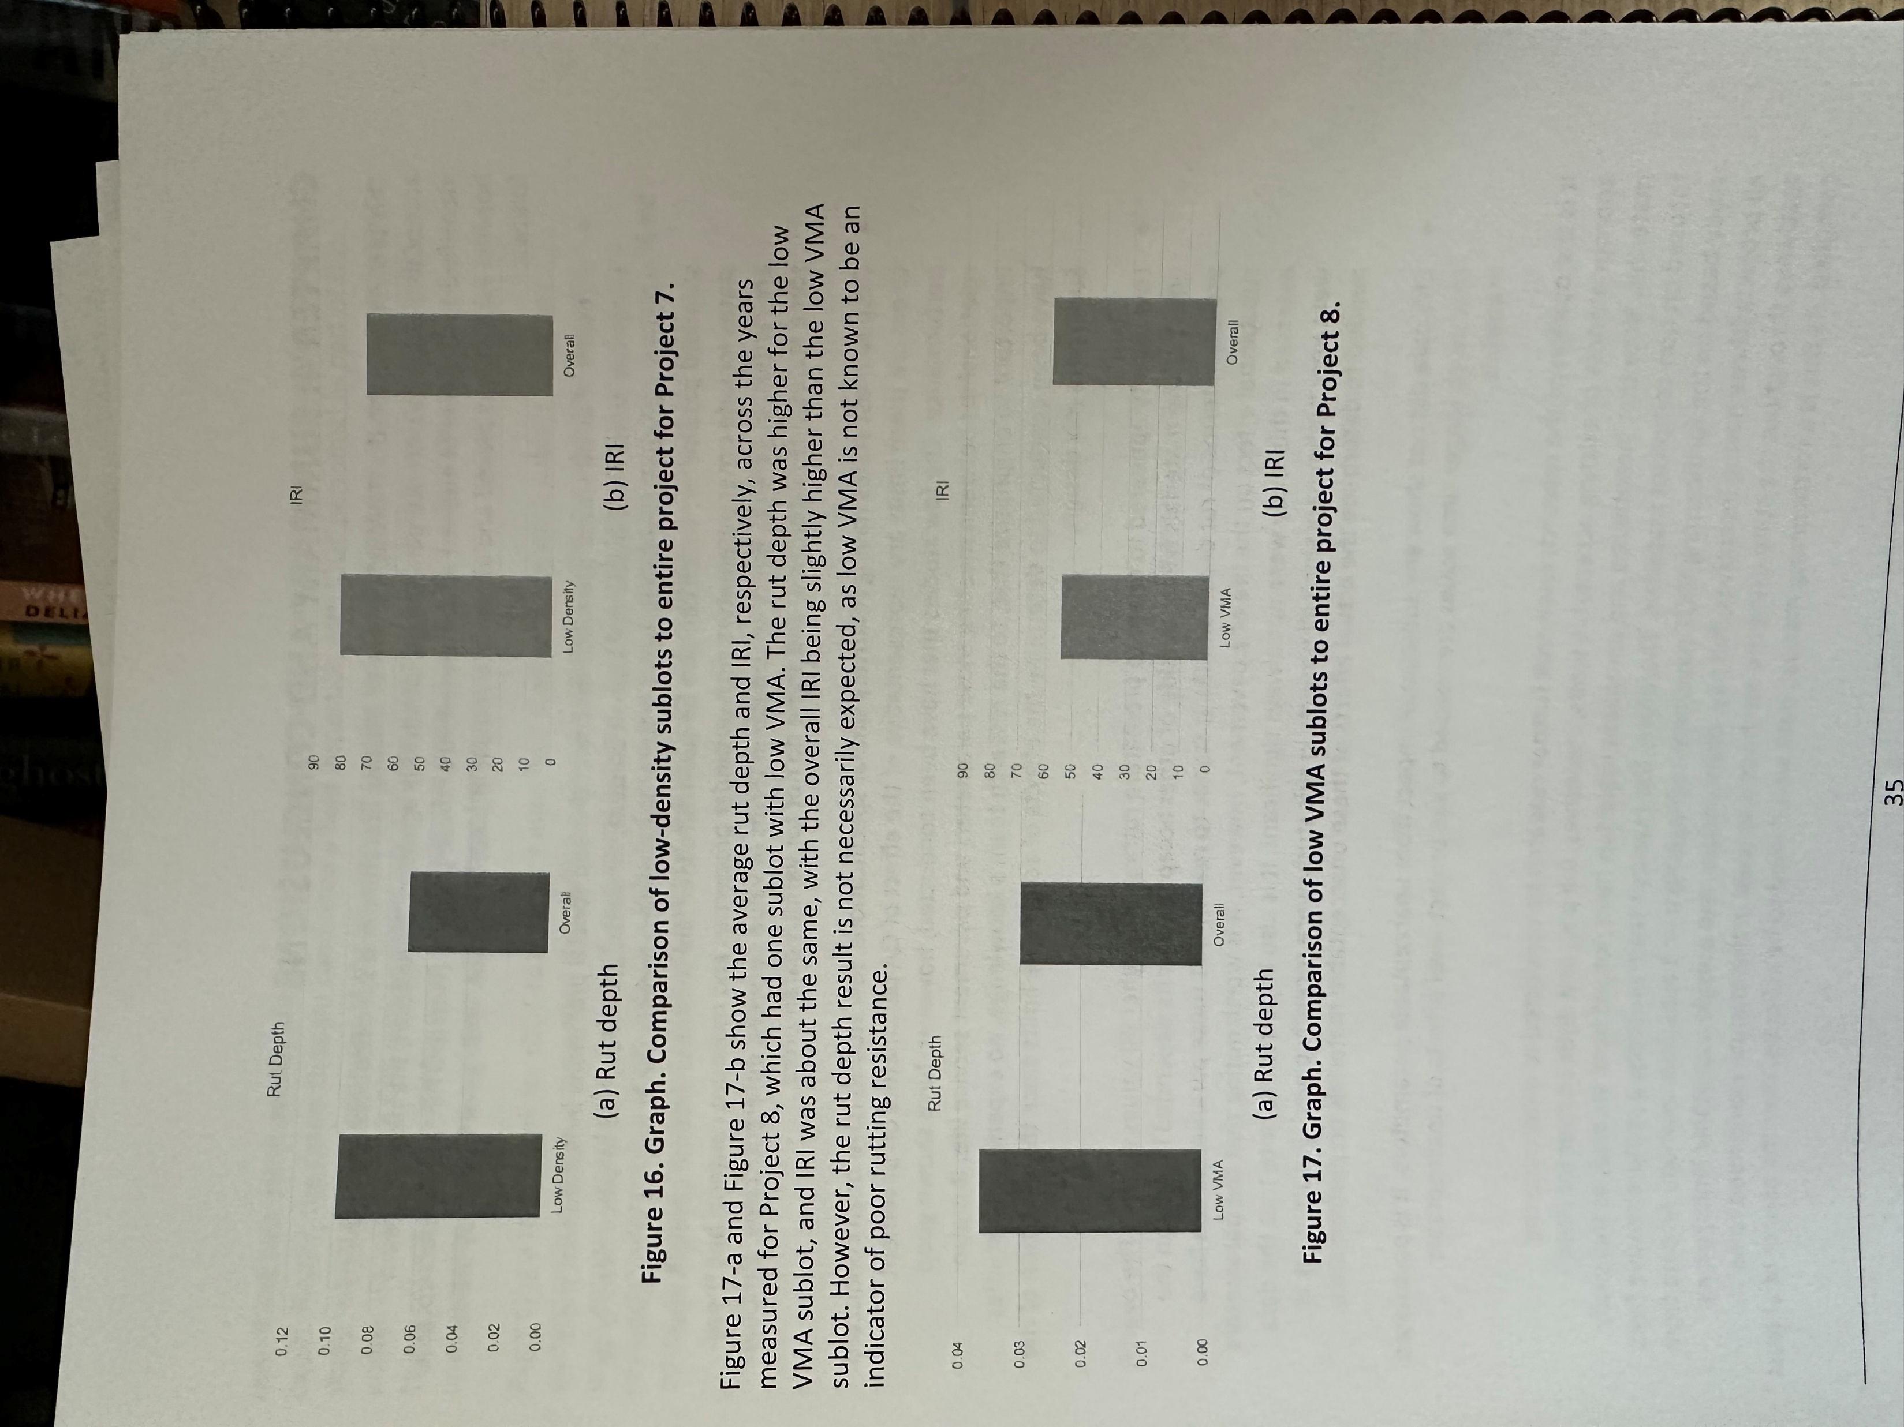
ILLUSTRATIONS
a | Illustrations. Use code a when the term illustration, illustrations, or one of their equivalents, is present in field 300. Also use code a for types of illustrations not covered by any of the more specific codes.
b | Maps. Use code b when the term map, maps, or one of their equivalents, is present in field 300.
d | Charts. Use code d when the term chart, charts, or one of their equivalents, is present in field 300.
o | Photographs. Use code o when the term photograph, photographs, or one of their equivalents, is present in field 300. You may use code o to indicate actual photographs (which would most often be represented as units of extent in field 300 subfield ǂa) and/or photographic reproductions (which would commonly be represented as illustrative content in field 300 subfield ǂb). If the photographic illustrations are of minor importance code a may be used.
Notes:
Most of the technical reports that I create records for have illustrations (graphs are considered illustrations by BFAS) and charts at minimum and many have maps (b) and photographs (o) as well.
Illustrations – a for graphs, tables, and illustrations
Maps – use b
Charts – use d
Photographs – use o

Slide 13
CATALOGING SOURCE /
CONFERENCE PUBLICATION
d | Other. Use to indicate that the source of the cataloging data is an organization other than a national bibliographic agency or a participant in a cooperative cataloging program.
0 | Not a conference publication. The following types of publications are not conference publications: Works composed of, or based on, a single paper Hearings of legislative bodies Courses given in a school, unless the main entry is the name of a conference
Notes:
From BFAS:
Source
"If you are inputting original cataloging on a workform or new record, enter blank, c, or d in Srce. OCLC users at authorized national bibliographic agencies enter blank. BIBCO and CONSER participants, except for those at authorized national bibliographic agencies, enter c when creating records as part of those programs. In all other cases OCLC users enter d. Do not change the code when editing a record."
Items cataloged by the CMC will always have a d in the Srce field.
Conference publication. The following types of publications are considered to be conference publications:
Proceedings, including collections or partial collections of papers (or of contributions, essays, etc., that are based upon papers) presented at a conference
A partial collection, defined as a work containing two or more papers (or contributions, essays, etc., that are based upon papers) presented at a conference
A collection of preprints of conference papers
None of the examples I chose for this presentation are conference publications.

Slide 14
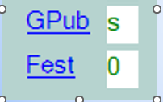
GOVERNMENT PUBLICATION /
FESTSCHRIFT
c | Multilocal. Published or produced by or for a multilocal jurisdiction, which is defined as a regional combination of jurisdictions below the state level.
f | Federal/National. Published or produced by or for a federal or national government body (e.g., a sovereign nation, such as Canada). Used for the governments of England, Wales, Scotland, and Northern Ireland.
l | Local. Published or produced by or for a local government jurisdiction such as a town, city, county, etc.
m | Multistate. Published or produced by or for a regional combination of jurisdictions at the state, provincial, territorial, etc., level.
s | State, provincial, territorial, dependent, etc. Published or produced by or for a government body at the state, provincial, territorial, or other dependent jurisdictional level.
Notes:
Most of the government documents that I catalog are either s or f, but I’ve had occasion to use the others such as m for Multistate. There is an example for that later on in the slides.
This is not a festschrift, and I have never cataloged one in my time as a cataloger. BFAS states “a complimentary or memorial publication usually in the form of a collection of essays, addresses, or biographical, bibliographic, scientific, or other contributions. It often embodies the results of research, issued in honor of a person, an institution, or a society, as a rule, on the occasion of an anniversary celebration. A true festschrift generally mentions the person, institution, or society it commemorates on the title page, cover, etc. The title of the work may or may not use the word festschrift. Other indications that an item is a festschrift include phrases such as: papers in honor of, in memory of, commemorating, and their equivalents in foreign languages.”

Slide 15
TARGET AUDIENCE / BIOGRAPHY / LITERARY FORM /
TYPE OF CONTROL / MODIFIED RECORD / INDEX /
LANGUAGE CODE / COUNTRY OF PUBLICATION, ETC.
Notes:
Here is the big chunk of fixed fields:
Audn – IDOT doesn't ask for this field to be populated. If they did, I would probably use f for specialized.
Biog - None of these examples have biographical information so this field stays blank.
LitF - All of these examples are non-fiction so 0 is entered here.
Ctrl - None of the examples are controlled so leave that field blank.
MRec - None of the examples are transcriptions of LC or NLM printed copy so leave that field blank.
Index – this particular example has no index so 0 is entered here.
Lang - Text of the document is in English so eng goes in this field.
Ctry - This was published in Illinois so ilu goes here.

Slide 16
TYPE OF DATE-PUBLICATION STATUS
DATE 1 AND DATE 2
Notes:
DtSt – this item has an issue date of May 2025, I used e for detailed date.
e Detailed date. Use if the issue date includes year and month or year, month, and day. Code uu is used for the final two characters of Date 2 if the day is unknown for an event known to have occurred on a specific day, such as an original broadcast date. Leave the final two characters of Date 2 coded blank if there is no day of month given on the item and no day can be inferred. Use the form yyyy,mm.
Dates - 2024, 05 (since it is the May 2025 issue)
264 – put the year only in brackets
500 – put the month and year in quotation marks and remember to put a period after the second quotation mark (BFAS does not instruct you to add the period, but MARC Report will flag the lack of a period as an error)
***Keep in mind - None of my examples are continuing resources as those are a whole other discussion on their own. These transportation documents are parts of different SERIES not SERIALS.

Slide 17
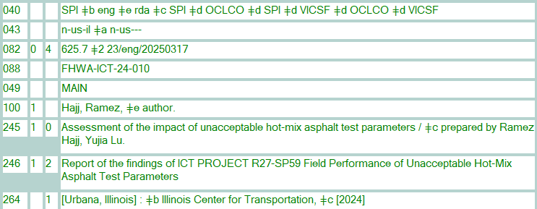
0xx to 2xx
Notes:
022 ISSN is not added for these examples – put in 490 and 830 instead. **Remember these are part of a series not a serial publication. On the slide is the error message I received when I tried to add 022 in the record.
027 Field 027 contains a Standard Technical Report Number (STRN) or an International Standard Technical Report Number (ISRN) assigned to a technical report. The technical report number is usually the primary means of identifying a specific technical report. – none I could find on the resource - used 088 instead
040 – SPI indicates that the Illinois State Library created the record, eng because the record is in English. This has nothing to do with the Lang that the actual text is in, rda because the record uses RDA, OCLC and I (VICSF) have made changes to the record.
043 – for this particular example, I used two area codes since the document discusses how the topic affects roads in Illinois, but the researchers studied similar tests in other states.
049 – auto-generated
074 GPO Item number The United States Government Printing Office (GPO) item number. GPO uses the item number to manage the distribution of publications within its depository library system. While the item number relates to categories of publications, it is not an order number or the unique number that identifies each entry in the Catalog of U.S. Government Publications. None that I could find on this resource.
082 – Dewey Decimal number
086 United States Superintendent of Documents (SuDOC) numbers – none I could find on the resource itself, but Pam did find a way to do an additional search. I still did not include the 086 field since I didn't find it on the item itself.
******"I found a SuDOC number and searched for that in OCLC: C3.186, changed the drop-down to Gov Doc Number (gn:) and had 12 search results. This page has a list of SuDOC numbers, if you want to search for others on your own, https://libguides.libraries.wsu.edu/c.php?g=1083084&p=7894730 "
088 Report number For technical reports, a report number that is not a Standard Technical Report Number (STRN). Use field 027 for standard report numbers formulated according to the STRN Standard, ANSI Z39.23-1983. Use field 088 for nonstandard report numbers.
100 – first author listed, other authors go in 700 field
245 – title
246 – varying form of title – 1 note, added entry 2 Distinctive title
264 - There are many agencies credited on the cover and the tech report page so it can be difficult trying to parse out which agency did what (publisher, issuing body, sponsoring body).

Slide 18
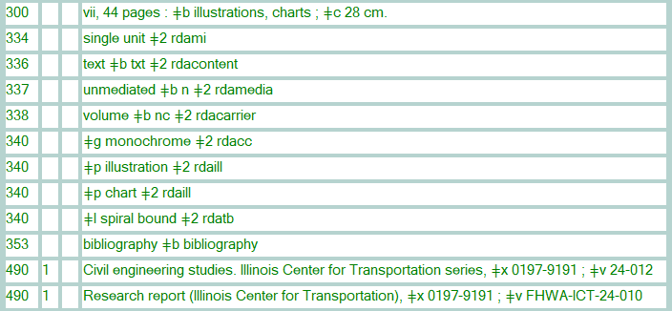
3xx to 4xx
Notes:
300 - note the . at the end of the field because of series.
This is part of a series which means that the ISSN goes in subfield x in both 490 fields. In the 490s, the x subfield comes before the v subfield
The report number is 24-010, but the series it is part of is 24-012
---------------------------------------------------------------------------------------------Extra notes below
Repeat subfield ǂx when ISSNs for both a series and subseries are recorded.
490 1 Lund studies in geography, ǂx 1400-1144 ; ǂv 101. ǂa Ser. B, Human geography, ǂx 0076-1478 ; ǂv 48
830 0 Lund studies in geography ; ǂv v. 101 ǂx 1400-1144
830 0 Lund studies in geography. ǂn Ser. B, ǂp Human geography ; ǂv v. 48 ǂx 0076-1478
Note: When an item contains an ISSN for the series, but lacks a series title, the ISSN is recorded in field 500.
500 "ISSN 0399-3388"

Slide 19
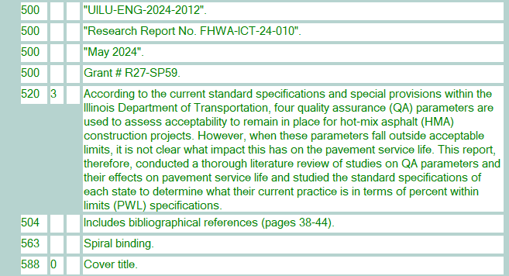
5xx
Notes:
500 (4 instances) - performing organizing report #, report #, report date, grant # add "" to record
520 – description – might be able to paraphrase and make it shorter and delete indicator 3
504 – makes note of the bibliography
563 – info about binding
588 – where I got the title info

Slide 20
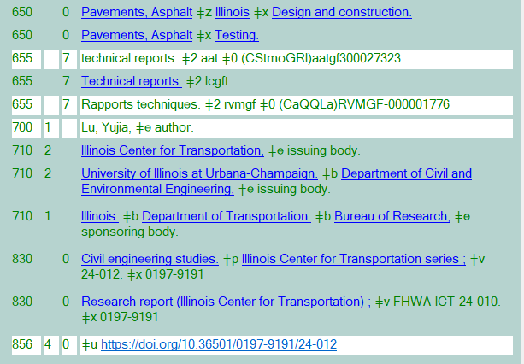
6xx to 8xx
Notes:
650 topical term
655 genre form
***the two genre terms that haven't been controlled were added by the system, not me***
700 – will have several instances depending on the number of authors
710 – issuing bodies and sponsoring body
830 – series info – both have ISSN in x subfield and x comes after v in this case. If you use MARC Report to double check your work, ignore the comments about field 830 needing a period at the end. When that field is controlled, the period disappears for some reason.
856 – Electronic location and access

Slide 21
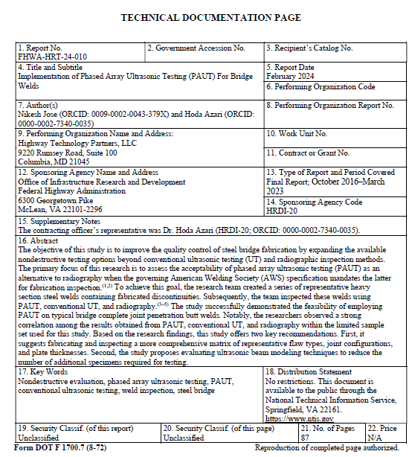
EXAMPLE 2
OCLC #1450302748 ish
Notes:
I chose this record because it has quite a few variations in the fields which I wanted to discuss. The reason why I have ish after the OCLC number for this example is that the record I found in OCLC is for the online version and not the print version (if a print version even exists). I decided to "create" a dummy record for the print document.

Slide 22
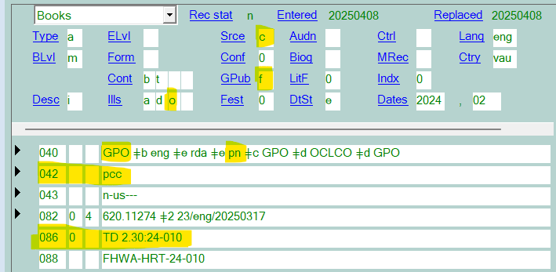
EXAMPLE 2
OCLC #1450302748 ish
Notes:
Srce is c because it was added by GPO which is a participant in pcc, a cooperative cataloging program. GPub is f for federal.
022 – I did not find an ISSN on the pdf of the record and this is not part of a series so there is no ISSN present in a 022, 490, 500, or 830 field.
040 - GPO ǂb eng ǂe rda ǂe pn - [Original cataloging by GPO, which uses RDA supplemented by the provider-neutral guidelines]
086 is in the record because the GPO had the SUDOC number at hand and put it in the record.

Slide 23
EXAMPLE 2
OCLC #1450302748 ish
record
Notes:
340 – this item has color illustrations, charts, and photographs. Note that the plural is not used in the 340s, but is used in the 300.
500 – The sponsoring agency code # was listed on the technical documentation page.
856 – There are two instances.

Slide 24
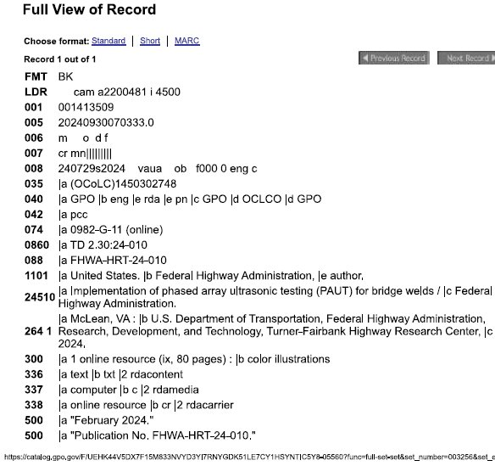
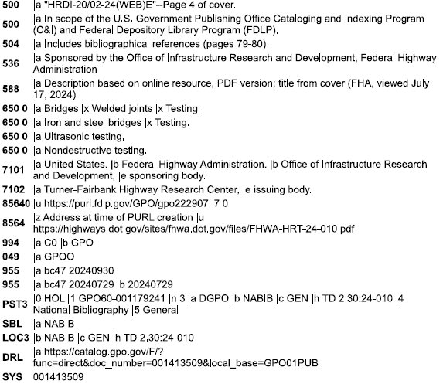
EXAMPLE 2 – CGP view
OCLC #1450302748 ish
https://catalog.gpo.gov
Notes:
This is the record as it appears in the CGP. Remember : this is a record for an online resource, not print.

Slide 25
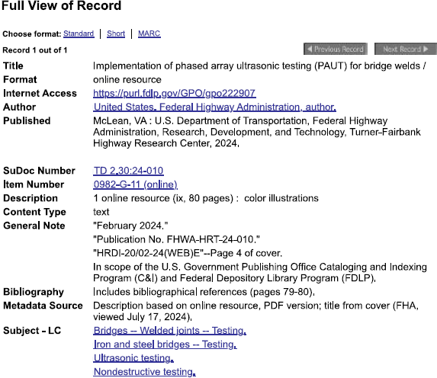
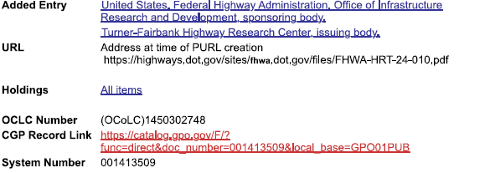
EXAMPLE 2 – CGP view
OCLC #1450302748 ish
Notes:
SuDoc No. TD 2.30:
Item No. 0982-G-11 (074 field)
Record No. 112758

Slide 26
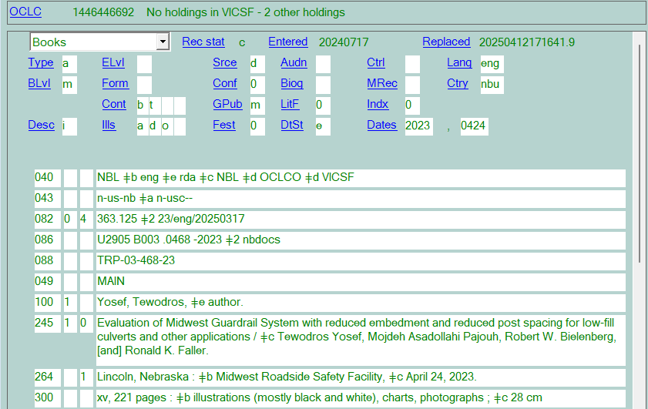
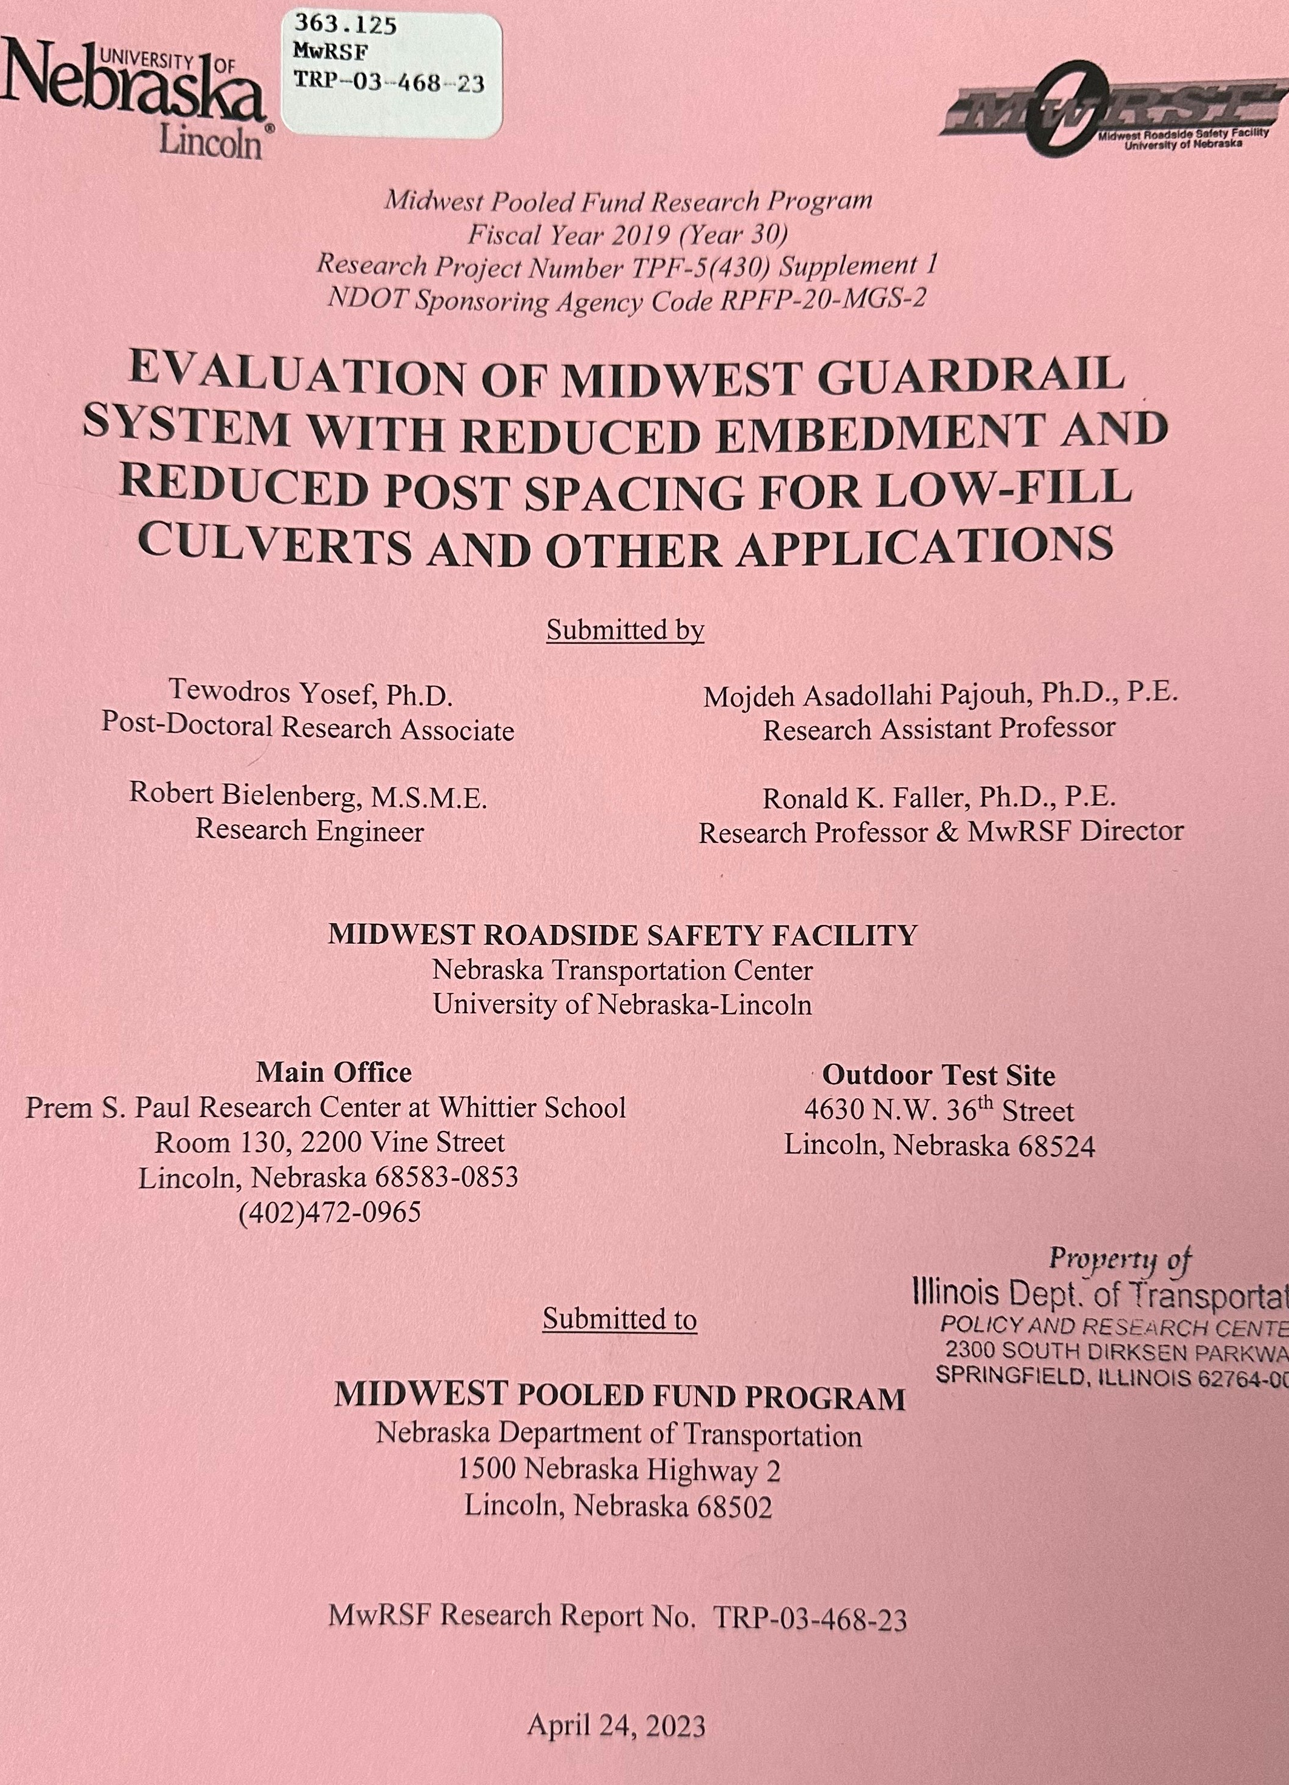
EXAMPLE 3
OCLC #1446446692
Notes:
Example 3 - 1446446692
Uses m for Multistate in GPub
DtSt - e
Dates – this has month, day, year
043 n-usc to denote the midwest
086 creator NBL added it so I left it there
264 – has the full date in subfield c
536 – ***no period at the end of the field***

Slide 27
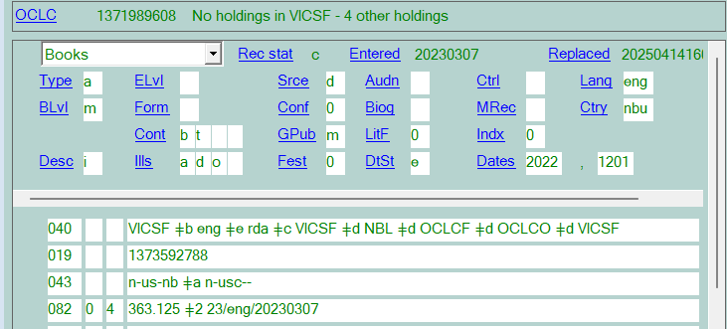
EXAMPLE 4
OCLC #1371989608
Notes:
Example 4 1371989608
m for Multistate in GPub
DtSt - e
Dates – this has month, day, year
043 n-usc to denote the midwest
513 – makes note that this is a final report

Slide 28
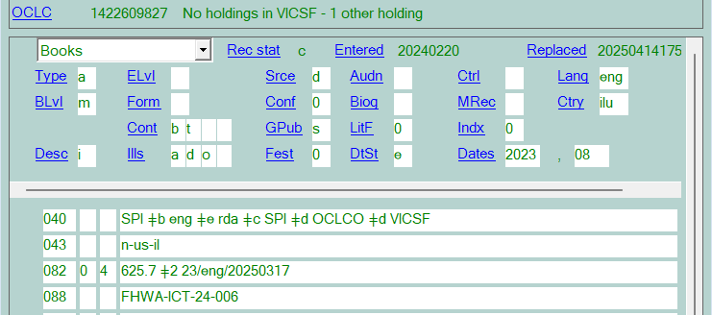
EXAMPLE 5
OCLC # 1422609827
Notes:
EXAMPLE 5
OCLC # 1422609827
082 – for most of the items that they send to me, IDOT already has this number on the spine label.

Slide 29
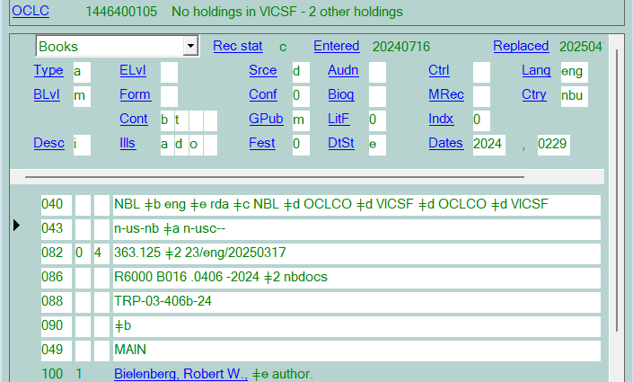
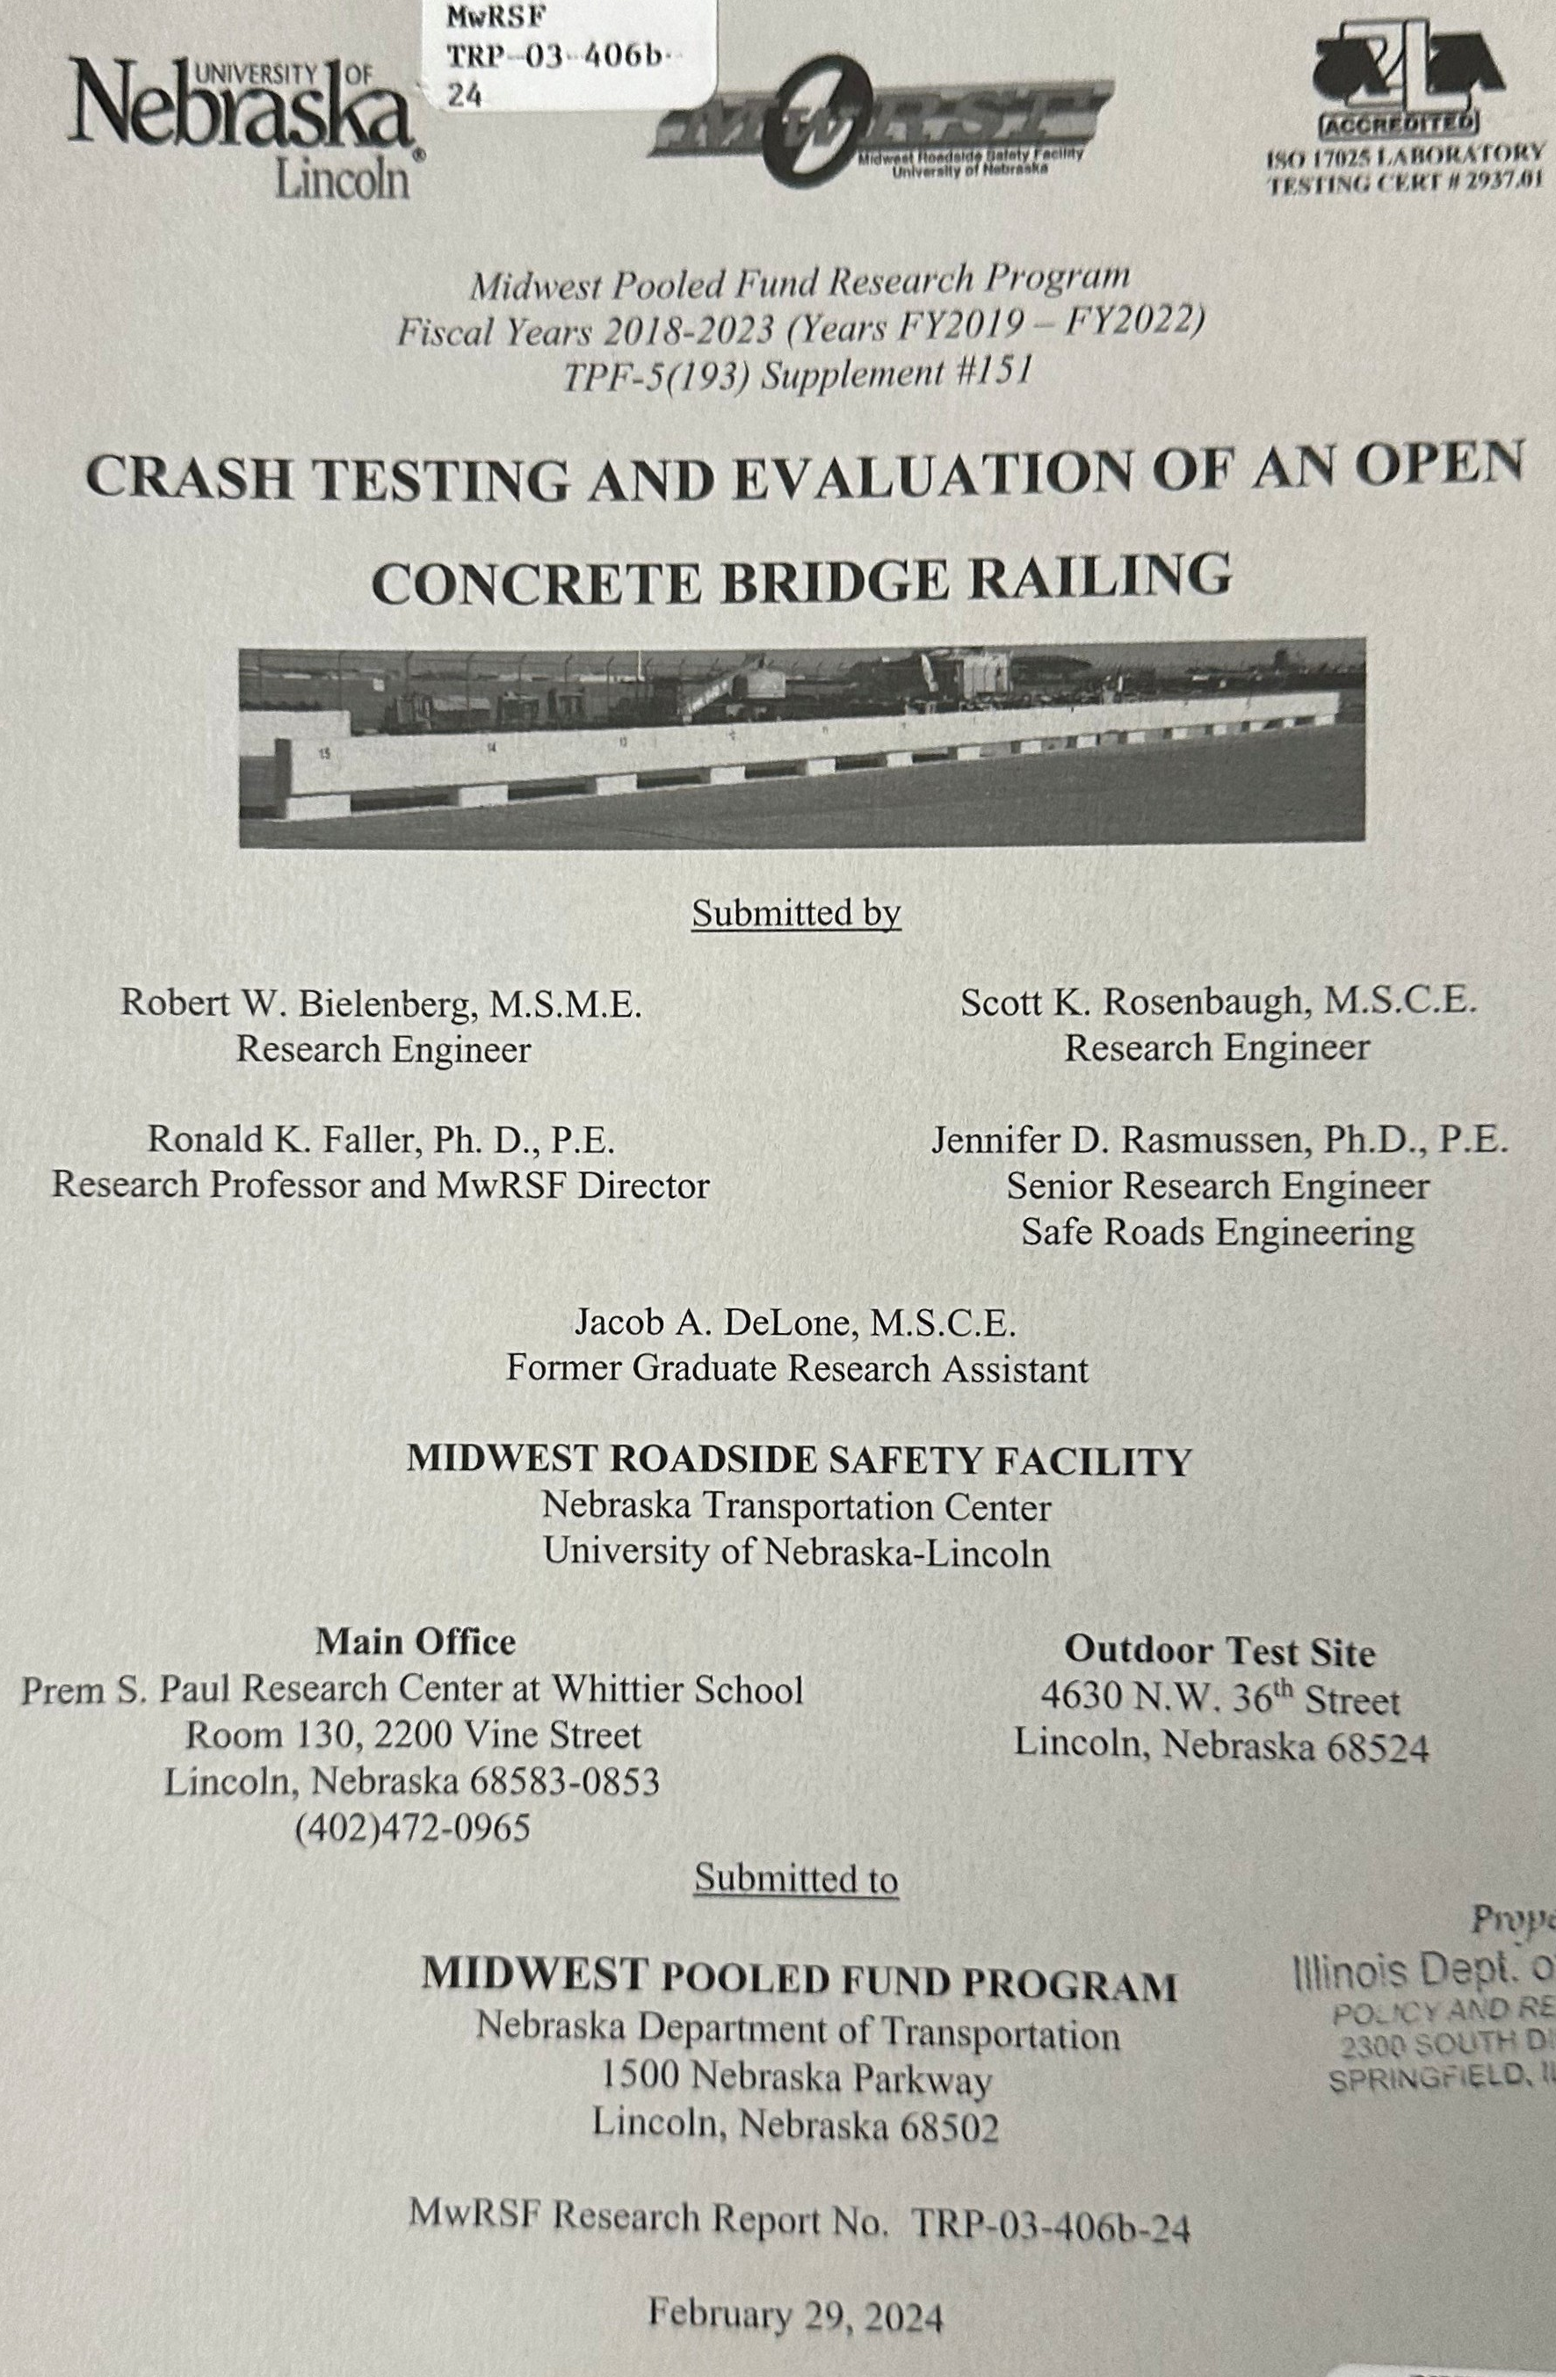
EXAMPLE 6
OCLC # 1446400105
Notes:
Example 6 - OCLC # 1446400105
Uses m for Multistate in GPub
Even typos can sometimes be controlled!!!

Slide 30
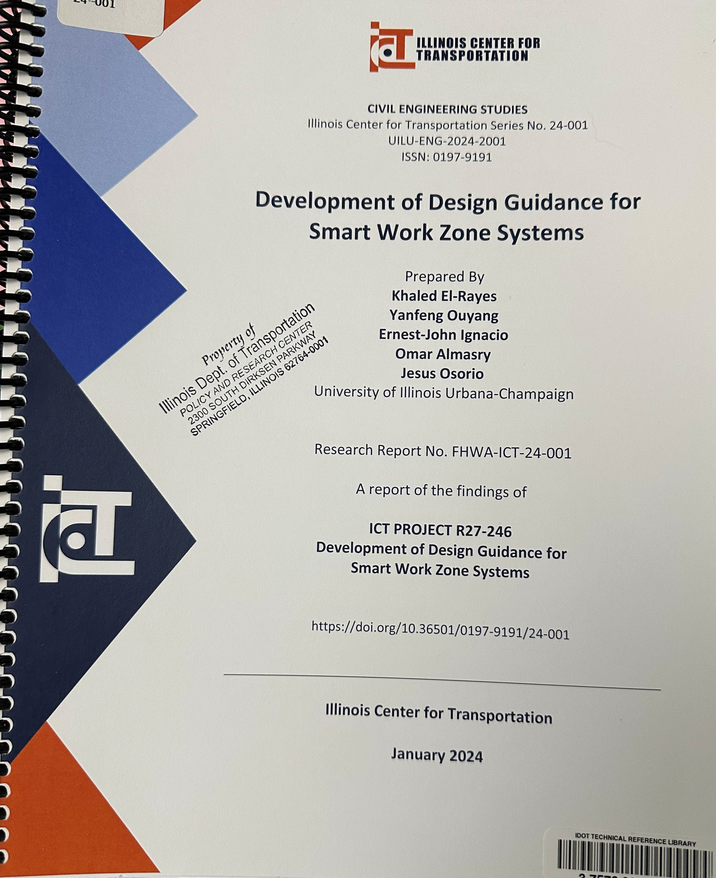
EXAMPLE 7
OCLC # 1455431348
Notes:
EXAMPLE 7
OCLC # 1455431348

Slide 31
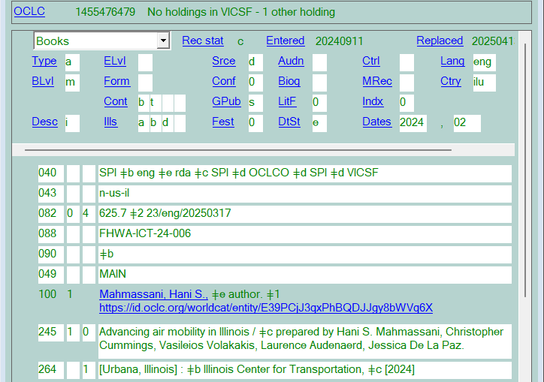
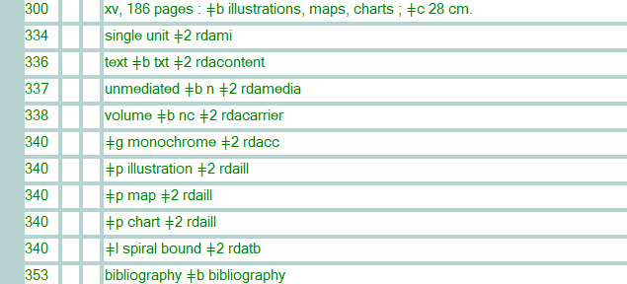
EXAMPLE 8
OCLC #1455476479
Notes:
EXAMPLE 8
OCLC #1455476479

Slide 32
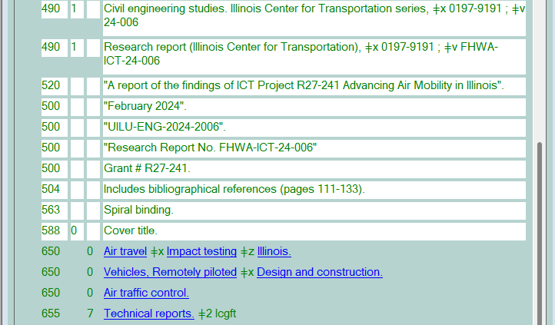
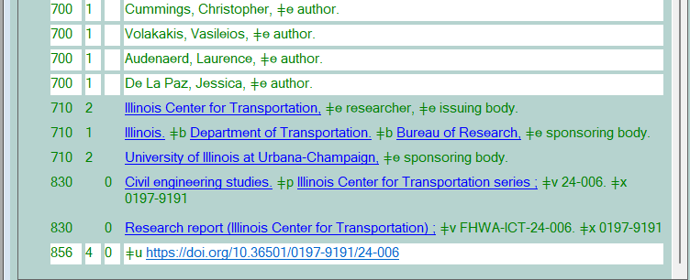
EXAMPLE 8
OCLC #1455476479

Slide 33
RESOURCES
https://www.ilsos.gov/departments/library/depository_programs/documentslist.html
https://www.oclc.org/bibformats/en/home.html
https://www.fdlp.gov/cataloging-and-classification/bibliographic-cataloging-overview
https://www.doi.gov/library/collections/federal-documents
https://libguides.fdlp.gov
https://godort.libguides.com

Slide 34
QUESTIONS?

Slide 35
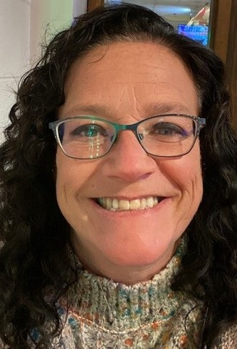
ON THE CALL TODAY​
Questions? Contact the CMC: cmc@illinoisheartland.org ​
Dr. Pamela Thomas​
Bibliographic Grant Manager – Our fearless leader.​
Barb Scoby​
CMC Cataloger - Presenter​
Mary Cornell​
CMC Cataloger
Kat Anderberg​
Metadata Cataloger
Ryan Rafferty​
Special Project Cataloger​
Katie Roberts​
Special Project Cataloger
Andrea Giosta​
Special Project Cataloger​

