Slide 1
Series
Linda Johnson, SHARE Cataloging Supervisor
Charlie Jorgenson, SHARE Cataloger
SHARE Cataloger’s Training Session
Tuesday, May 13, 2025

Slide 2
What is a series?
A group of related resources where each resource has an individual title proper.
Plus includes a collective title that applies to the group as a whole.
The parts of the series may or may not be numbered.

Slide 3
Examining a book to find series titles/phrases
Notes:
This is book with a wealth of series information: it appears on the title page (our preferred location), the cover, the spine, and a page listing the entries in the series. It also provides the sequence number of the item in the series!

Slide 4
What if the series appears in variant phrasing?
Notes:
The series phrase appears in three different variations: “A Steel Brothers Novel,” “Steel Brothers,” and “Steel Brothers Saga,” but as our preferred source is the title page, the variant we want is “Steel brothers saga,” which is indeed what appears in the series authority record. If there were no authority record and the series info were not on the title page, what would we put in the 490?

Slide 5
Creating Series Authority Records
In 2006 the Library of Congress decided they would no longer create or update series authority records (SARs).
The responsibility for series policy decisions and for series authority training now rests with PCC member institutions other than LC.
SHARE and the CMC have staff members trained to create SARs. Contact either if you are interested in having an SAR created.

Slide 6
MARC tag 490 - transcribed directly from item
MARC Bibliographic Records
First indicator 1 traced should have a corresponding 8XX field.
Good practice to click on the controlled title to make sure the series title is correct.
First indicator 0 untraced will have no corresponding 8XX field.
Good practice to search the authority file, if found change first indicator to 1 and add the appropriate 8xx with the series name as it appears in the 1xx.
Notes:
The information in the 490 is transcribed as it appears on the item. In the 8XX field it appears as it is listed in the SAR 1xx field.

Slide 7
490/440
MARC Bibliographic Records
440 field was used for series under AACR2 rules. If a record contains a 440 instead of a 490 do the following:
Change the 440 to 490.
Search the authority file to see if traced or untraced.
Untraced add a first indicator of 0.
Traced add a first indicator of 1 and add an appropriate 8XX field using the form of the name found in the 1XX field of the authority record.

Slide 8
Fixed fields in SARs
Notes:
I am going to cover a few of the fixed fields in SARs in the next slides.

Slide 9
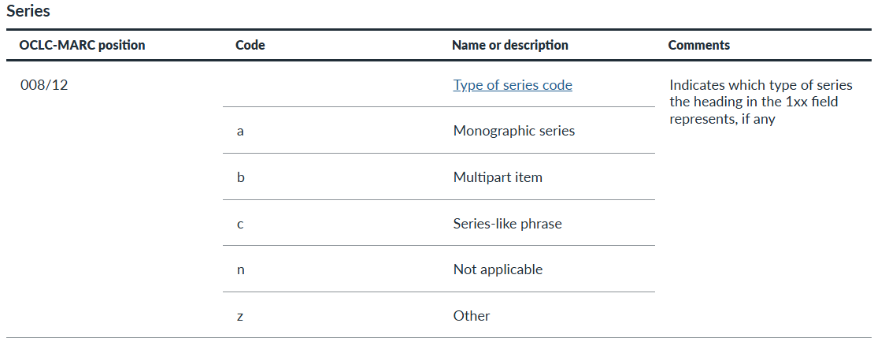

Slide 10
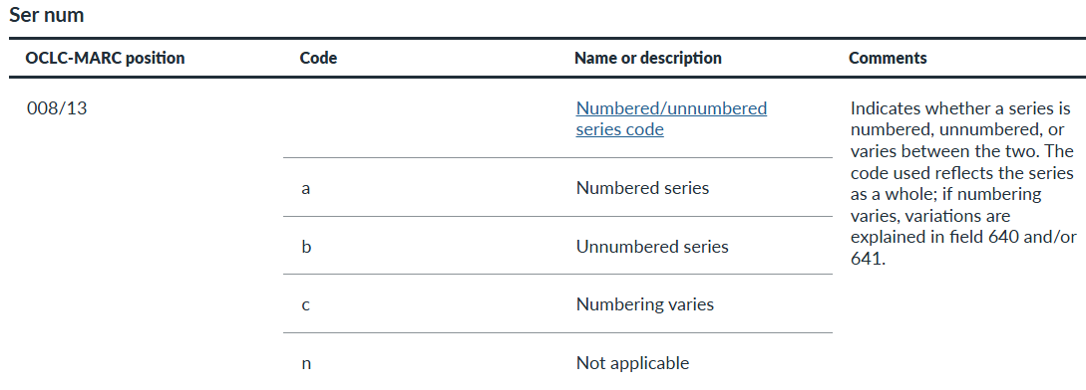

Slide 12
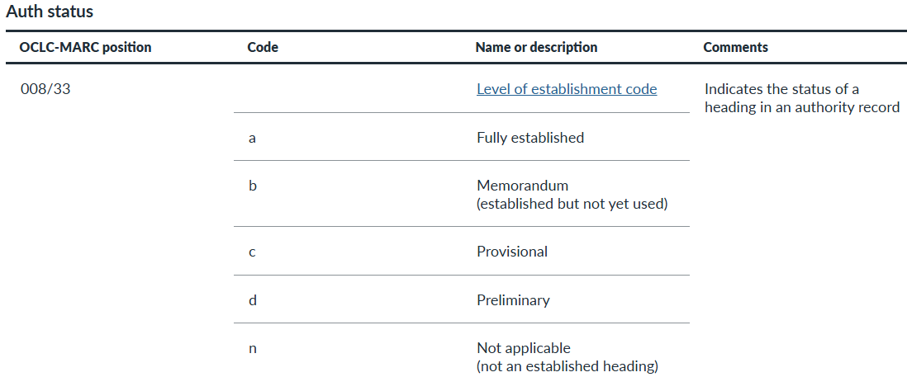

Slide 13
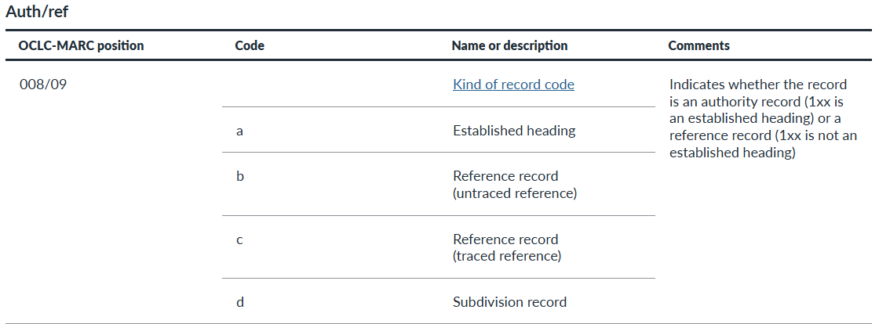

Slide 14
1XX fields: SAR to Bib Record View
SAR
Bibliographic record
100 1_ Bradley, Alan, ǂd 1938- ǂt Flavia de Luce mystery
110 2_ Village Jeweler (Firm). ǂt Jewelry care series
800 1_ Bradley, Alan, ǂd 1938- ǂt Flavia de Luce mystery.
810 2_ Village Jeweler (Firm). ǂt Jewelry care series.

Slide 15
1XX fields: SAR to Bib Record View
SAR
Bibliographic record
111 2_ Reaching Forward South Conference ǂd (2025 : ǂc Effingham (Ill.)). ǂt Reaching Forward South Conference series
130_0 Love finds you
811 2_Reaching Forward South Conference ǂd (2025 : ǂc Effingham (Ill.)). ǂt Reaching Forward South Conference series
830_0 Love finds you.

Slide 16
SAR: 642 Field
Series Numbering Example
Series numbering example that is to be followed in the sequential designation portion of a series added entry tracing in bibliographic records for individual issues of the series named in the 1XX field of an established heading record for a series.
Used only when a numbered series is to be traced in bibliographic records.

Slide 17
SAR: 645 Field
Series Tracing Practice
Code specifies whether the series is used as a series added entry or as an untraced series note in bibliographic records.

Slide 18
SAR: 667 Field
Nonpublic general note
Note that provides general information about a 1XX heading for which a specialized note field has not been defined.
Each distinct item of information is contained in a separate 667 field

Slide 19
SAR: 670 Field
Source Data Found
Citation for a consulted source in which information is found related in some manner to the entity represented by the authority record or related entities.
Each source citation is contained in a separate 670 field.

Slide 20
Types of series
Author/Title: Individual parts are by the same creator.
Example: Flynn, Vince,ǂd1966-2013.ǂtMitch Rapp novel.
May be searched in the authority file by author’s name or title.

Slide 21
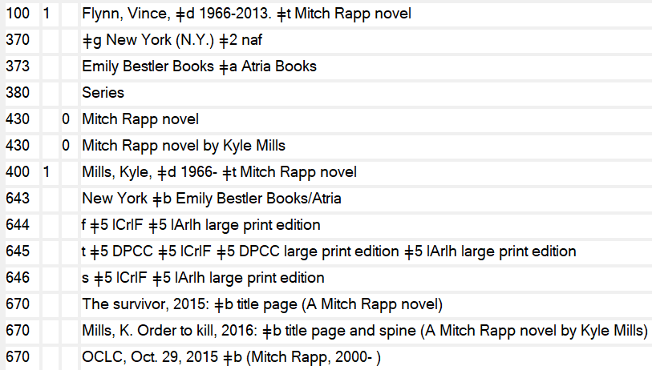
Author/Title
490 1_Mitch Rapp ; $v [11]
800 1_ Flynn, Vince, $d 1966-2013. $t Mitch Rapp novel.
Notes:
Notice that the 490 field has a $v [11], which was the cataloger’s decision to add the [11]. In the 8XX field it appears as it is listed in the SAR 1xx field with no number, as the series is not a numbered series in the SAR. We will see more about this in a few slides.

Slide 22
Types of series
Title: Individual parts are by different creators.
Example: Whistle Stop Cafe mysteries
May be searched in the authority file by title.

Slide 23
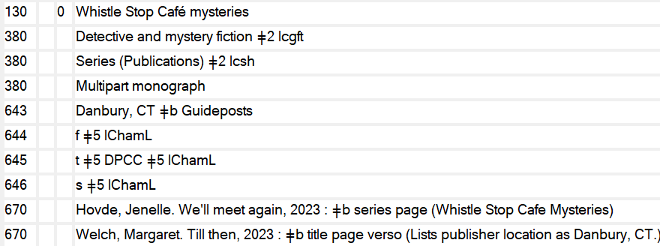
Title
490 1_ Whistle Stop Café Mysteries ; $v [bk. 9]
830_0 Whistle Stop Café mysteries.

Slide 24
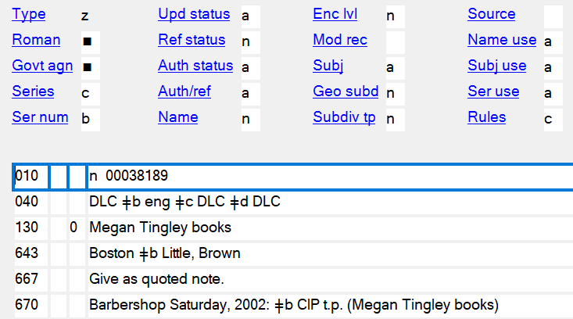
Series-like phrase: Appears on a resource but is not considered a series title
500_ _ “Megan Tingley books”--Title page.
Notes:
When you search the don’t just assume because it is listed that it can be used as an SAR. You must open the listing and read the notes.

Slide 25
Untraced series
490 0_ Golden friendly book
Notes:
This is a hard one for me to wrap my head around! When you look at the 645 field you will see “n” meaning not traced. Why would someone create an SAR for something that can not be used? The only thing I can think of is that it was being incorrectly being used as a series and someone decided to created an untraced SAR to keep people from using it. Once again, a good reason to read the SAR.

Slide 26
Numbered vs unnumbered series
Numbered series
Unnumbered series
Fixed field - Ser num “a” means the series is numbered.
Field 642 - shows the format used in numbering the series.
Fixed field - Ser num “b” means the series is unnumbered.
Field 642 - not present.

Slide 27
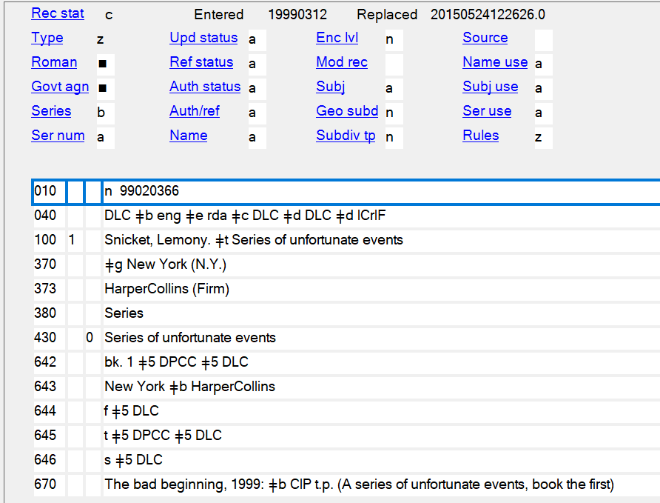
Numbered series
490 1_ Series of unfortunate events ; $v book 5
800 1_ Snicket, Lemony. $t Series of unfortunate events ; $v bk. 5.
Notes:
645 field has a t means traced series, then use form of series name in the 100 field in 800. 100/800 130/830. 642 field for numbering, tells the form of numbering to use in the MARC record. Fixed fields: Series b means multipart item. Ser num “a” means the series is numbered.

Slide 28
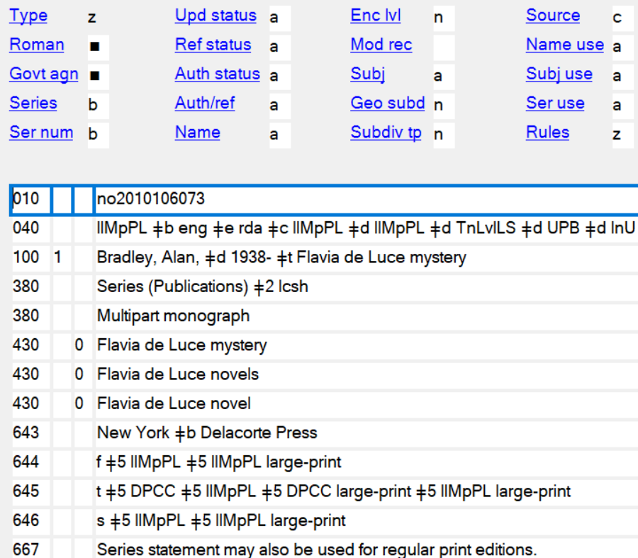
Unnumbered series
490 1_ A Flavia de Luce novel ; ǂv bk. 9
800 1_ Bradley, Alan, ǂd 1938- ǂt Flavia de Luce mystery.
No 642 field present.

Slide 29
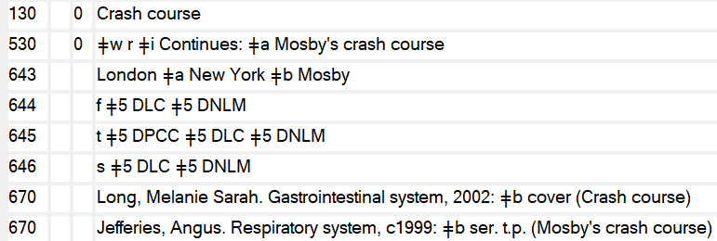
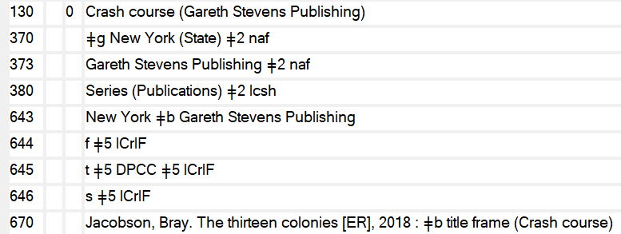
Qualified series vs Unqualified series
Series statement on the book Crash course, published by Gareth Stevens Publishing.
Notes:
Qualified by specific publisher, place, etc. Usually because the names is generic enough that there needs to be a way to distinguish between them. If qualified with added info in the 1XX field, it can only be used for items in that series by that specific publisher. If unqualified in the 1xx field, read notes in the SAR to see if it is appropriate for your item.

Slide 30
Qualified series vs Unqualified series
Unqualified
Qualified
490 1_ Crash course
830 _0 Crash course
490 1_ Crash course
830 _0 Crash course (Gareth Stevens Publishing)
Notes:
The 490 field is as it appears on the item. The 8XX fields are as they appear in the authority record.

Slide 31
Audiobook authority records
For audiobooks in a series, you will usually find one series authority record for those works, whether the format is a print book or an audiobook.
However, some series have an authority record specifically for audiobooks

Slide 32
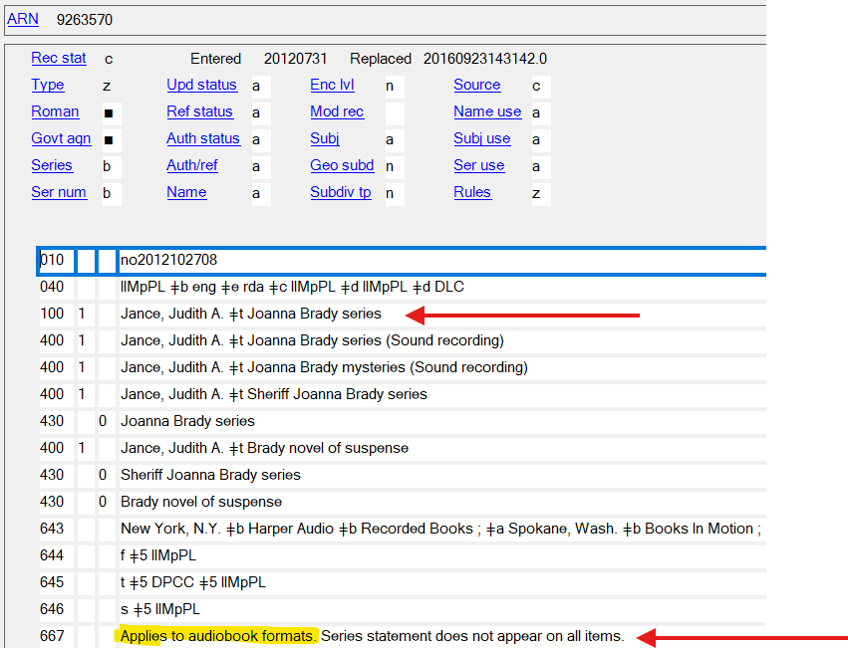
Audiobook authority records
Some audiobook series authority records may not specifically state in the 100 $t that they are audiobook series, but rather you must check the 667 to see if the scope of that record is applied to audiobooks.
It’s not necessary to add an 8xx $s Spoken word to audiobook records, but if it appears in a traced series authority record, we will leave it.

Slide 33
Questions?

