Slide 1
The Power of a Name: Examining the Importance of Authority Records
Mary Cornell, CMC Cataloger
Online with the CMC: May 8, 2025
Notes:
Hello all! Welcome to Online with the CMC. As mentioned, today we will be talking about The Power of a name : examining the importance of authority records. I am your presenter, Mary Cornell.

Slide 2
Agenda
Previously on …
Vocabulary lesson
What is an authority record?
Components of an authority record
Types of authority records
Fields in an authority record
Sources
Notes:
Our agenda today includes several items. We will initially look at Previously on, then have a very brief vocabulary lesson, speak on what an authority record is, take a glance at components in an authority record, define the different types of authority records, list out some basic fields that can be found in authority records, and then I will mention my sources.

Slide 3
Previously on…
Getting Serious About Series: https://youtu.be/TfezJ5WJslE
By Any Other Name:
https://youtu.be/pnuZWP191iA
Online with the CMC Videos:
https://www.youtube.com/playlist?list=PLFY6RqmxIgRHFVRKOlFenIexJL2BCTfHs
Notes:
Before we get into our webinar, I just wanted to point out a couple of past webinars that get into specific types of authority records. Firstly, we have Dr. Pam Thomas’ “Getting serious about series,” which talks a great deal about the formation of series in general but also looks at series authority records. Second, we have my presentation from, what feels like another lifetime ago, “By Any Other Name: NAF: Name Authority File Ins and Outs,” which looks extensively at different kinds of name authority records including personal names, corporate names, and family names. We are planning in the future looking at more specific types of authority records, but this webinar today is a very brief 101 essentially. And lastly, if you are ever looking for our back catalog of Online with the CMC trainings, they can be found in the playlist link, that does include a few non-Online with the CMC videos, at the bottom of the slide.

Slide 4
Vocabulary Lesson
PCC
SACO
NACO
SACO Funnel
NACO Funnel
Notes:
To start our vocabulary lesson, let’s look at some acronyms.
PCC- The Program for Cooperative Cataloging – “is an international cooperative effort aimed at expanding access to library collections by providing useful, timely, and cost-effective cataloging that meets mutually-accepted standards of libraries around the world.” The PCC has four programs it fosters: BIBCO, CONSER, NACO, and SACO. We won’t be looking at the first two, because they deal more with bibliographic records.
SACO - The Subject Authority Cooperative Program (SACO) enables member institutions to submit proposals for additions to Library of Congress Subject Headings (LCSH), Library of Congress Children's Subject Headings (CYAC), Library of Congress Genre/Form Terms (LCGFT), Library of Congress Demographic Group Terms (LCDGT), Library of Congress Medium of Performance Thesaurus for Music (LCMPT), and Library of Congress Classification (LCC) schedules. The proposals submitted to these different vocabularies can be additions (new headings), changes to current headings, or deletion of current headings.
NACO (Name Authority Cooperative Program) - Through this program, participants contribute authority records for personal, corporate, and jurisdictional names, uniform titles, and series to the LC/NACO Authority File. Membership in NACO is open to individual institutions willing to support their staff through a process of training, review, and direct contributions of records to the LC/NACO Name Authority File. NACO participants also make changes to existing records within certain parameters. To contribute to NACO, you must either be a part of a PCC Library or work with a Funnel that you can contribute through.
NACO Funnel - A NACO funnel project is a group of libraries that have joined together to contribute name authority records to the national authority file. Frequently, funnel members create records in modest numbers and consolidate their efforts to make a more significant contribution in terms of quantity.
SACO Funnel - A SACO funnel is a group of libraries (or catalogers from various libraries) that have joined together to contribute subject authority records for inclusion in the Library of Congress Subject Headings. Funnel participants may work in the same subject area.
I am part of two SACO/NACO Funnels. I am part of the SACO Funnel for Gender and Sexuality, and I am also a part and co-coordinator of the SACO/NACO Occult and Esoteric Funnel. I also create and update NACO records for the CMC.

Slide 5
Vocabulary Lesson Cont.
Qualifier
Tag
Variable Data Field
Subfield codes
Notes:
Qualifier: An addition to an access point or variant access point to further clarify its identity or to make it unique in the database.
Tag: Each field is associated with a 3-digit number called a "tag."
Variable Data Field: The variable data fields are grouped into blocks according to the first character of the tag, which with some exceptions identifies the function of the data within the record. The type of information in the field is identified by the remainder of the tag. 0XX Standard numbers, classification numbers, codes, 1XX Headings (established and unestablished), 2XX Complex see references, 3XX Complex see also references, 4XX See from tracings, 5XX See also from tracings, 6XX Treatment decisions, notes, 7XX Linking entries, 8XX Alternate graphics, and 9XX Reserved for local implementation. These fields may seem like MARC Bibliographic fields but are very different.
Subfield code: Subfield codes are one lowercase letter (occasionally a number) preceded by a delimiter. A delimiter is a character used to separate subfields.
We’ll have some more terms as we go along, but these are some frequently used terms I wanted to let you all know about.

Slide 6
What is an Authority Record?
An authority record is created for the standardized form of a name or term.
Notes:
According to the Library of Congress, an authority record is: “created for the standardized form of a name or term. This form is sometimes called the authorized, authoritative, or established form. On the authority record the standardized form is the key element for which the record was made, so it is also called the heading.” OCLC adds on “An authority record contains information about a name, a uniform title, or a topical subject heading. Each authority record may contain the established form of the heading, see from references, see also from references, and notes. The record also contains coded data that describes the characteristics of the heading or record.” To translate this to bibliographic records, these authority terms would be found in your 1XX fields, 240, 65X fields, and 7XX fields. These records are your authors, subject headings, genre terms, illustrators, and much more! They bring records together, keep records by creators with similar names that are separate creators apart, provide instructions on how to use a term, and give references. I’ve got a couple of examples in the slide, showing just the authorized form of some terms. The first is the authorized term for Champaign, Illinois. Champaign is a 151 field because it is a geographic name, and it uses (Ill.) in the parentheses as that is the authorized form for Illinois used as a qualifier. Our second example is for the actor Nick Offerman, Joliet native and probably most well known in my personal bubble as Ron Swanson on Parks and Recreation. He is also a U of I alum. His name, like many personal names, is authorized as last name, first name, with a qualifier of his year of birth, 1970.

Slide 7
What is an Authority Record?
Authority records contain three basic pieces:
Heading
Cross references
Notes
Notes:
According to the Library of Congress: “An authority record includes three basic components:
1) Headings, 2) Cross references, and 3) Notes. 1) Heading: We saw this in the last slide, this is another name for an authorized term. The standardized "authoritative" form of a name, subject, or title that is used for access points on bibliographic records. The purpose of using standardized names and subjects on bibliographic records is to help related records be retrieved together.
2) Cross references: References that direct a user from a variant form of a name or subject to the authoritative form (this is called a see reference) or from one authoritative form to another authoritative form because they are related to one another (this is called a see also reference). For MARC authority records, the references are carried or "traced" on the record for the authoritative heading.
3) Notes: Notes that contain general information about standardized headings or more specialized information, such as citations for a consulted source in which information is either found or not found about a heading.”
I have three examples for this. First, we have two examples of a cross reference. The first cross reference is a “see” cross reference for Champaign. As you can see, the qualifier of Ill. isn’t formulated the same way as the authorized heading, so this a variant. The second is a “see also” cross reference of “West Urbana (Ill.),” which is another authorized heading that is linked to Champaign. This was the historical name of Champaign in the mid-1800’s and items were published about the area under this name hence it is also an authorized form. Our last piece ‘notes’, which in authority records falls between the 667-68X fields, is shown in an example of a 667 field from West Urbana (Ill.)’s authority record. This field is called a non-public note field and for the authority record example, it informs catalogers that the authorized heading West Urbana should not be used as a subject. There are several historical headings where you will find similar notes in their authority records, which is why it is imperative to look through records’ notes before utilizing them in bibliographic records.

Slide 8
Components of an Authority Record
The leader
The directory
The variable fields
Notes:
Next, we are going to look at components of an authority record. The leader: The Leader provides information required for the processing of a record. The data elements contain numbers or coded values and are identified by relative character positions. The Leader is 24-character positions long and is the first field in a MARC 21 authority record.
The Directory is a series of entries that contain the tag, length, and starting location of each variable field within a record. Each Directory entry is 12-character positions in length.
Variable fields are identified by a three-character numeric tag that is stored in the Directory entry for the field. It is important to note that there are two types of variable fields. Variable control fields are the 00X fields. Although these fields are identified by a field tag in the Directory, they contain no indicator positions or subfield codes. Instead, they may contain either a single data element or a series of fixed-length data elements identified by relative character positions. The 008 field, for example, is referred to as Fixed-Length Data Elements, or Fixed Field Codes. Variable data fields, on the other hand, contain two indicator positions stored at the beginning of each field and a two-character subfield code preceding each data element within the field.
I know this sounds like a lot of very technical information because it is, but I am going to give you examples of the leader and variable fixed fields in the next couple of slides and we’ll look at more variable fields later on. The directory is coded within the two other components, so we won’t dive deeper into that.

Slide 9
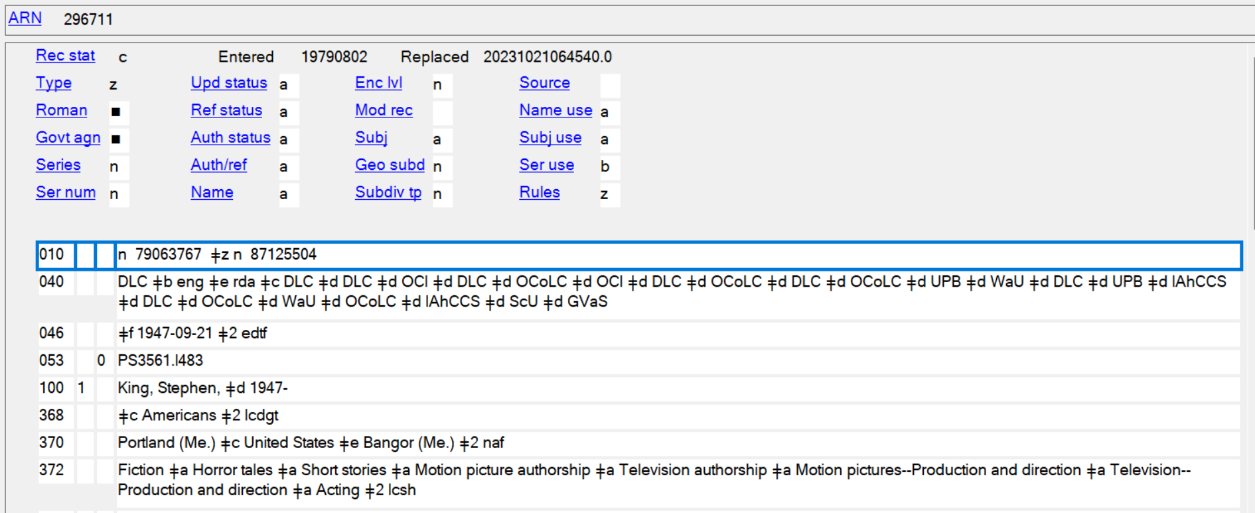
The Leader
Notes:
Of note, some of the elements of an authority record leader are unseen because they are either defined at a deeper computing level, think for instance being able to see the data of elements of a website in XML (much like the directory components), or they are undefined. I am going to speak particularly to elements that can be viewed in the authority record. Our example I am using for these components is from the name authority record for author Stephen King.
So firstly, we’re looking at Record Status, which I have highlighted in yellow in the upper left corner. There are several statuses you find in this field. They include: a - Increase in encoding level, c - Corrected or revised, d – Deleted, n – New, o – Obsolete, s - Deleted; heading split into two or more headings, and x - Deleted; heading replaced by another heading. Looking at this record, we see that the rec status is – c, which means it has been corrected or revised. You can also see this in the 040 field, by the additions of a subfield d. Those additions indicate any time the authority record has been updated.
Next, we have type of record, which is highlighted in green. The code of ‘z’ tells us this is an authority record.
The encoding level is highlighted in blue. An encoding level can either be coded as o - for an incomplete authority record or n - for a complete authority record, as this record is coded.

Slide 10
Fixed Field Elements
Notes:
We are going to look at the variable control fields or the fixed field elements in an authority record. The first field is the 001/010, which is highlighted in orange. This is the “control number assigned by the organization creating, using, or distributing the record.” In this instance with Stephen King, his control number is 79063767. The other number in this field is a separate name authority record that was merged into this one.
Next, we have, the 003, or the control number identifier also highlighted in orange. This is the “MARC code for the agency whose system control number is contained in field 001/010 (Control Number).” In this record, this is the ‘n’ before the number, which marks this record as a Library of Congress created control number. Another example of this in a subject authority record, it would be ‘sh’ at the beginning of the 010 field which would mark the record as a Library of Congress subject heading.
The 005 field is the Date and Time of Latest Transaction. This can be seen at the top of the record highlighted in light purple. This shows “sixteen characters that specify the date and time of the latest record transaction and serve as a version identifier for the record.” To break it down in our example, this shows the latest version was updated, October 21, 2023 at 6:45:40 AM.
Lastly, we have the fixed-length data elements, which would be in the ‘008’ field in a bibliographic record, though they are different components in an authority record. There is a huge list of different elements you can find in a record, which is included in my resources list. I am going to look at the fields available in Stephen King’s record. These are all highlighted in pink.
As an FYI, if you ever question what you should put in any of these fixed field elements, you can always click the text next to the field and it will take you to a list of authority record formats for each field.
Type – this is always z, as z codes the record as an authority record.
Roman – This is the Romanization scheme. This would only include a code if the 1XX was in non-Latin script, otherwise it is coded blank.
Govt agn – This is government agency. If the heading is the name of a body created or controlled by a government, a one-character code denotes the jurisdictional level of the body. You may see this if say this were a country name or part of a city government. The Library of Congress always codes this as blank. However, it can also be coded as I - International Intergovernmental, f - Federal/National, a - Autonomous or semi-autonomous component of Malaysia, s - State, provincial, territorial, dependent, etc., m - Multistate, c - Multilocal, l - Local, z - Other, o - Government agency-type undetermined, u - Unknown if heading is for government agency. It is blank in this record, as Stephen King is not part of a government agency.
Series - Indicates which type of series the heading in the 1XX field represents, if any. These are coded as a - Monographic series, b - Multipart item, c - Series-like phrase, n - Not applicable, z - Other.
Series Numbering- This is straightforwardly whether a series is numbered or unnumbered. This can also include if a series started out as unnumbered but became numbered later in the series or vice versa. These are coded as – a - Numbered series, b - Unnumbered series, c - Numbering varies, n - Not applicable.
Ref Status- Indicates whether references have been evaluated and whether those references are consistent with the heading. These are coded as a - Tracings are consistent with heading, b - Tracings are not necessarily consistent with heading, n - Not applicable. I will show what references are in Stephen King’s record in the next slide as it is coded as ‘a’ in his record. This means there are references in his authority record and they correlate with his name, whether through sources, etc.
Geo Subd- Indicates whether the 1XX heading can be subdivided geographically. These are coded as blank - Not subdivided geographically, i - Subdivided geographically-indirect, and n - Not applicable. Personal names like Stephen King’s cannot be subdivided geographically, but names like geographic names, unsurprisingly can.
Name use - Represents the author aspect of the heading. These are coded as either a - Heading appropriate for main or added entry or b - Heading not appropriate for main or added entry. As this is an author record, it would be coded as a. All subject authority records would be coded as b.
Ser use- Represents the series aspect of the heading. Like name use, there are two options here either a - Heading appropriate as series added entry or b - Heading not appropriate as series added entry. Commonly, you would only find this as ‘a’ in a series authority record or possibly a name/title record.
Lastly! Rules-Represents the cataloging rules used for establishing the name, name/title, or uniform title heading in the 1xx field. The options for this are: a - Earlier rules, b - AACR1, c - AACR2, d - AACR2 compatible heading, n - Not applicable, z - Other. The most common codes you would see in an authority record are either c, as many authority records were created in AACR2 and z which is the code used for RDA based records. Now, if you’re updating a record say today, you would change this code to ‘z’, if it isn’t already, as you should be updating a record to RDA standards.

Slide 11
Fixed Fields Cont.
Notes:
This is to give you all a visual of what ‘Ref Status’ refers to. For Stephen King’s record, we’re looking at the 4XX fields, the see fields, and the 5XX fields, the see also fields. The 4XX fields are variant identities. For Stephen King, these are his name in other languages as seen on expressions of his works, ranging from Hebrew to Russian and more. The 5XX fields look at other authority records that Stephen King is associated with. For instance, the alternate identity of Richard Bachman, as referenced in the name linked at the end of this field, is a pseudonym King wrote under for a number of years. The corporate body, Rock Bottom Remainders (Musical group) references a musical group that King is a member of. For all 5XX fields, you would find Stephen King’s name included in a 5XX field as well, linking the records to one another. The last 500 field included is what you find in the record for Richard Bachman, linking the two.

Slide 12
Types of Authority Records
Subject
Name
Uniform Title
Series
Notes:
There are four types of authority records.
Subject authority records: A subject heading may be a single term, phrase, or a group of terms. The tag for the subject is based on the first term or phrase in the heading -- topic, genre/form, geographic, chronological, personal name, corporate name, meeting name, or title.
Name: A name heading may be a personal, corporate, meeting, or jurisdiction (including geographic) name.
Uniform Title: A uniform title heading consists of a title not associated with a particular author (creator). It can include titles for works such as films, television shows, etc.
Series: This is also known as a name/title record and consists [commonly] of both a name and a title of a work. The name portion contains a personal, corporate, meeting, or jurisdiction name. The title portion contains the title by which an item or a series is to be identified for cataloging purposes. Series titles also can be attributed to publishers, imprints, etc.
I am going to show you an example of name, subject, uniform title, and series authority records on the next few slides.
Lastly, as relayed earlier, we do have a very thorough presentation about name authority records and series authority records available if you want to dig deeper into those.

Slide 13
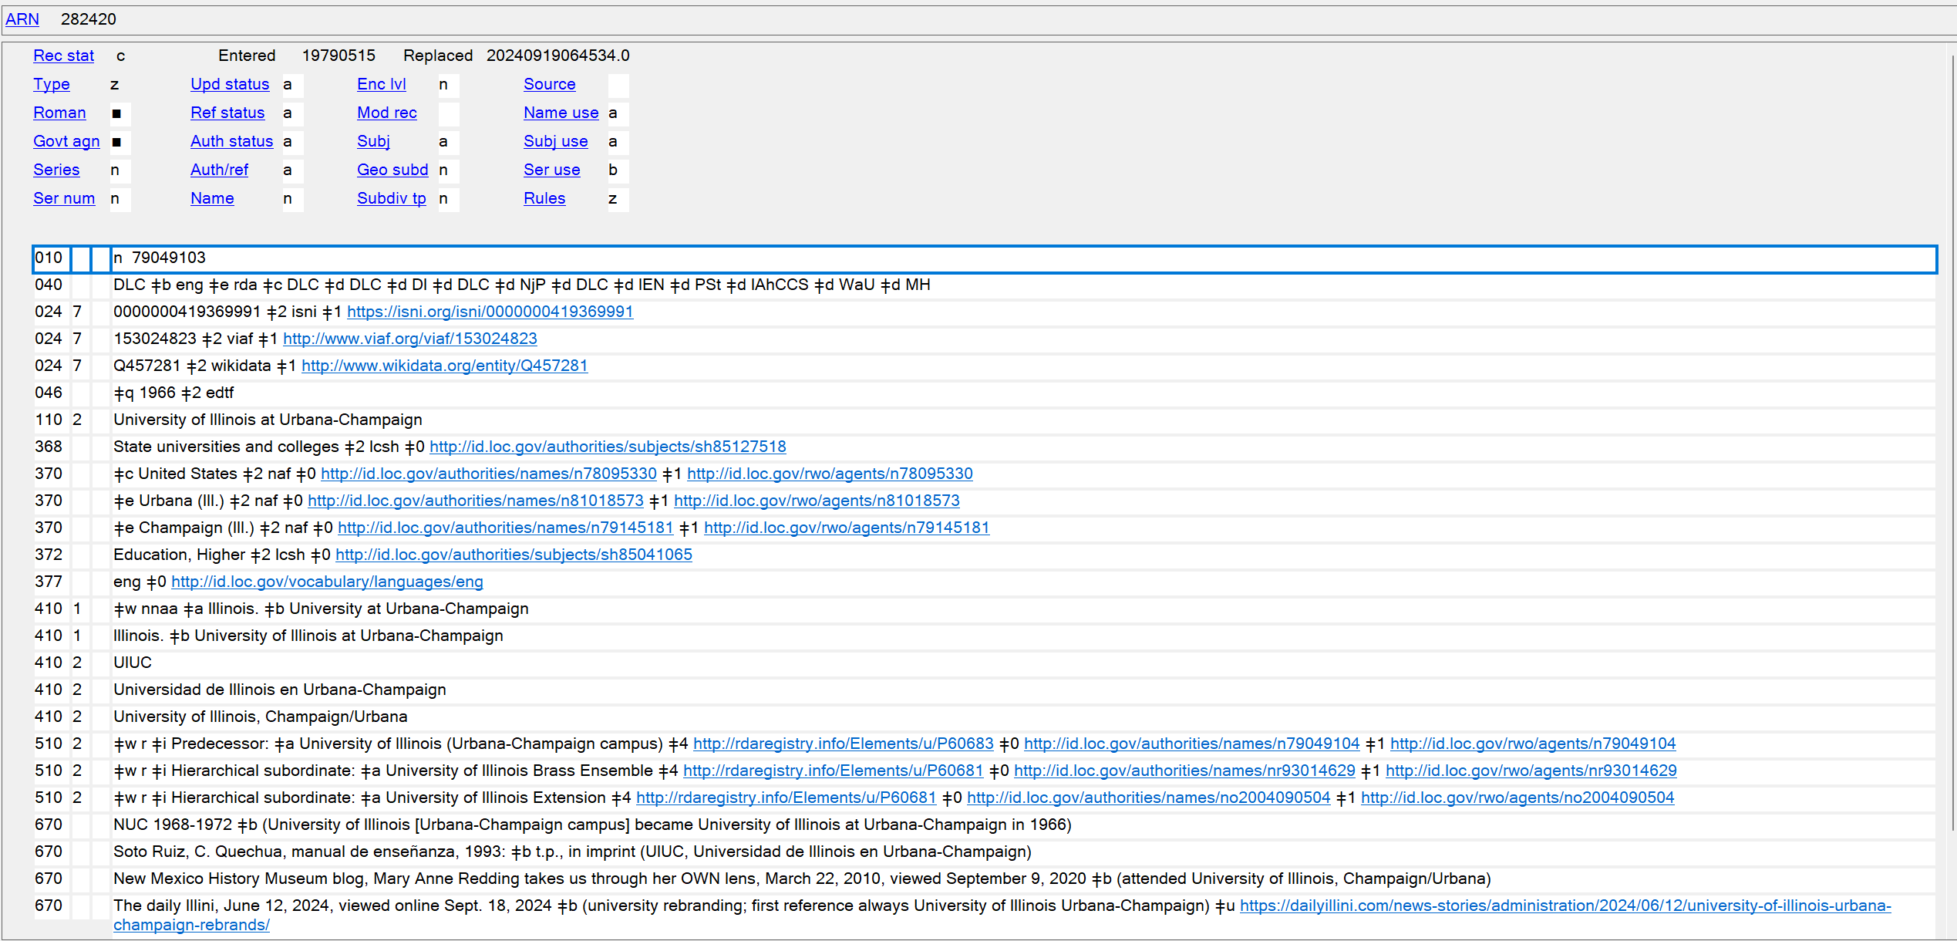
Name Authority Record
Notes:
Name authority record: You will find these headings in a 100/110/111/151/700/710/711 field in an authority record, or a 100/110/111/600/610/611/651/700/710/711 in a bibliographic record. Our example here is a corporate name authority record for University of Illinois at Urbana-Champaign. Corporate headings are 110 fields in both authority records and can be in bibliographic records. As you’ll see in the 410 and 510 fields, there are not only different variants of this name, but also in the first 510 we see a previous name that the university was known under, “University of Illinois (Urbana-Champaign campus).”

Slide 14
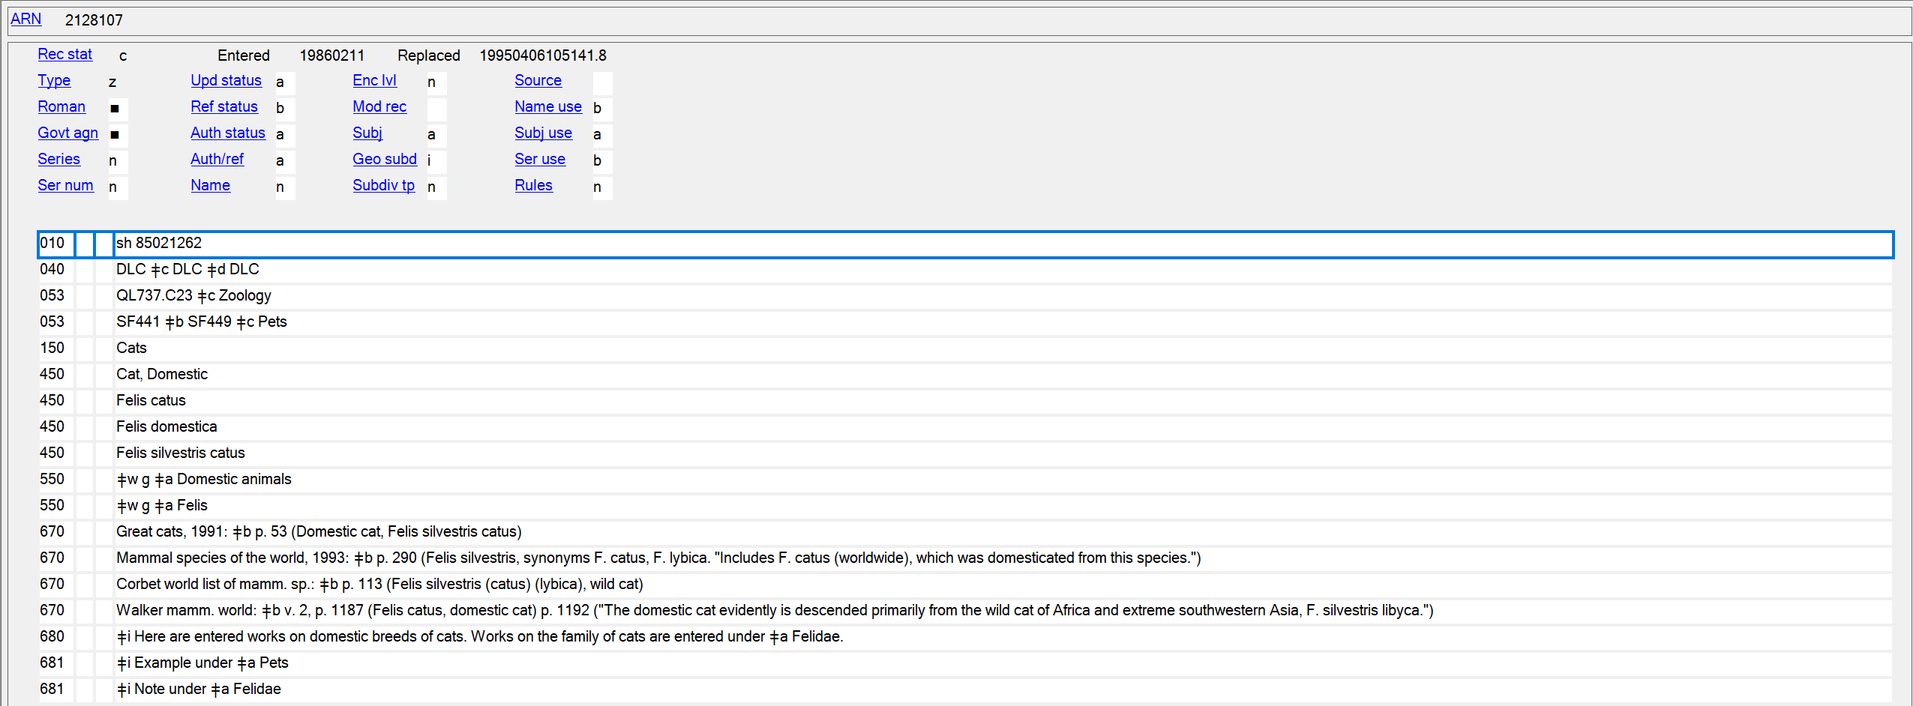
Subject Authority Record
Notes:
Subject Heading Authority Record: Our example here is a topical subject heading authority record for cats. Much like in the name authority record, there are variant names in the MARC 450 field, mainly looking at the Latin classification for cats, and there are 550 MARC fields as well. Both 550s are broader terms for cats.

Slide 15
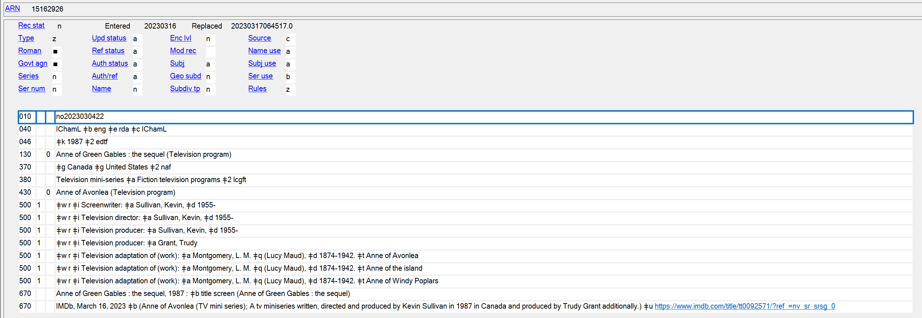
Uniform Title
Notes:
Uniform title authority record: I want to look at a few fields in our example record Anne of Green Gables : the sequel. Firstly, I wanted to point out the 430. If you’re like me and grew up watching this miniseries, Anne of Avonlea was mainly what it was called, however, from looking at the disc label, the title screen, and DVD artwork, the title proper should be as we see it established here. This is further supported by the last three 500’s in this record that show this miniseries is an adaptation of three of Montgomery’s novels: not only Anne of Avonlea, but also Anne of the island and Anne of Windy Poplars. It does make it more difficult to consider this title when even IMDb calls it Anne of Avonlea … but I would like to believe the work itself should be what we use as our source of heading (and PCC agrees!)

Slide 16
Series Authority Record
Notes:
Series authority record: Our example here is the for series The Jane Austen Society mystery series. First and foremost, if any of you like cozy mysteries set in England, with folks who like Jane Austen, the answer is yes, you should give this series a try. Also, of note in this record are the 400s, which lists the alternate name of C. E. Lawrence, which is another pseudonym the author writes under, but also a 400 with the name Carole Buggé, which is the author’s real name. I also want to point out the 64X fields, which are fields specific for series authority records. We’ll look at them in more depth later on.

Slide 17
0XX Fields
Library of Congress number:
Geographic Area Code:
Special Coded Date:
LC Classification Number:
Notes:
Next, we’re going to look at the variable fields in a record. Firstly, we are going to look at the 0XX fields, which are the numbers and code fields. We won’t be covering every possible field you could use in this range and every range following, but we’ll look at the most commonly used across authority records. If you want to follow along and have access to the slides already, you can find these different fields in the link for Marc 21 Format for Authority Data.
Our first field is the 010, or the Library of Congress field - Unique number assigned to a record by the Library of Congress (LC) or cooperative cataloging partner contributing authority records to the Name Authority Cooperative Program (NACO) database. The field is also assigned to records created by LC for the Library of Congress Subject Headings (LCSH). Our example for this comes from the authority record for the country England. What is interesting about this record, is firstly we have ‘n’ which tells us the authority record is a name record, followed by an LC number. It also includes in a subfield z ‘sh’ which stands for subject heading authority record and an LC number for that. The subfield z tells us that England’s authority record was originally created as a subject heading authority record but was changed to a name authority record.
Second, is the 043 field or the Geographic Area Code field - Geographic area codes (GAC) associated with the 1XX heading in an established heading record or a subdivision record. Source of the code in subfield $a is MARC Code List for Geographic Areas. More precise identification of geographic areas associated with a geographic name heading may be contained in field 052 (Geographic Classification Code). Subdivision records would be often found in subject headings, so think about when you’re creating a topical or geographic subdivision when you’re cataloging. Our example for this also comes from the England authority record and breaks down as e - Europe, uk - United Kingdom, and en - England. This field is found most commonly in geographic name heading records and subject heading subdivision records but can be used in other records as well.
Third, we have the 046 field or Special Coded Dates field - Dates that are associated with the entity described in the record. These include: For a person: a person's date of birth, date of death, and the date or date range of the person's period of activity. For a corporate body: a date or range of dates on which a conference, etc., is held, or a date with which the corporate body is otherwise associated (e.g., date of establishment, date of termination, period of activity). For a family: a significant date associated with the family. For a work or expression: see subfield $k (Beginning or single date created). The date and time are recorded according to Representations of Dates and Times (ISO 8601) in the pattern yyyy, yyyy-mm, or yyyymmdd (4 for the year, 2 for the month, and 2 for the day) unless subfield $2 (Source of date) specifies another date scheme. Our example shows the birth and death dates of Jane Austen. Her birth dates are in subfield f, her death dates in subfield g, and then the field is closed out with subfield 2 of edtf, which stands for extended date/time format.
Lastly, we’re looking at the 053 field or LC Classification Number field - Single LC classification number or a number span associated with a 1XX heading in an established heading record or a subdivision record. Source of the classification number is Library of Congress Classification and/or the LC Classification Additions and Changes that are maintained by the Library of Congress. The hyphen (-) between the two class numbers in a range of numbers may be generated based on the presence of both subfields $a and $b. This field is more often utilized in subject heading authority records but can also be found in name authority records. Our example for this is the 053 field of Jane Austen. As was described in the last sentence of the definition of the field, Jane Austen’s classification is created in a range. This range includes not only her works, but also her correspondence, and literary criticism about her works.

Slide 18
1XX Fields
Personal Name:
Uniform Title:
Topical Term:
Geographic Name:
Notes:
For our next set of fields, we’re going to look at five more fields in the 1XX fields.
Our first field is the 100 field or Heading-Personal Name field - Our example is of Jane Austen, that includes 100, with a first indicator of 1, which lets us know the name starts with a surname in the order of last name, first name, hence Austen, Jane. This is followed by a comma and a qualifier of Austen’s life span, from her birth year of 1775 to her death year of 1817.
Second, is the 130 field or Heading-Uniform Title field - In an established heading record, field 130 contains the established form of a uniform title. In a reference record, this field contains an unestablished form of a uniform title. Going along with our slight Jane Austen theme, the example is for the 2005 motion picture adaptation of Jane Austen’s novel Pride & Prejudice. The first indicator is blank, the second indicator is ‘0’ as there are no non-filling characters (as you would see if this started with ‘the’ or ‘a’). Then it is the title of the film with (Motion picture) to differentiate that this is a motion picture and also includes the year, as there have been multiple film adaptations of Pride & Prejudice, so this allows for specification for the particular title record.
Third, is the 150 field or Heading – Topical Term field - In records for references and node labels, this field contains an unestablished form of a topical term. Our example for this is the topical term Social classes. 150s have both indicators as undefined, so those are blank. Then we have our topical term Social classes in a subfield a.
Lastly, is the 151 field or Heading-Geographic Name field – “Geographic name used as a heading in an established heading record, an established heading and subdivision record, a traced or an untraced reference record, or a reference and subdivision record.” Our example of this is the geographic name heading for Dublin, Ireland. This is set up as Dublin with Ireland in parentheses as a qualifier. The qualifier is necessary for Dublin as there are multiple Dublin counties and Dublin cities that exist.

Slide 19
3XX Fields
Other Attributes:
Associated Place:
Associated Language:
Form of Work:
Notes:
Next, we are going to look at the 3XX fields or General Information about the Headings fields. There is a single 2XX field in authority records, the 260 field, Complex See Reference – Subject field. I have personally never seen it in an authority record and couldn’t find examples of it. If you’re curious, do go hunt it out! These fields provide information about geographic location, areas of interest, associated places, etc. that tell us more specifics about a heading, including some historical information. I also want to note one field that I am not going to look at an example of, is for any authority record, particularly personal name records, the 375 field per The PCC Committee update of Friday, April 15th, 2022 stated “Do not record the RDA gender element (MARC 375) in personal name authority records. Delete existing 375 fields when editing a record for any other reason.”
First, we’re looking at the 368 field or Other Attributes of Person or Corporate Body field - Any attribute that serves to characterize a person or corporate body or that may be needed for differentiation from other persons or corporate bodies and for which separate content designation is not already defined. For a person: Can include designations of rank or honor or office of a person or other attributes. For a corporate body: Can include designations indicating the type of corporate body or jurisdiction, or other attributes. Continuing with Jane, the authority record includes attributes of Jane having been English and a Briton. The 368 does not include indicators, the attributes are included in a subfield c, as these other attributes. A subfield 2 of lcdgt is included as this vocabulary came from the Library of Congress Demographic Group Terms. I also to note that with Jane Austen while both attributes included are true, as far as we know Jane never lived outside of England, so including the narrower term English alone would have sufficed for this record.
Second, we’re delving in the 370 field or the Associated Place field - A place associated with persons, corporate bodies, families, works, and expressions. For a person: the place associated with a person's birth, death, residence, and/or identity. For a corporate body: a significant location associated with a corporate body (e.g., location of a conference, etc., location of the headquarters of an organization.) For a family: a place where the family resides or has resided or has some connection. For a work or expression: the place from which a work or expression originated. Field 370 should be repeated when start and end periods in subfields $s and $t pertain to a different associated place. I feel like we’ve been looking at England and Jane Austen a lot, so let’s step back to our friend Stephen King for this field. The 370 field doesn’t include indicators. In subfield a, we have that Stephen King was born in Portland, Maine (which is what Me. stands for.) Then in the subfield c is an associated country of the United States. Lastly, in subfield e, we have King’s place of residence, which is Bangor, Maine. This is followed by a subfield 2 of naf, which means that all of these field terms are geographic authority records in the name authority file = naf.
Third, we are looking at the 377 field or the Associated Language field - Codes for languages associated with the entity described in the record. Includes the language a person uses when writing for publication, broadcasting, etc., a language a corporate body uses in its communications, a language of a family, or a language in which a work is expressed. As both of our authors used so far wrote in English, I decided to look up another name. Our example is for author Gabriel Garcia Marquez, most popularly known for his novel, 100 Years of Solitude, and his primary language for publication was Spanish, as seen above. The 377 has no indicators, includes the code ‘spa’ for Spanish and then a subfield 0 that links this field to the authority record for Spanish.
Our last 3XX field is the 380 field or the Form of Work field - A class or genre to which a work belongs. May be used to differentiate a work from another work with the same title. Multiple forms of work from the same source vocabulary may be recorded in the same field in separate occurrences of subfield $a (Form of work). Terms from different source vocabularies are recorded in separate occurrences of the field. We are going back to our example of the 2005 Pride & Prejudice film adaptation. In the 380, this shows an example of the multiple forms of work. All of these terms in the 380 are LCGFT or Library of Congress Genre and Form Terms. They include Motion Pictures, Romance Films, Film Adaptations, Fiction Films and Feature Films. And if some day someone wants to make the term ‘Films of manners’ styled after the ‘Novels of Manners’ used for Regency fiction, I am sure that could be included as well.

Slide 20
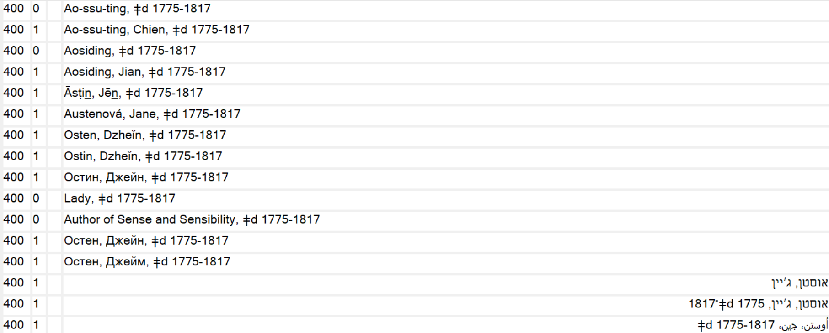
4XX Fields
Notes:
Next, we are going to look at 4XX fields, which are See From Tracing fields. These include variants of the authorized 1XX field.
First, we have the 400 field or See From Tracing for Personal Names field - Tracing for a personal name see from reference. These are the 400 fields for Jane Austen. As you can see, most of these are the see from references for her name in other world languages. However, they also include a couple of alternate names Jane may have been known under such as Lady, 1775-1817 and Author of Sense and Sensibility, 1775-1817.

Slide 21
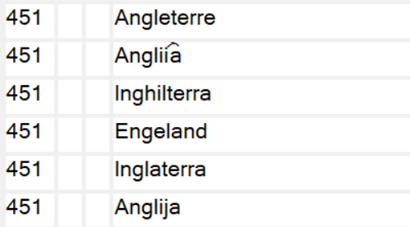
4XX Fields Cont.
Topical Term:
Geographic Name:
Notes:
Second, we are going to look at the 450 field or the See From Tracing Topical Term field - Tracing for a topical term see from reference. Our example is from Social classes. This looks at other terms that you might want to use as a cataloger but are referenced under Social classes. These are Class distinction, Classes, Social, and Rank.
Lastly, we’re looking at the 451 field or the See From Tracing Geographic Name field - Tracing for a geographic name see from reference. Like the terms for Jane Austen, these include terms for England in other world languages and also a different spelling of England as Engeland.

Slide 22
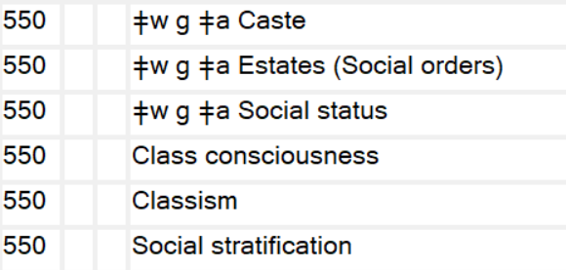
5XX Fields
Personal Name:
Topical Term:
Notes:
So, for our 5XX fields, we’re going to look at the same fields we did for the 4XX fields. These will be a little different though, because these fields point to other authorized headings, not just variant names.
Firstly, we have the 500 field or the See Also From Tracing Personal Name field - Tracing for a personal name see also from reference. We’re going to jump to another author, because we did talk briefly about Stephen King’s 500 fields already and Jane Austen doesn’t have any. These are the 500 fields for Anne Rice. One of them is the pseudonym that Anne wrote romantic and erotic fiction under, Anne Rampling. The other is also a name that Anne wrote erotica under in the 1980’s, A.N. Roquelaure. The subfield w in these fields breaks down as: n-not applicable, n-not applicable, n-not applicable and c-Reference not displayed, field 663 used. So, this record would include a 663 field that explains these references.
Second, we’re looking at the 550 field or the See Also From Tracing Topical Term field - Tracing for a topical term see also from reference. The difference between this field and the 450 is these are terms that are authorized and can be used in bibliographic records. We have two types of terms here. The first three 550s are broader terms or BTs. They start with a subfield w, which is a control subfield, with a code of ‘g’ which marks them as broader terms. The last three are related terms or RTs that could be used as well if they meet the needs of your record.

Slide 23
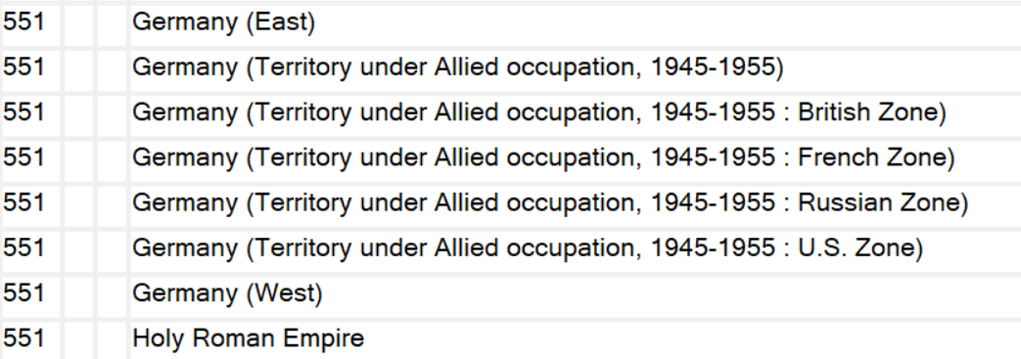
5XX Fields
Geographic Name:
Notes:
Lastly, we have the 551 field or See Also From Tracing Geographic Name field - Tracing for a geographic name see also from reference. For this example, I looked for a complicated one. These are the 551 fields for Germany. As you can see by looking at the different fields, these are all historic names. We have Germany (East) and Germany (West) from the Cold War. There are different zones of Germany from post WWII. Then, we also have the 551 from when Germany was a part of the Holy Roman Empire. I’ll explain a bit more about these different fields and how you as a cataloger might utilize them when we look at the 6XX fields.

Slide 24
6XX Fields
64X fields:
Notes:
There are three different areas of the 6XX fields in authority records, the 64X, the 66X, and the 667-68X.
First, we have the 64X fields, which are fields that help set up tracing for series. Fields 640-646 contain information concerning the treatment of a 1XX series heading when that heading is used in bibliographic records. Other series treatment information is contained in the fixed-length data elements of field 008 and in link, standard number, and call number fields in the 01X-09X fields. Our example for these fields is the 64X fields for the series authority record of the Jane Austen Vampire trilogy by Michael Thomas Ford. The 643 is the series place and publisher. In the subfield a, it notes this series is published in New York and in subfield b, it notes that the publisher is Ballatine Books. In the 644 field, is the series analysis practice. One-character alphabetic code that indicates a specific organization's analysis practice for a series named in the 1XX field of an established heading record for a series. This is coded as f to denote a full analysis. The organization in the subfield 5, is the MARC code for IHLS as a cataloging agency, IChamL. The 645 is the series tracing practice. One-character alphabetic code that indicates a specific organization's tracing practice for a series named in the 1XX field of an established heading record for a series. This series is coded as a ‘t’ in the a subfield, which denotes that it is traced as a series added entry. Lastly, the 646 is the series classification practice, or the one-character alphabetic code that indicates a specific organization's classification practice for a series named in the 1XX field of an established heading record for a series. This series is coded as s, which denotes that volumes are classified separately.

Slide 25
6XX Fields Cont.
66X Fields:
Notes:
Second, we have the 66X fields. The one field I want to point out for sure is the 663 field or the Complex See Also Reference-Name, as we ran into this with Anne Rice. This is “Explanatory text and the headings referred to that are required when relationships exist between an established name and other established names that cannot be adequately conveyed by one or more simple cross references generated from 5XX See Also From Tracing fields.” As you can see in the example above, this field essentially spells out what we saw in the 500s. In the subfield a it relays” “For works of this author written under other names, search also under” and then in the two subfield b’s the two authorized names are included.

Slide 26
6XX Fields Cont.
667-68X Fields:
Notes:
Lastly, we have the 667-68X fields or the Notes fields. We are going to look at the two most common fields for this range.
First, we have the 667 field or the Nonpublic General Note field - Note that provides general information about a 1XX heading for which a specialized note field has not been defined. Information may be permanent or temporary and may or may not be written in a form that is adequate for public display. Each distinct item of information is contained in a separate 667 field. General note for public display is contained in field 680 (Public General Note). The two big notes for Germany include the first which explains the different 551 fields in the record and their historic context. The second 667 field gives guidance on how to use Germany as a heading, but also how to use the other authorized terms in the record while cataloging.

Slide 27
6XX Fields
667-68X Fields:
Notes:
The second field we are going to look at here is what I feel personally as someone who works with authority records is the second most important field in an authority record and that is the 670 field or Source Data Found field. Citation for a consulted source in which information is found related in some manner to the entity represented by the authority record or related entities. May also include the information found in the source. Each source citation is contained in a separate 670 field. Citations and information in this field are often not written in a form adequate for public user display. Essentially this field is imperative when creating any authority record because it sets up your case so to speak on why the authority record is important enough to be created and where all the information in the rest of your record is coming from source wise. Our example is for a name authority record I created to replace a subject authority record for Brigit, who is a Celtic goddess. The source at the bottom is from the original subject authority record. The other three sources include information that is found in the rest of the record from the 370 to the 400’s, and even the 368 field. In the subfield a for each source is the source itself. In the subfield b is the information taken from the source mentioned in subfield a. The subfield u is the URL for the website of the source or where the source was found.

Slide 28
7XX Fields
Established Heading Linking Entry, Personal Name
Notes:
Most of the 7XX fields are linking fields. As per MARC 21: “The 7XX Heading Linking Entry fields provide a machine link within a system between equivalent or hierarchical headings whether they are structured in the same or different form, are from the same or different authority files or printed thesauri, or whether they exist as separate authority records. The inclusion of a linking entry field in an established heading or established heading and subdivision record for a name, name/title, uniform title, topical term, form term, or extended subject heading or in an established heading record for an authorized subject subdivision.” We’re going to look at one of the linking fields to give you an idea of how these are utilized.
700 Established Heading Linking Entry – Personal Names - Personal name heading that is equivalent to the heading contained in the 1XX field or the same record. It links headings within a system or from different thesauri or authority files. Our example is from MARC 21 and looks at how a children’s name/title heading varies from the LC name heading. The 700 children’s heading will point back to the official name heading in the 100.

Slide 29
8XX Fields
Electronic Location and Access:
Alternate Graphic Representation:
Notes:
For our last set of fields, I will admit I was surprised to see these mentioned in authority records, as I think often we find these two examples more in bibliographic records. The 8XX fields are “Fields 856, 857, 880, 883, 884, and 885 are the only 8XX fields defined in the MARC 21 authority format at the present time. For the most part, these fields carry over the definitions found in the other MARC 21 formats.” The definition agrees with me! We are going to look at two 8XX fields that I see most often.
Firstly, the 856 field or the Electronic Location and Access field – This field is “information needed to locate and access electronic information. The field may be used in an authority record to provide supplementary information available electronically about the entity for which the record was created. The phrase "networked electronic resource" is used to refer to an electronic resource for which content is accessed using a network protocol like telnet, http, ftp, etc.” It is a repeatable field. Our record is looking at the Library of Congress Copyright Office. The 856 has a first indicator of 4 relaying that “Access to the electronic resource is through the Hypertext Transfer Protocol (HTTP).” The field for the web address starts with a ‘u’ subfield, relaying that this is a URI or uniform resource identifier, which “provides standard syntax for locating an object using existing Internet protocols or by resolution of a persistent identifier (PID). Field 856 is structured to allow for the creation of a URL from the concatenation of other separate 856 subfields. Subfield $u may be used instead of those separate subfields or in addition to them.”
Second, the 880 field or the Alternate Graphic Representation field – This field is “full content-designated representation, in a different script, of another field in the same record. Field 880 is linked to the associated regular field by subfield $6 (Linkage). A subfield $6 in the associated field also links that field to the 880 field. The data in field 880 may be in more than one script.” The most frequent usage I have seen of this field is in a world language record with non-Latin script. The example does also speak to this, as it is showing a Russian name and the associated 880 with Cyrillic script (not pictured). The first subfield of 6 relays that the 880 is linking to the 100 field and the a and q subfields in the 880 are relaying that these subfields are the same as the associated fields in the 100.

Slide 30
Resources
Authority record format. https://help.oclc.org/Metadata_Services/Authority_records/Authorities_Format_and_indexes/Get_started/10Authority_record_format#Subj_use
Authority records. https://help.oclc.org/Metadata_Services/Authority_records/Authorities_Format_and_indexes/Get_started/20Authority_records
Control subfield w character positions in the 4XX and 5XX fields. https://help.oclc.org/Metadata_Services/OCLC_MARC_records/Content_designators_for_authority_data/Control_subfield_%E2%80%A1w/Control_subfield_%E2%80%A1w_elements
Marc 21 Format for Authority Data https://www.loc.gov/marc/authority/
Notes:
And here are my resources!

Slide 31
Resources
PCC (Program for Cooperative Cataloging). https://www.loc.gov/aba/pcc/
PCC NACO Participants’ Manual, 4th edition. https://www.loc.gov/aba/pcc/naco/documents/NACOParticipantsManual.pdf
PCC SACO Participants Manual, 2nd edition, revised. https://www.loc.gov/aba/pcc/saco/documents/SACOManual2007.pdf
Subdivision Authority Records https://www.loc.gov/catdir/cpso/subdauth.html
SHARE. Library of Congress Authority Records. https://librarylearning.org/system/files/2021-04/Introduction%20to%20Authority%20Records.pdf
Understanding MARC Authority records. https://www.loc.gov/marc/uma/pt1-7.html#:~:text=An%20authority%20record%20is%20created,is%20also%20called%20the%20heading.
Notes:
I want to point out that if this presentation doesn’t feel extensive enough, one of my sources, SHARE’s Library of Congress Authority Records also exists and is 80+ slides long.

Slide 32
ON THE CALL TODAY
Questions? Contact the CMC: cmc@illinoisheartland.org
Barbera Scoby
CMC Cataloger
Dr. Pamela Thomas
Bibliographic Grant Manager
Mary Cornell
CMC Cataloger
Eric McKinney
CMC Cataloging Trainer
Kat Anderberg
Metadata Cataloger
Ryan Rafferty
Special Project Cataloger
Katie Roberts
Special Project Cataloger
Andrea Giosta
Special Project Cataloger
Notes:
On the Call Today, we have Barb Scoby, Dr. Pam Thomas, myself, Mary Cornell, Eric McKinney, Kat Anderberg, Ryan Rafferty, Katie Roberts, and Andrea Giosta. Any questions?

