Slide 1
SHARE Cataloger Training Session November 2025
Mahomet Library’s
Genrefication Project
Presented by Tammy Caputo
Notes:
Welcome everyone! Thank you Jennifer and Anna for inviting me to speak today about Mahomet Library’s genrefication project. This was an exciting project for us to work on and I am thrilled to have the opportunity to share the details of the project with other members of the library community.

Slide 2

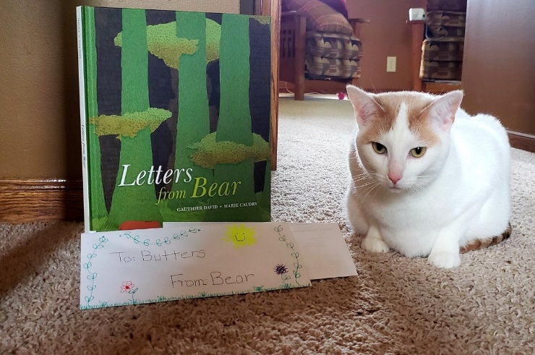
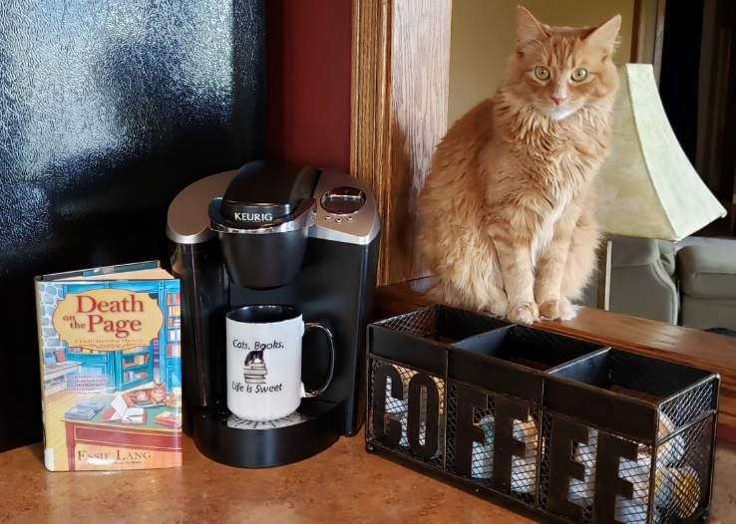
About Me
Me & Jim
Second and FAVORITE career is as a librarian
7 years in Mahomet elementary schools as a library assistant
18 total years with MPL
various positions including 8+ years as a cataloger
current position is Assistant Director
First career was as a computer programmer/systems analyst
Archer Daniels Midland (ADM)
Union Pacific Railroad
JoJo
Butters
JoJo
Notes:
Let me introduce myself!
My second and FAVORITE career is as a librarian…
My first career was…
My husband Jim & I raised two children. We have two beautiful grandchildren. AND we enjoy the company of our two cats JoJo and Butters (who, I might add, are avid library fans too!)
One more thing about me…

Slide 3

About Me
I my job!
Notes:
Shall we get started?!

Slide 4
What We Will Cover Today
What is genrefication?
Notes:
The first thing we will talk about today is the definition of genrefication.

Slide 5
What We Will Cover Today
What is genrefication?
Why did we decide to genrefy our adult fiction collection?
Notes:
Next we are going to talk about the reasons we decided to genrefy our adult fiction collection.

Slide 6
What We Will Cover Today
What is genrefication?
Why did we decide to genrefy our adult fiction collection?
How did we do it?
Notes:
How did we do it? will be the third part of my presentation.

Slide 7
What We Will Cover Today
What is genrefication?
Why did we decide to genrefy our adult fiction collection?
How did we do it?
Cataloging a genrefied collection
Notes:
And last we will talk about what is involved in cataloging and maintaining a genrefied collection

Slide 8
What We Will Cover Today
What is genrefication?
Why did we decide to genrefy our adult fiction collection?
How did we do it?
Cataloging a genrefied collection
Questions
Notes:
There will also be time for questions at the end.

Slide 9
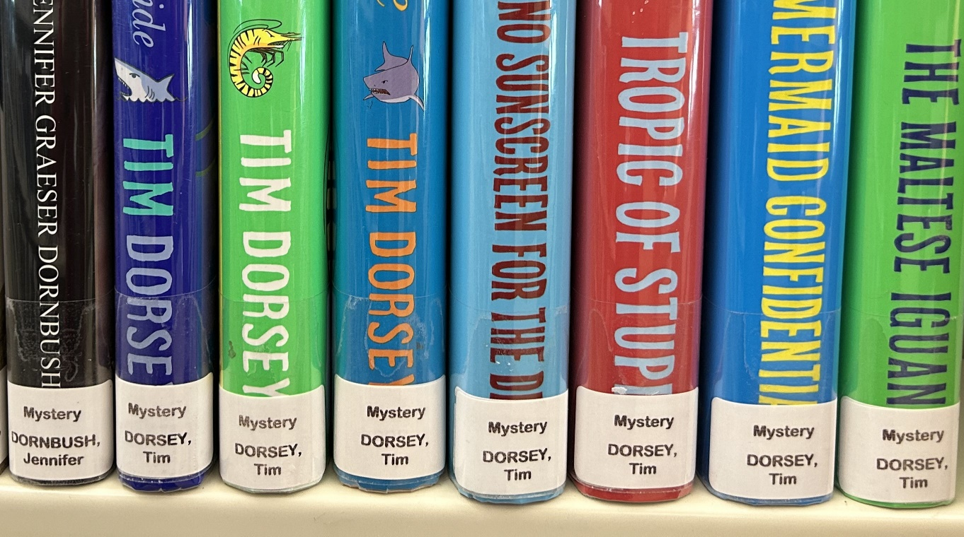
What is Genrefication?
Genrefication is the process of reorganizing a collection by arranging materials according to genres or categories instead of the traditional Dewey Decimal or alphabetical-by-author system.
Notes:
So, what is Genrefication?
The picture shown is part of our mystery collection.

Slide 10
“Why in the world would you do this?”
Notes:
You might ask…Why in the world would you do this?
It’s a lot of work.
It will take months to complete.
It can be difficult to categorize a book in one genre.
Will patrons like the change?
Yes, it was a lot of work.
Yes, it did take months to complete.
Yes, it is difficult to categorize a book in one genre but it is quite doable.
and Yes, our patrons did like the change. (at least the majority of them)
There were two reasons we made the decision to genrefy our adult fiction collection.

Slide 11
“Why in the world would you do this?”
Part of our strategic plan
Make the facility easier for patrons to use
Notes:
One aspect of our strategic plan challenges us to make the facility easier for patrons to use.
Our director, John Howard, wanted to explore the possibility of generfying our adult fiction collection as a way to make it easier for patrons to find materials they are looking for.

Slide 12
“Why in the world would you do this?”
Part of our strategic plan
Make the facility easier for patrons to use
Based on responses from our patron survey
Notes:
The second reason was based on responses from our patron survey.

Slide 13
“Why in the world would you do this?”
How would reorganizing the adult fiction collection impact your ability to find materials you are interested in?
Notes:
One question we asked patrons was

Slide 14
“Why in the world would you do this?”
How would reorganizing the adult fiction collection impact your ability to find materials you are interested in?
62% of patrons responding said it would make it easier for them to find books they are interested in

Slide 15
“Why in the world would you do this?”
How would reorganizing the adult fiction collection impact your ability to find materials you are interested in?
62% of patrons responding said it would make it easier for them to find books they are interested in
another 20% of patrons responding said it would have no impact on their ability to find books they are interested in

Slide 16
“Why in the world would you do this?”
When selecting books to read, how often do you limit your search to books in a specific genre?
Notes:
We also asked patrons

Slide 17
“Why in the world would you do this?”
When selecting books to read, how often do you limit your search to books in a specific genre?
42% of patrons responding said they usually look for books in specific genres

Slide 18
“Why in the world would you do this?”
When selecting books to read, how often do you limit your search to books in a specific genre?
42% of patrons responding said they usually look for books in specific genres
another 38% of patrons responding said they sometimes look for books in particular genres but also enjoy browsing the whole collection
Notes:
After seeing a high percentage of patrons responding in a positive manner, we chose to move forward with the project.

Slide 19
Since We Are Changing Spine Labels…
Notes:
Our staff had to handle every single book in our adult fiction collection. We decided to take advantage of this opportunity to make it even easier for patrons to find the materials they are looking for.

Slide 20
Since We Are Changing Spine Labels…
Change the call number from the first 3 letters of the author’s last name to the author’s entire name
Notes:
Our staff had to handle every single book in our adult fiction collection. We decided to take advantage of this opportunity to make it even easier for patrons to find the materials they are looking for.
We changed the call number on each book from the first 3 letters of the author’s last name to the author’s entire name.

Slide 21
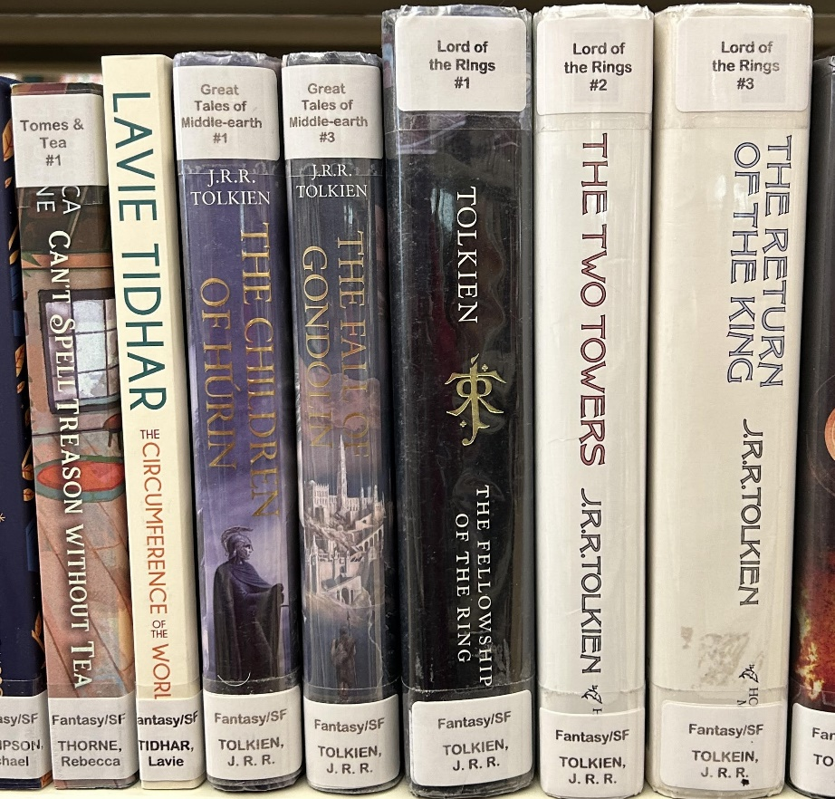
Since We Are Changing Spine Labels…
Change the call number from the first 3 letters of the author’s last name to the author’s entire name
Add the series name & numbers to the spine
Notes:
Add the series name & number to the spine
In this picture you can see the series information at the top of the spine and the author’s full name on the call number label.

Slide 22
Since We Are Changing Spine Labels…
Change the call number from the first 3 letters of the author’s last name to the author’s entire name
Add the series name & numbers to the spine
Make the facility easier for patrons to use
Notes:
Our strategic plan guides us in our decision making process. These two decisions were no exception. We continue to find ways to ‘make the facility easier for patrons to use’.

Slide 23
The Plan
Notes:
How did we do it?
The plan consisted of 5 parts.

Slide 24
The Plan
Decide which genres to organize the collection by

Slide 25
The Plan
Decide which genres to organize the collection by
Decide how to determine the genre of a book

Slide 26
The Plan
Decide which genres to organize the collection by
Decide how to determine the genre of a book
Layout staff workflow

Slide 27
The Plan
Decide which genres to organize the collection by
Decide how to determine the genre of a book
Layout staff workflow
Genrefy, genrefy, genrefy

Slide 28
The Plan
Decide which genres to organize the collection by
Decide how to determine the genre of a book
Layout staff workflow
Genrefy, genrefy, genrefy
Move the books!

Slide 29
What Genres Did We Use
Based on our patron survey:
Mystery (62.2%) Mystery
Thriller/Suspense (55.1%) Thriller
Romance (47.2%) Romance
Historical Fiction (42.5%) Historical
Fantasy (21.3%) Fantasy/SF
Science Fiction (19.7%) Fantasy/SF
Horror (8.7%) Horror
Westerns (7.9%) Western
Notes:
Let’s look at the first step in our plan. We used the 8 most popular genres based on the results of our patron survey. We ended up combining the Fantasy and Science Fiction genres into one: Fantasy/SF.

Slide 30
What Genres Did We Use
Based on our patron survey:
Mystery (62.2%) Mystery
Thriller/Suspense (55.1%) Thriller
Romance (47.2%) Romance
Historical Fiction (42.5%) Historical
Fantasy (21.3%) Fantasy/SF
Science Fiction (19.7%) Fantasy/SF
Horror (8.7%) Horror
Westerns (7.9%) Western
We added a General Fiction genre for books that do not fall into the above genres. Fiction
Notes:
We added a general fiction genre…
We ended up with a total 8 genres.

Slide 31
How Did We Determine the Genre
Notes:
The next step in our plan was to decide how we were going to determine the genre. To ensure consistency, it was important the same procedure was followed by all staff members responsible for genrefying.

Slide 32
How Did We Determine the Genre
Genre Decision Flowchart (flowchart page 2)
Notes:
To teach staff the genrefication process, I created a flowchart laying out various parts of the project. One section of the flowchart steps staff members through the genre decision making process.
Let’s take a look.

Slide 33
How Did We Determine the Genre
Genre Decision Flowchart (flowchart page 2)
The grey area: Authors who write in more than one genre
If an author’s books ended up in different genres, we wanted to easily convey this to patrons.
Notes:
Let’s talk a little bit more about the ‘grey area’.
We wanted a way to inform patrons the author writes in more than one genre. We kept track of these authors in a spreadsheet

Slide 34
How Did We Determine the Genre
Genre Decision Flowchart (flowchart page 2)
The grey area: Authors who write in more than one genre
If an author’s books ended up in different genres, we wanted to easily convey this to patrons.
We used a spreadsheet to keep track of these authors.
Notes:
We kept track of these authors in a spreadsheet

Slide 35
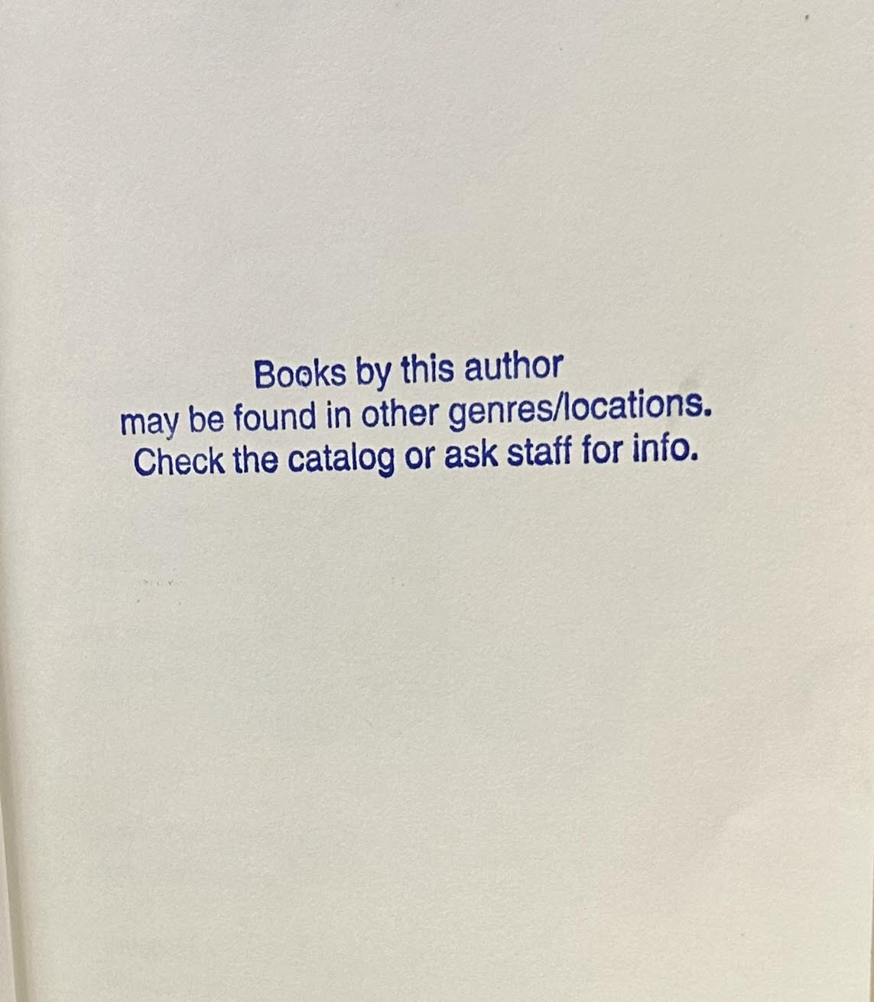
How Did We Determine the Genre
Genre Decision Flowchart (flowchart page 2)
The grey area: Authors who write in more than one genre
If an author’s books ended up in different genres, we wanted to easily convey this to patrons.
We used a spreadsheet to keep track of these authors.
We placed this message on the first page of all the author’s books.
Notes:
Using the spreadsheet, we eventually stamped this message on the first page of all the author’s books.

Slide 36
Layout of Staff Workflow
Start here (flowchart page 1)
Determine the genre (flowchart page 2)
Add additional genre label if necessary & print the call number label (flowchart page 1)
Determine the series (flowchart page 3)
Label the books (flowchart page 4)
Reshelve the books (flowchart page 5)
Repeat steps 1-6 until the end of the alphabet is reached
Notes:
Our genrefication process had six parts.
Let’s dive into the flowcharts to see what they were.
Start here – Where?
Determine the genre
Add additional genre label if needed
Determine the series – we chose ‘Goodreads’ and ‘Fantastic Fiction’ as our source for series information
Label the books – We involved the community in the part of the project. Our volunteers loved helping us out!
Reshelve the books – They went right back on the shelf where they were.

Slide 37
Move the Books!
The day finally arrived
We closed for the day
In the morning we held our yearly staff training session
In the afternoon we moved the books
Notes:
After months and months of work, the day to MOVE THE BOOKS finally arrived.

Slide 38

Move the Books!
Moving the books meant moving them three times

Slide 39
Move the Books!
Moving the books meant moving them three times
(approximately 10,000 of them)

Slide 40
Move the Books!
Moving the books meant moving them three times
(approximately 10,000 of them)
Once onto tables/carts by genre (to be sorted by author)

Slide 41
Move the Books!
Moving the books meant moving them three times
(approximately 10,000 of them)
Once onto tables/carts by genre (to be sorted by author)
Once to the ‘record changers’ for shelf location changes

Slide 42
Move the Books!
Moving the books meant moving them three times
(approximately 10,000 of them)
Once onto tables/carts by genre (to be sorted by author)
Once to the ‘record changers’ for shelf location changes
Once to their new location on the shelves

Slide 43
Move the Books!
Moving the books meant moving them three times
(approximately 10,000 of them)
Once onto tables/carts by genre (to be sorted by author)
Once to the ‘record changers’ for shelf location changes
Once to their new location on the shelves
It was a long and rewarding day for all of us.
Moving the Books (video & pictures)

Slide 44
Project Timeline
2022 – Surveyed patrons
Early Summer 2023 – Developed ‘The Plan’
Late Summer 2023 – Began genrefying
Late Summer 2024 – Finished genrefying

Slide 45
Cataloging a Genrefied Collection
Determine the genre of the book
We follow the same procedure used when the entire collection was being genrefied
Notes:
The last topic we will talk about today is cataloging a genrefied collection.
We have three catalogers on staff – what do they need to know to maintain a genrefied collection.
Obviously they need to know how to determine the genre of a book. They use the same procedure used when the entire collection was being genrefied.

Slide 46
Cataloging a Genrefied Collection
Determine the genre of the book
We follow the same procedure used when the entire collection was being genrefied
Check if the author writes in more than one genre by searching in Polaris
Item record search by author (for Mahomet Library only)
Sort by shelf location
Notes:
They have to check if the author of the book they are cataloging writes in more than one genre.
For example, let’s look at the author Rhys Bowen.

Slide 47
Cataloging a Genrefied Collection
Determine the genre of the book
We follow the same procedure used when the entire collection was being genrefied
Check if the author writes in more than one genre by searching in Polaris
Item record search by author (for Mahomet Library only)
Sort by shelf location
If the author writes in more than one genre, stamp the book with the multiple genre stamp
If the book you are cataloging is a new genre for the author, all of their books have to be stamped.

Slide 48
Cataloging a Genrefied Collection
Another picture of the stamp used when authors write in more than one genre

Slide 49
Cataloging a Genrefied Collection
Check to see if the book is part of a series
We follow the same procedure used when the entire collection was being genrefied

Slide 50
Cataloging a Genrefied Collection
Check to see if the book is part of a series
We follow the same procedure used when the entire collection was being genrefied
When creating spine labels, be consistent with series and author names
Notes:
This means going you have to out in the stacks and look at other books by the author.

Slide 51
Cataloging a Genrefied Collection
Check to see if the book is part of a series
We follow the same procedure used when the entire collection was being genrefied
When creating spine labels, be consistent with series and author names
Help patrons find their favorite authors via the Aspen catalog
Notes:
Helping patrons find materials in the Aspen is not necessarily a cataloging step, however, being consistent in our cataloging procedures makes it much easier for patrons.
Using author Rhys Bowen again, let’s search the Aspen catalog to see how easy it is.

Slide 52
Key Takeaways
Genrefying a collection has to make sense to your patrons. It is not for everyone.
Notes:
There are four key takeaways from today’s presentation.

Slide 53
Key Takeaways
Genrefying a collection has to make sense to your patrons. It is not for everyone.
Genrefying a collection takes a lot of planning and a lot of time to complete.

Slide 54
Key Takeaways
Genrefying a collection has to make sense to your patrons. It is not for everyone.
Genrefying a collection takes a lot of planning and a lot of time to complete.
Genrefying has some ‘grey areas’. Don’t drive yourself crazy trying to make a decision. If the decision ends up being a bad one, change the genre!

Slide 55
Key Takeaways
Genrefying a collection has to make sense to your patrons. It is not for every library.
Genrefying a collection takes a lot of planning and a lot of time to complete.
Genrefying has some ‘grey areas’. Don’t drive yourself crazy trying to make a decision. If the decision ends up being a bad one, change the genre!
The most important decision you can make is to require the procedures to be followed by all staff who are genrefying. Consistency is crucial.

Slide 56

Questions?
Email: tammy@mahometpubliclibrary.org
Phone: 217.586.2611

