Slide 1
Preserving Community Memories: Lessons from IHLS’s Mobile Memory Lab
Linda Johnson, SHARE Cataloging Supervisor
Third Thursday – Thursday, January 15, 2026

Slide 2
What is the Mobile Memory Lab?
MML team members photograph and scan items for inclusion in the Illinois Digital Archive where they become part of the historical record.
Funded by a grant from Illinois Humanities.
CMC provides metadata cataloging required for inclusion in IDA.
Participants preserve pieces of their family or community legacy for generations to come!

Slide 3
MML Timeline
Began with former members of the Cataloging Maintenance Center (CMC) staff.
FY2025 CMC Metadata Cataloger Kat Anderberg led the project.
FY2026 the grant was extended and increased so SHARE was brought on board to lead the digitization events with Kat providing the metadata cataloging.

Slide 4
The Illinois Digital Archives (IDA) was created in 2000, as a repository for the digital collections of the Illinois State Library as well as other libraries and cultural institutions in the State of Illinois.
What can you find in the Illinois Digital Archives?
Photographs, slides, glass negatives
Oral histories
Manuscripts and letters
Federal government documents
Postcards
Posters
Videos
Newspapers
Maps
and much more.
From https://www.idaillinois.org/
Notes:
A service of the Illinois State Library and the Office of the Illinois Secretary of State.

Slide 5
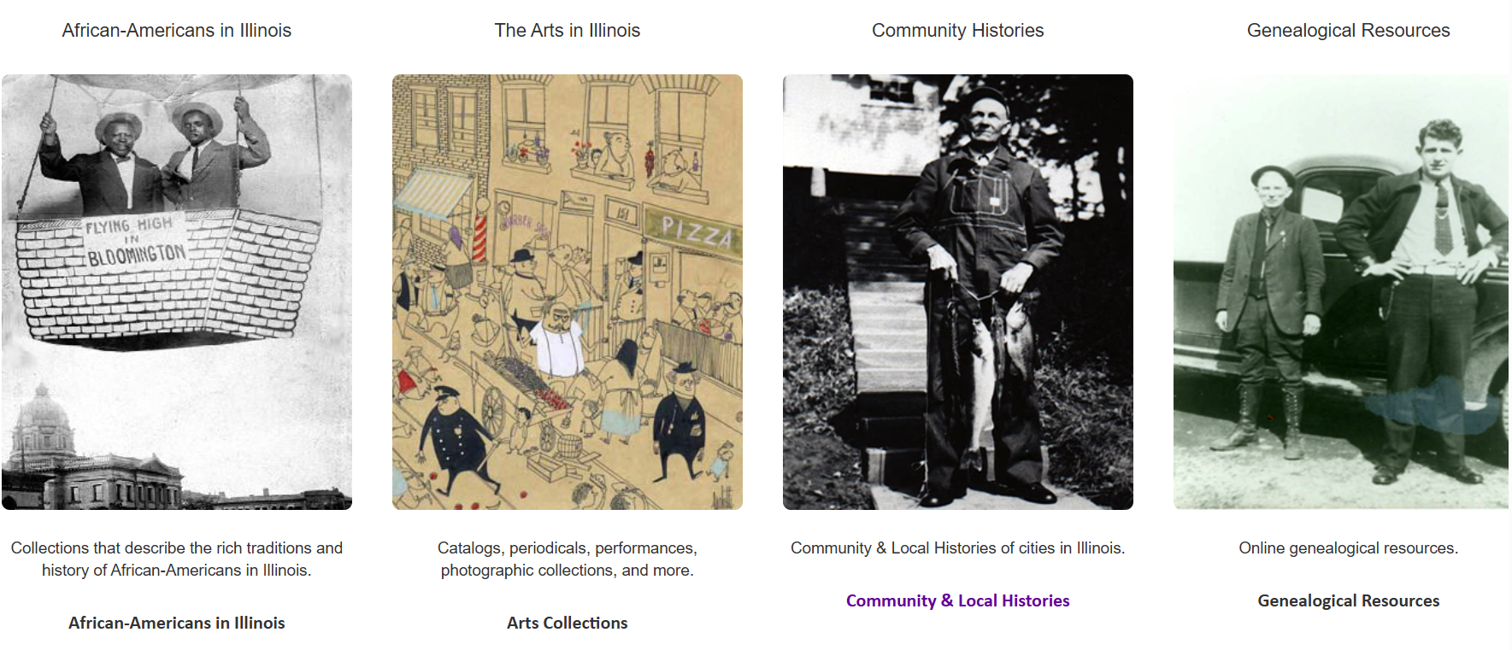
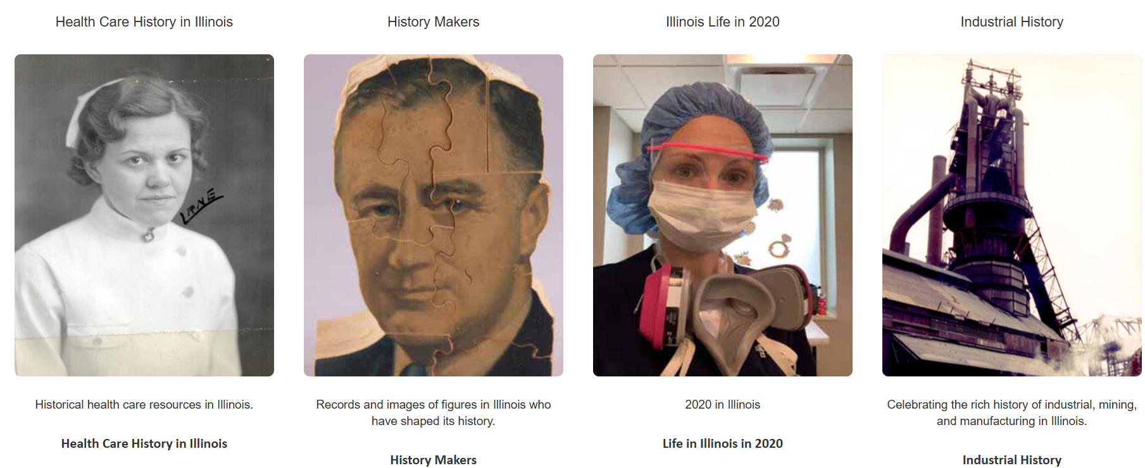
IDA Sample of Topics and Photos

Slide 6
Linking to IDA
Illinois Digital Archives can be added to Aspen, your online card catalog.
Contact Dena Porter dporter@illinoisheartland.org if interested.

Slide 7
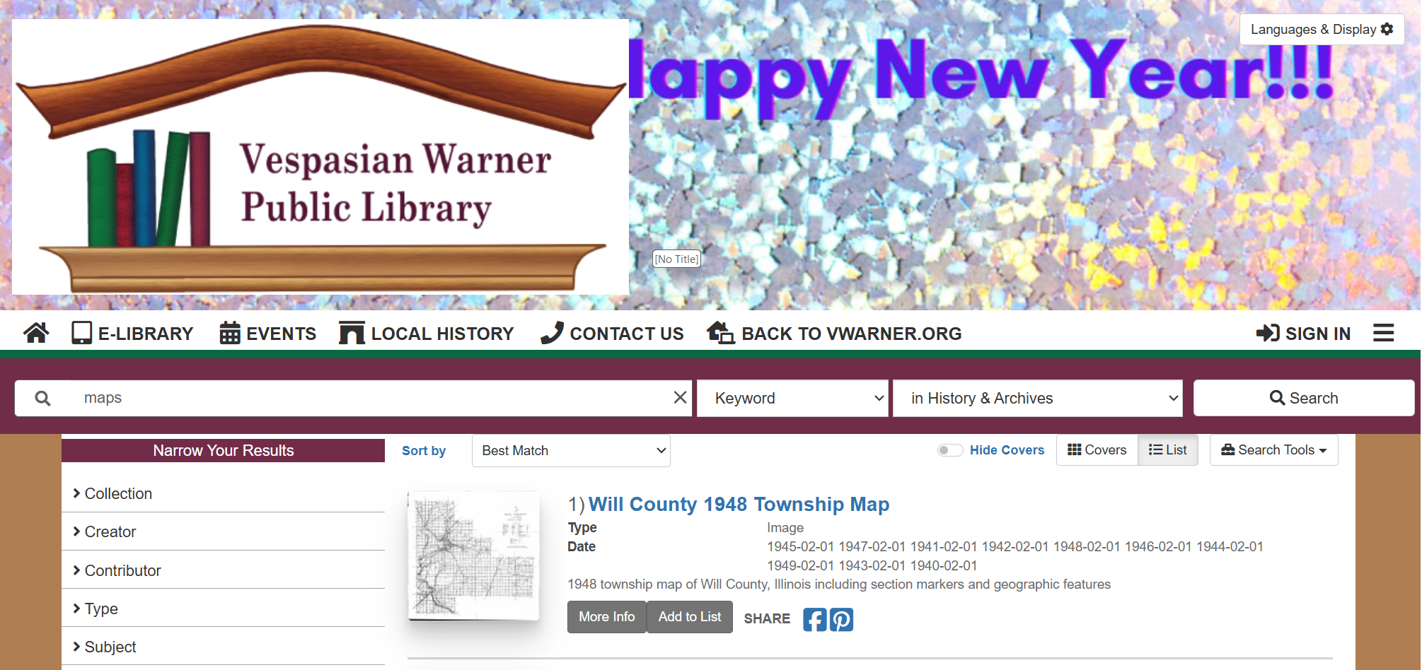

Slide 8
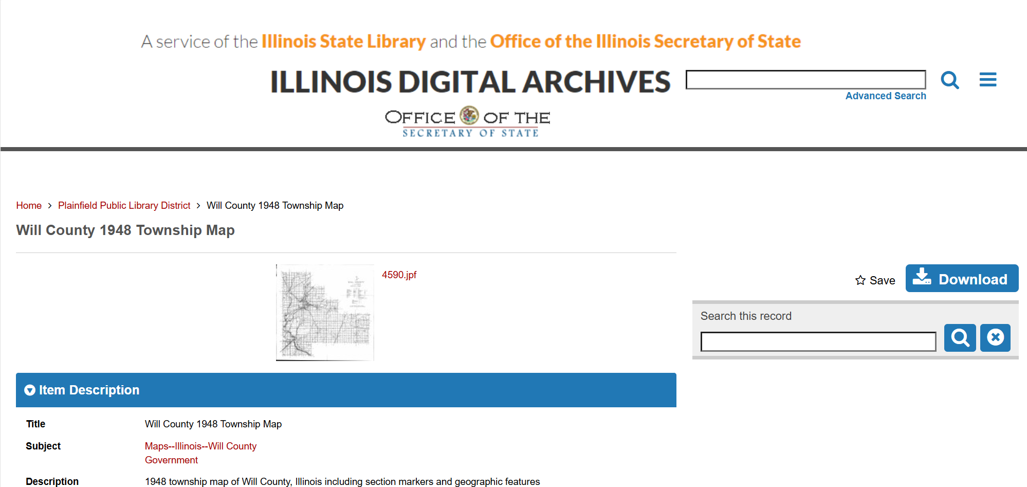

Slide 9
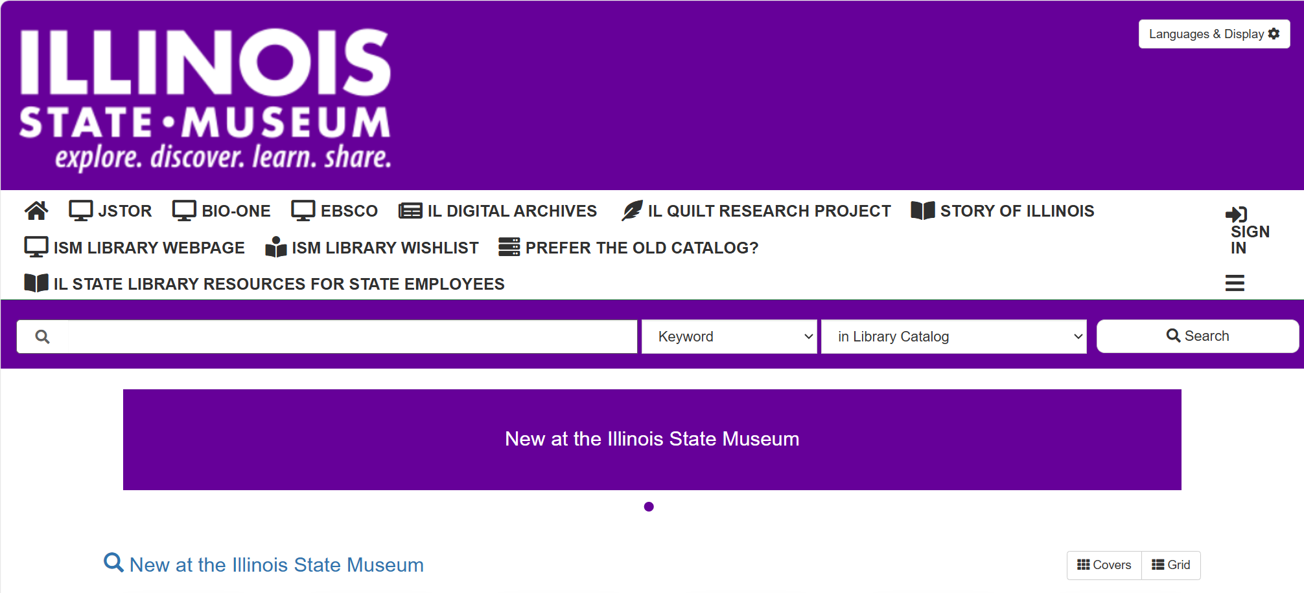

Slide 10
Digitization
Digitization alone does not preserve an object. Scanning or photographing an item does not stop the original from aging, degrading, or being damaged.
Digitization supports preservation indirectly. By creating a digital copy, people can access the information in the item without touching the original.
Reduced handling helps protect fragile materials. When researchers use the digital version instead of the physical one, the original item is handled less, which slows wear and tear.
Allows remote access for a wider audience.
Digital copies make materials available to users regardless of location.

Slide 11
Strongest response has been from libraries that:
Have a strong community interest in local history.
Have staff that is knowledgeable and enthusiastic about the MML.
Schedule and confirm appointments with patrons before the event.
Make use of IHLS provided promotional materials.

Slide 12
Lessons - Patrons
Have their items organized with what is most important to them first.
Have information on the items that they can share either verbally or in writing.

Slide 13
Lessons for MML staff
Be prepared to say no if an item is copyright protected or to let the patron know that time has run out.
Patrons want to share their stories and treasured items and appreciate having someone listen.

Slide 14
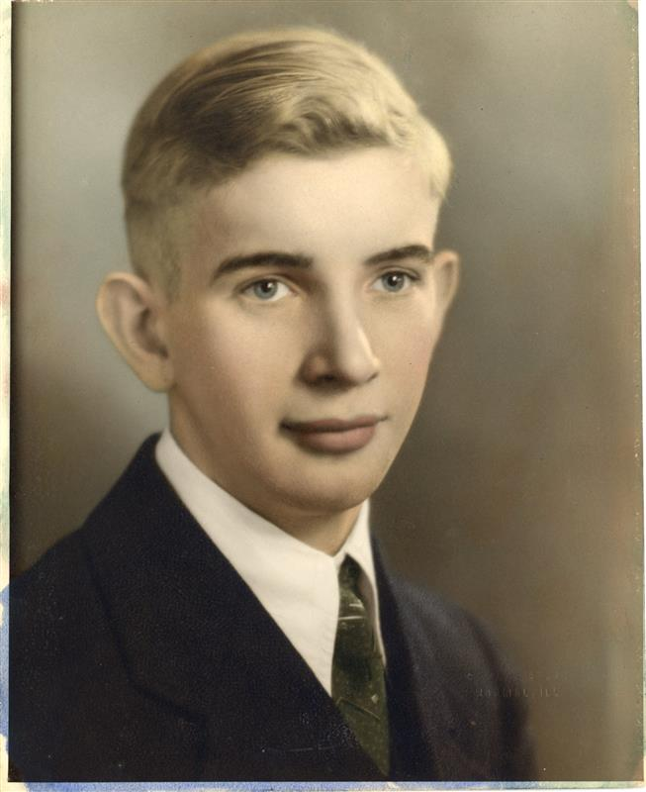
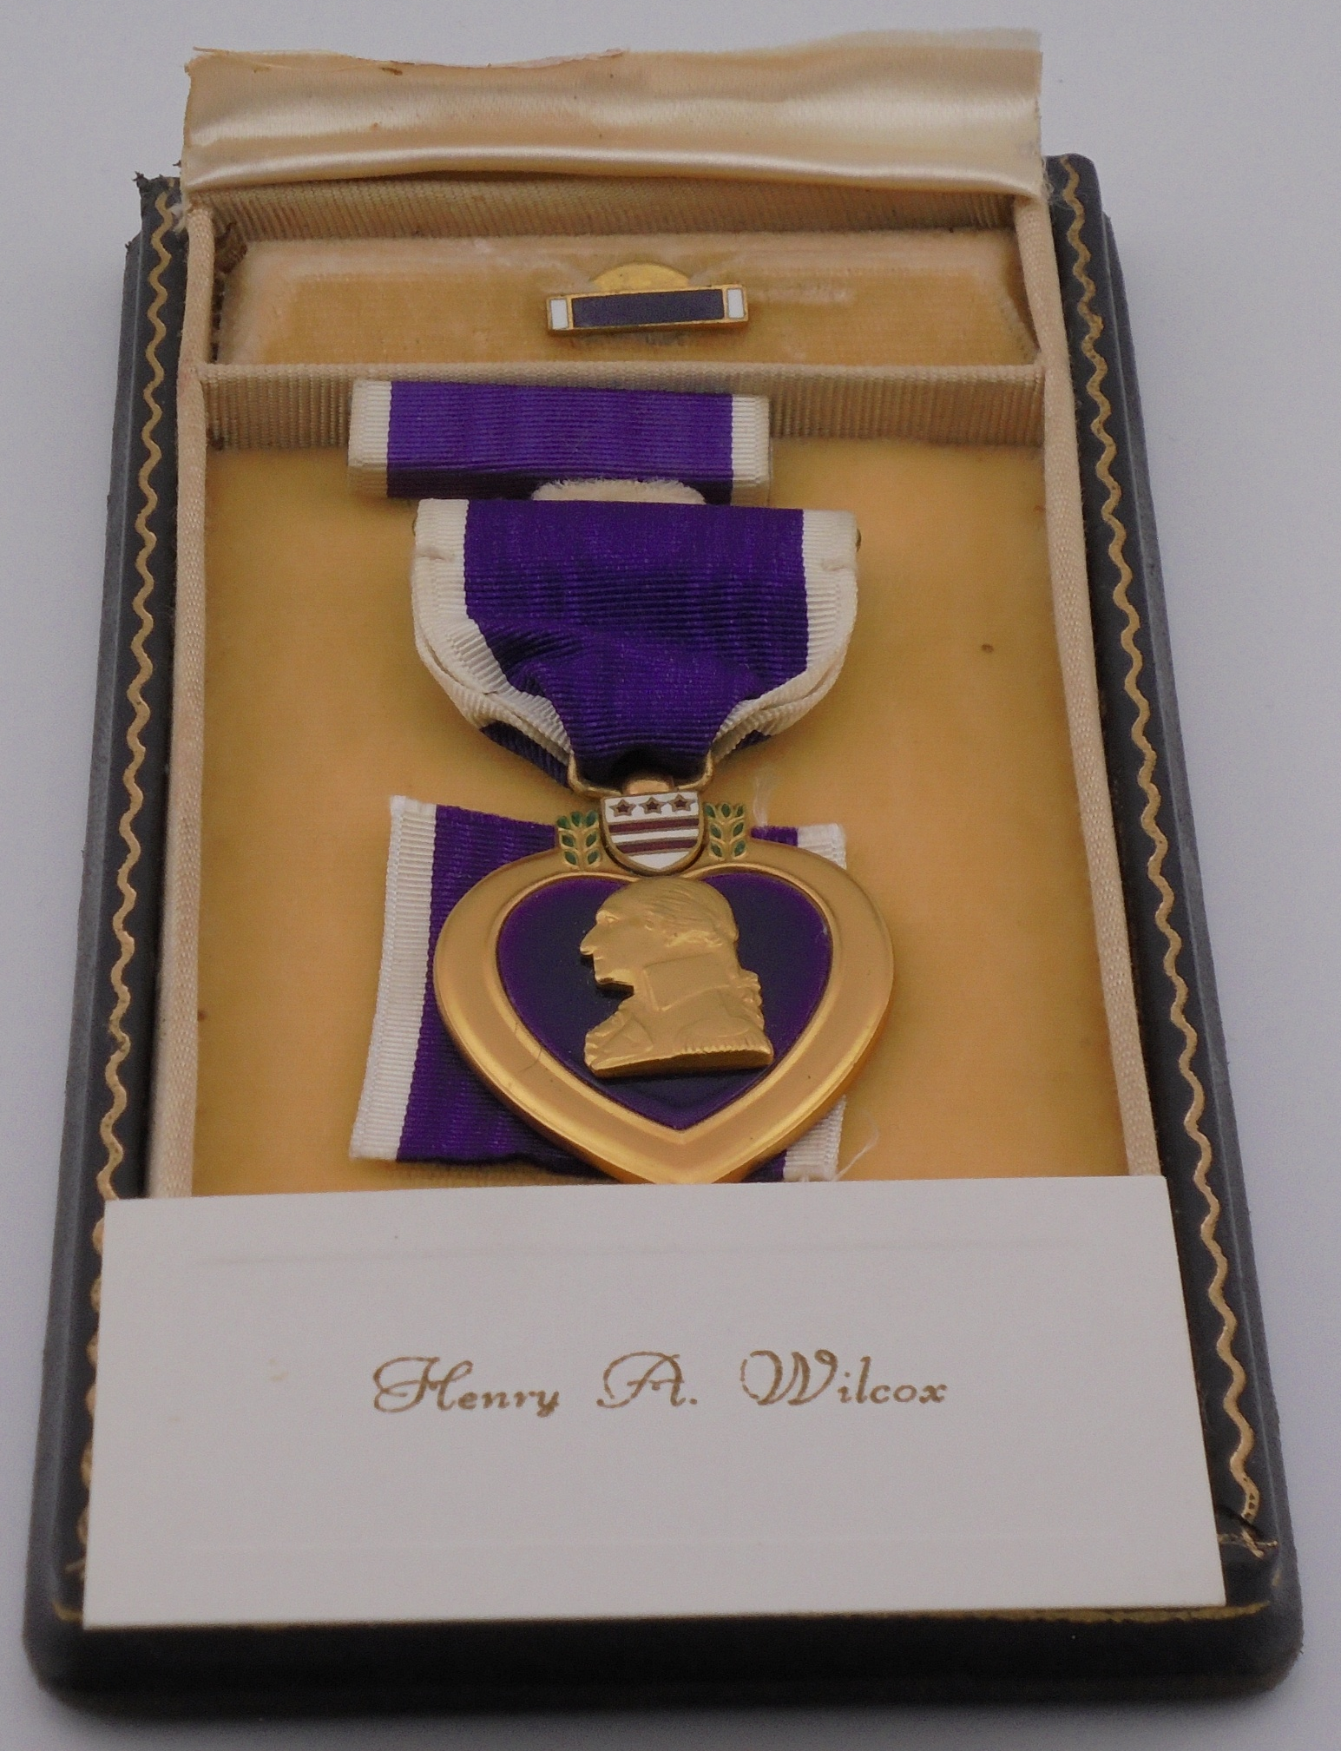
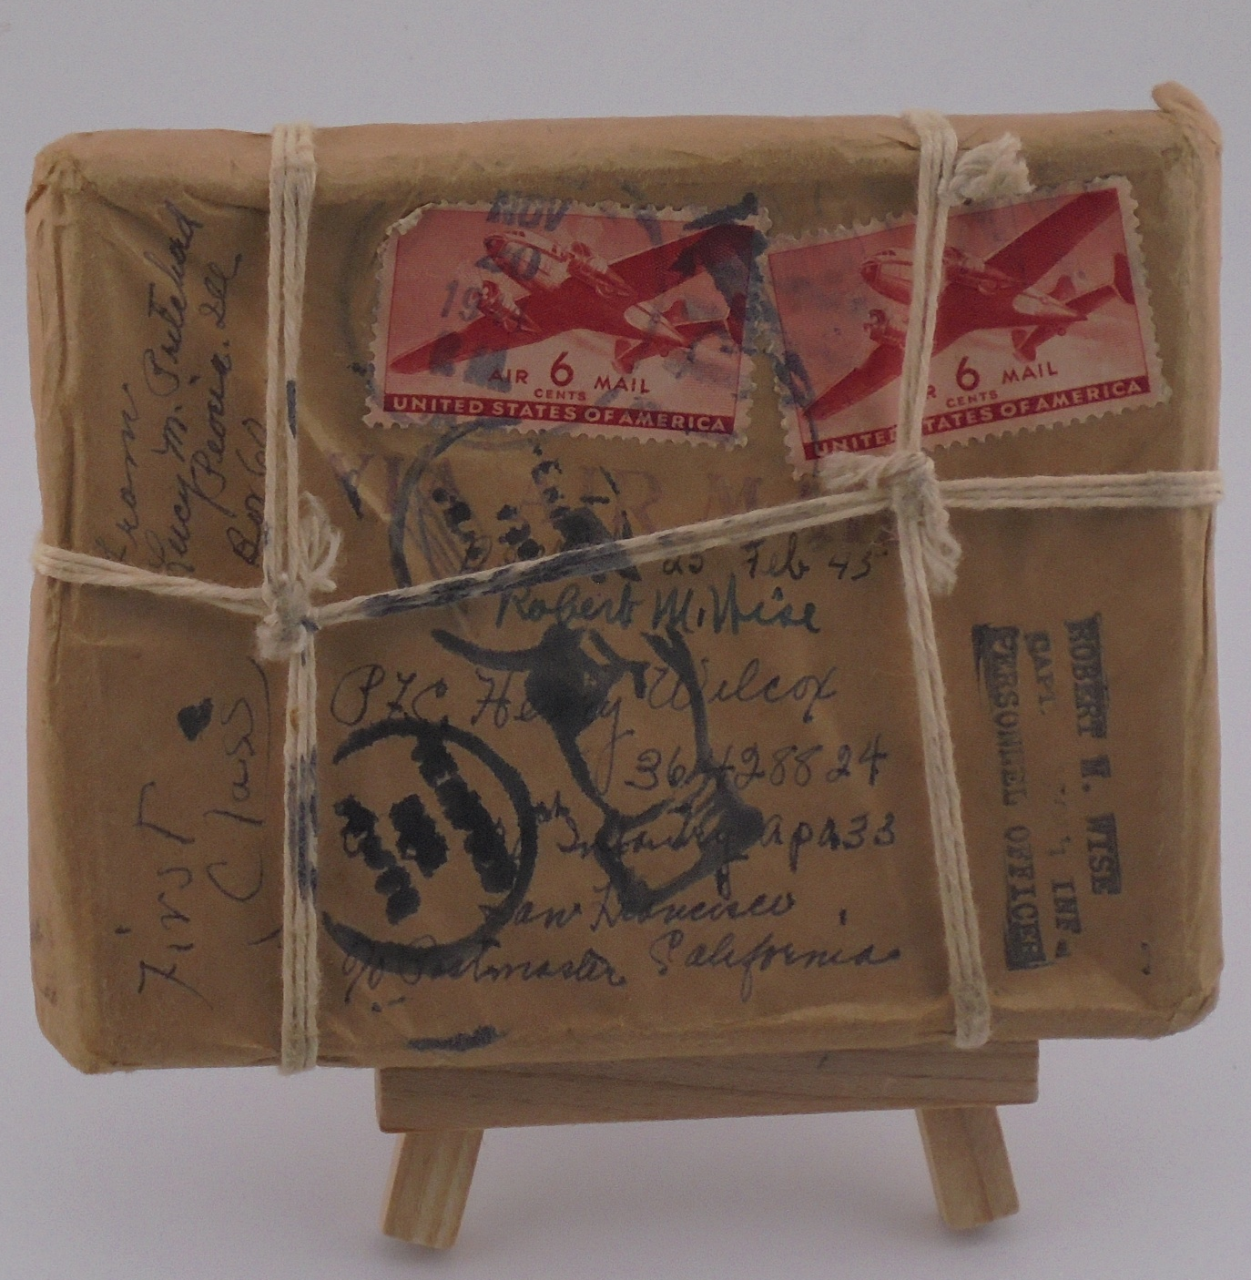
Henry A Wilcox 10/3/1920 - 2/25/1945
Notes:
Henry A. Wilcox was born on October 3,1920 in Illinois and died on February 25, 1945, on the island of Luzon in the Philippines. Henry was one of three sons born to George and Ella Wilcox. Henry was not married and had no children at the time of his death. His brothers never had children, so these items passed to his cousin who brought them to the MML event at Catlin Public Library. Henry was posthumously awarded the Purple Heart, pictured in the middle. The package tied with string on the right, which is a bit bigger than an index card and about ½ inch thick was sent to Henry by his aunt while he was serving in the Pacific Theater. He passed away before he could receive it and the military returned it to his aunt. It has never been opened. Also digitized were letters to and from family members, the letter notifying the family of Henry’s death, and condolence letters from U.S. senators and congressmen.

Slide 15
Starting your own project - Supplies
Small budget supplies
Computer
Scanner
Digital camera
Copyright release form
Larger budget supplies – add the following
Light box
Tripod
Flash drives
Higher quality scanner
Higher quality camera

Slide 16
In-house project
Staff costs can become a factor.
Better quality control by trained staff.
Digitize just library owned materials or include patron items?
If including patrons, finding those interested in participating.
What role do you want your library to play?

Slide 17
Volunteer project
Less cost for staff time.
Less quality control.
Would need to train volunteers.
Finding those interested in volunteering and sharing their items.
What role do you want your library to play?

Slide 18
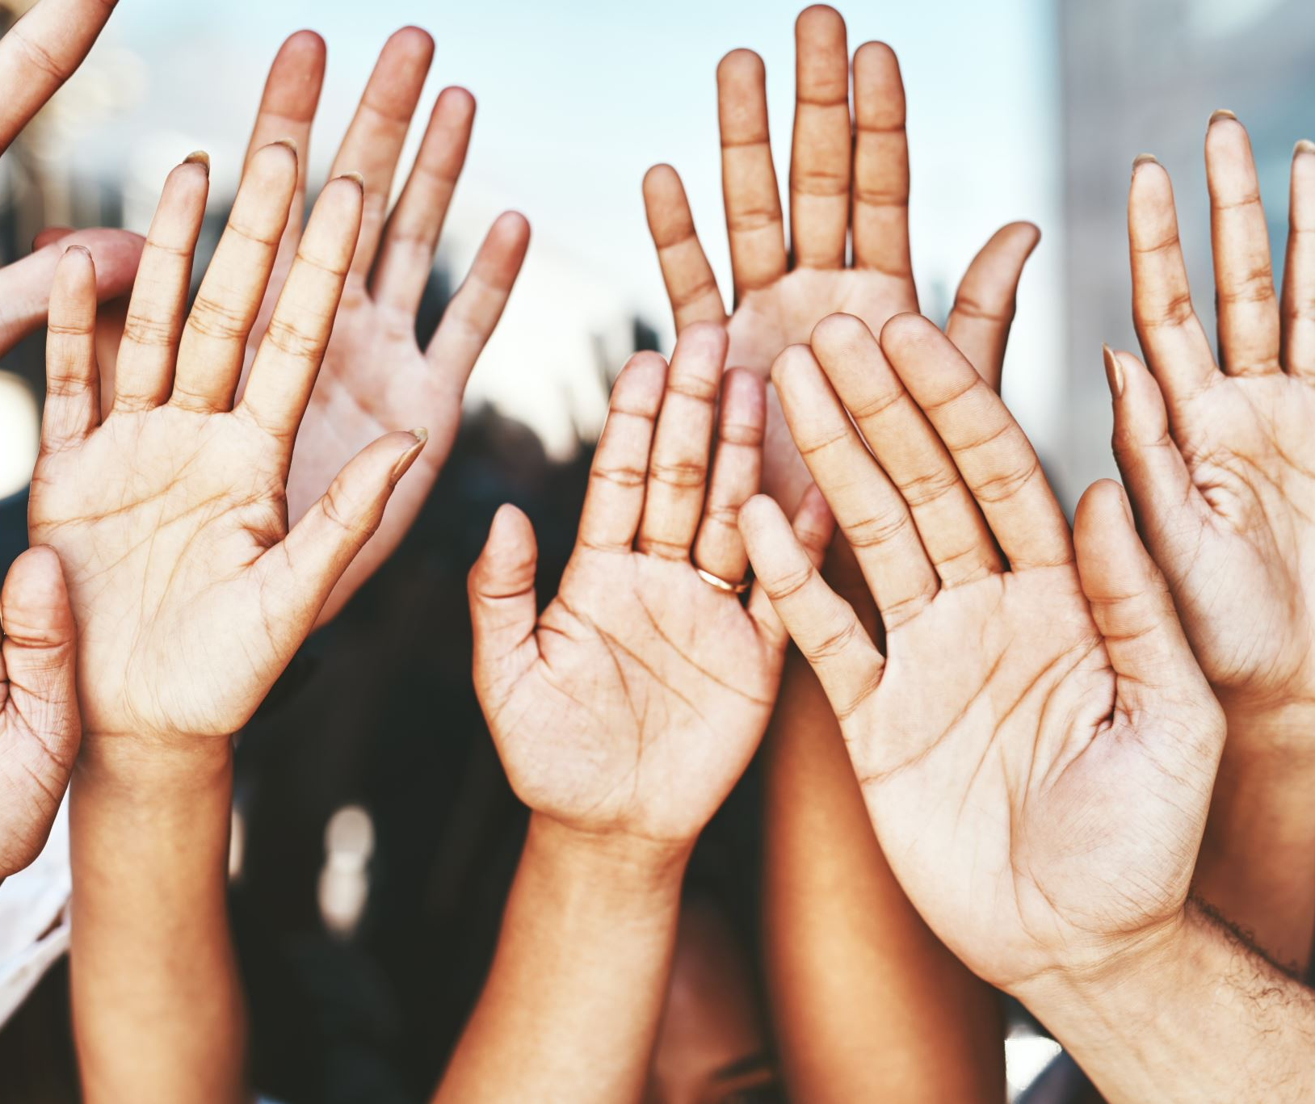
Common denominator in both approaches
Finding interested community members to participate!
Notes:
Both as digitizers and as patrons willing to donated their historical items for inclusion. If you have a community with an active interest in local history, a lot of the work is already done for you! If not, you might want to try to gauge or build community interest before you dive into creating a project.

Slide 19
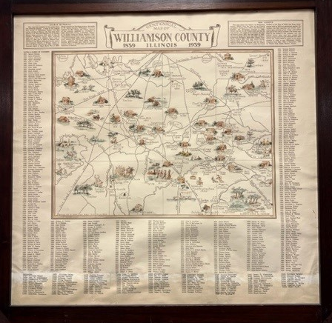
Volunteer projects in my community

Slide 20
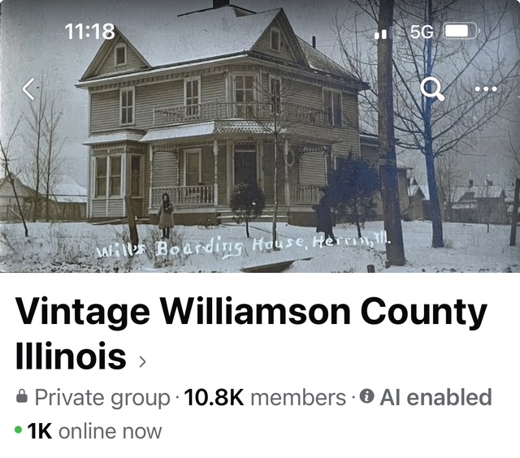
Local History Enthusiasts
From Facebook.com

Slide 21
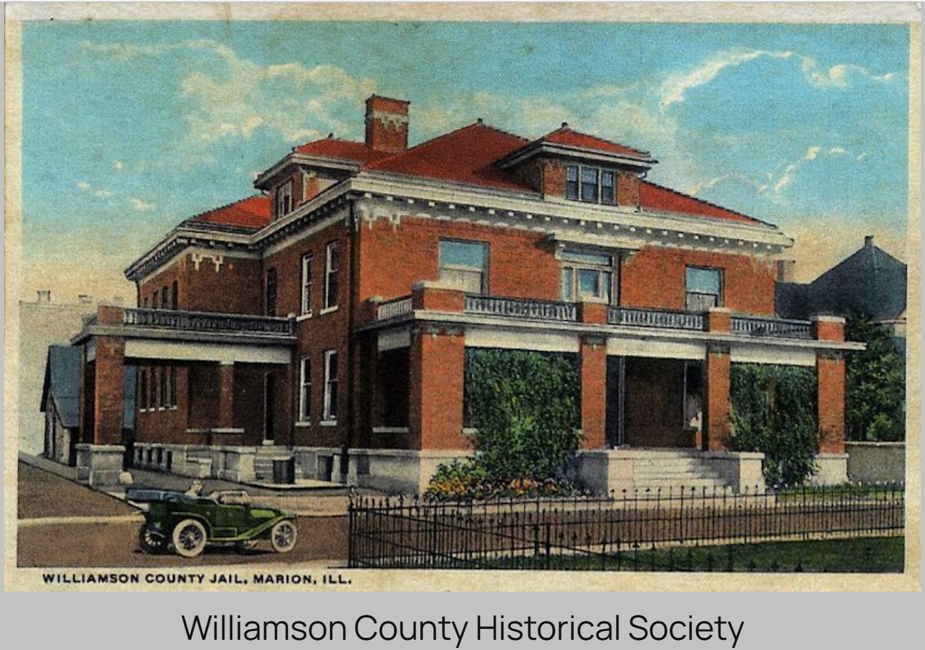
Local Historical Societies
www.wcihs.org

Slide 22
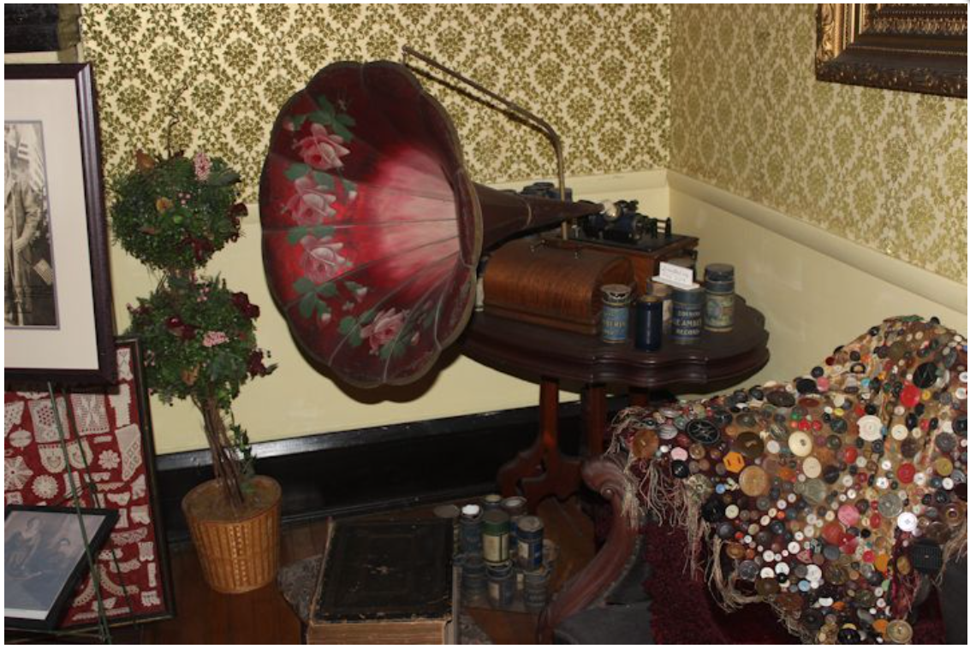
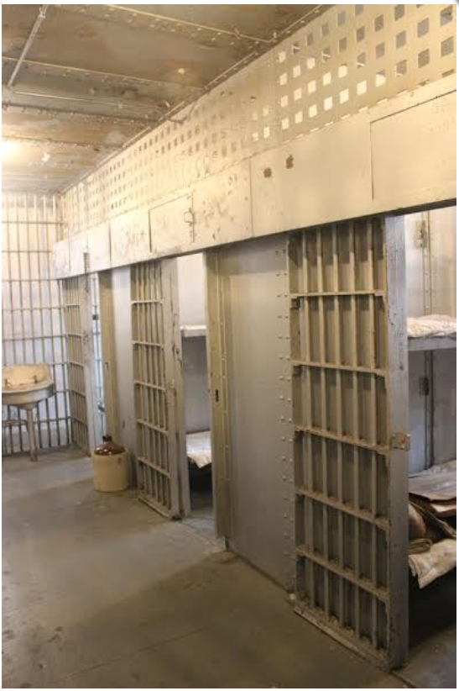
Interior of the Williamson County Historical Society
Front parlor of the sheriff’s home
Jail cells in the rear of the building
From www.wcihs.org

Slide 23
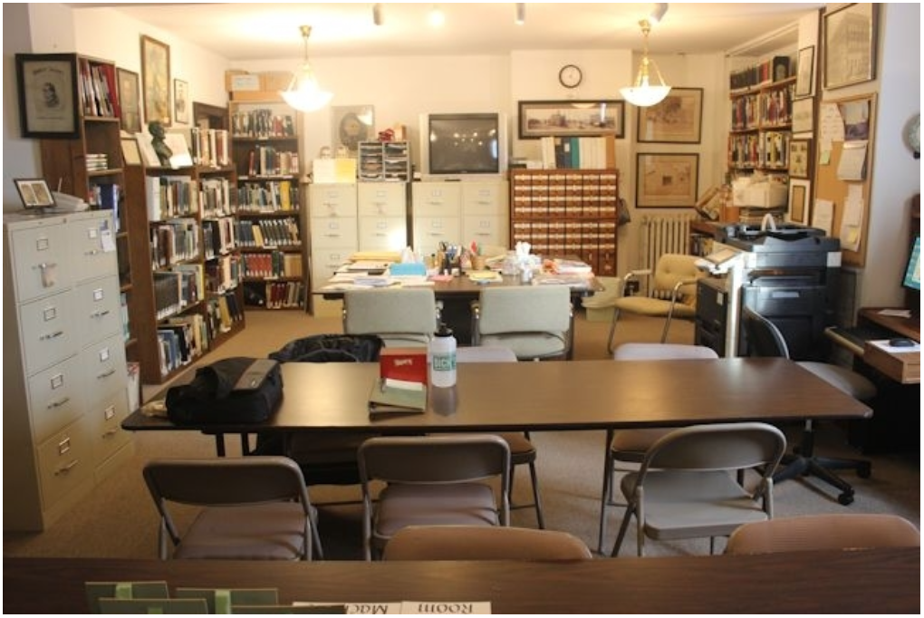
Local history and genealogical library
From www.wcihs.org

Slide 24
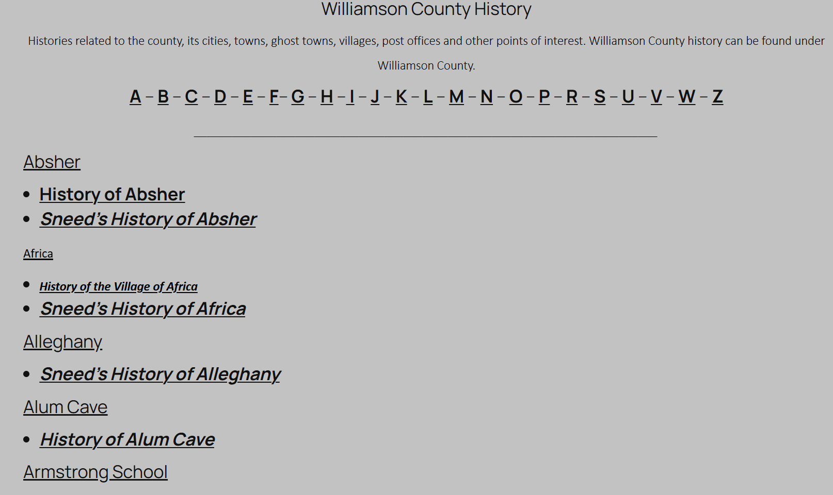
From www.wcihs.org

Slide 25
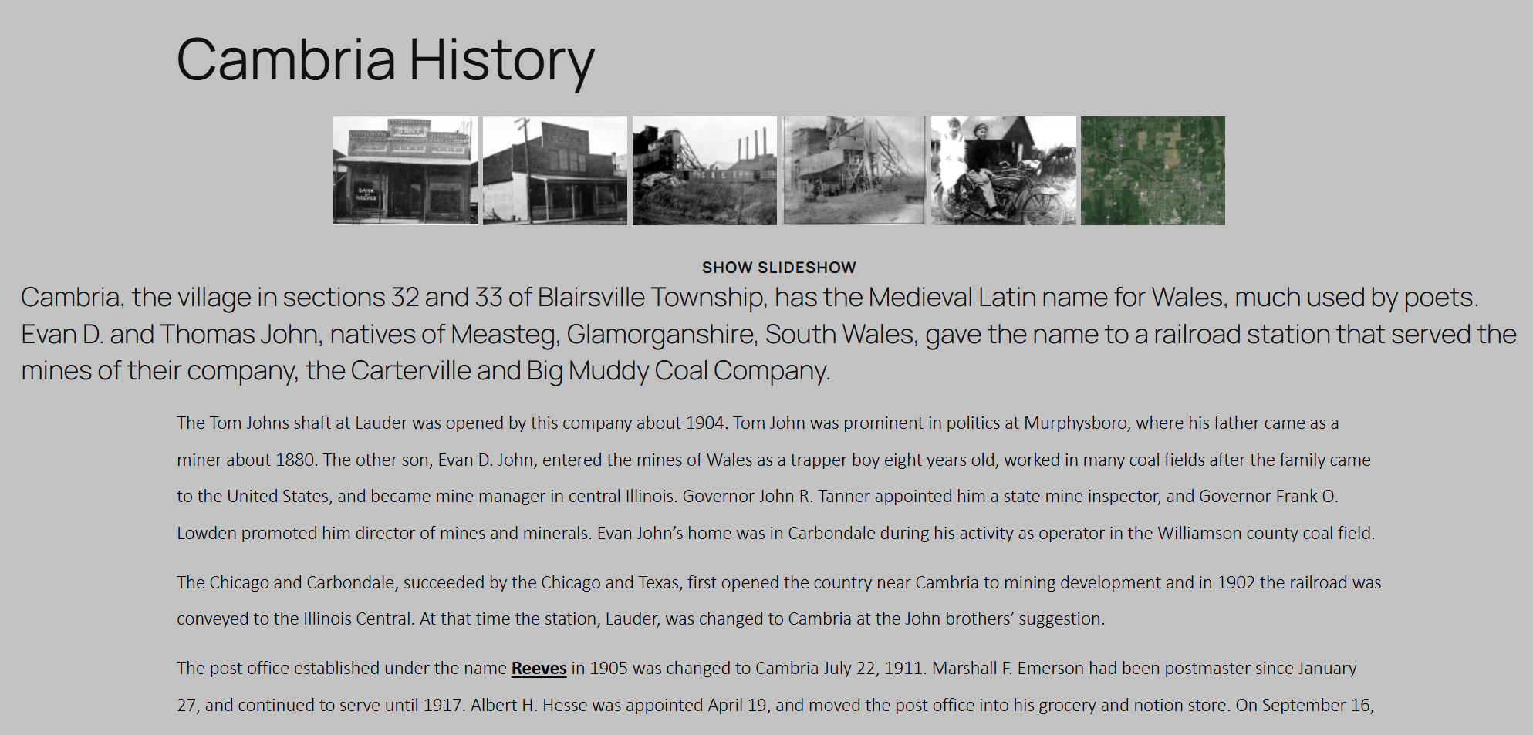
From www.wcihs.org

Slide 26
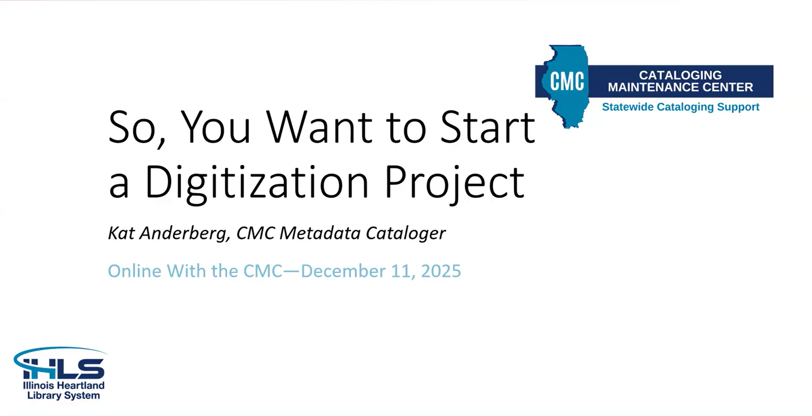
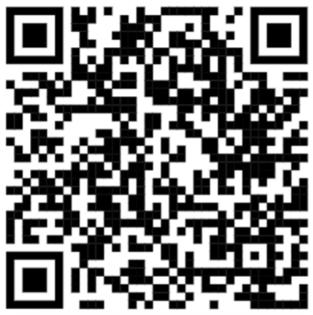
Kat’s Online with the CMC presentation
Link: Online with the CMC: So, You Want to Start a Digitization Project

Slide 27
Next MML events
Galesburg Public Library - February 26th from 3:00 to 7:30 p.m.
Mascoutah Public Library - March 14th from 9:30 a.m. to 6:00 p.m.
Chester Public Library - March 19th from 10:00 a.m. to 6:00 p.m.
SIUE Lovejoy Library - March 24th and March 25th from 9:00 a.m. to 3:00 p.m.
Groff Memorial Library - April 11th from 10:00 a.m. to 2:00 p.m.
C.E. Brehm Memorial Public Library - April 18th from 10:00 a.m. to 4:00 p.m. and April 19th from 1:00 p.m. to 4:00 p.m.

