Slide 1
Updates and Reminders for a New Year
Catalogers Training Session
February 10, 2026
Notes:
Welcome
Reminders about muting microphones, putting questions in the chat box, and changing name so that CE can be credited appropriately

Slide 2
Agenda
Announcements
  SHARE
  IHLS
Reminders
CMC Update
Presentation
Reaching Forward South – April 10, 2026

Slide 3
Announcements
SHARE
SHARE Bib Services
  856 Field Cleanup
  OCLC Holdings Update – Date Scheduled!!

Slide 4
Reminders
GMDs
  Please make sure that you are including GMDs (when appropriate) in Polaris records.
Editing OCLC Records
  Please don’t change dates, publication locations, pagination, etc., if your item doesn’t match.
  If unsure, reach out to us or create a new record.
Notes:
Linda

Slide 5
CMC Update
Focus on Cataloging 3D Objects, April 20-May 3, 2026.
  Register in L2.
  Dr. Pamela Thomas will spend two weeks providing hands-on cataloging of 3D Objects. During the course, students will originally catalog 3D objects. Cataloging knowledge and experience is strongly recommended.
Focus on Cataloging Realia, May 18-31, 2026.
  Register in L2.
  Dr. Pamela Thomas will spend two weeks providing hands-on cataloging of realia. During this course, students will originally catalog realia. Cataloging knowledge and experience is strongly recommended.
Notes:
Pam

Slide 6
CMC Update
Upcoming Online with the CMC: Focus on Deriving a Record, March 9–22, 2026. Register in L2.
  Have you found records in OCLC that are almost a match, but you need to create a new bibliographic record? Or do you? If you find a close match, you can derive a new record. Eric McKinney will teach you how to do that.
Focus on Cataloging CDs, April 6–19, 2026. Register in L2.
  Cataloging CDs can be challenging—what MARC (MAchine-Readable Cataloging) fields are required, and which ones are optional? How do you fill out the fixed-field elements? Eric McKinney will guide you through the process of creating bibliographic records for CDs.
Cataloging Basics, April 27–June 7, 2026. Register in L2.
  This six-week crash course in basic cataloging dives into cataloging using RDA, the Resource Description and Access standards, and using MARC, the MAchine-Readable Cataloging standards. Eric McKinney will cover MARC fields 0XX-8XX and fixed-field elements, the most commonly used fields when cataloging library items.
Focus on Cataloging 3D Objects, April 20-May 3, 2026. Register in L2.
  Dr. Pamela Thomas will spend two weeks providing hands-on cataloging of 3D Objects. During the course, students will originally catalog 3D objects. Cataloging knowledge and experience is strongly recommended.
Focus on Cataloging Realia, May 18-31, 2026. Register in L2.
  Dr. Pamela Thomas will spend two weeks providing hands-on cataloging of realia. During this course, students will originally catalog realia. Cataloging knowledge and experience is strongly recommended.
Notes:
Pam

Slide 7
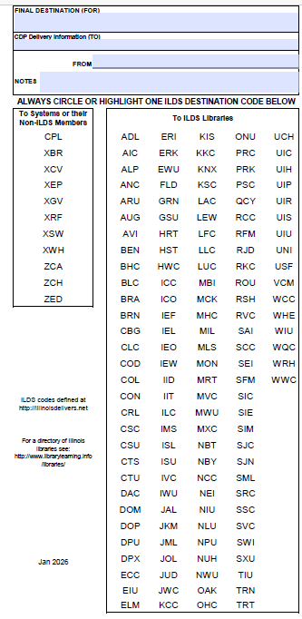
CMC Update
CMC Resources
Cataloging Request Form
CMC Cataloging Training
CMC Web page
The CMC Chronicles
Online with the CMC Recordings
ILDS Label
Notes:
Pam

Slide 8
Updates and Reminders for a New Year
Notes:
Today’s presentation will cover updates and reminders for the a new year.

Slide 9
Agenda
Polaris Original vs. Polaris Leap
Polaris Leap 7.7 & 7.8
What Leap can’t do…Yet!
SHARE Policies and Procedures - Update
Notes:
We’ll be discussing the following topics:
Polaris Original vs. Polaris Leap
Updates to Polaris Leap in 7.7 and 7.8
What Leap can’t do…yet!
Update on SHARE Bibliographic Services-related policies and procedures.

Slide 10

Polaris Original
Polaris Original is not going away in the immediate future, HOWEVER…
Polaris Original is now considered legacy software.
Only ongoing security updates and critical bug fixes will be addressed.
No significant new features are planned.
Notes:
We have also been told that Polaris Original-focused staff at Innovative will not be replaced when they leave or retire.

Slide 11
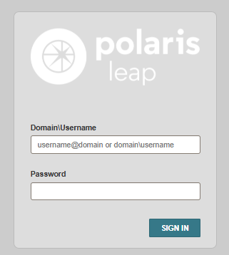
Polaris Leap
Polaris Leap is now the primary focus, and all new development efforts will be directed toward it.
We highly encourage that library staff begin integrating Polaris Leap into daily work functions.
Notes:
Documentation updates will be entirely focused on Polaris Leap, unless there is a critical update or fix to Polaris Original.

Slide 12
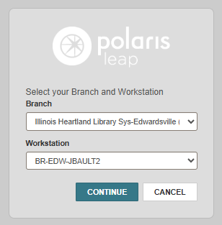
Polaris Leap – Log in
https://leap.illinoisheartland.org
Username in the following format:
  SHARE\First Name.Last Name
Password: Same password you use for Polaris Original
Select your branch and workstation
Notes:
Reminder of how to log into Polaris Leap.

Slide 13
Polaris Leap 7.7 Updates
Saving a Set of Find Tool Filters as Your User Default
Comparing bibliographic records in Leap
Checking for duplicate bibliographic records without saving
New keyboard shortcuts
Selecting a range of records
Loading all records in a record set
Serials in Leap
Acquisitions

Slide 14
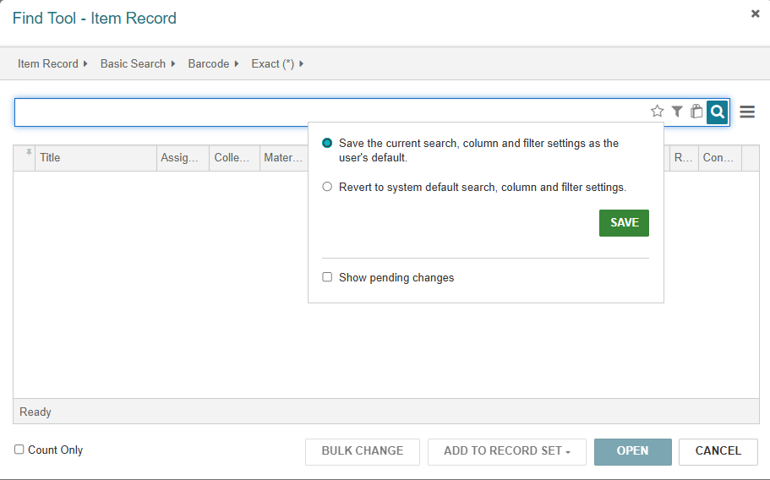
Saving a Set of Find Tool Filters as Your User Default

Slide 15
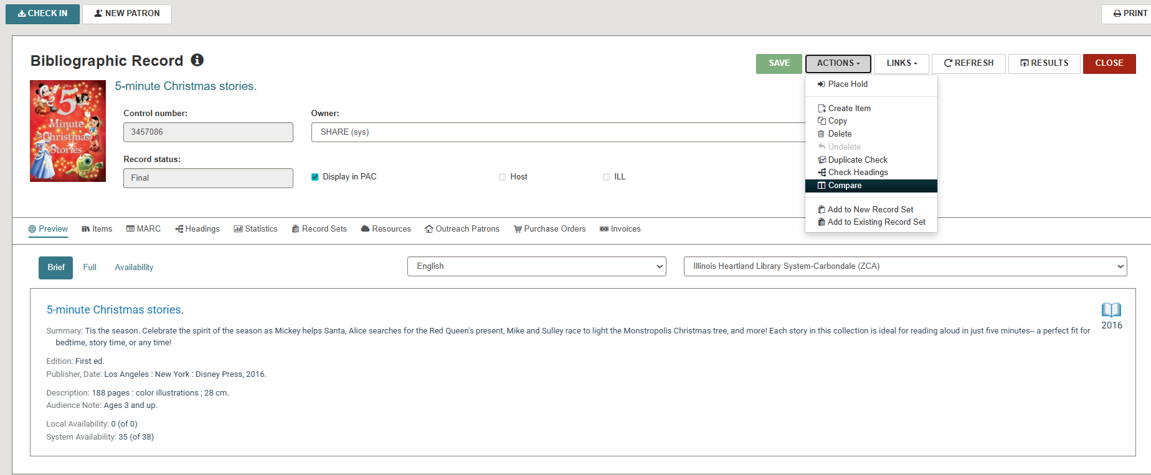
Comparing Bibliographic Records
Notes:
This is called the Current Record. Choose the Action drop-down and Compare.

Slide 16
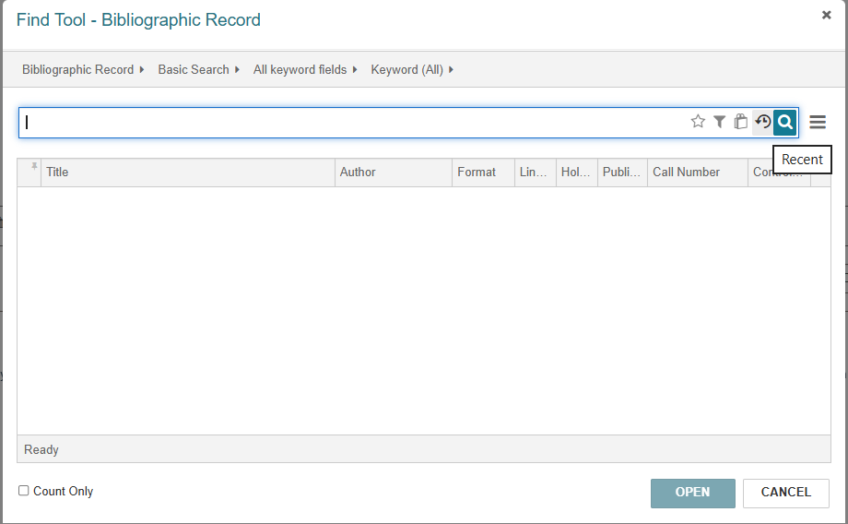
Comparing Bibliographic Records – Recent Searches
Notes:
Instead of doing the search all over you can choose the Recent search button, it looks like a timer to me, when you hover over it, it says Recent.

Slide 17
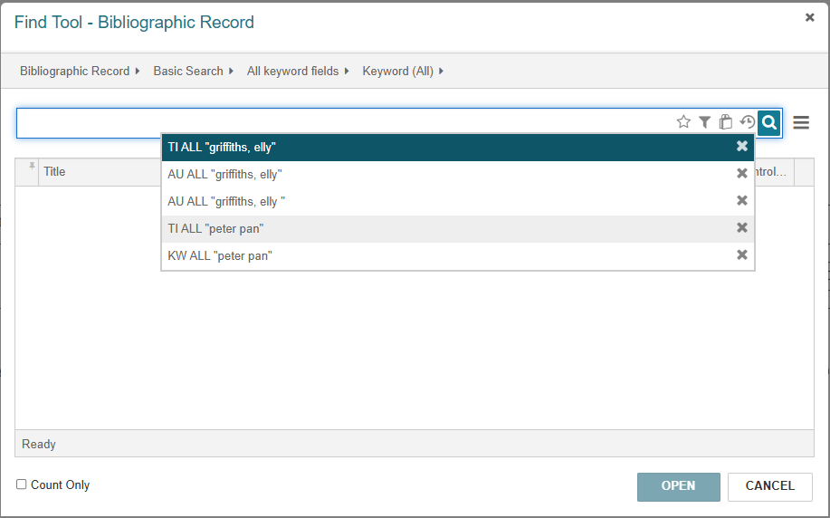
Comparing Bibliographic Records– Recent Searches
Notes:
In the pop up you can choose the same search that you used to find your first record.

Slide 18
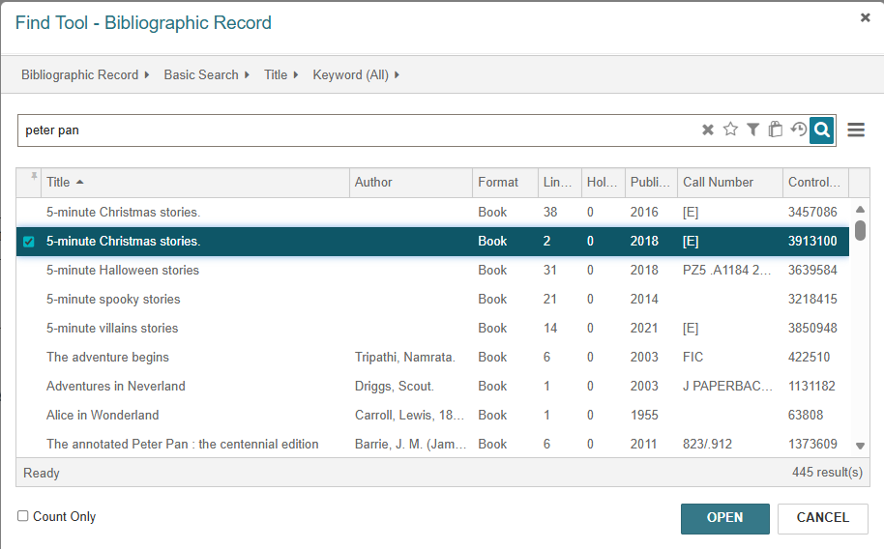
Comparing Bibliographic Records – Choosing Compare Records
Notes:
Double click to open the next record, called the Compare Record.

Slide 19
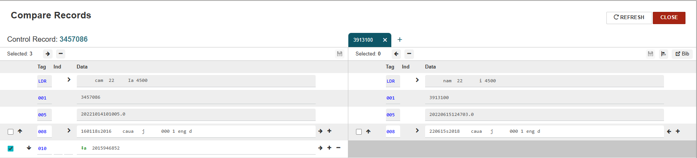
Comparing Bibliographic Records - First Compare Record
Notes:
The records will now be side by side with the current (first record) on the left and compare (second record) on the right.

Slide 20
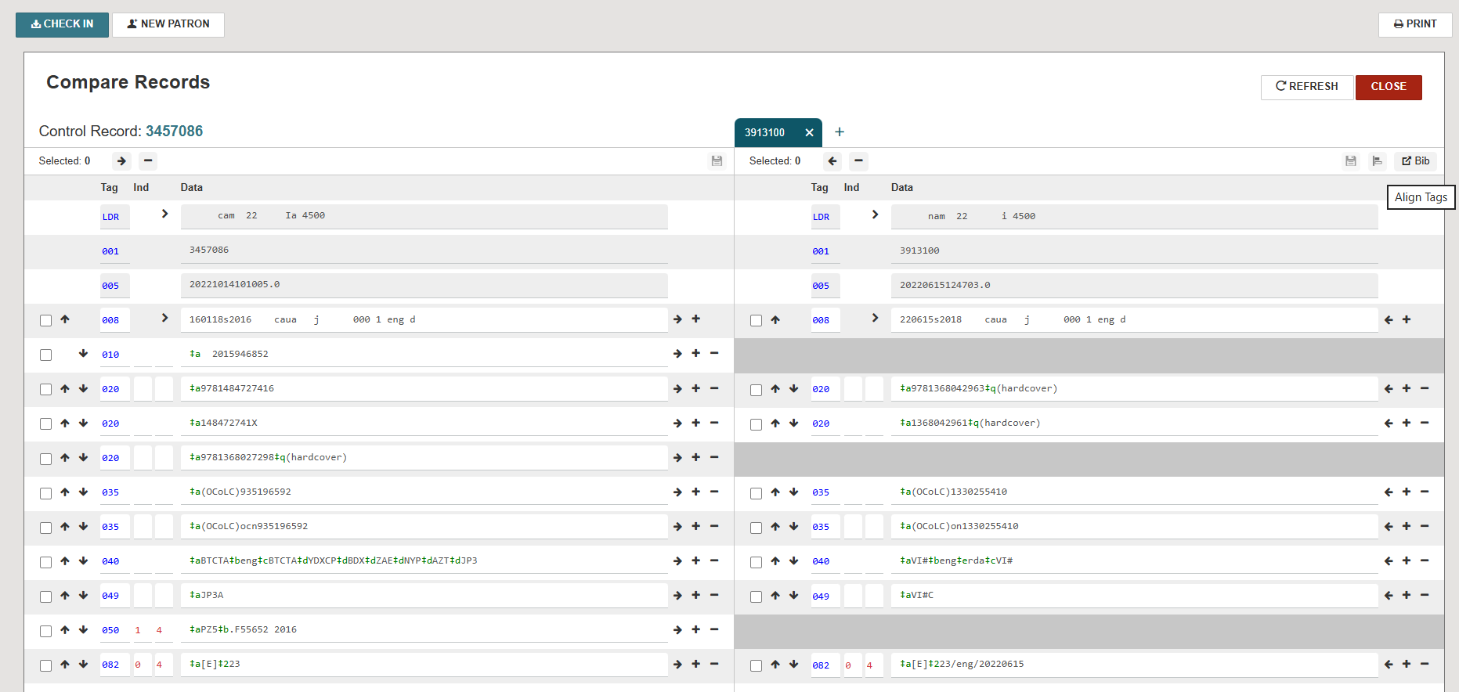
Comparing Bibliographic Records – Align Tags
Notes:
Click the Align Tags button to line up the display tag to tag. If one record has a tag but the other does not, a gray blank will appear so that the display is lined up.

Slide 21
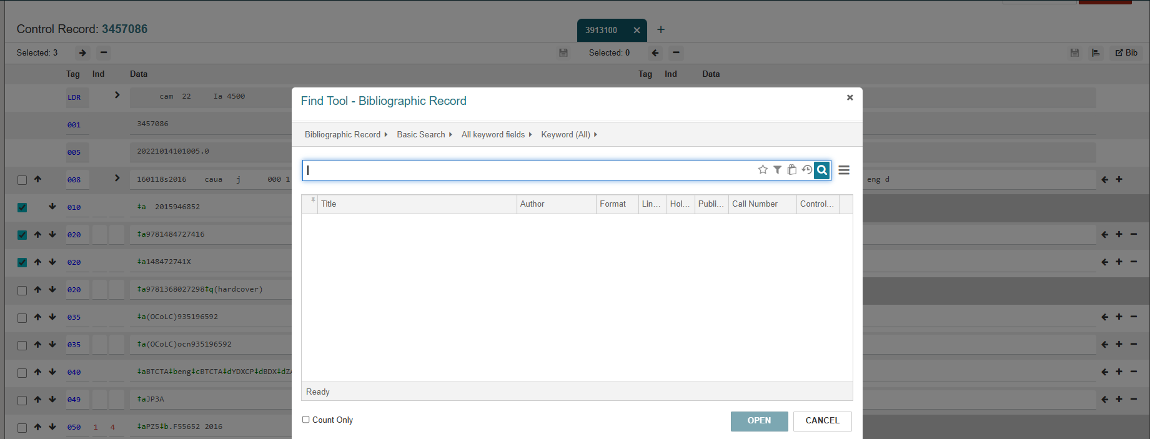
Comparing Bibliographic Records – Multiple Compare Records
Notes:
You can now compare and edit up to 20 bib records. Once you have two records open, click the plus sign next to the Compare Record tab, see the red arrow above, and the Find Tool will open, and you may search again to add another record.

Slide 22
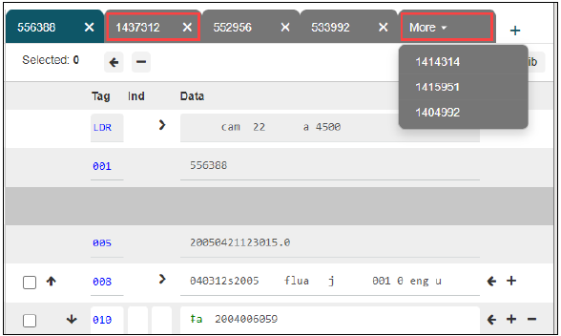
Comparing Bibliographic Records – Multiple Compare Records
Notes:
All Compare Records after the first will appear as tabs on the right side of the screen. If there are more than four records, a More Tab with a drop down menu to select the record will be present. This means that a Current Record can only be side by side with one record at a time and that Compare Records can't be compared to each other, only the Current record. You can close and remove a compare record from the workform by clicking the X on the tab.

Slide 23
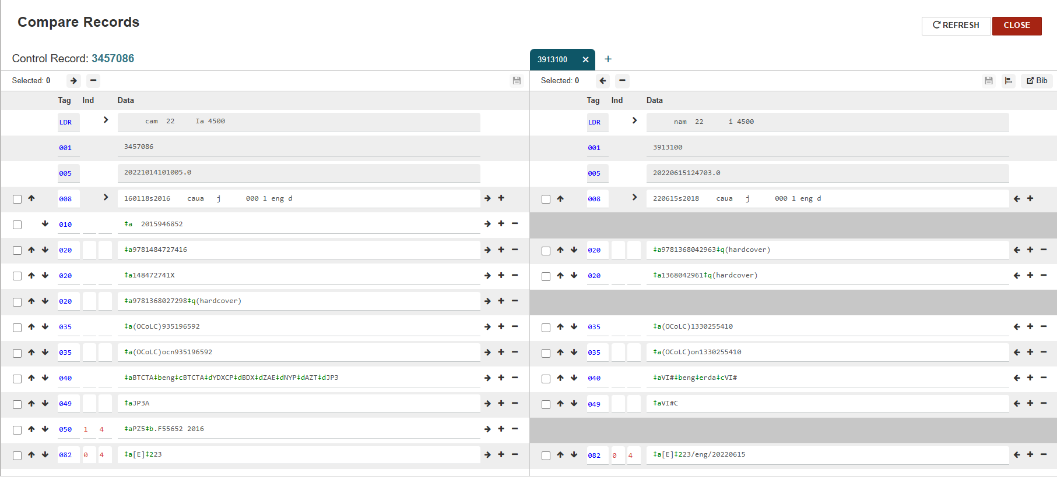
Copying MARC Tags from One Record to Another
Notes:
The Leader, 001 tag, or the 005 tag cannot be copied, and you can see that there are no boxes next to them to click. To copy one tag at a time, select the left or right arrow next to the tag and Leap copies the tag from one record to the other.

Slide 24
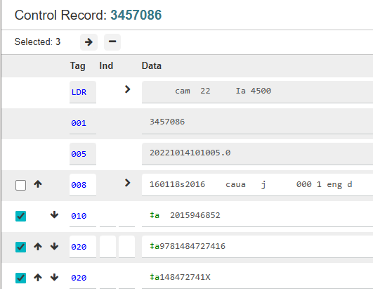
Copying MARC Tags from One Record to Another
Notes:
To copy multiple tags: check the box next to the tag you want to copy, at the top you will see the number of tags selected, click the arrow to move it to the other record. In the Current Record the arrow points to the left, in the Compare Record the arrow points to the right. The minus sign will delete the selected tags.

Slide 25
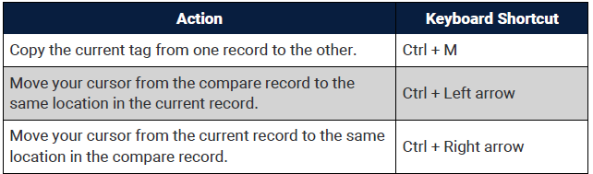
Compare Records Workform – Keyboard Shortcuts

Slide 26
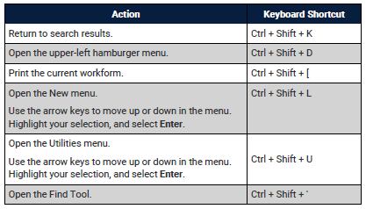
Keyboard Shortcuts
Can be used through Polaris Leap

Slide 27
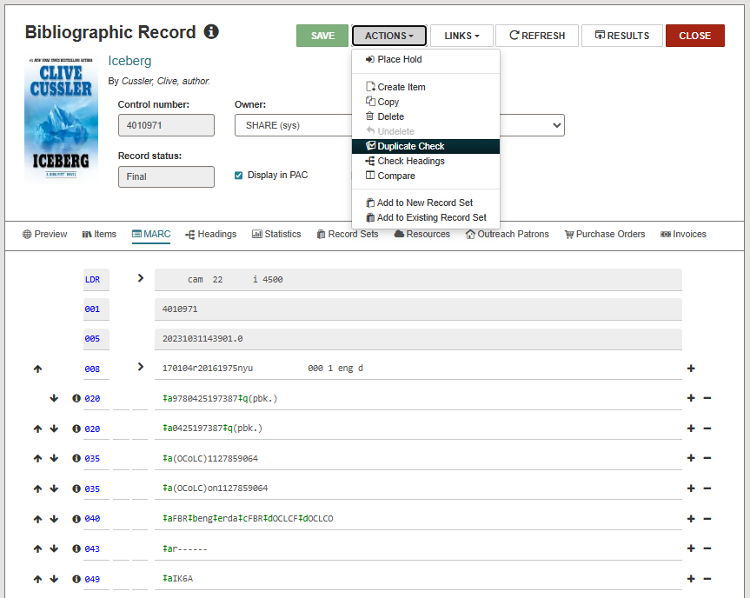
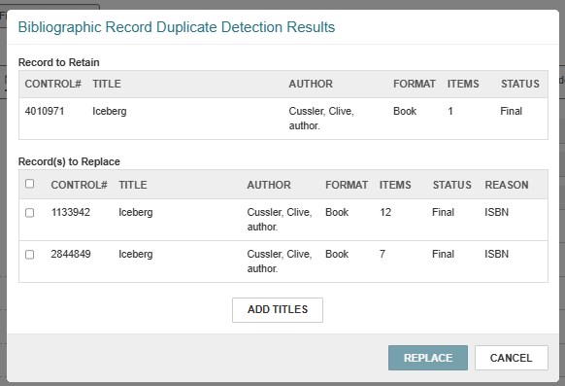
Checking for duplicate bibliographic records without saving
Notes:
In your open record select Actions>Duplicate check. The Bibliographic Record Duplicate Detection Results box opens.

Slide 28
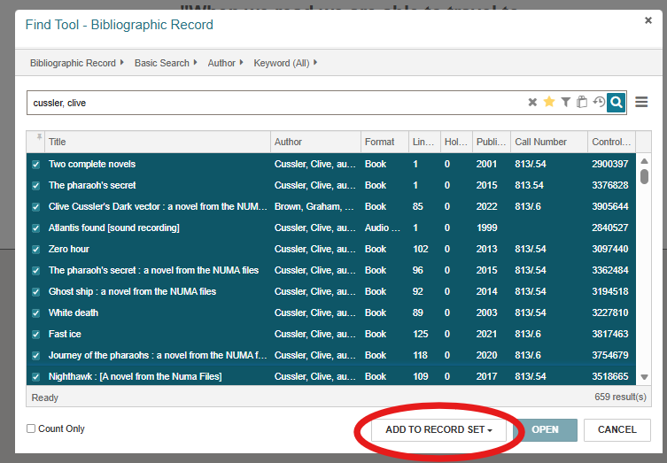
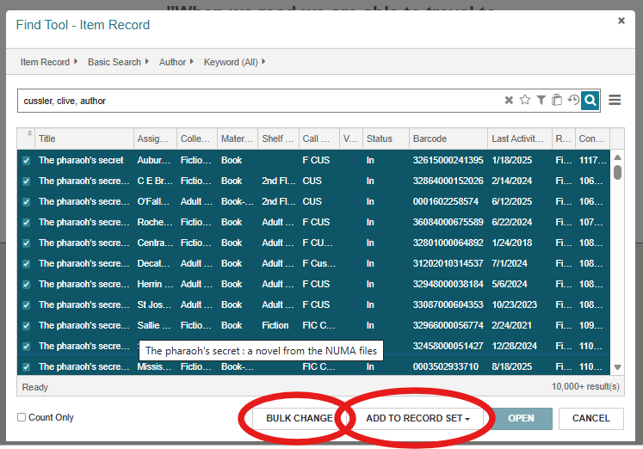
Selecting a Range of Records (Shift + click)
Can add selected bibliographic records to a record set.
Can bulk change selected item records or add them to a record set.
Notes:
On the left in the bibliographic record find tool you can select a range of records to add to a record set by clicking the box next to the first record, scrolling down to the last record wanted and shift + click the box, the add to record set option will show up.
On the right in the item record find tool you can select a range of records in the same way as with the bib record search. Once the item records are selected you have the option of making a bulk change or adding to a record set.

Slide 29
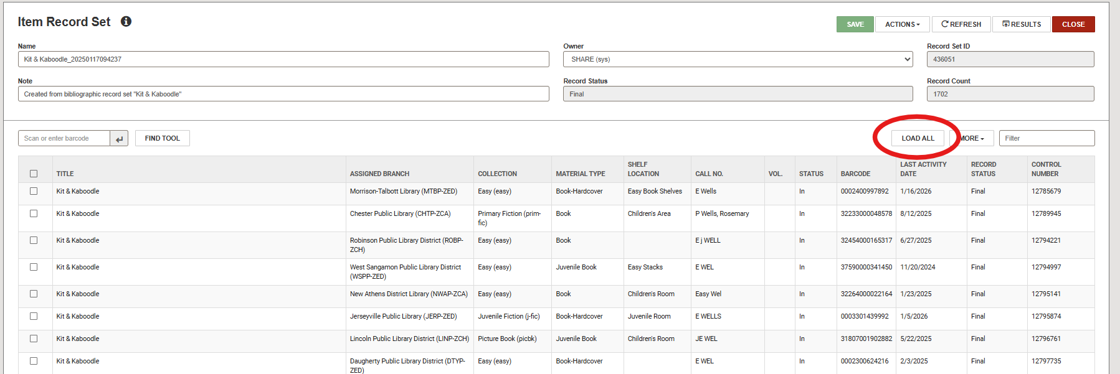
Loading All Records in a Record Set
Used for record sets with more than 250 objects.
Notes:
After the record set has been named and saved select Load All, circled in red, to load all of the records.

Slide 30
Serials in Polaris Leap
No new updates for 7.7 and 7.8
Stay tuned for separate training sessions on Serials in Leap.

Slide 31
Acquisitions
Receiving EDI Orders that use ASN
Distributing Taxes, Charges, or Credits across Invoice Line Items
Support for Subfunds and Manually Adjusting Fund Balances
Notes:
Jennifer

Slide 32
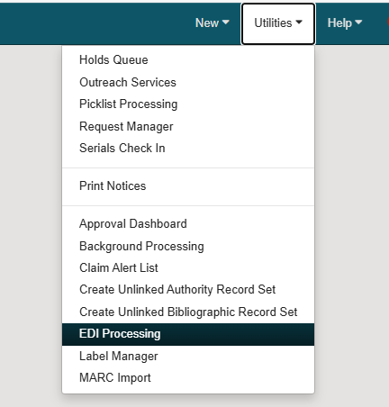
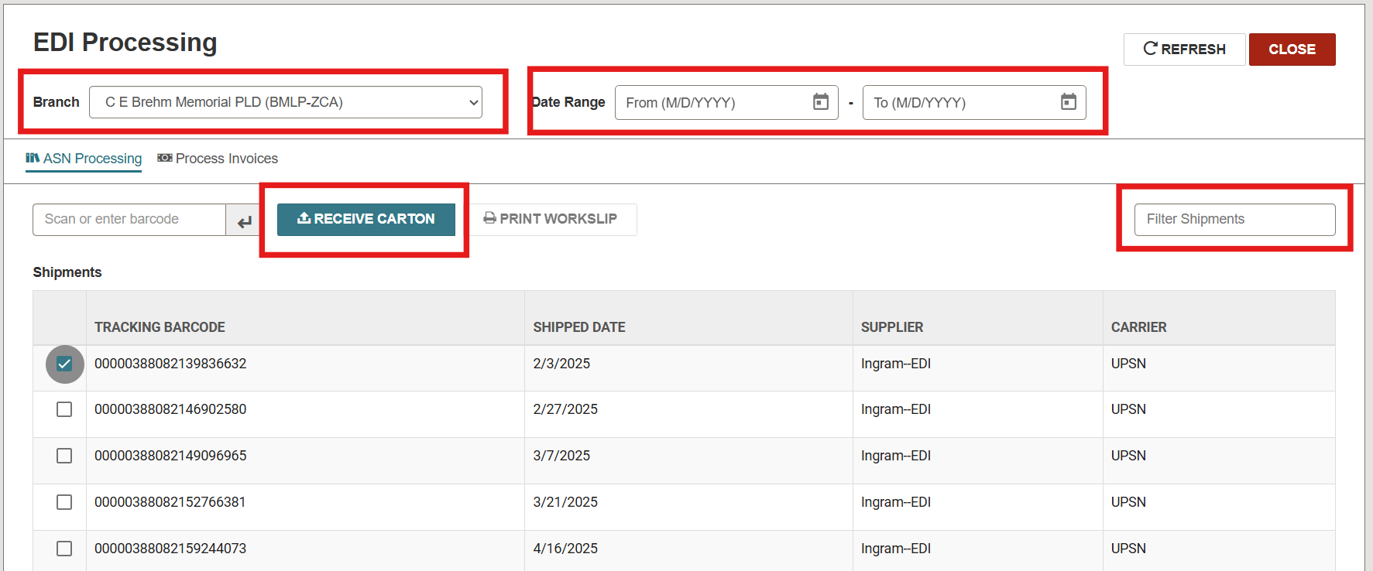
Receiving EDI Orders that use ASN
Notes:
Leap now supports receiving EDI orders that use advanced shipping notice (ASN). Version 7.7 includes a new EDI Processing workform that lets you receive ASN shipments and print purchase order line-item work slips after receiving a shipment.
To receive an ASN shipment:
1. Select Utilities, and then EDI Processing. The EDI processing workform appears. ASN shipments appear on the ASN processing view.
2. Select the shipment you want to receive. You can search by Branch, date range, shipment’s tracking barcode, or use the filter shipment box to filter the list of shipments by any value that appears in the shipments table.
3. Select receive carton, and then yes.
4. After receiving the shipment, you can print work slips for the purchase order line items that were received.

Slide 33
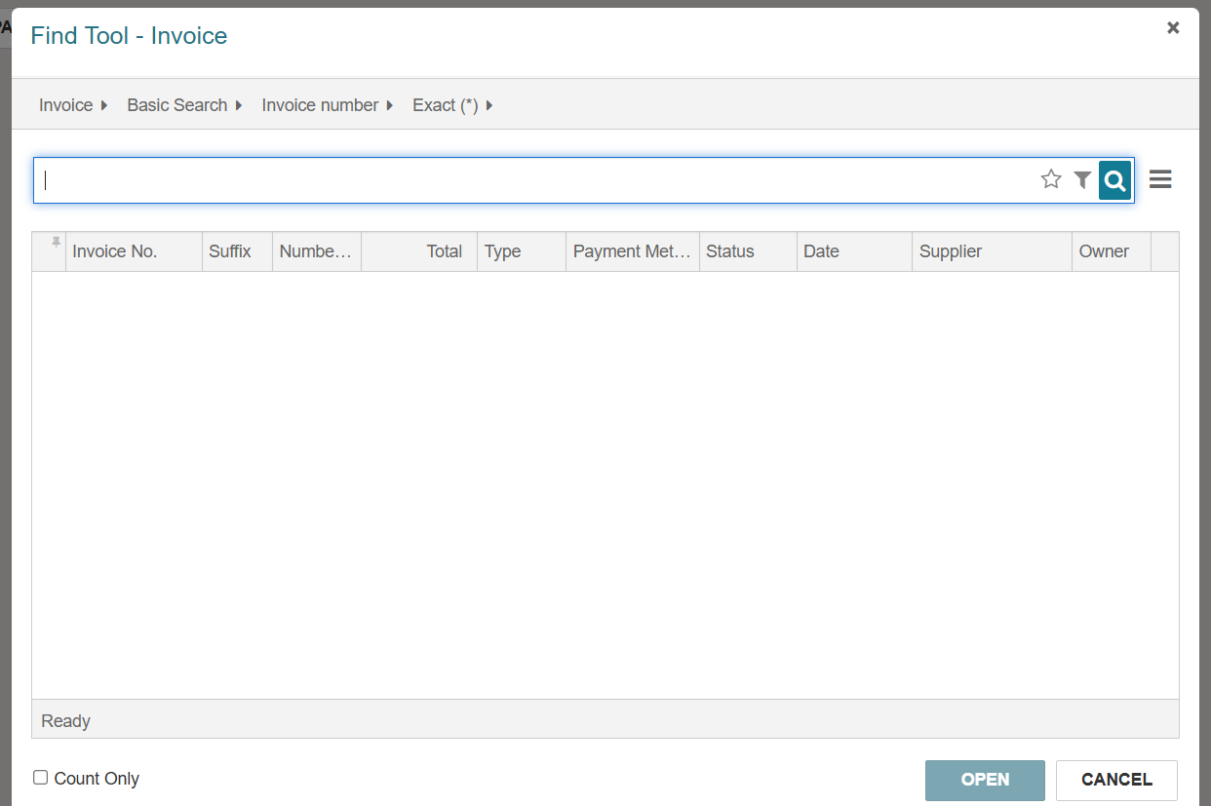
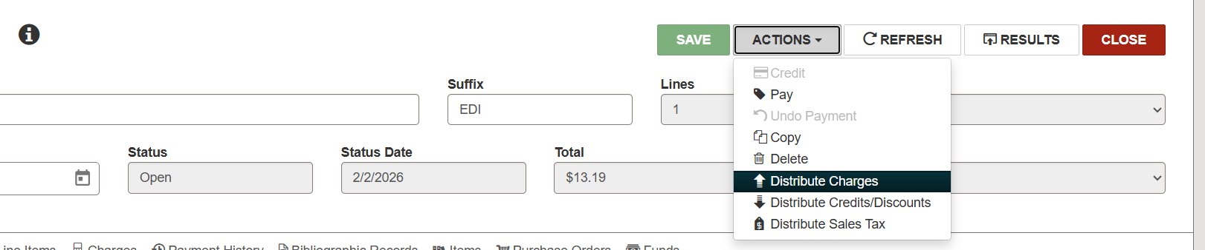
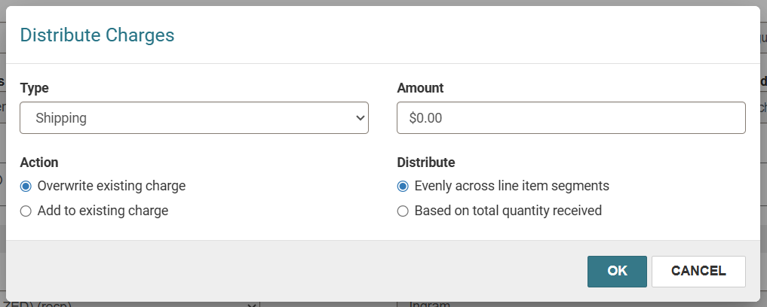
Distributing Charges Across Invoice Line Items
Notes:
You can now distribute taxes, charges, or credits across multiple line items and segments in an invoice.
To distribute charges on an open invoice:
Find the invoice you want to edit, and open it in the invoice workform.
Select actions, and then distribute charges from the menu bar
Select from one of the charge types
Select one of two options under action
Select one of two options under Distribute.
Enter the amount to distribute in Amount
Press ok

Slide 34
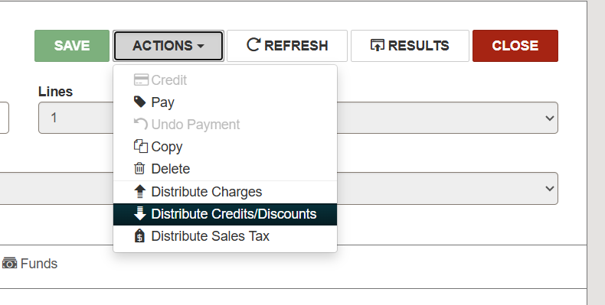
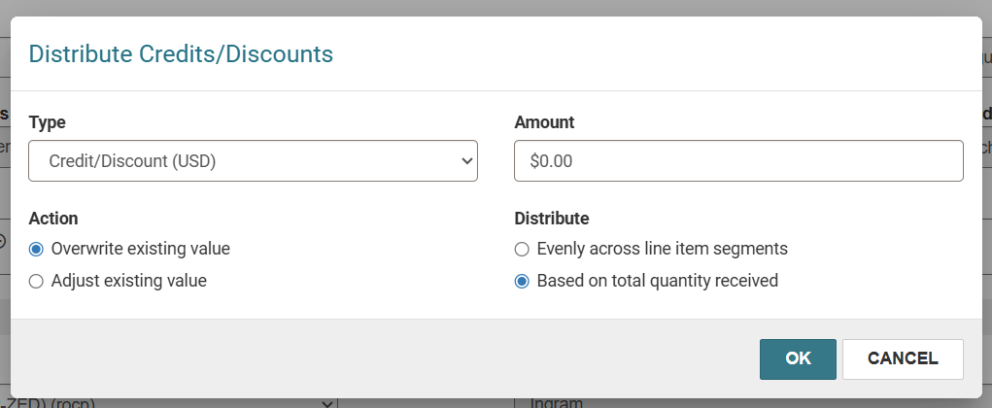
Distributing Credits or Discounts Across Invoice Line Items
Notes:
To distribute credits or discounts:
Find the invoice you want to edit, and open it in the invoice workform.
Select actions, and then distribute credits/discounts from the menu bar
Select from one of the credit or discount types
If you selected credit/discount in the previous step, select one of the two options under action and one of the two options under Distribute. If you selected Discount in the previous step, simply type the percentage amount and select ok.
Enter the credit/discount amount to distribute in Amount
Press ok

Slide 35
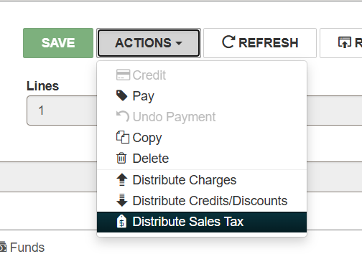
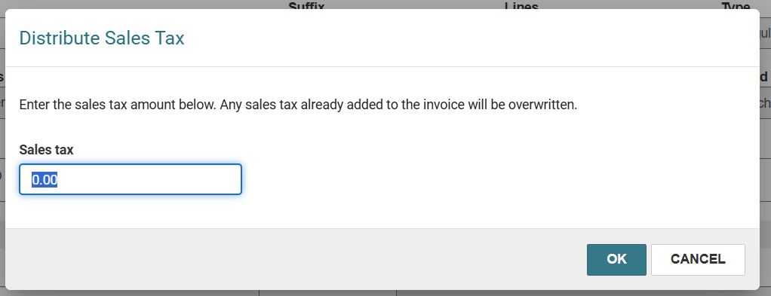
Distributing Sales Tax Across Invoice Line Items
Notes:
To distribute sales tax:
Find the invoice you want to edit, and open it in the invoice workform.
Select actions, and then Distribute Sales Tax
Enter the sales tax amount to add to the invoice.
Select ok

Slide 36
Support for Subfunds and Manually Adjusting Fund Balances
Creating a new Fiscal Year
Adding Funds
Viewing and Adding Subfunds
Notes:
You can now add and manage subfunds in Leap.
A new subfunds view on the Fund workform allows you to see associated subfunds or quickly check spending within your materials budget. New options in the Adjust Fund Balances dialog allow you to manually adjust balances for funds and subfunds.

Slide 37
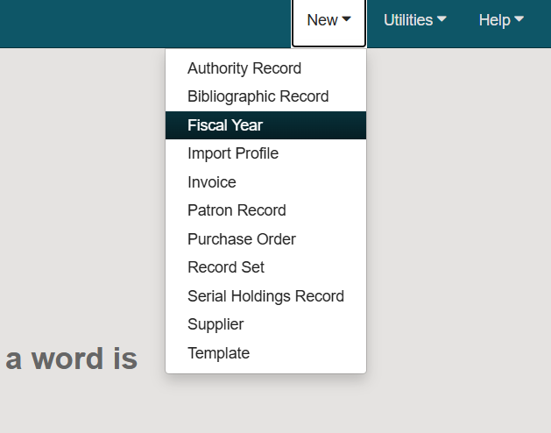
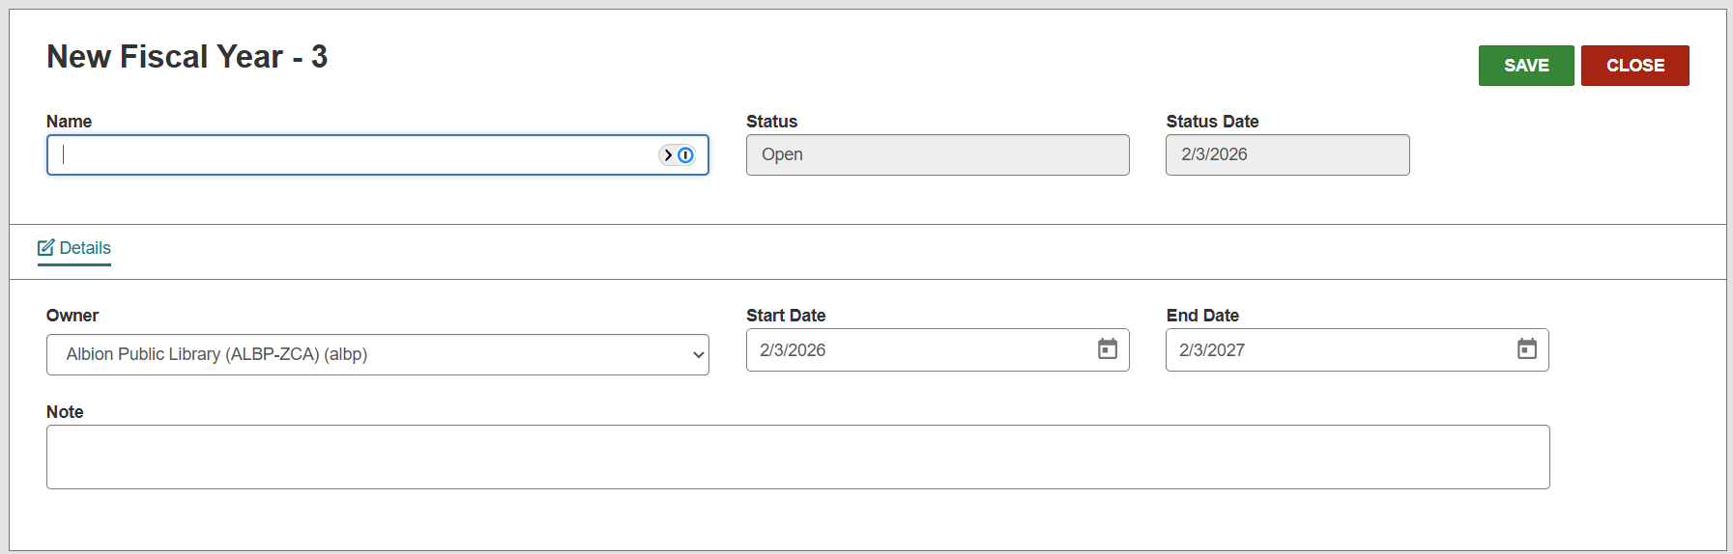
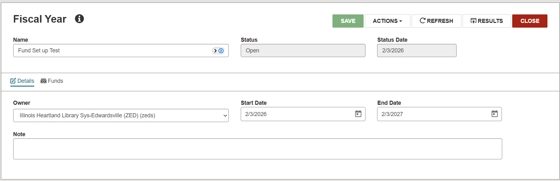
Creating a New Fiscal Year
Notes:
To create a new fiscal year, you will select:
New → Fiscal Year
Name your Fiscal year and select your start and end dates, and then press Save.
Once your new fiscal year is created, you can then see the option to create new Funds.

Slide 38
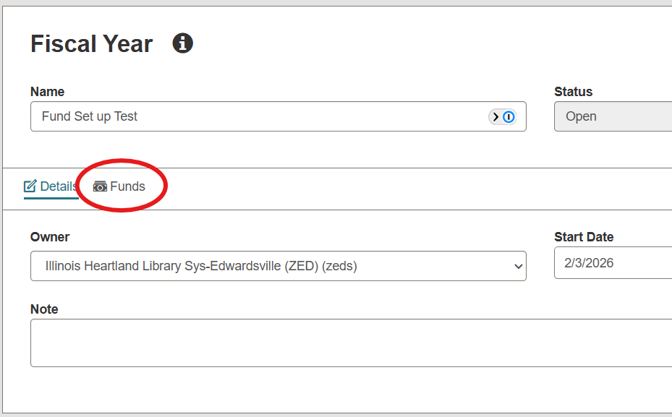
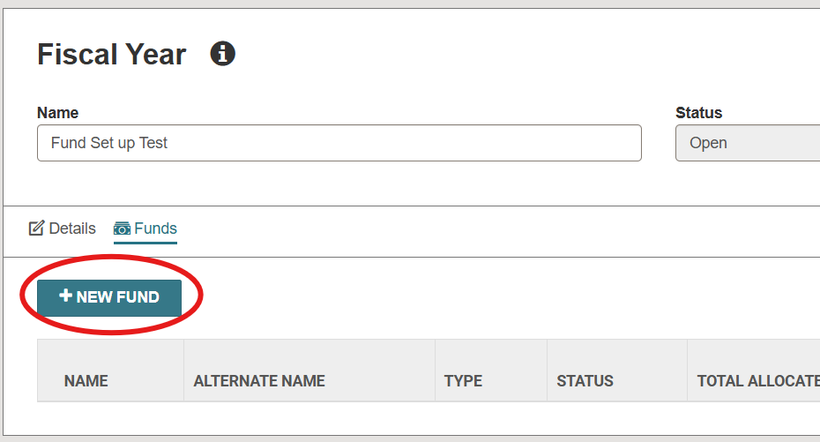
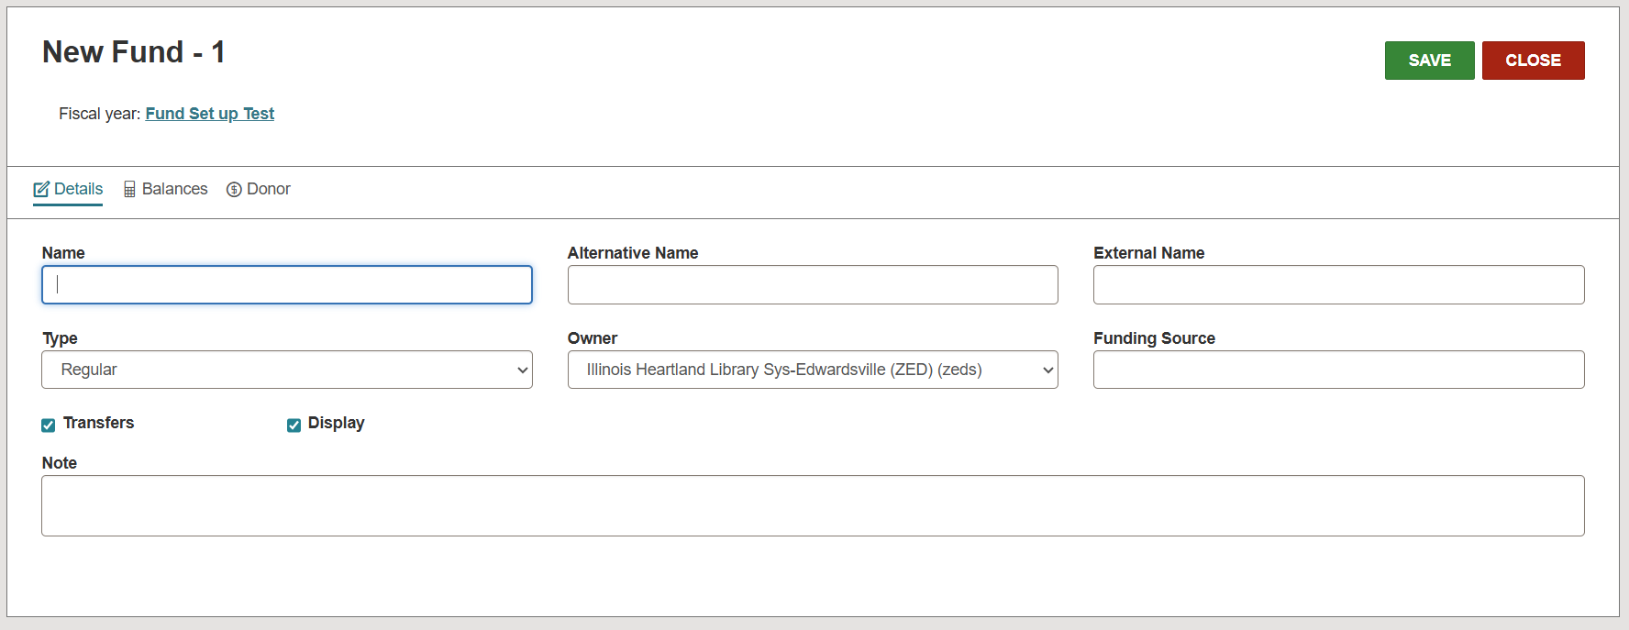
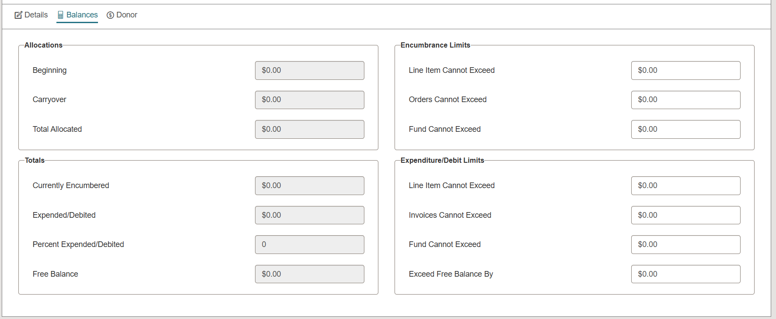
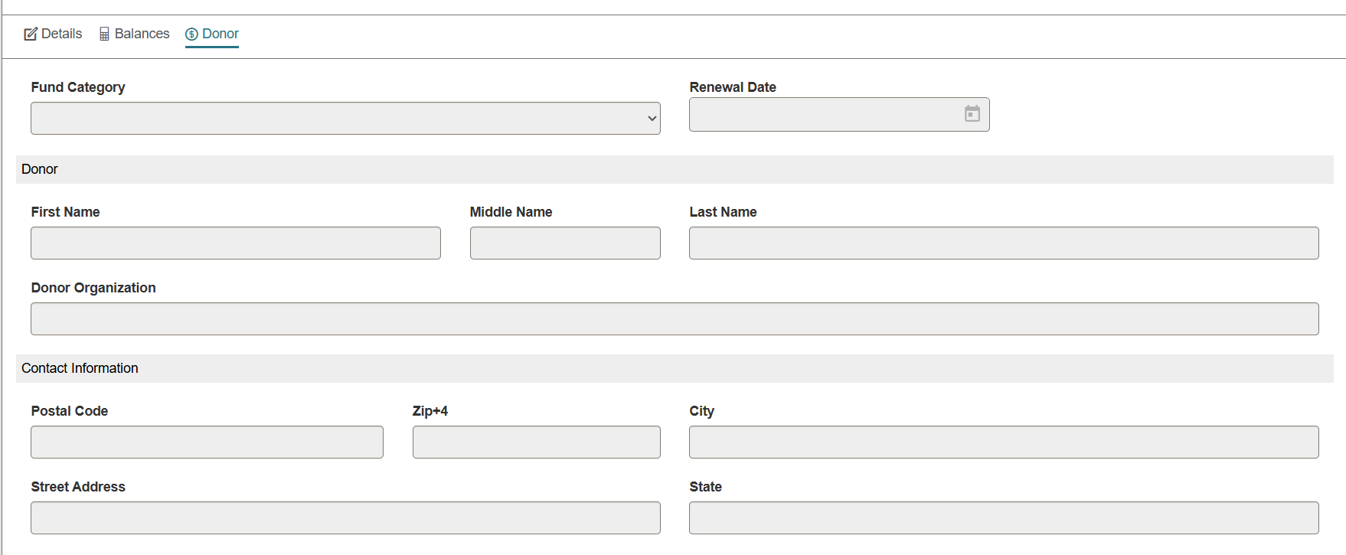
Adding Funds to a New Fiscal Year
Notes:
To add a new fund:
In your Fiscal Year, select the funds tab.
Select the “new fund” button
Name your new fund, provide an alternate name, if necessary, change the type, and you can provide a funding source. Press save.
Once your new fund is created, you can double click on the fund name, and then you can allocate funds and also enter donor information.

Slide 39
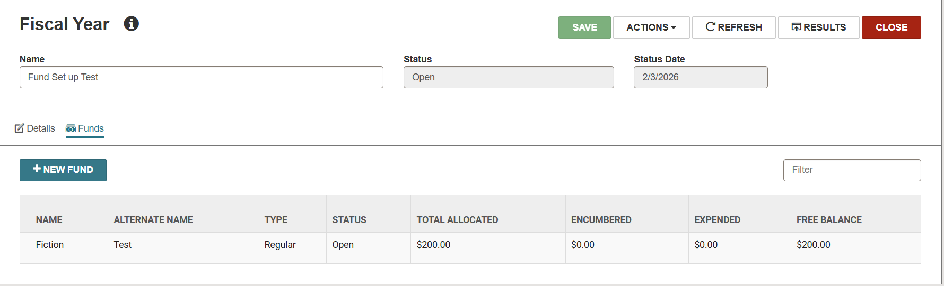
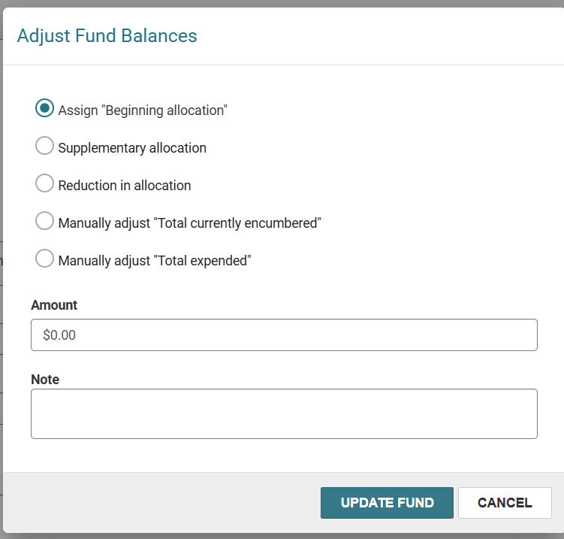
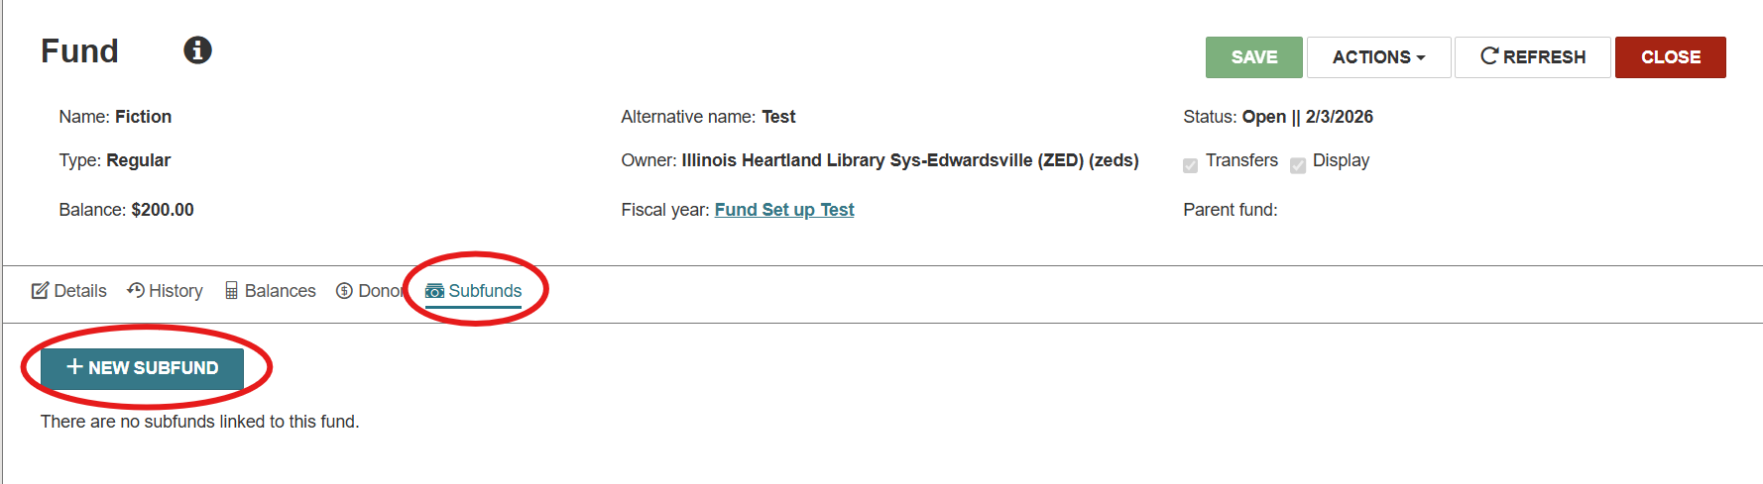
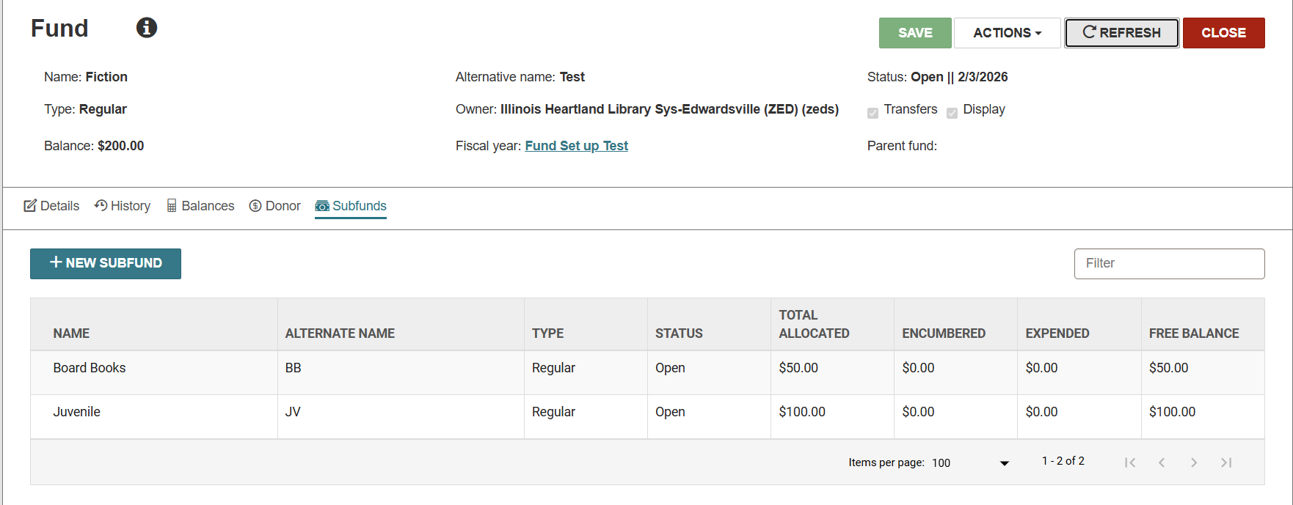
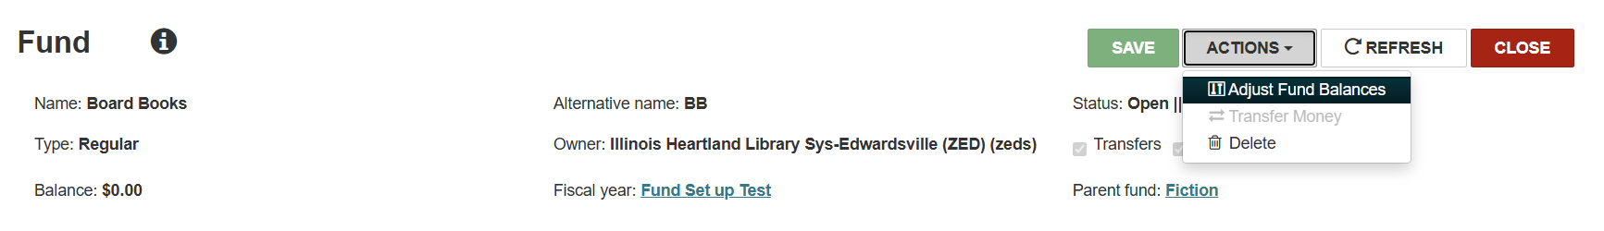
Adding Subfunds
Notes:
To add subfunds:
Double click on the fund that you want to add subfunds under.
Select the “Subfunds” tab.
Select the “+New Subfund” button.
Fill out the Subfund form and then select “Actions → Adjust fund balances”
You can manually adjust the fund balances by filling out the box that pops up and then selecting “Update fund.”

Slide 40
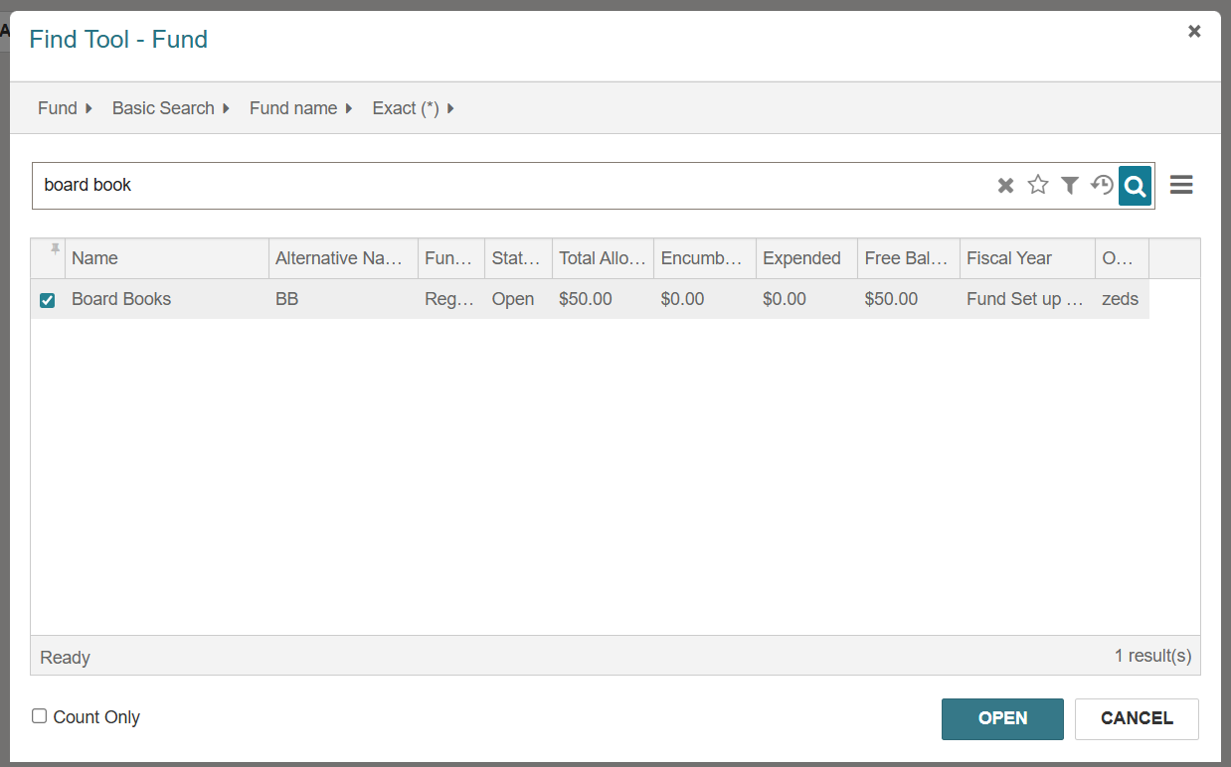
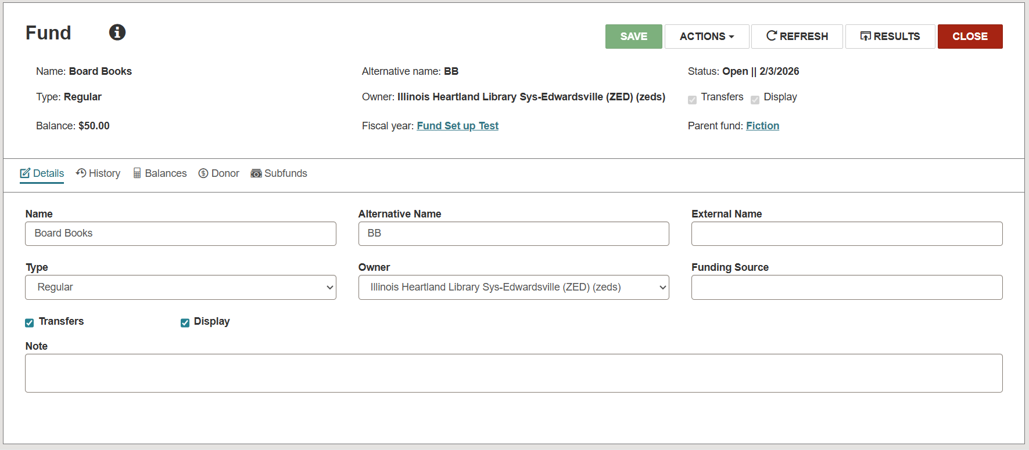
Viewing Subfunds
Notes:
To view a subfund record:
Use the Find tool to search for the name of the subfund you want to edit, and open it in the fund workform.
The subfund opens in a Fund workform with the fiscal year and the parent fund linked in the header.

Slide 41
Polaris Leap 7.8 Updates
Renewal Count Statistics
New Views in Leap Workforms
Acquisitions

Slide 42
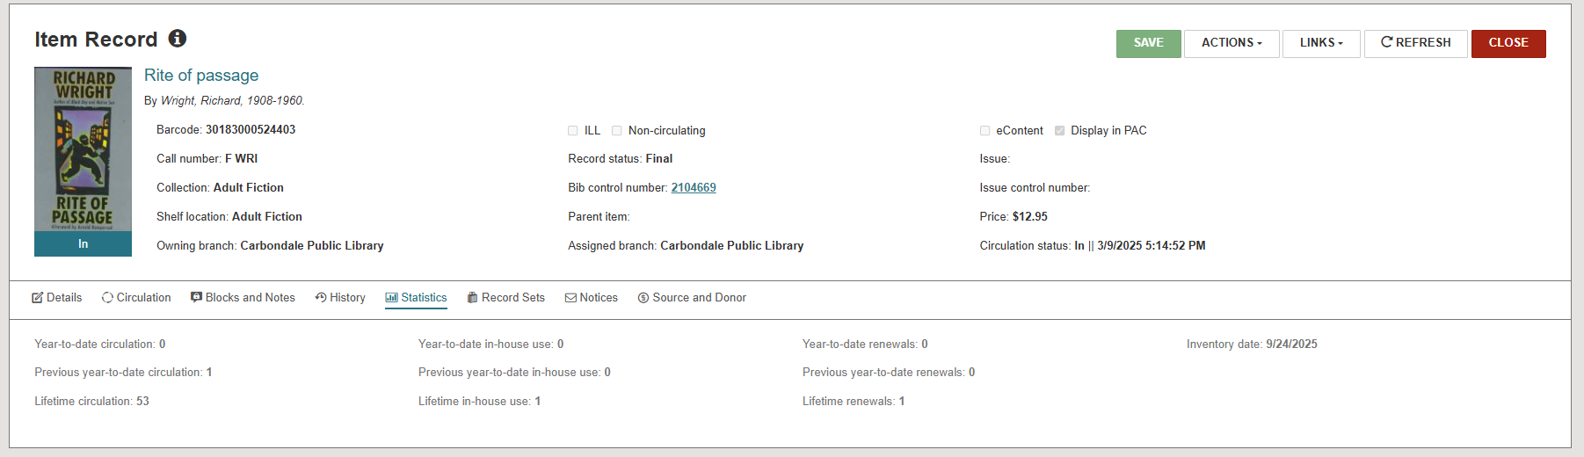
Renewal Count Statistics in Leap
Notes:
The item record workform and the bibliographic record workform now display renewal count statistics. On each workform the statistics view now includes the following statistics for the item or bibliographic record: year-to-date renewals, previous year-to-date renewals, and lifetime renewals.

Slide 43
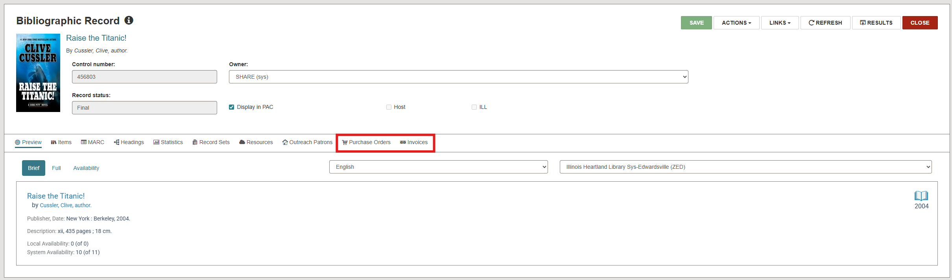
New Views in Leap Workforms – Bib Record
Notes:
You can now navigate between workforms using the added views in several Leap workforms.
From the Bibliographic Record workform, you can now view and open purchase order records and invoice records

Slide 44
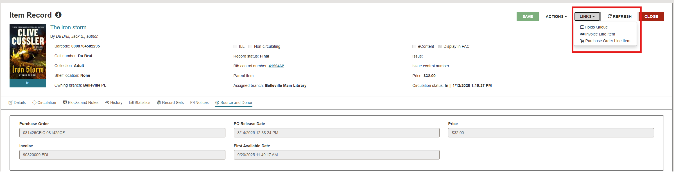
New Views in Leap Workforms – Item Record
Notes:
From the Item record workform, you can now view and open purchase order line item records and invoice line item records

Slide 45
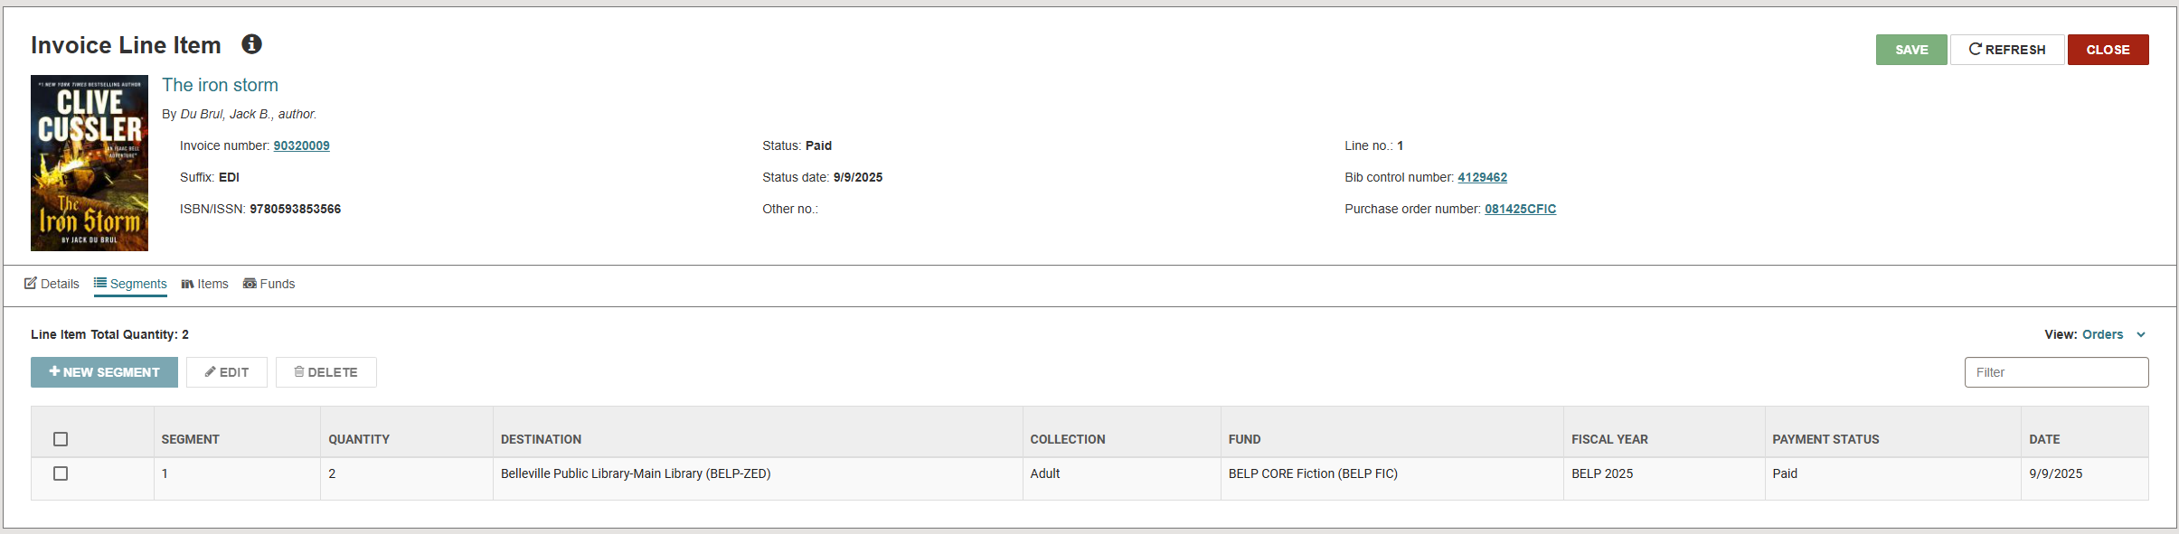
New Views in Leap Workforms – Invoice Line Item
Notes:
From the Item record workform, you can now view and open item records.

Slide 46

New Views in Leap Workforms – Purchase Order Line Item
Notes:
From the Item record workform, you can now view and open item records.

Slide 47
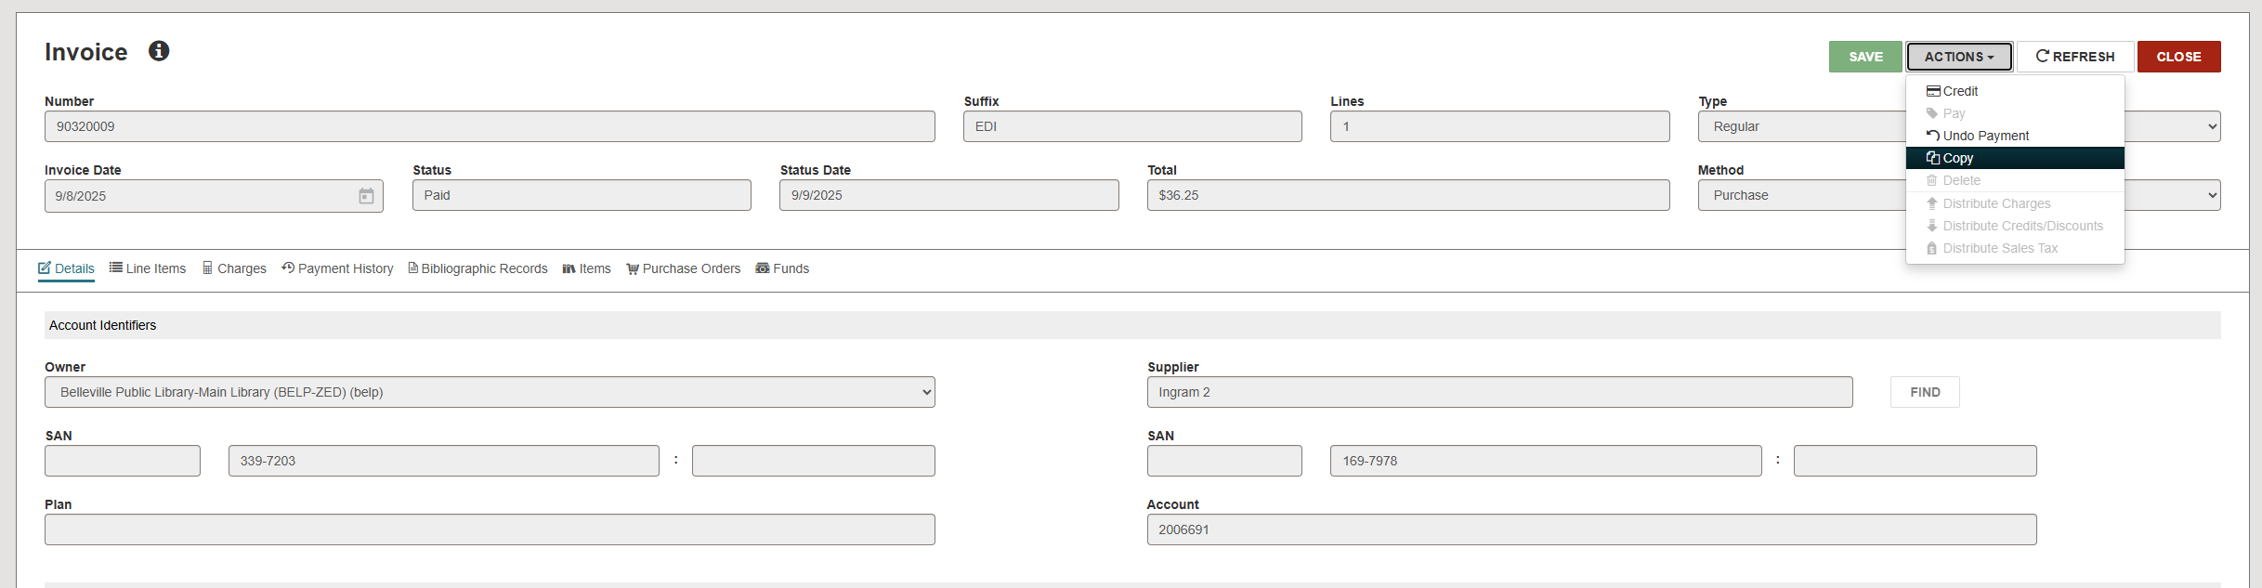

Acquisitions – Copying an Invoice
Notes:
You can now copy an invoice in Leap if you have the necessary permissions.
To copy an invoice:
Find the invoice you want to copy, and open it in the invoice workform
Select actions → copy. The new invoice workform appears with the values from the original invoice.
Change at least one of the following values: Number, suffix, type, and/or supplier.
Change values in the other fields if needed.
Select save.

Slide 48


Acquisitions – Checking for Duplicate Segments in Purchase Orders
Notes:
Use the Purchase Order (PO) workform, you can now detect possible duplicate PO line item segments in other purchase orders.
An important note: Leap allows you to check for duplicates only if the PO has a status of Pending.
To check for duplicate purchase order records:
Find the purchase order record you want to check, and open it in the Purchase Order workform.
Select Actions → Duplicate check. Leap performs the duplicate check and displays results on the Purchase Order Duplicate Detection Results dialog box.
Do one of the following:
Select a row in the list to go to the Purchase Order Line item workform
Select print to print a report that lists the duplicates in the dialog
Select cancel to return to the purchase order record.

Slide 49



Acquisitions – Process EDI Invoices Workform
Notes:
You can now manually process EDI invoices in Leap.
You can now view and manage unprocessed EDI invoices on the Process Invoices view of the EDI processing workform. You can select one or more unprocessed invoices and generate a partial shipment invoice for it.
To generate an invoice for an EDI Shipment:
Select utilities → EDI processing
Select the Process Invoices view in the box that opens.
Leap displays a list of the unprocessed EDI invoices for your current branch. Search and select the one that you want. You can view the purchase order line items that are linked to an unprocessed EDI invoice by selecting an unprocessed invoice and then Select “View PO line items.”
Once you have found the unprocessed invoices that you want to generate invoices for, select them by clicking the box next to them, and then select “generate invoice.”
Select yes in the box that pops up.

Slide 50
Acquisitions – EDI Integrations
Polaris currently supports EDI ordering and invoicing for the following suppliers:
Audio Book Services
Brodart
Children’s Plus, Inc.
Findaway World
Gale-Cengage Learning
Ingram
Libraria
Library Bound
Library Services Centre
MDM Entertainment
Micromarketing
Midwest Library Service
Midwest Tape
Penworthy
Quality Books
Rainbow Books
Recorded Books
Scholastic Library Publishing
Ulverscroft
United Library Services
Whitehots
James Bennett
Blackstone
Notes:
These are the suppliers that Polaris currently supports for EDI ordering and invoicing.

Slide 51
What Leap Can’t Do…Yet!
Developed & In Development for Future Upgrades:
  Polaris 8.0
    Dated patron notes
    Bibliographic record templates (including on-order bibliographic templates)
    Automatic MARC Import for Vendor Files
    Offline check-in
    Fiscal year rollover utility
  Polaris 8.1
    Return to place in record set results
    Enter a reason when cancelling holds
    Find Tool Window expansion
    Stacked sorting
Not currently slated on the roadmap
  Macros
  Multiple windows (possibly 8.1)

Slide 52
SHARE Policies and Procedures
FY24 – FY25 – SHARE Bib Services Policies and Procedures were reviewed, updated, and removed (when necessary).
FY25 – FY26 – SHARE Bib Services portion of the SHARE website was updated with all the changes.
FY26 – One new Bib Services-related policy will be going up for member vote at the 2026 Members Meeting later this spring.

Slide 53

SHARE Policies and Procedures – Key Changes
Notes:
Shortening titles
Streamlining content
Putting in logical alphabetical order

Slide 54


SHARE Policies and Procedures – Key Changes

Slide 55


Reaching Forward South – April 10, 2026

Slide 56

Reaching Forward South – April 10, 2026

